Slide 1
This document contains research conducted for the benefit of Steelcase and our subsidiaries and partners.
When referencing this research internally,
please use the following format:
WorkSpace Futures, Hybrid Project Based Learning, 2023
This citation should appear on any slide containing a referenced data point (e.g. a chart, an insight).
Before sharing this research with external audiences (e.g. customers, dealers, A+D) please reach out to Andrew Kim, akim@steelcase.com.

Slide 2
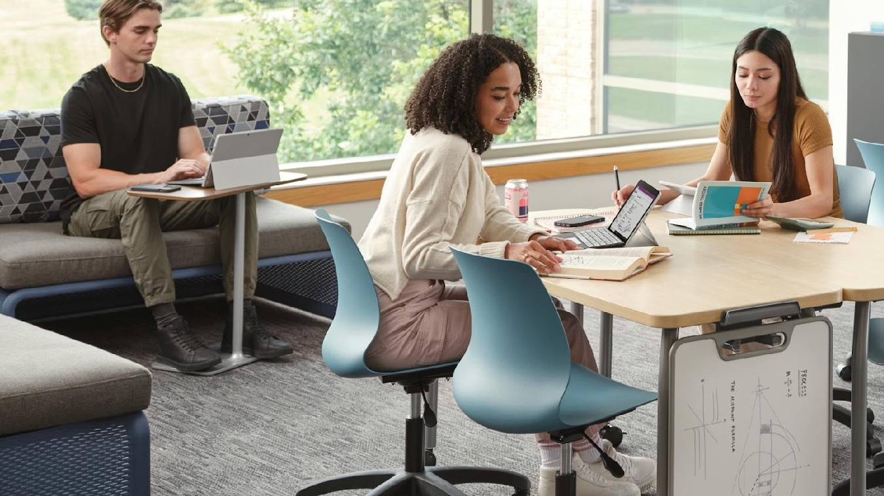

Project-based
Learning Spaces
v
Notes:
Welcome! And thank you for joining me today.
Today, we’re here to talk about new research and insights related to project-based learning spaces.
Through close collaboration with a leading North American research university, this idea of project-based learning spaces became reality. Students divided into teams and worked on different, specific spaces.

Slide 3
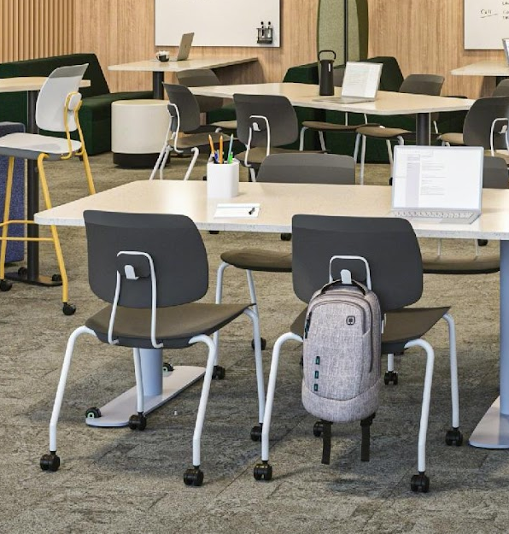
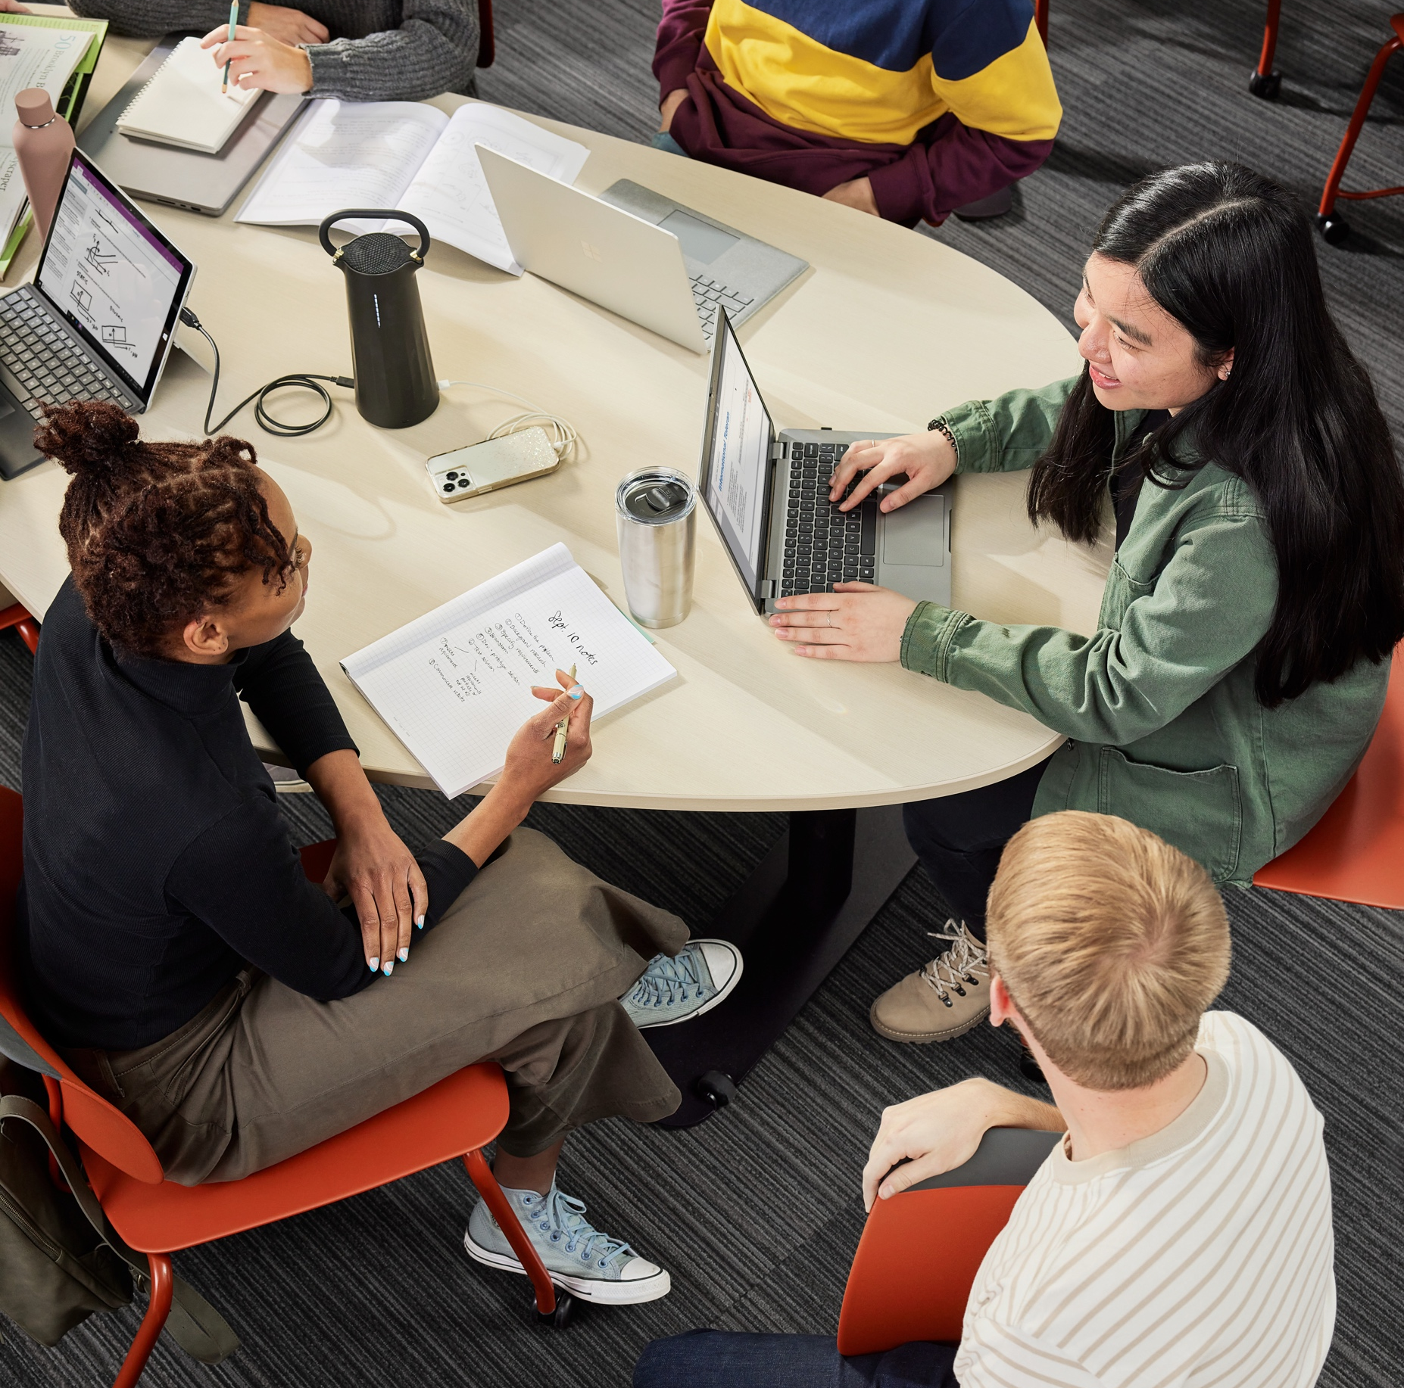
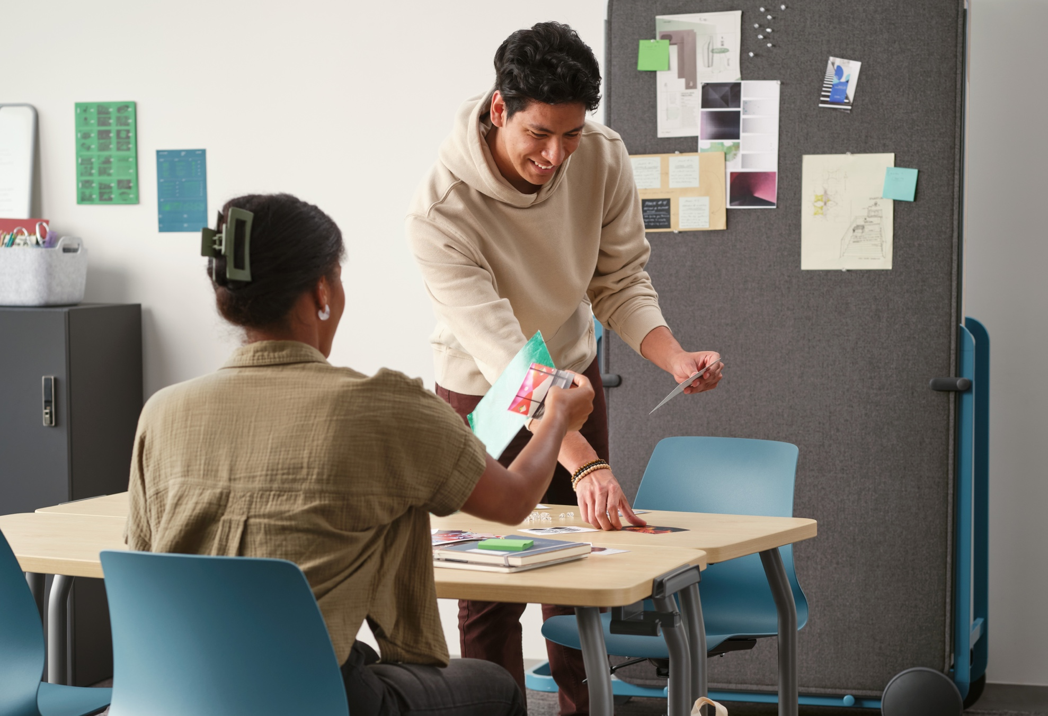
Spaces need to evolve when and where learning does
Notes:
Through the project experience, there were some key findings that impacted the design principles geared towards supporting a shift in how learning happens. Because learning has evolved, it was important to look at how learning spaces needed to evolve as well.

Slide 4
Understanding
Project-based Learning
Notes:
Let’s start by defining project-based learning.

Slide 5
“Students work on a project over an extended period of time that engages them in solving a real-world problem or answering a complex question. They demonstrate their knowledge and skills by creating a public product or presentation for a real audience.”
Buck Institute, HQ PBL
Notes:
Project-based learning, or PBL, is an approach that has been in use since the 1990s to support student-centered learning and self-directed knowledge creation.
PBL is a teaching method designed to enable students to learn while doing.
With PBL, the project drives the learning, rather than having a project to be completed after the learning takes place.

Slide 6
Key Characteristics of Project-based Learning
Challenging problem or question
Authenticity
Sustained inquiry
Collaboration
Student voice and choice
Public product
Reflection
Notes:
Some of the key characteristics of project-based learning include:
Starting with a challenging problem or question
Grounding the problem or question in the real world (Authenticity)
Allowing for sustained inquiry
Promoting collaboration
Giving students voice and choice about the direction they take
Creating an end-product that’s public-facing
Allowing for a reflection on learnings

Slide 7
About Our
Research
Notes:
Steelcase is proud to conduct thorough and responsible research. Let’s dive into the research conducted for project-based learning.

Slide 8
Learning experiences are shifting to higher order levels of thinking. Project-based learning is helping students develop higher levels of thinking.
Creating
The bottom two levels of Bloom’s Taxonomy form the foundation for any learning experience.
The four higher-level learning tiers are the space opportunity for project-based learning.
Evaluating
Analyzing
Applying
Understanding
Remembering
Notes:
Bloom’s Taxonomy is a classification system used to define and distinguish different levels of human cognition, i.e. thinking, learning, and understanding.
Educators have typically used Bloom’s taxonomy to inform or guide the development of assessments (tests and other evaluations of student learning), curriculum (units, lessons, projects, and other learning activities), and instructional methods such as questioning strategies.
While the bottom two levels of Bloom’s Taxonomy form the foundation for any learning experience, the four tiers above relate to higher-level learning experiences requiring different levels of cognition — ones that are ideal for project-based learning.
While schools attempted to deliver higher learning experiences virtually during the pandemic, today higher cognitive and generative activities are conducted in-person.

Slide 9
Central Question:
How might we design for project-based learning to cultivate higher order thinking skills?
Notes:
Steelcase researchers wanted to know…
As hybrid learning transforms in-person learning, how might we design for higher cognitive learning experiences to support project-based learning?

Slide 10
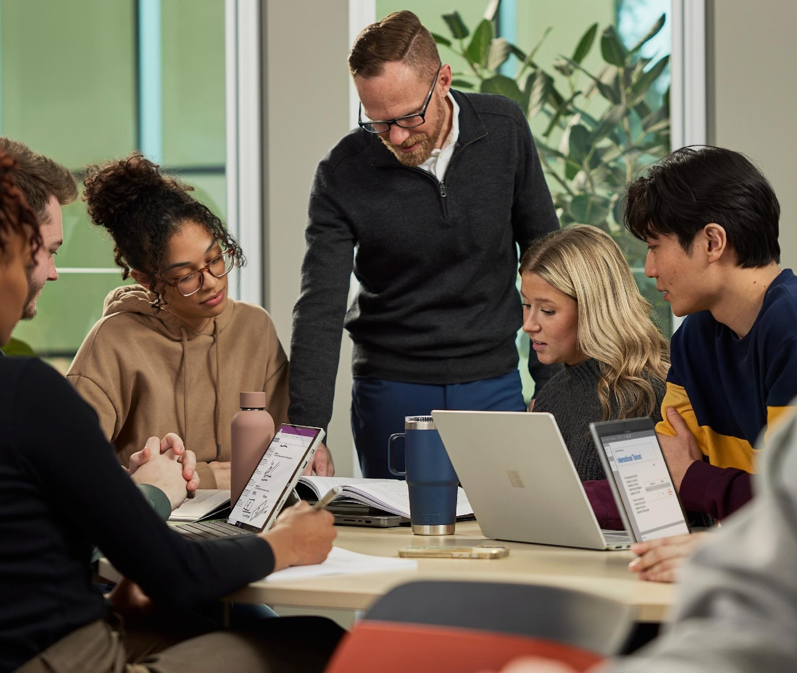
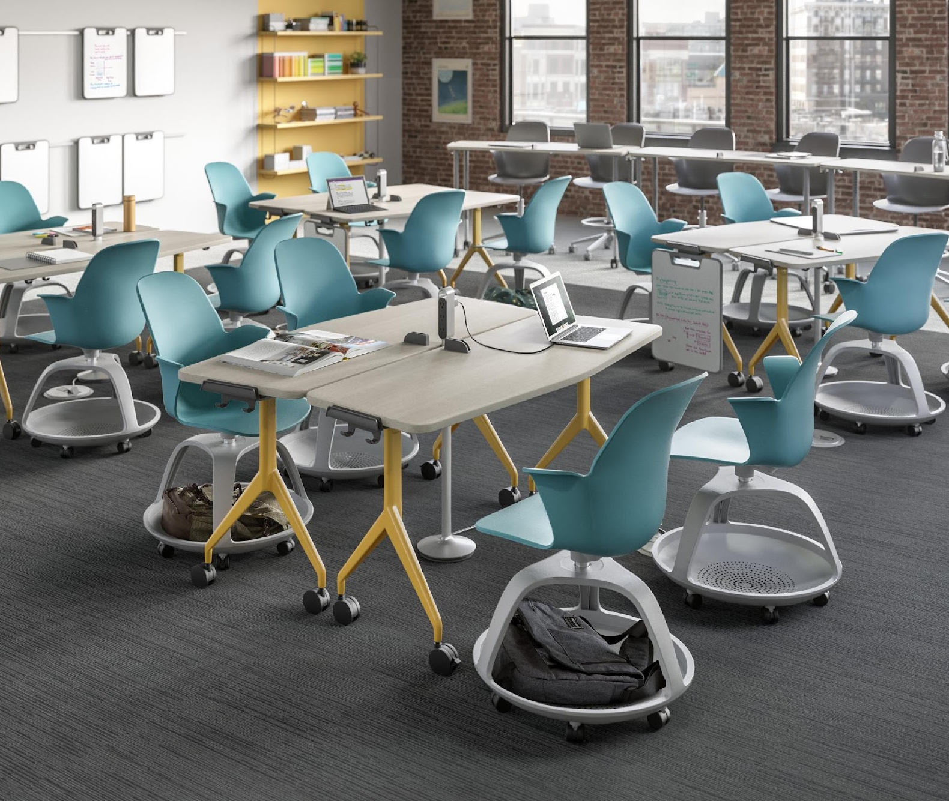
Key Objectives for the Project
02
Informing learning applications that support project-based learning
01
03
Identifying key spatial insights for project-based learning experiences
Informing furniture products that support project-based learning
Notes:
The researchers had three key objectives for this project:
Identifying key spatial insights for project-based learning experiences
Informing learning applications that support project-based learning
Informing furniture products that support project-based learning

Slide 11
University Interior
Design Program
+
Steelcase WorkSpace Futures
and Steelcase Learning groups
Notes:
Steelcase WorkSpace Futures and Steelcase Learning groups collaborated with a leading North American University Interior Design Program (two faculty members and 41 third-year interior design students) to explore design approaches to formal and informal learning spaces that would support project-based learning (PBL) in higher education settings.

Slide 12
Research Avenues
01
02
03
04
Understanding Project-Based Learning
Interviewing Faculty and Academic Leaders
Observing Learning Spaces
Developing Applications
and Products
Literature on project-based learning was reviewed.
Faculty and instructional center leaders were interviewed to understand their thoughts and needs around project-based learning.
A variety of learning spaces in academic classroom buildings, libraries and residence halls were observed.​
Insights and design principles were translated into applications and product concepts.​
Notes:
The research followed a five-step process.
Prior to the start of the course, design faculty conducted administrator and faculty interviews and tours.
Steelcase presented the brief to the students, and teams of four students selected a PBL learning space to explore. Collectively the teams looked at eight spaces across three buildings.
Students conducted research, including space measurements, existing space modeling in Revit, observations, photos, interviews and some optional surveys. They were asked to analyze user activities, postures, and interactions with others, identifying user tools (digital and analog) and artifacts, pain points, workarounds and insights.
To better understand the current Steelcase portfolio, students participated in in-person and virtual tours.
Steelcase also interviewed high school teachers and higher education faculty and visited a high school school with a project-based learning program.

Slide 13
Observations
Spaces Observed
Observations of individual learning spaces
Interviews with
learners and staff
Limited learner surveys
Classrooms
Makerspace
Media recording studio
Design thinking studio
3D scanning studio
VR lab
Residence hall in-between spaces
Notes:
Using their observations, students and researchers created the following project deliverables:
Learning space case study, including space documentation, activities, postures, artifacts and key findings.
Product concepts, modifications to existing Steelcase products or new product platforms.
Applications, including floor plans, 3D drawings and color renderings.

Slide 14
Key Findings + Insights
Notes:
What were some of their key findings?

Slide 15
4C’s of Project-based Learning
Classroom
Collaborate
Create
Communicate
Notes:
An overarching finding is that project-based learning takes place in 4 types of spaces: classroom, collaboration spaces, create/maker spaces and spaces to communicate, or share, information.
Classroom focuses on the activities that happen within the confines of a physical classroom.
Instructors presenting the question/challenge and guiding the project-based learning process
Class time can also include large group discussions, direct instruction, reflection and feedback
Collaborate highlights the highly collaborative nature of the work – with each other and with external partners – performed by students engaged in PBL projects.
Students collaborating with one another in teams in formal and informal learning spaces, in-person and virtually
External sponsors may be a collaborative partner along the process
Create highlights the generative work that drives the development of tangible deliverables.
Students coming together to co-generate thinking and create tangible deliverables
Create mode supported by specialized spaces including design thinking, makerspaces, immersive spaces, 3D scanning spaces and media recording studios
Communicate reflects the reliance on feedback and formal presentations as part of the PBL process.
Feedback, reflection and revision throughout the project
Dry run presentations to peers and instructor
Final presentations to the instructor, classmates and/or external audiences

Slide 16
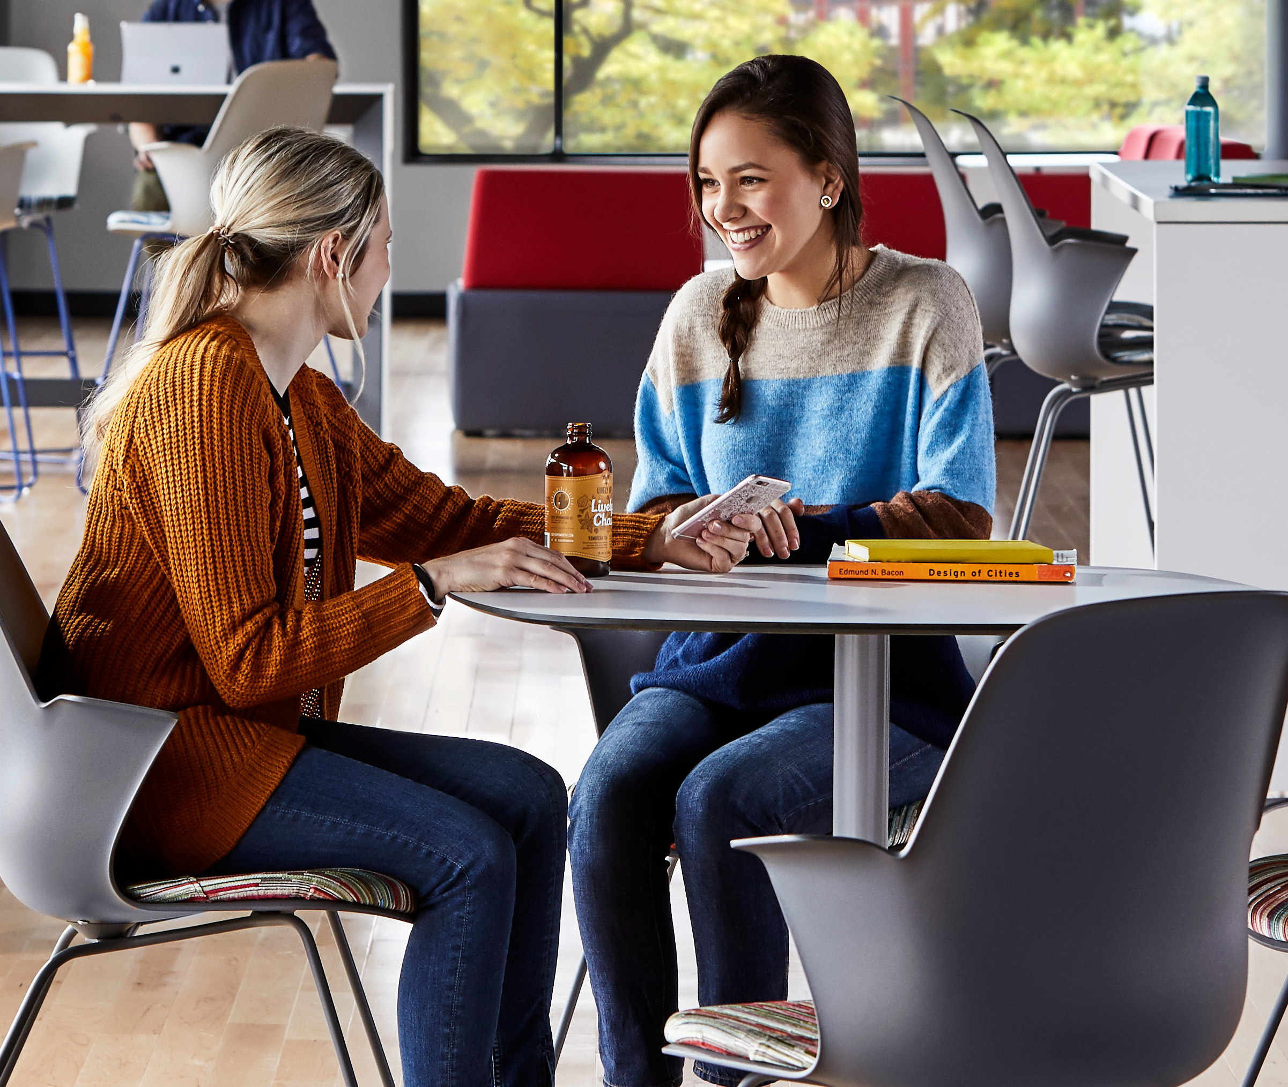
Key
Findings
01
02
Formal learning spaces are not optimized to support PBL
Informal learning resource spaces are often used
for PBL activities outside normal class time
03
04
Performance ancillary needs of learners
are not being met
Technology and tools
are being provided, but learners often do not know how best to use them
Notes:
We are highlighting four key findings discovered in our research.
1. Formal learning spaces are not optimized to support PBL.
2. Informal learning resource spaces are often used for PBL activities outside normal class time.
3. Performance ancillary needs of learners are not being met.
4. Technology and tools are being provided, but learners often do not know how best to use them.
Let’s dig into a little more detail on each of these discoveries.

Slide 17
01
Current classroom learning environments are not optimized
to support PBL in function or tone
Too much hierarchy, but professional settings are
needed for certain activities
Inflexible furniture and tools
Inadequate flex space
Hybrid is not well supported
Notes:
In-between spaces adjacent to classrooms are key places to support PBL activities
Undergrad Business Professor: “I would want students to think about other students and me as peers. I would prefer a space without hierarchy.” like a boardroom round table.
Some key findings included:
Educators aim to be facilitators or peers for the PBL process, but classrooms are hierarchical and optimized for the transmission of knowledge.
Educators and learners seek professional settings for meetings and presentations.
It is mostly on the faculty to take advantage of flexible furniture layout for PBL approaches.
Flex spaces – adjacent in-between spaces to classrooms – are key places to support PBL activities before, during and after class.
External guests join remotely, but classes are not designed to support hybrid experiences.

Slide 18
02
PBL activities often happen in other
spaces on/off campus,
outside the formal
class time/location
Libraries provide spaces that support PBL, but learners are
not aware of them
Library staff are an important resource to guide usage
Furniture lacks performance and appropriate ergonomics
Notes:
Spaces need to support the performance and extreme posture needs of learners.
College Student: “The new furniture is comfortable, but overall very low.”
Key findings for informal learning spaces were that:
Not everything happens in person, yet certain phases of the projects require the participants to be in the same space.
University libraries are important resources to support PBL as part of formal course or outside of it. They provide various spaces and resources for different modes and phases of PBL.
Learners are not always aware of the library resource spaces and how to utilize them. Library staff serve as important guides with the use of the space.

Slide 19
03
Learners seek spatial performance for individual and group PBL activities, but the environment is often designed for social
or waiting experiences
Seating is uncomfortable
and unused
There is a lack of varied
seating options for different
body types and postures
Task surfaces are not
optimized for laptop use
Privacy is lacking
Notes:
For learners’ ancillary needs, it was found that:
Lounge seating is uncomfortable and is unused.
The task surfaces used for lounge settings are ineffective. Students are often using laptops, yet worksurfaces are not optimized for laptop use.
There is a lack of seating options. Students have highly varied postures, often extreme postures, yet furniture supports traditional corporate postures.
There is a lack of various privacy levels. Students value privacy and often prefer booth settings.

Slide 20
04
Technology and tools are being provided, but learners often do not know how best to use them.
Learners are not aware of
shared spaces and programs
Staff are a resource to train
Spaces don’t support
multiple groups
Insufficient storage and
cord management
Spaces need to support both digital and analog tools
Notes:
The intent of shared resources spaces is frequently not obvious to learners.
The research found that:
Shared resource spaces and programs often go unnoticed.
Staff serve an important role for facilitating the use of the technology and tools, whether through 1:1 experiences or group workshop experiences.
Spaces are often poorly set up to support multiple groups at the same time.
There is insufficient storage for tools, materials and student projects. It is necessary to have easy access and organization of tools and resources.
There is a need to support both digital and analog tools.
Cord management is often an issue.

Slide 21
Design
Principles
Notes:
Next, let’s look into some design principals that will help address the discoveries from our research.

Slide 22
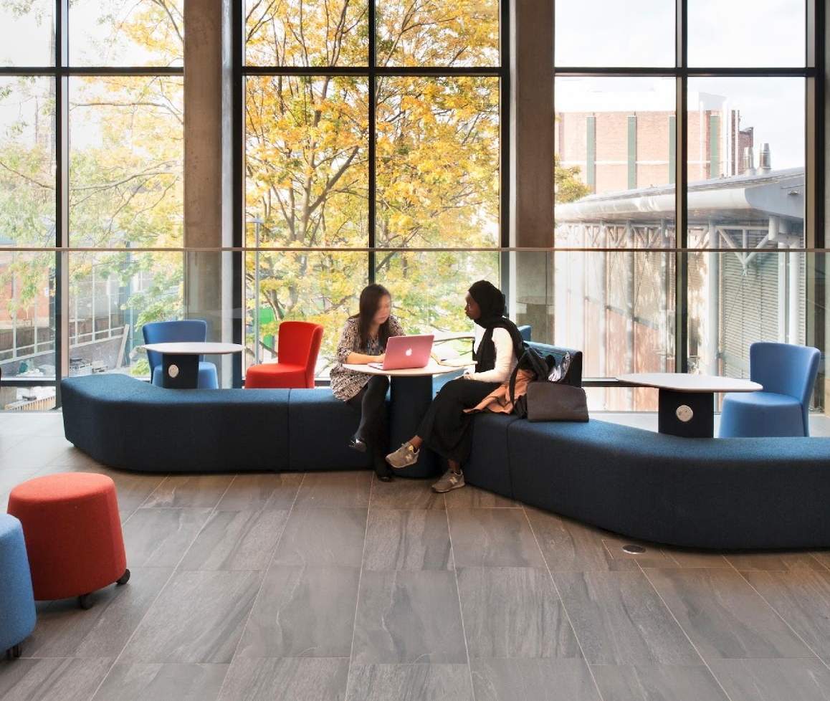
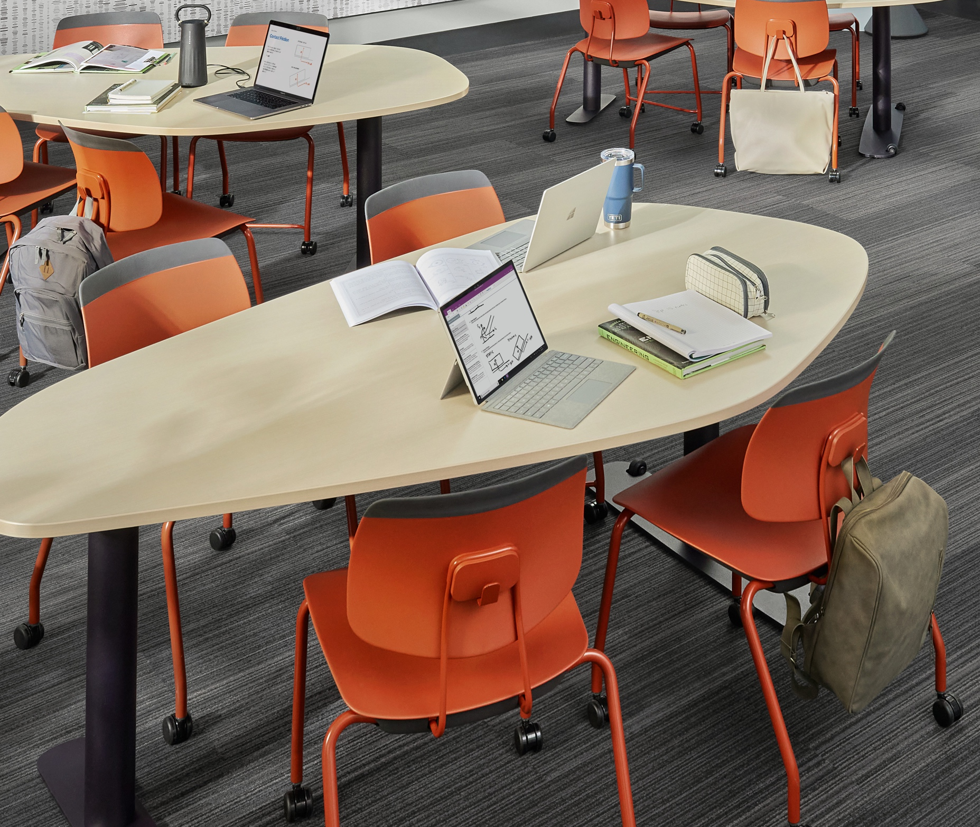
Design Principles
02
Interactions
Create formal and informal learning spaces that support less hierarchical and more authentic interactions.
01
03
Process
Tools
Optimize the built environment to support the different phases of project-based learning.
Design “doing” spaces to host the physical and digital tools needed to support project-based learning.
Notes:
Process:
Optimize the built environment to support the different phases of project-based learning.
Support multiple classroom modes of teaching and learning.
Allow for easy and seamless transitions.
Interactions:
Create formal and informal learning spaces that support less hierarchical and more authentic interactions.
Support both in-person and hybrid interactions for hybrid team meetings and external guests.
Create a sense of professionalism.
Tools:
Design “doing” spaces to host the physical and digital tools needed to support project-based learning.
Consider the range of tools for thinking, making and sharing.
Communicate the intent of tools.
Host and display project artifacts.

Slide 23
Applications
Notes:
Now let’s look at how the products for Steelcase Learning can be directly applied in the learning environment.

Slide 24
4C’s of Project-based Learning
Classroom
Collaborate
Create
Communicate
Notes:
Earlier we discussed the 4 Cs of project-based learning. Now we will look at each one and discuss applications that better support PBL. The first C is Classroom. In classrooms, researchers designed spaces that would:
Limit hierarchy in classroom spaces
Create a feeling of professionalism
Support different PBL phases of activity and group formation
Encourage cross-disciplinary interactions
Leverage in-between spaces for the before, during and after classroom experiences
Support bringing in virtual guest speakers

Slide 25
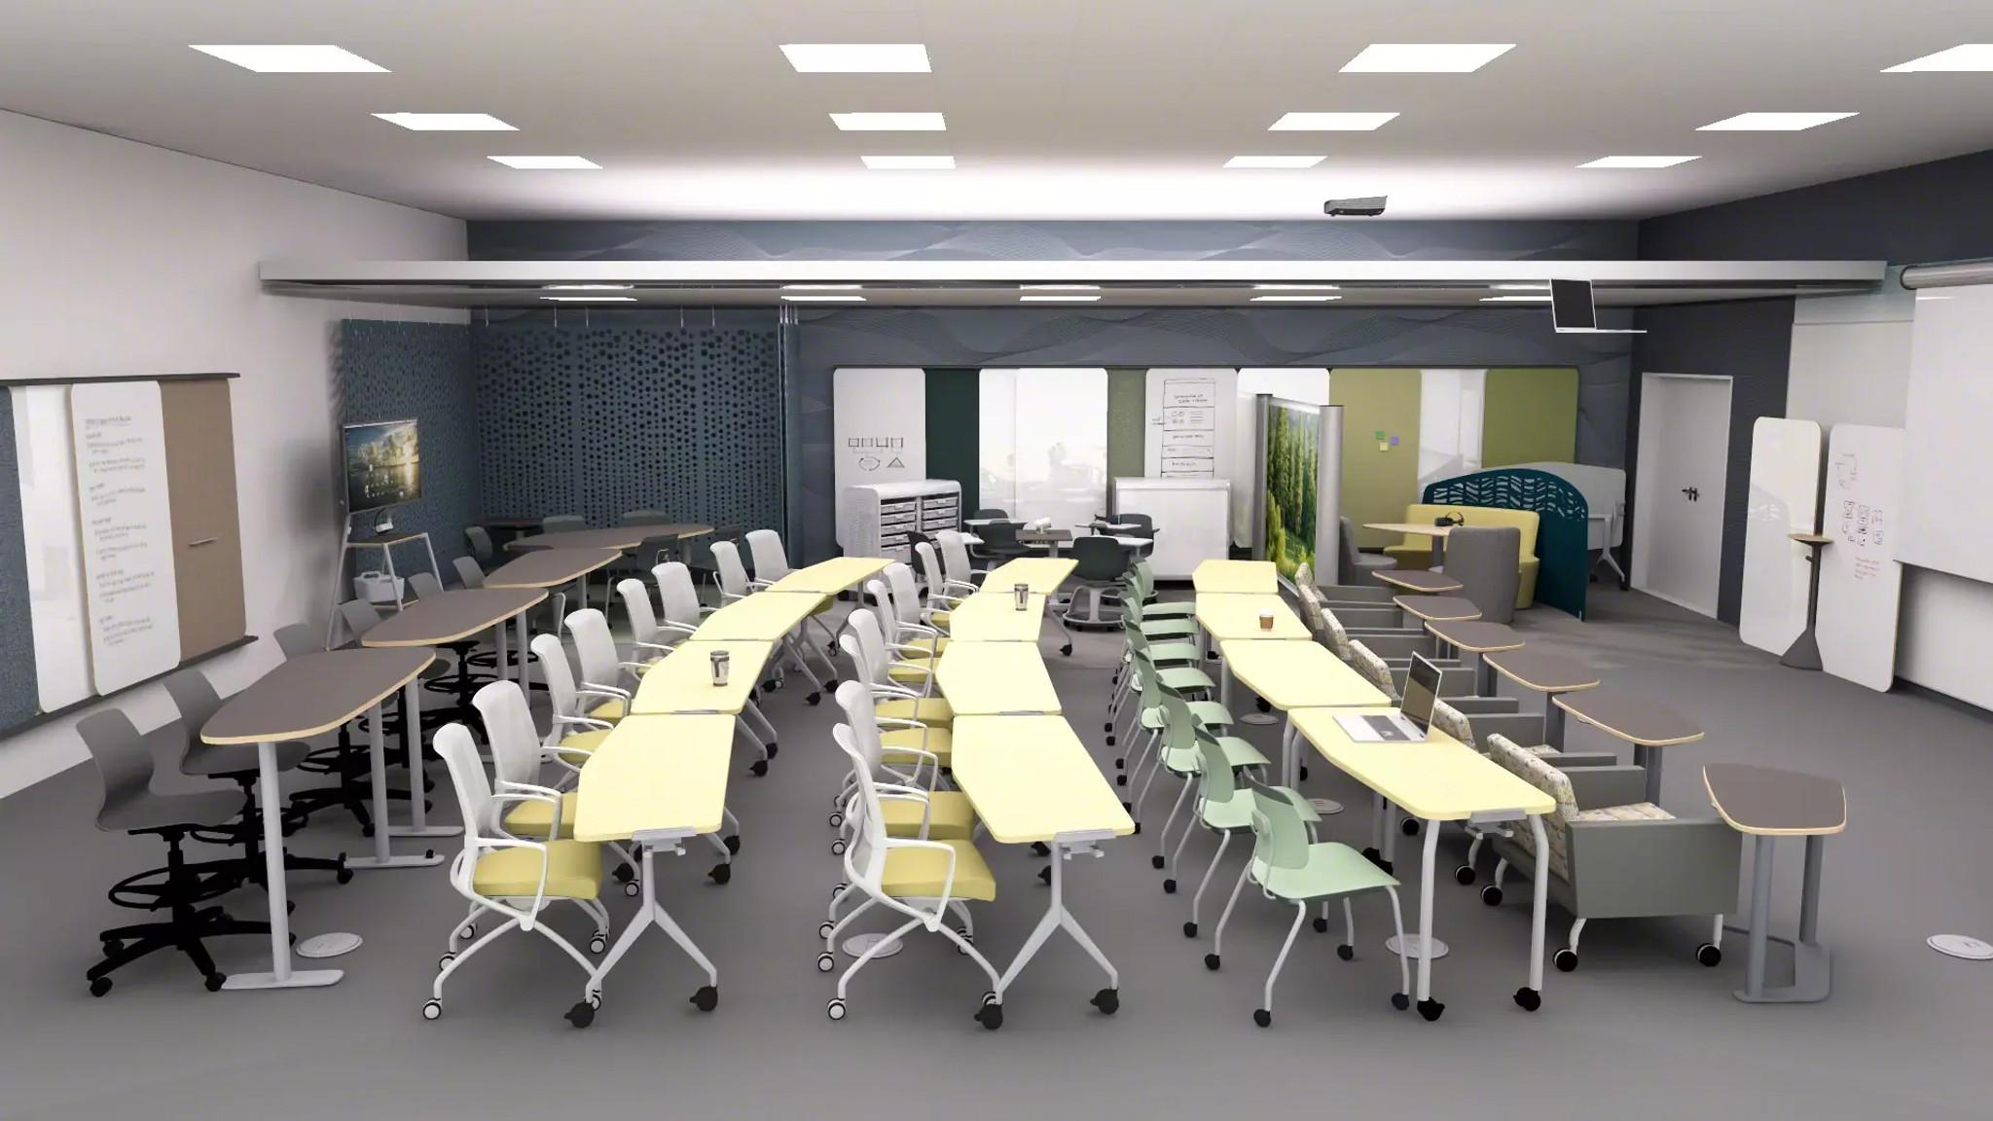
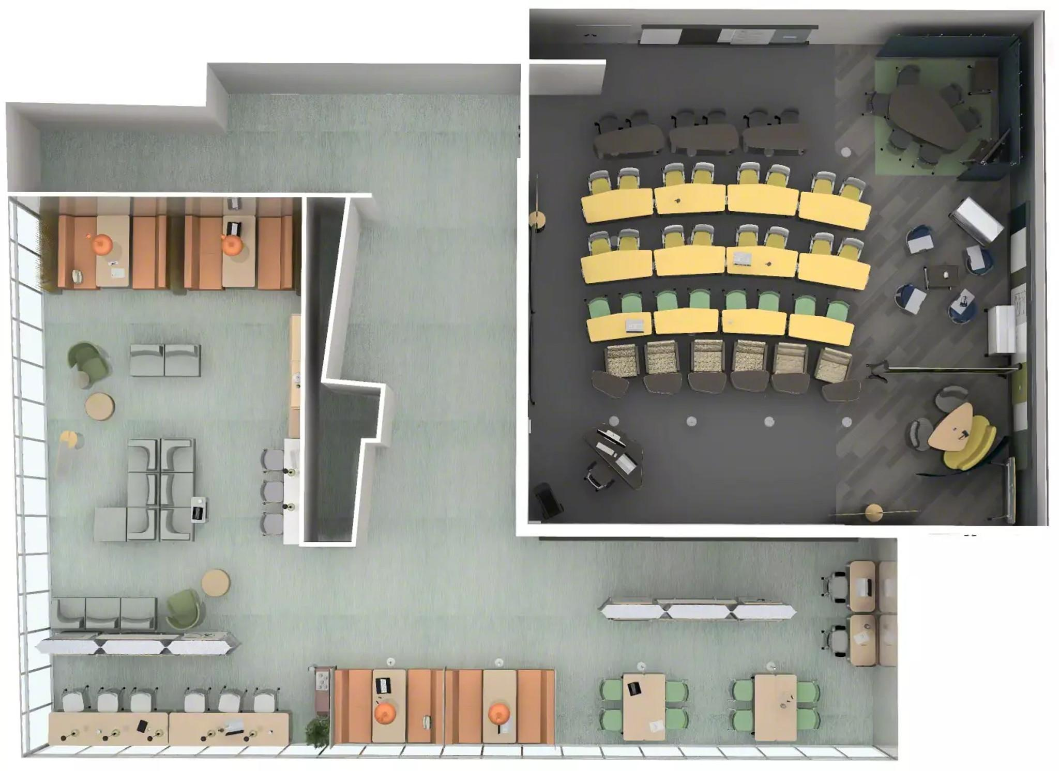
Classroom
Group work/studying
Writeable surface
Comfort to promote productivity
Different range of postures
Power access
Space Division
6
1
2
3
4
5
Notes:
This traditional classroom is packed with multiple different spaces and features to extract as much space from the room as possible. This allows students to have the most effective and enjoyable learning experience.
Taking up the majority of the space, in line with a traditional classroom or lecture hall, is the rows of desks. This cluster of desks offers four different seating options, and three different desk heights, for a range of different postures.
In the back, there are three different spaces for group work and studying to take place. The three spaces all offer a range of privacy, comfortable seating, writable surfaces and access to a whiteboard to collaborate with classmates.
Easy access to power allows remote participation.
Products Shown: Verb Flip Top Table, Agree Chair, Tenor Chair, Elbrook personal Table, Smith System Cascade Storage, Coalesse Sidewalk Lounge Chairs, Flex Whiteboards, Elbrook Tall Tables

Slide 26
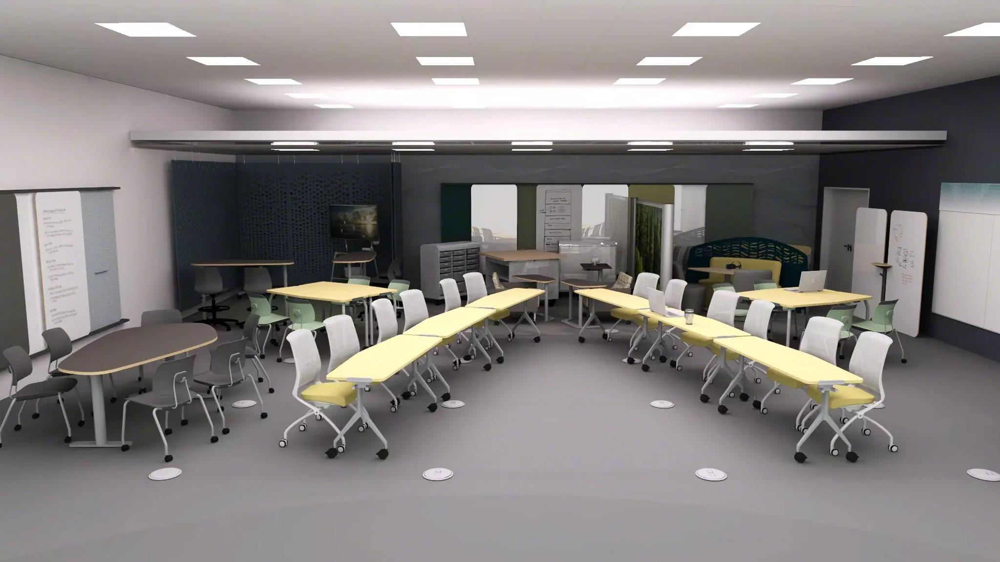
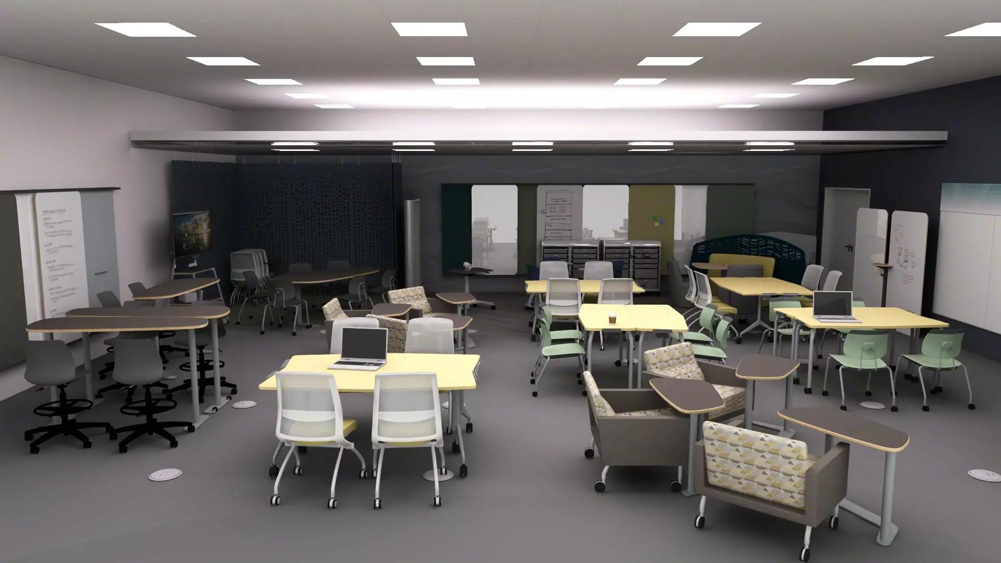
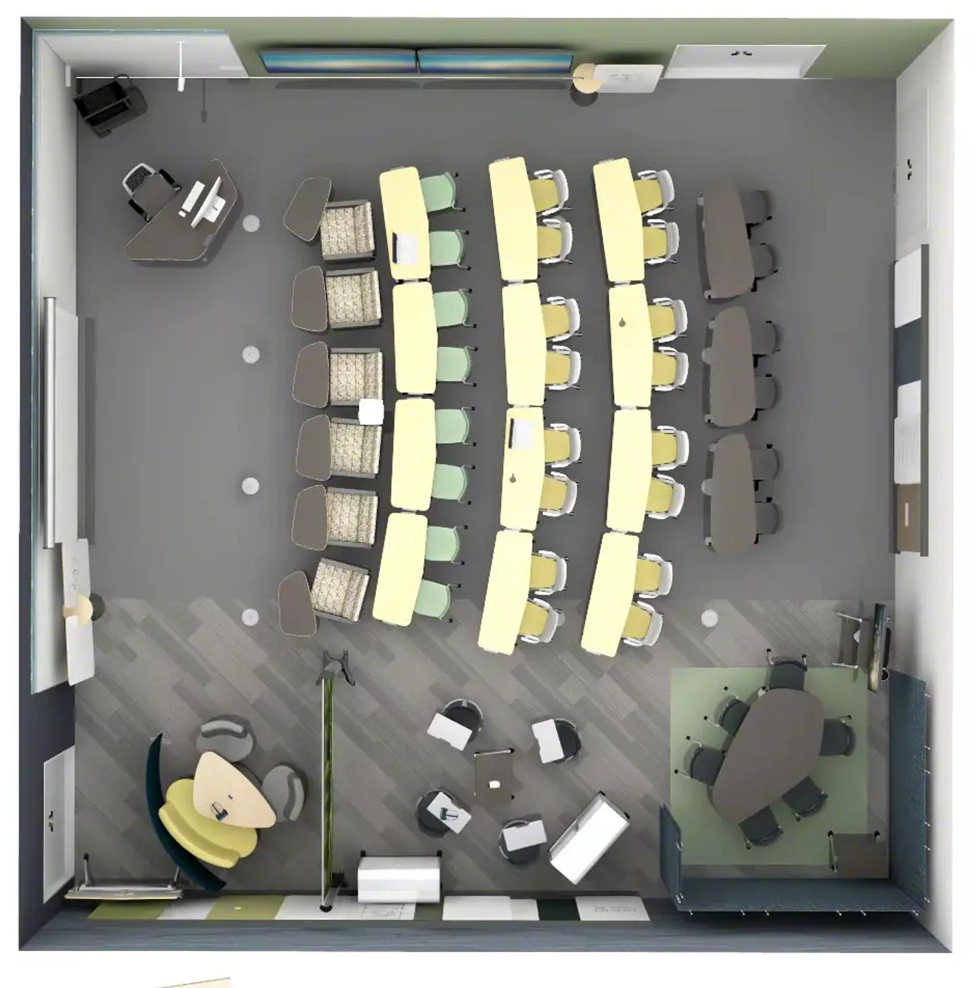
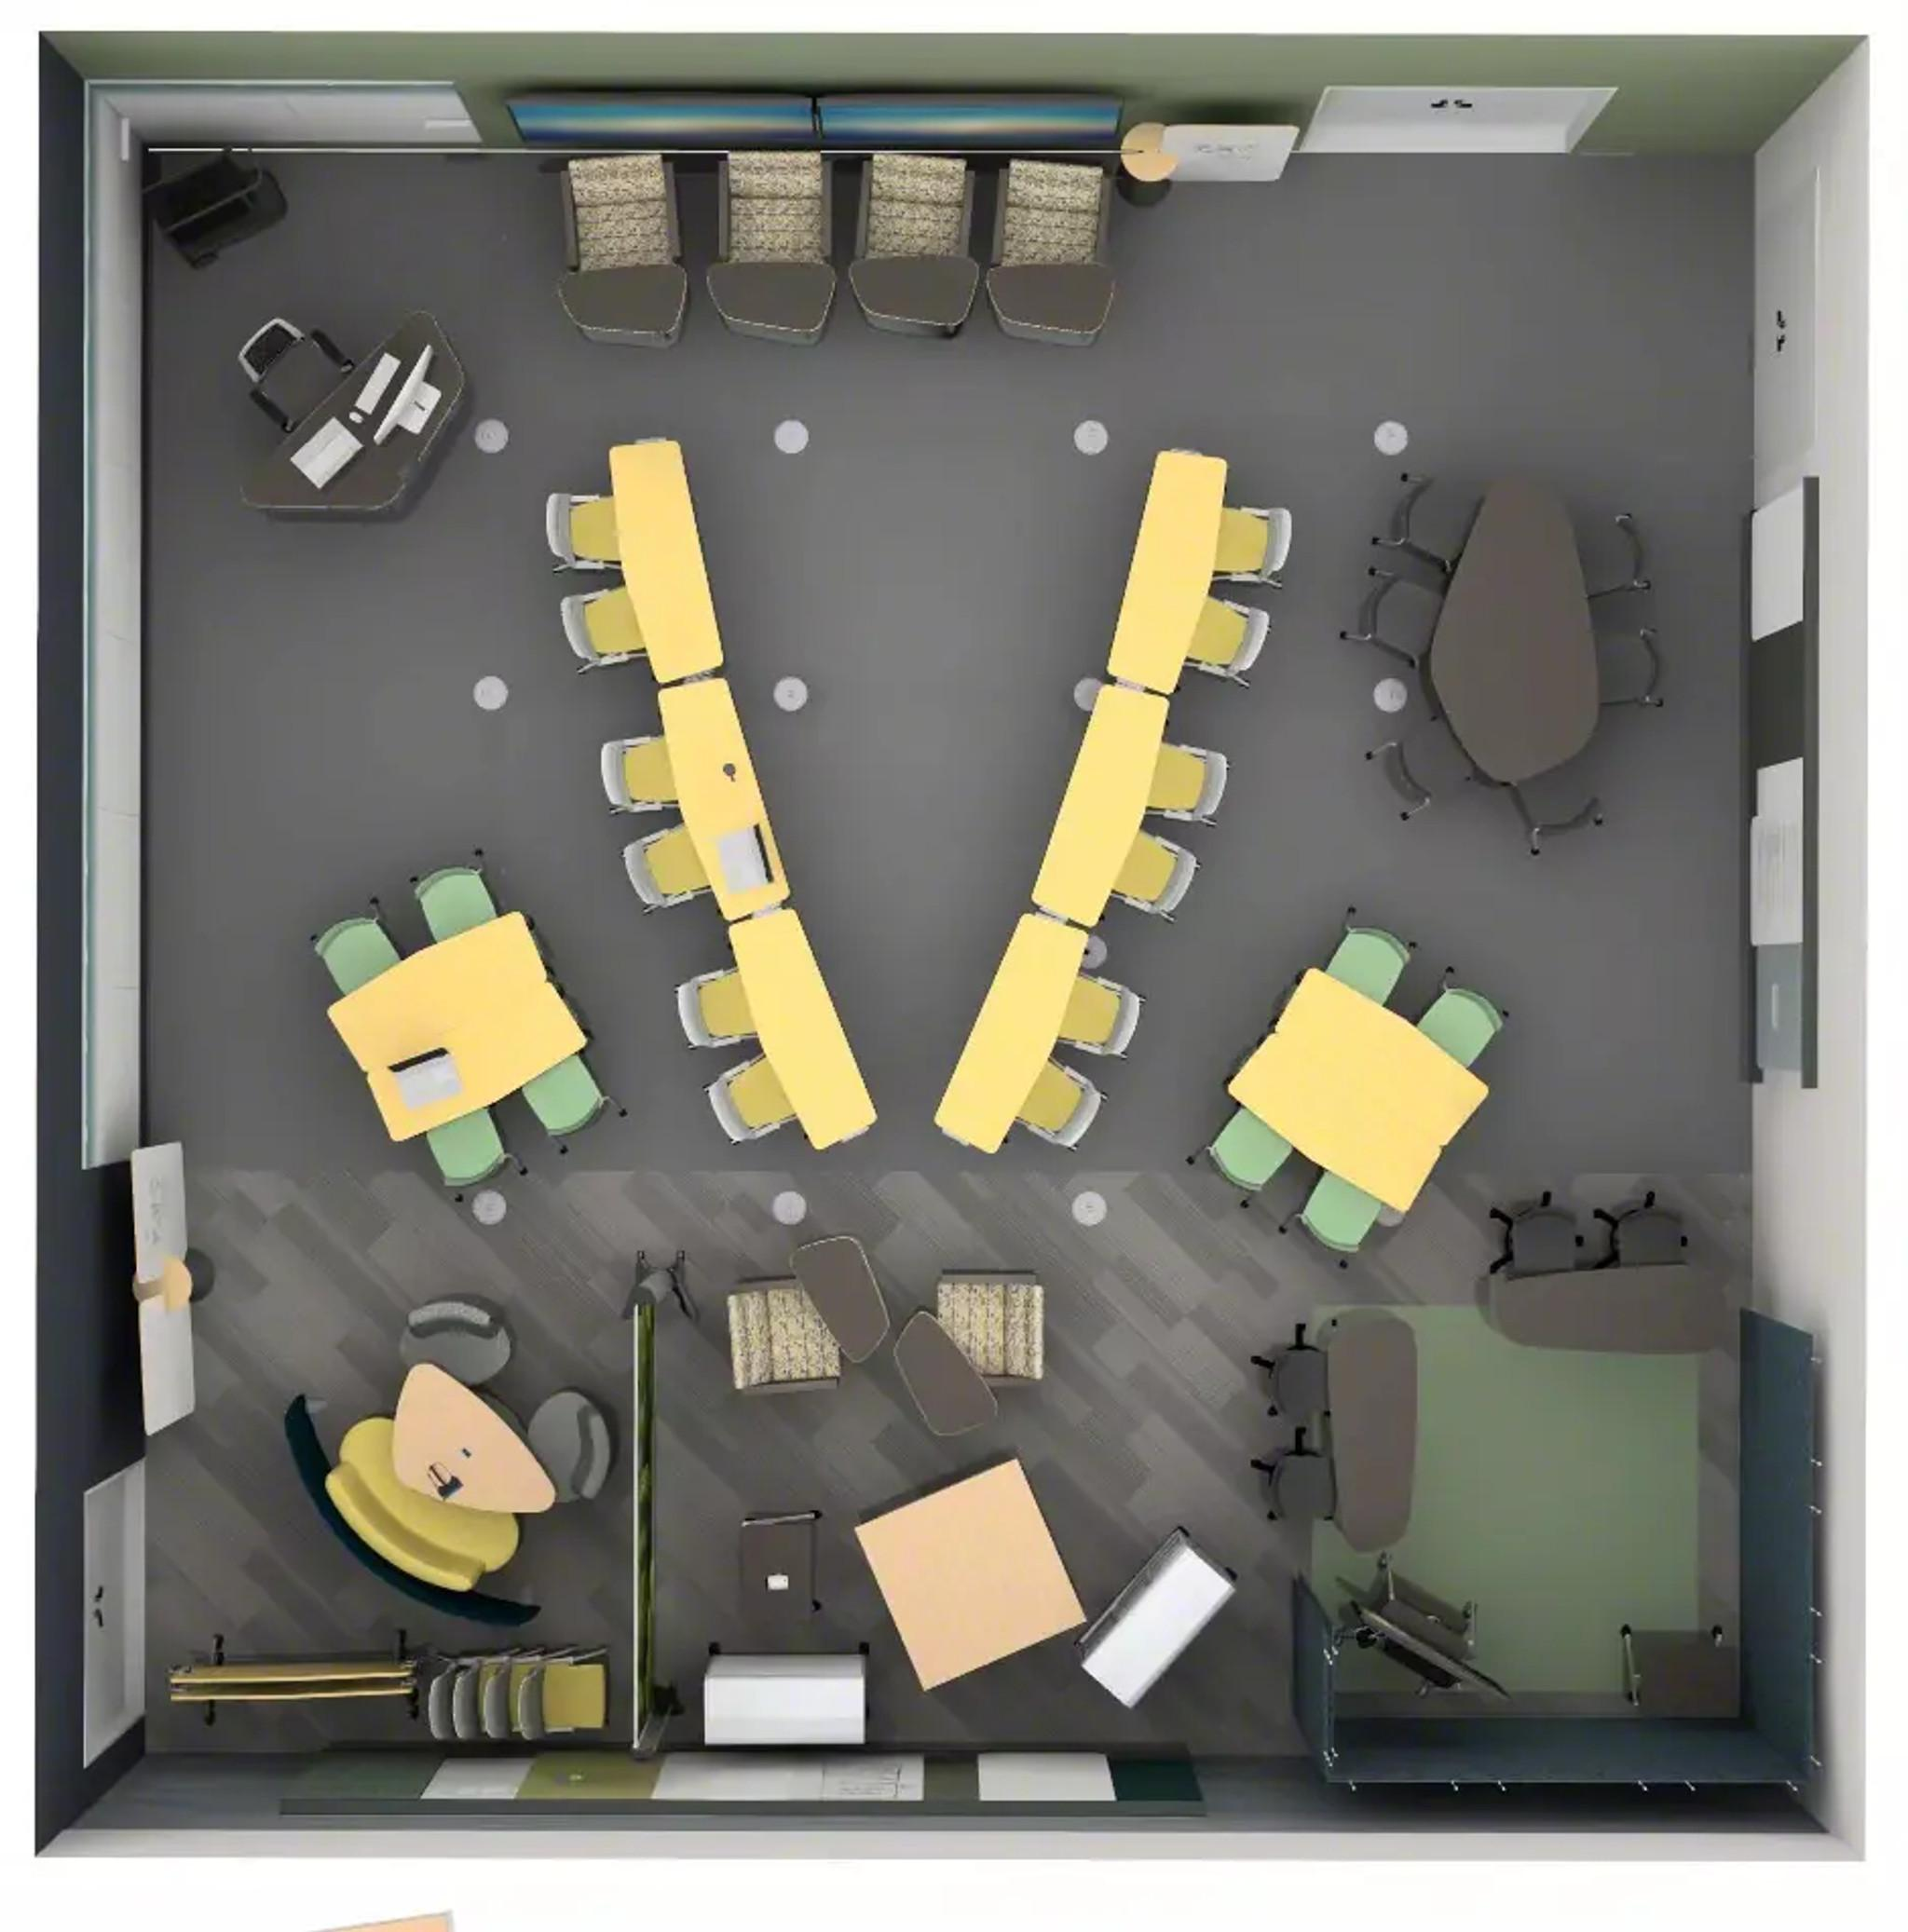
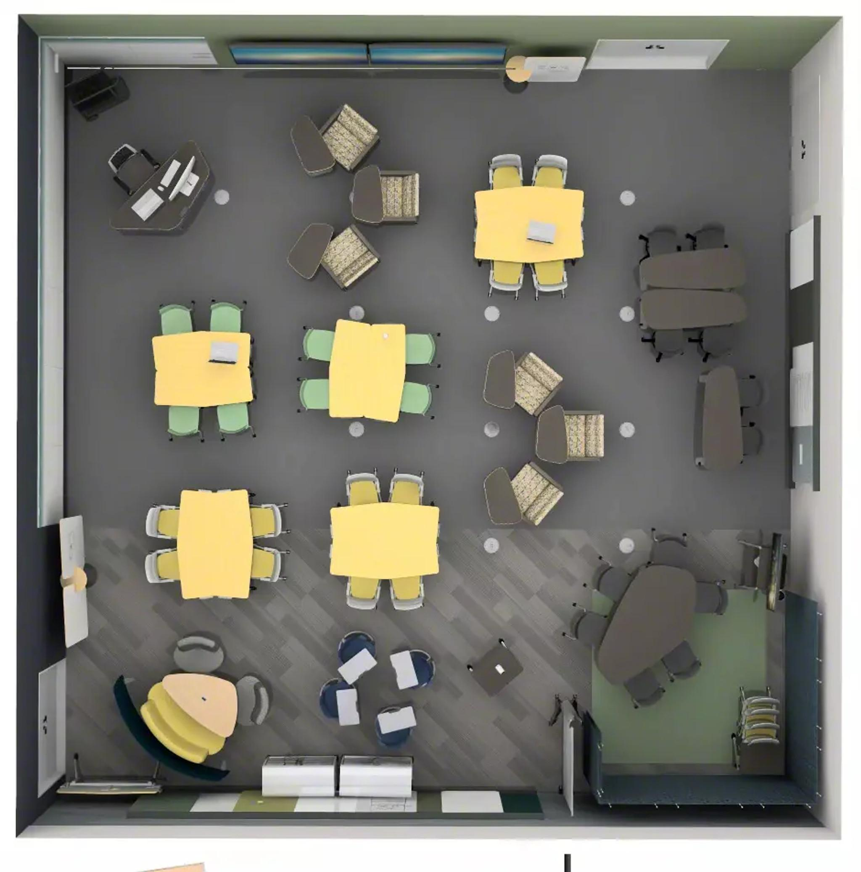
Classroom
Presentation Mode
Discussion Mode
Group Mode
Notes:
The rows of desks shown previously, which offer 4 different seating options, and three different heights for the writable surface, can also be easily transformed into the three modes shown above, all without compromising comfort.
Presentation is a traditional classroom style which has the student’s attention focused on the front of the room.
Project mode is for larger projects where the student’s attention can be on a large group.
Group mode is perfect for smaller groups to cluster off to work together without having to move all of their belongings, change seats, etc.

Slide 27
4C’s of Project-based Learning
Classroom
Collaborate
Create
Communicate
Notes:
The second C is Collaborate. In collaborative spaces, researchers designed spaces that would:
Encourage hybrid collaboration with peers and external collaborators
Design for multiple groups working at the same time
Support informative, evaluative and generative group modes
Increase the sense of professionalism
Provide more engaging and vibrant settings

Slide 28
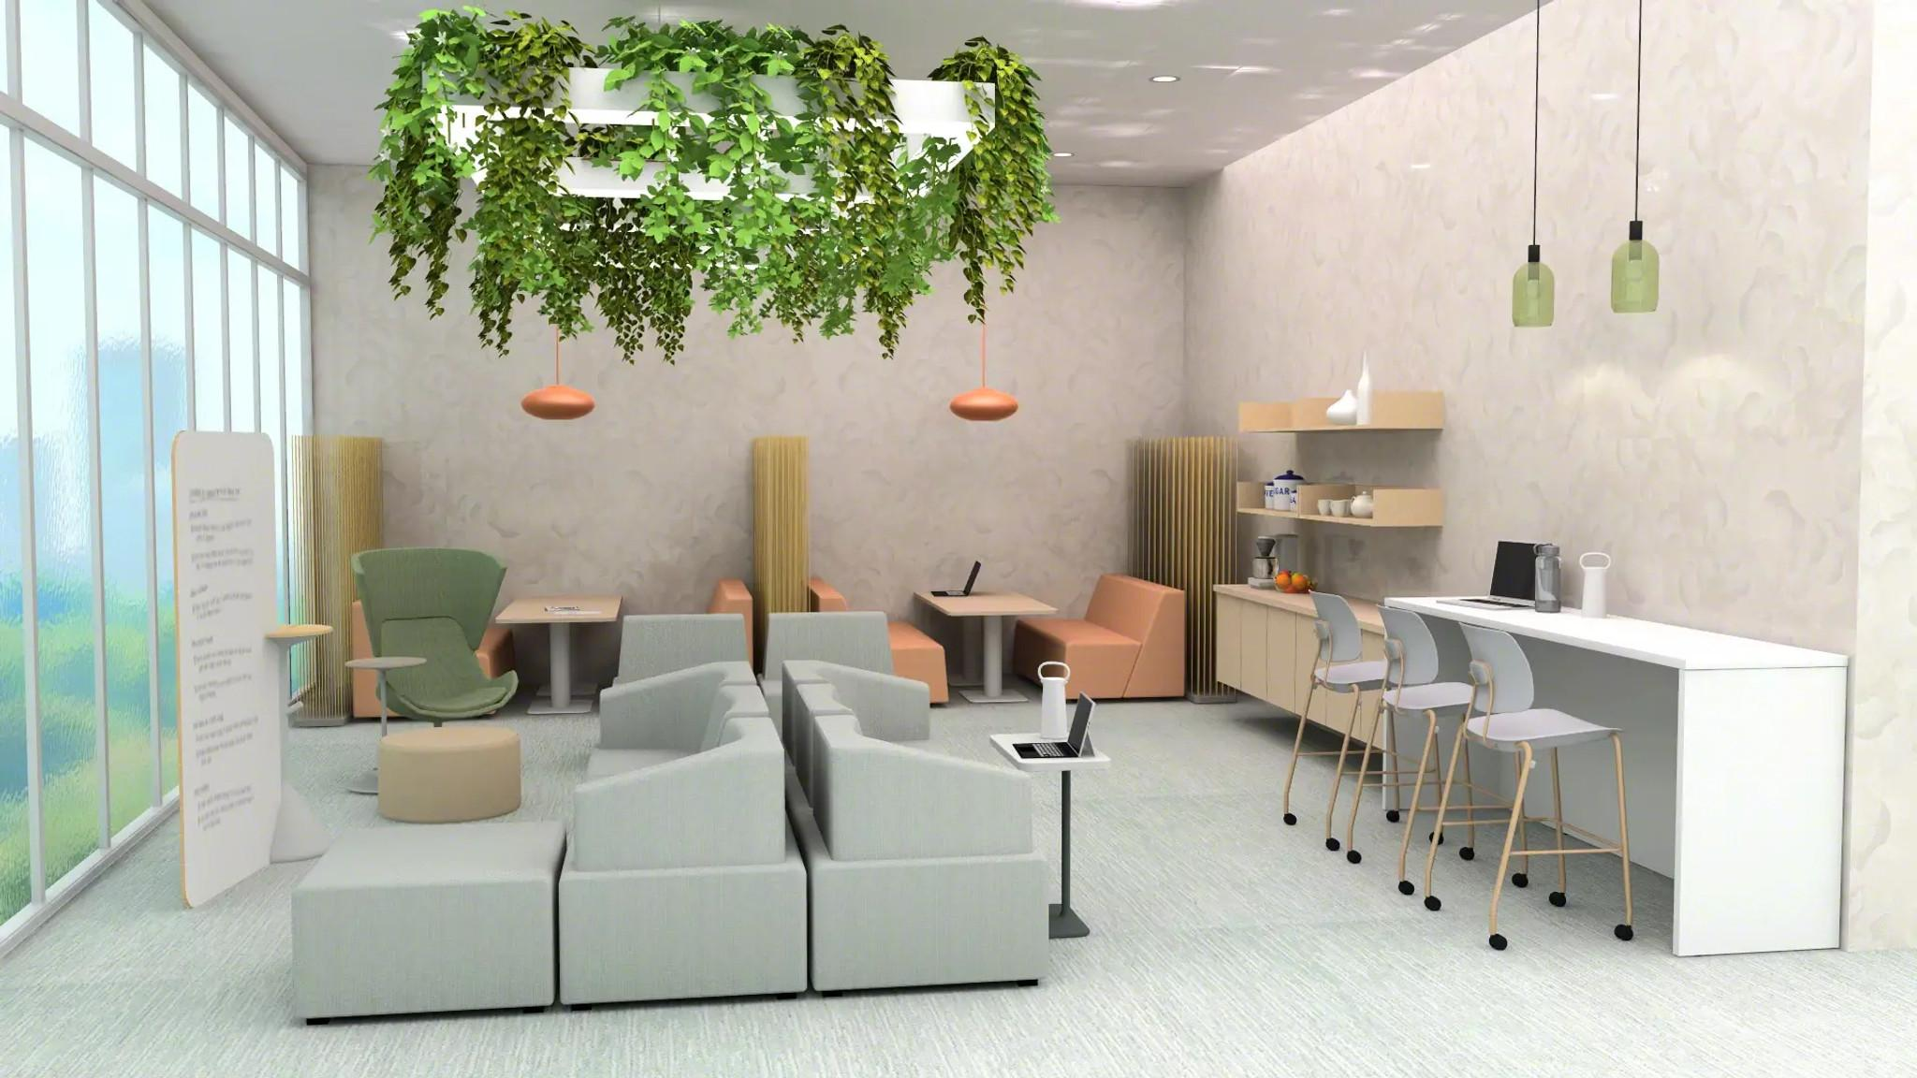
Academic Building In-Between Space
Group work/studying
Writeable surface for lounge settings
Individual resting
Comfort to promote productivity
Different range of postures
Power access
6
4
3
5
2
1
Notes:
Flex spaces have easy access to elevators, large windows, private conference/study rooms, whiteboards, booth seating, individual bar-height tables, water fountains, restrooms and classrooms. They are strategically placed in convenient locations to allow students to be productive and comfortable in the “in-between” time.
Starting on the left, there are back-to-back couches to maximize comfort and offer more reclined and relaxed postures, while also providing access to writing surfaces.
Directly behind, there are multiple seating options, creating a versatile space for both individual seating or resting, as well conversation, collaboration and more.
On the right side in the foreground, a high-top counter offers a varying height option with traditional seating to accommodate a range of postures, as well as access to power.
In the back, booth style workstations combine comfort and productivity with large couch-style seating and a large writing surface.
Products Shown: Campfire Lounge, Tenor Stools, Campfire Slim Table, Orangebox Avi, Flex Whiteboards

Slide 29
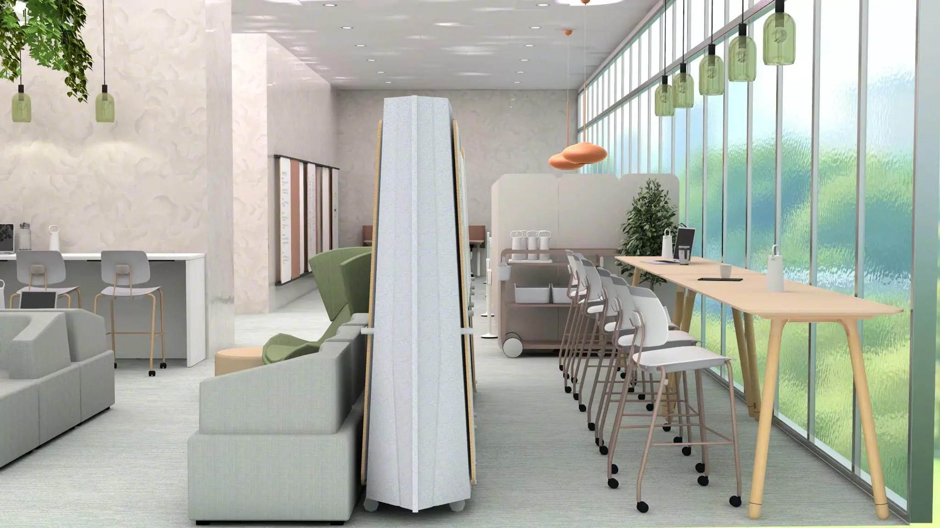
Academic Building In-Between Space
Writable surfaces
Privacy/Space division
Comfortable seating
Range of postures
Power access
1
4
5
2
3
Notes:
Here is another option for students in an in-between space that provides more privacy, quiet and separation from the previous open floor plan spanning off to the left.
Right in the middle there is a privacy wall/divider, which separates this space from the rest of the open floor plan and provides some acoustic privacy.
To the right is the private section which is separated from the rest of the room and allows students comfortable seating, sufficient workspace, and access to power.
To the the left of the privacy divider is comfortable lounge seating with access to the open format of the collaborative room.2
Products Shown: Flex Acoustical Boundary, Tenor Stools, Campfire Lounge, Coalesse Potretro415 Table

Slide 30
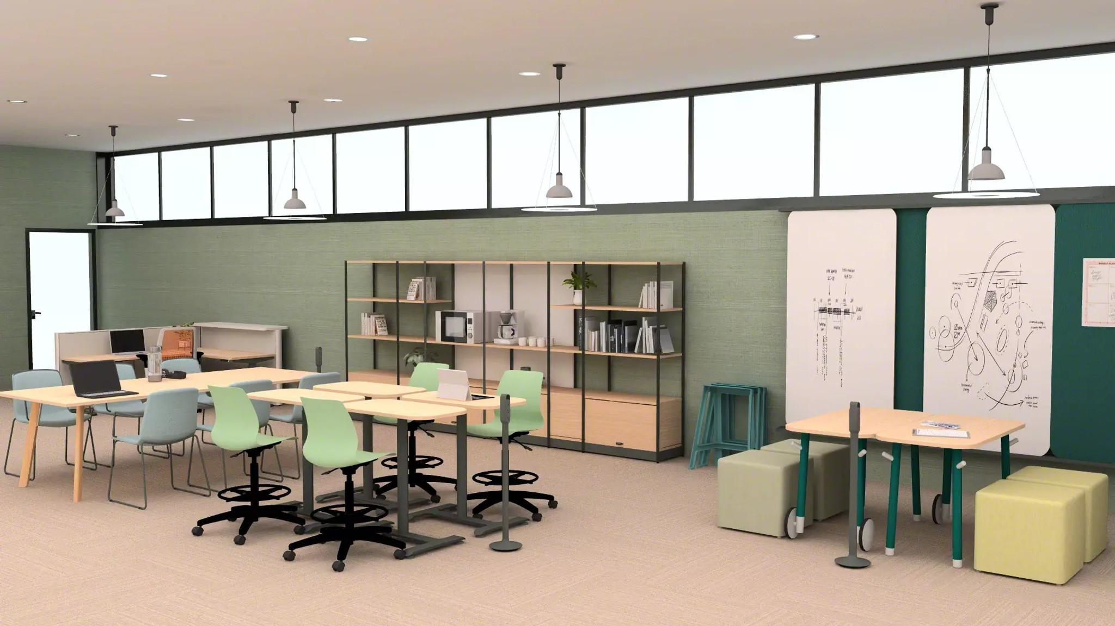
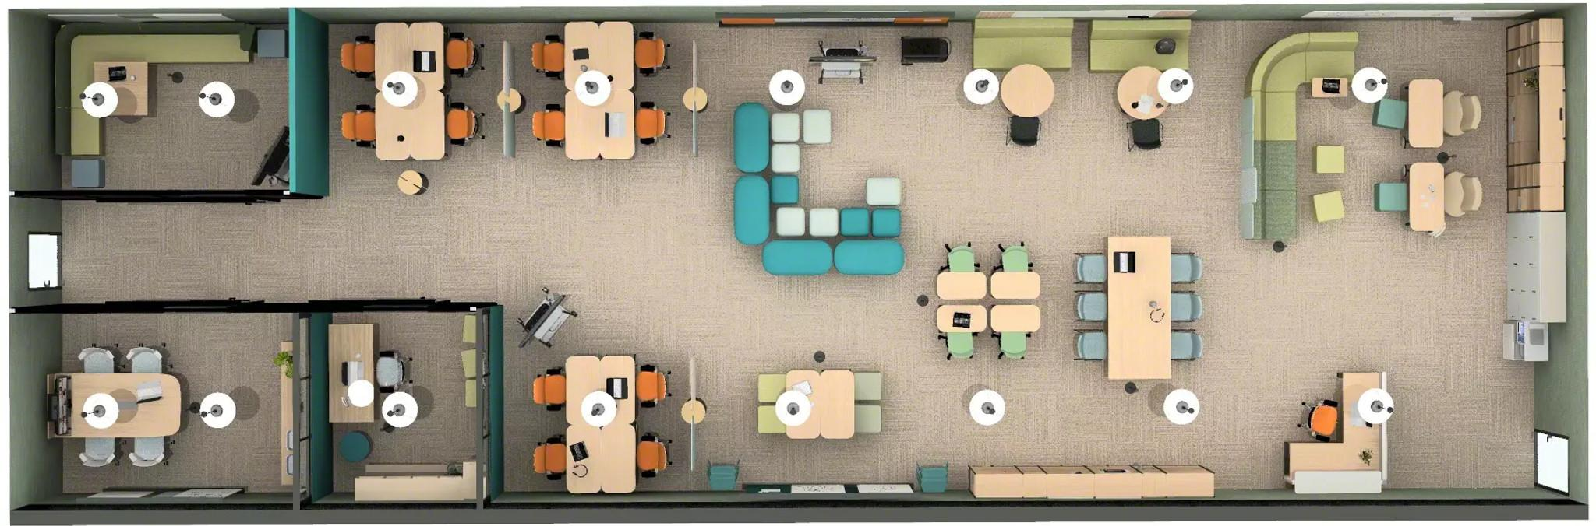
Project Design Studio #1
Collaboration + openness
Range of postures
Open storage
Writable + tackable surfaces
Flexibility
3
4
2
5
1
Notes:
The Studio is a space that provides support to students working on collaborative projects, helping to promote discovery work. The project design studio is one of the places on campus that encourages interdisciplinary work.
In the left background, there is a focused work area for independent work.
On the left side there is a large table that allows plenty of space for a variety of different materials that may be necessary for group work.
To the right of the large table, a small cluster of individual desks allows for more flexible group work to be done while also offering height-adjustable options.
Both seating areas offer easy access to open storage and materials.
On the right, there is a fourth seating option, with two tables and access to whiteboards to help maximize creativity and collaboration.
Products Shown: Agree Stools, Flex Personal Table, Flowform Square Ottoman, Flex Worktable, Flex Rails, Flex Active Frame, Cubb Chairs, Perch, Thread, Verlay Table

Slide 31
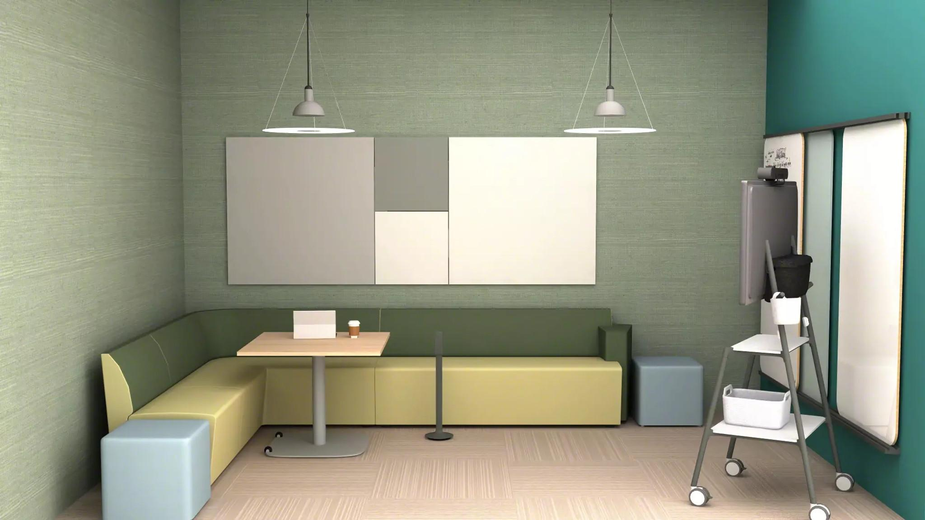
Project Design Studio #2
Private group work
Media display
Writable surfaces
Acoustical privacy
Vibrant colors
Flexible + storable lounge
4
1
3
2
5
6
Notes:
This enclosed project studio offers maximum privacy for group projects and collaboration.
Students have access to writable and tackable surfaces, as well as a mobile media display to work on and present their project.
There is comfortable, couch-style seating and other moveable seating options providing flexibility.
Products Shown: Away From The Desk, Flowform Square Ottoman, Flex Media Cart, Motif, Flex Rails, Thread, Elbrook Square Table

Slide 32
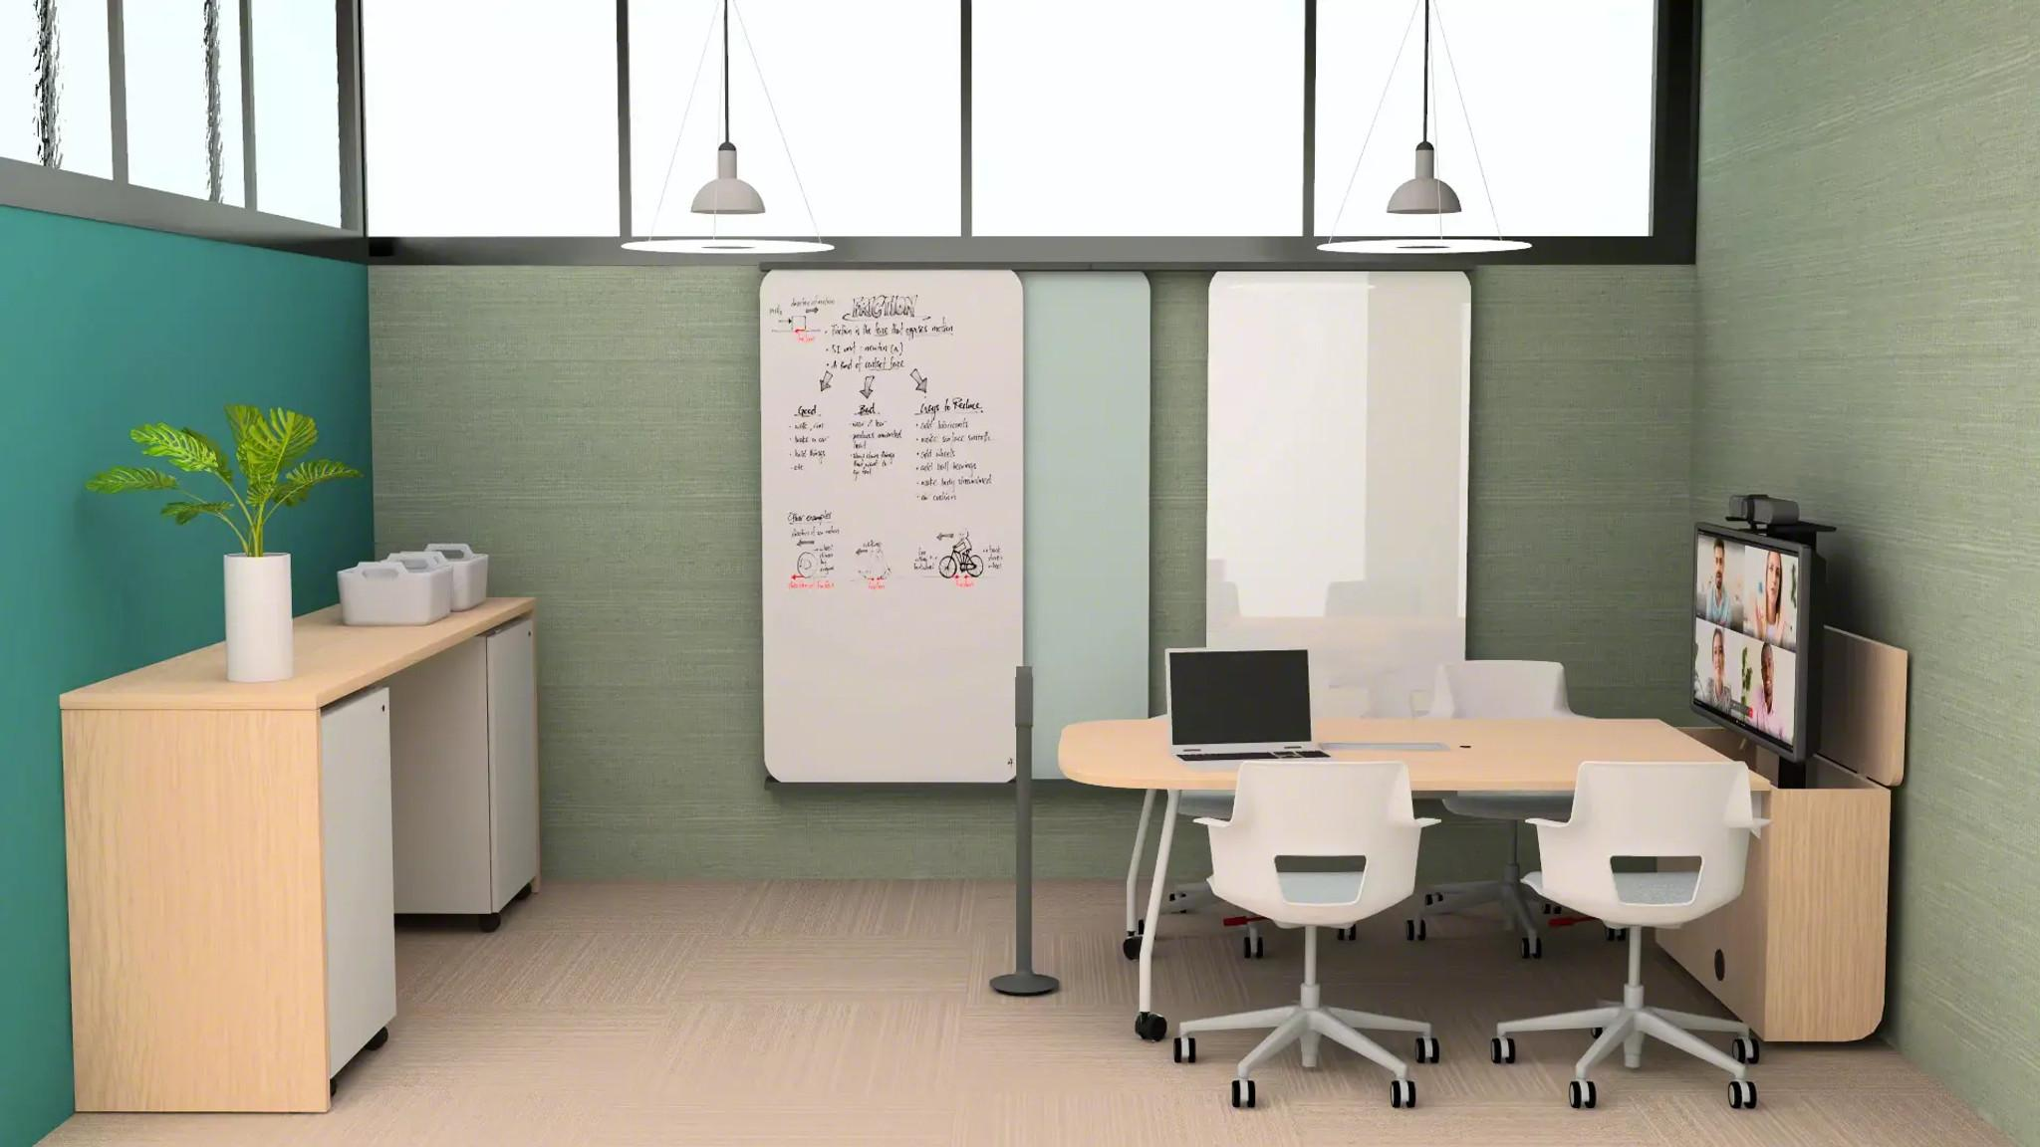
Project Design Studio #3
Private meeting/ conference room
Under worksurface storage
Writable + tackable surfaces
Media display
5
3
1
4
2
Notes:
Another design studio option offers acoustical privacy for students to facilitate focus work.
On the left is a standing worksurface with storage below, offering multiple posture options.
Along the back wall students have access to whiteboards and tackable surfaces providing a place to share ideas, solve problems and collaborate.
To the right, a four-person workstation, with access to a media display, gives students the opportunity to focus their attention on other participants and present as a group.
The media display can also be hidden by lowering into the cabinet.
Products Shown: Campfire Big Table Half Depth, Campfire Mobile Storage, Verb Active Media Table, Shortcut 5 Star Base Chair, Thread, Flex Rails

Slide 33
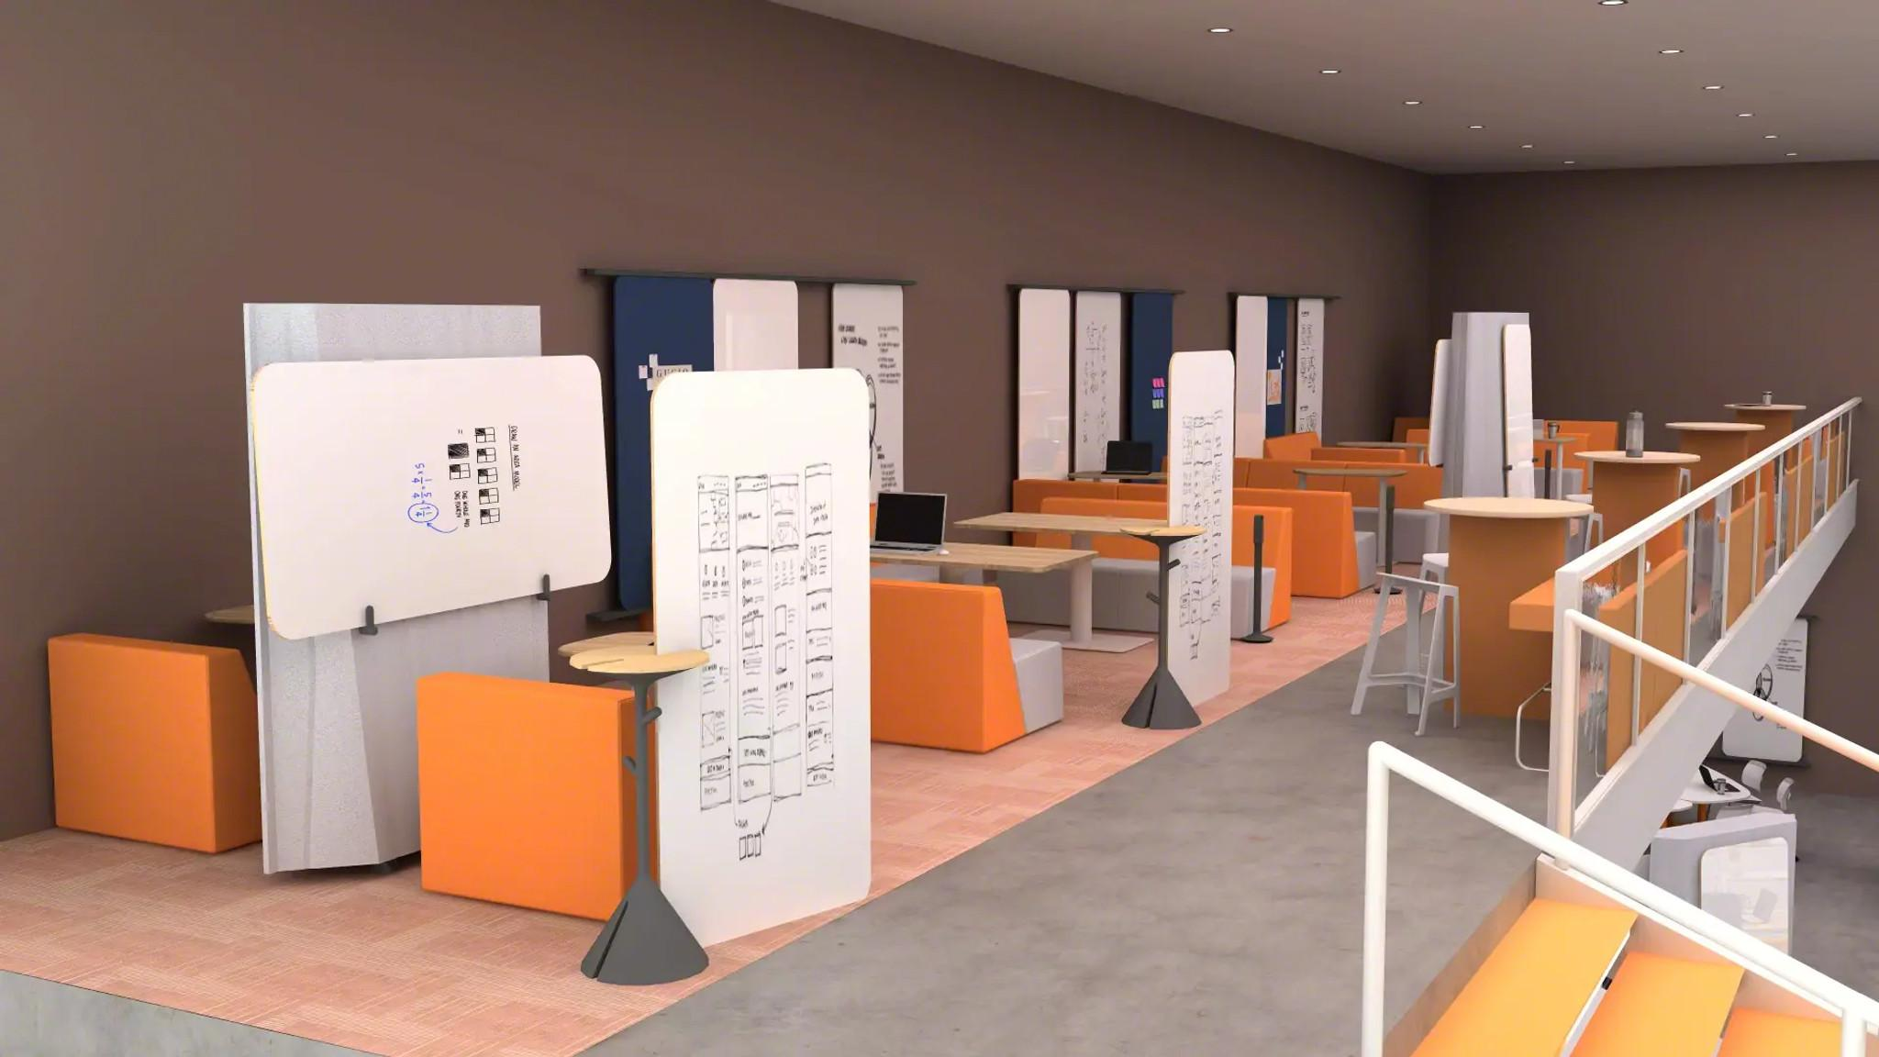
Multipurpose Space
Private studying
Collaborative space
Writable + tackable surfaces
Acoustical privacy
Power access
Seating variety
Working surfaces
3
4
7
6
2
5
1
Notes:
This multipurpose space offers great options for both private studying and collaborative work with other students.
On the left side of the room, booth-style lounge seating maximizes comfort for individuals or small groups.
The mobile privacy wall gives students the option to have complete individual privacy, or, if the wall is moved, to talk and collaborate with peers.
There is abundant access to whiteboards and other writing surfaces throughout the space.
Along the railing on the right side, high-top tables accommodate a range of postures and a more traditional writing surface if needed.
Easy access to power is allows for work on laptops, phones and tablets, as well as remote participation.
Products Shown: Campfire Lounge, Flex Boundary, Flex Stand, Flex Markerboards, Flex Rails, Border, Perch, Thread, Simple Rectangle Table

Slide 34
4C’s of Project-based Learning
Classroom
Collaborate
Create
Communicate
Notes:
The third C of project-based learning is Create. In looking at applications for creative spaces, researchers designed spaces that would:
Advertise and communicate the intent of the resource space.
Support facilitated experiences, including both one-on-one and workshop experiences.
Design for planning and ideating activities.
Support staff activities.

Slide 35
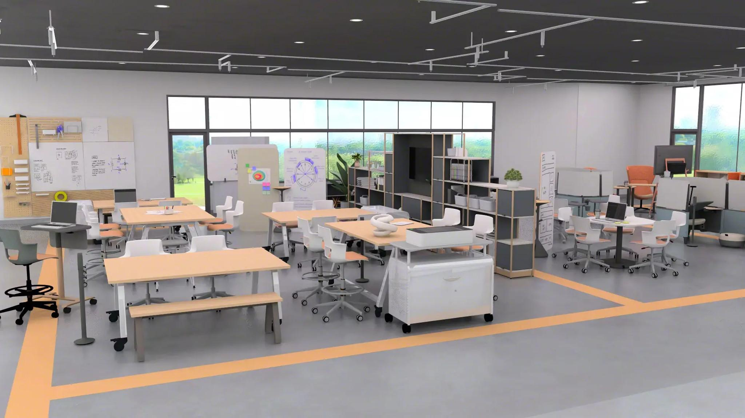
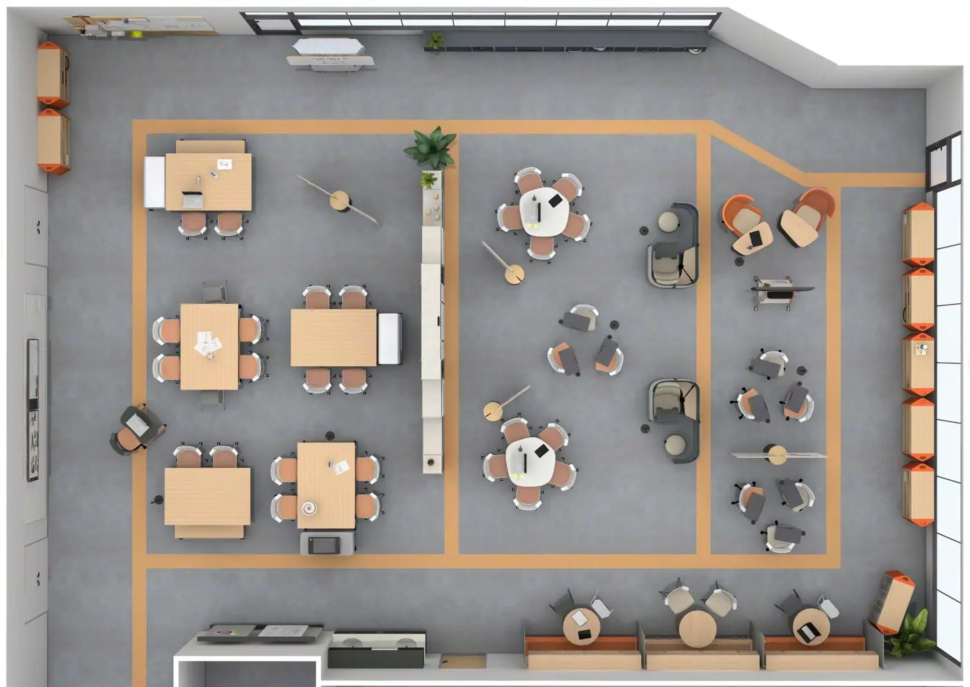
Makerspace
Make area
Think area
Working surfaces
Writable + tackable surfaces
Media display
Acoustical privacy
Open + enclosed storage
Seating variety
4
6
5
7
3
8
2
1
Notes:
The Makerspace may be utilized by students and residents. The space can also be used for lectures and studios throughout the week, and students come and go as they please. Collaboration is encouraged in this space, with much of the furniture having casters.
This space is large and intended to be a space for fostering creativity and ideas are brought to life.
In the foreground of the makerspace there are multiple tables, with varying options for seating including stools and benches.
To the right is a storage structure that both contains a media display and acts a partition, separating the Make and Think areas.
Behind the storage wall, there is a more private collaboration space. With comfortable seating and writeable surfaces, students have what they need to collaborate and think through the project at hand.
Along the back wall there are multiple writable and tackable surfaces for students to take advantage of for easy collaboration with their partners.
Products Shown: Planner Table & Bench, Shortcut 5 Star Base Chair, Shortcut Stool, Flex Personal Table, Cascade Storage, Flex Active Frame, Flex Stand, Motif, Flex Boundary, Elbrook Huddle Table, Thread

Slide 36
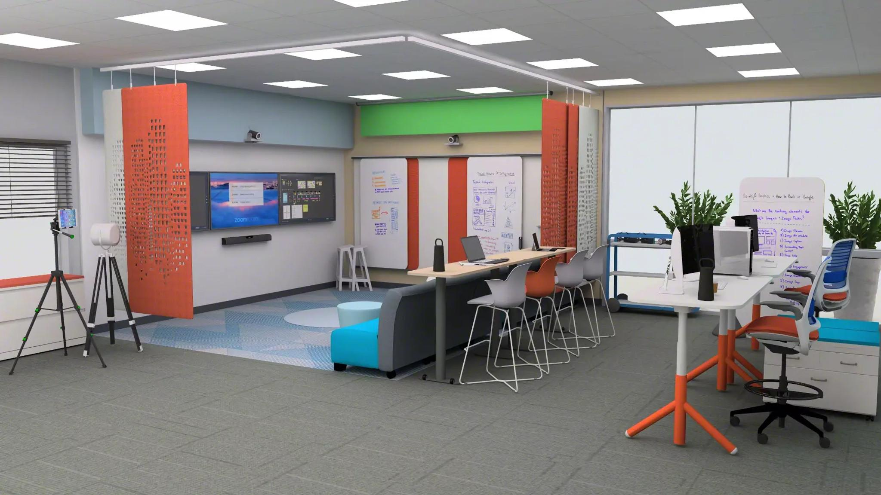
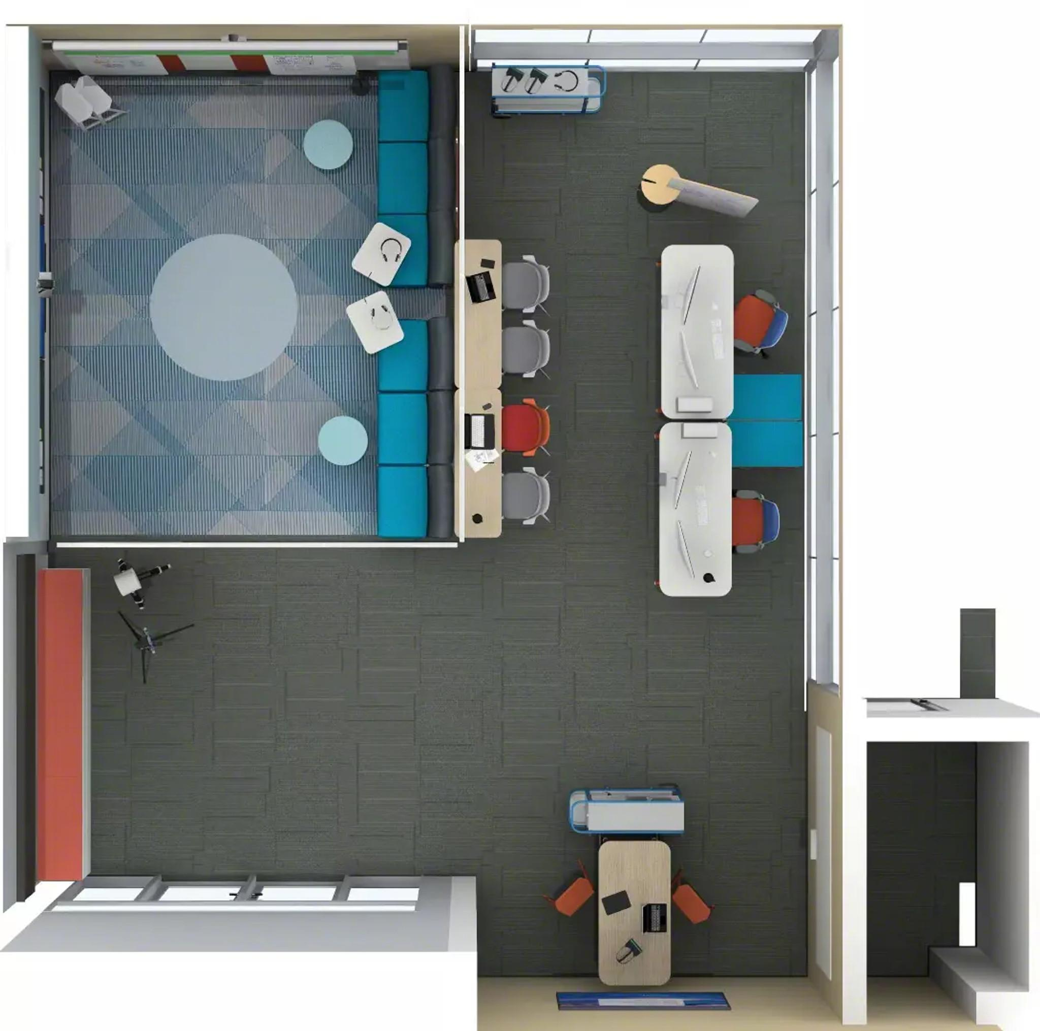
Digital Makerspace
Comfortable seating
Variety of postures
Worksurfaces
Use of storage
Content display
Writable + tackable surfaces
Space division + acoustical privacy
5
7
6
3
2
1
4
Notes:
Fittingly named, this space is similar to the Makerspace, except that it is tailored towards technology, media and a digital experience. The room’s orientation guides attention towards the large media display seen on the left wall.
Directly in front of the large media display is tiered seating, with lounge and standing-height/stool options. The hard-top surface allows students to easily take notes on, or make changes to, the presentation material. Whiteboards and tackable surfaces adjacent to the media display allow for group brainstorming.
Towards the back of the room are two larger, height-adjustable desks, offering additional options for viewing and observation or focused work with dual monitors and access to power and storage.
This room also features adjustable privacy panels to provide acoustic isolation.
Products Shown: Flex HAD, Series 1 Stool, Node Stool, Elbrook Rectangle Table, Jenny Lounge, Flex Cart, Flex Power, Flex Rails, Screens & Whiteboard, AMQ 3F Hanging Panels, Perch, Flowform Cylinder Stool

Slide 37
4C’s of Project-based Learning
Classroom
Collaborate
Create
Communicate
Notes:
The fourth C is Communicate. When seeking to foster communication, researchers designed spaces that would:
Function for both in-person and hybrid learners.
Consider synchronous and asynchronous experiences.
Support a range of group experiences from large collaboration/event activities to groupwork areas and individual activities.
Provide settings that can be easily rearranged.
Support a wide range of learner’s postures.

Slide 38
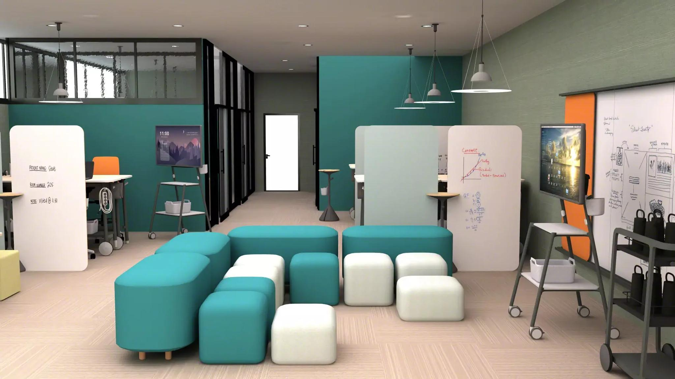
Project Design Studio Presentation Space
Collaboration + openness
Media display
Writable surfaces
Acoustical privacy
Power access
Range of postures
Storable lounge
2
4
3
5
1
7
6
Notes:
This room is tailored towards presentations and the ability to share and communicate as a team.
Front and center there are multiple seating options in an open concept, all facing toward the mobile media display on the right side of the room. They can be easily rearranged, and multiple seating heights accommodate a range of postures.
The media display is on casters and can be moved through the room for flexible viewing. A second display can be seen in the back left of the room.
On the left side, and in the back of the room are additional presentation spaces, segmented with acoustical privacy panels.
Each of these sections has a high-top table, giving students the option to either sit or stand.
Access to power makes screen sharing, remote access and note taking easy.
Products Shown: Common Bench, Season Pouf, Flex Media Cart, Flex Rails, Flex Stand, Flex Power, Flex Boards & Screens

Slide 39
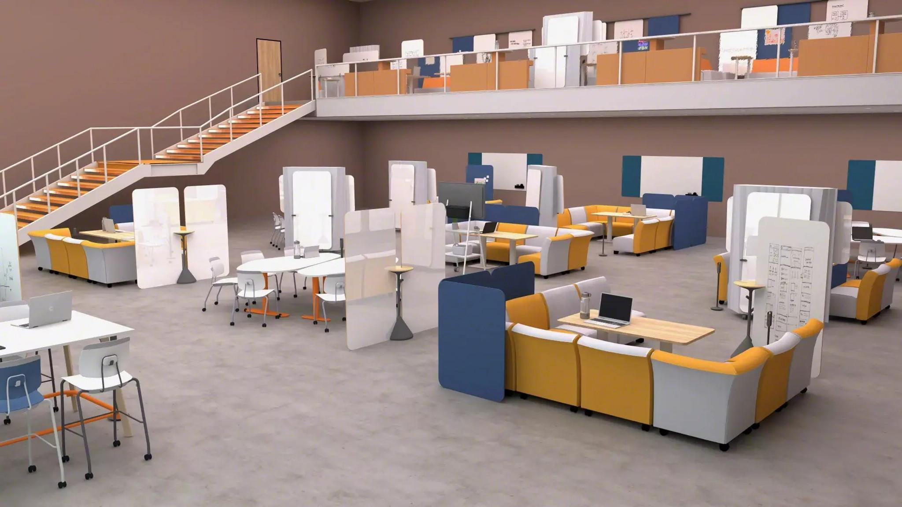
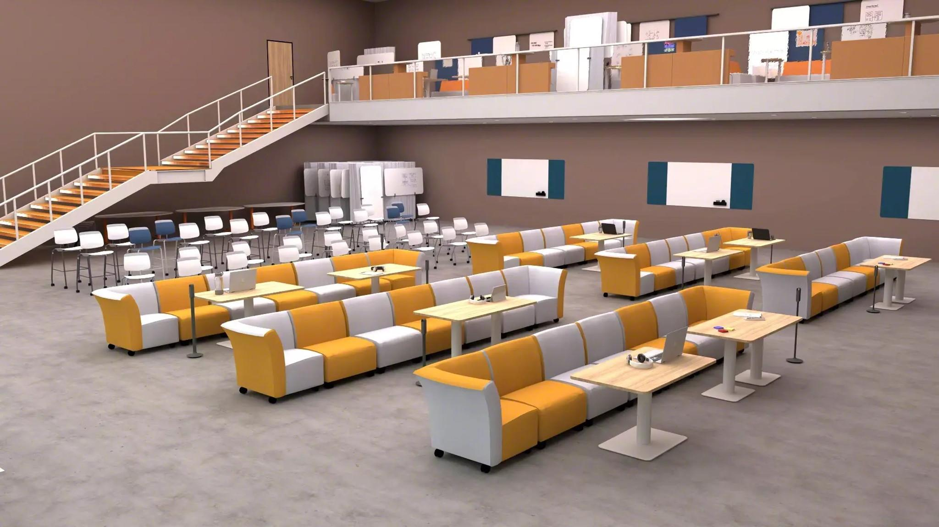
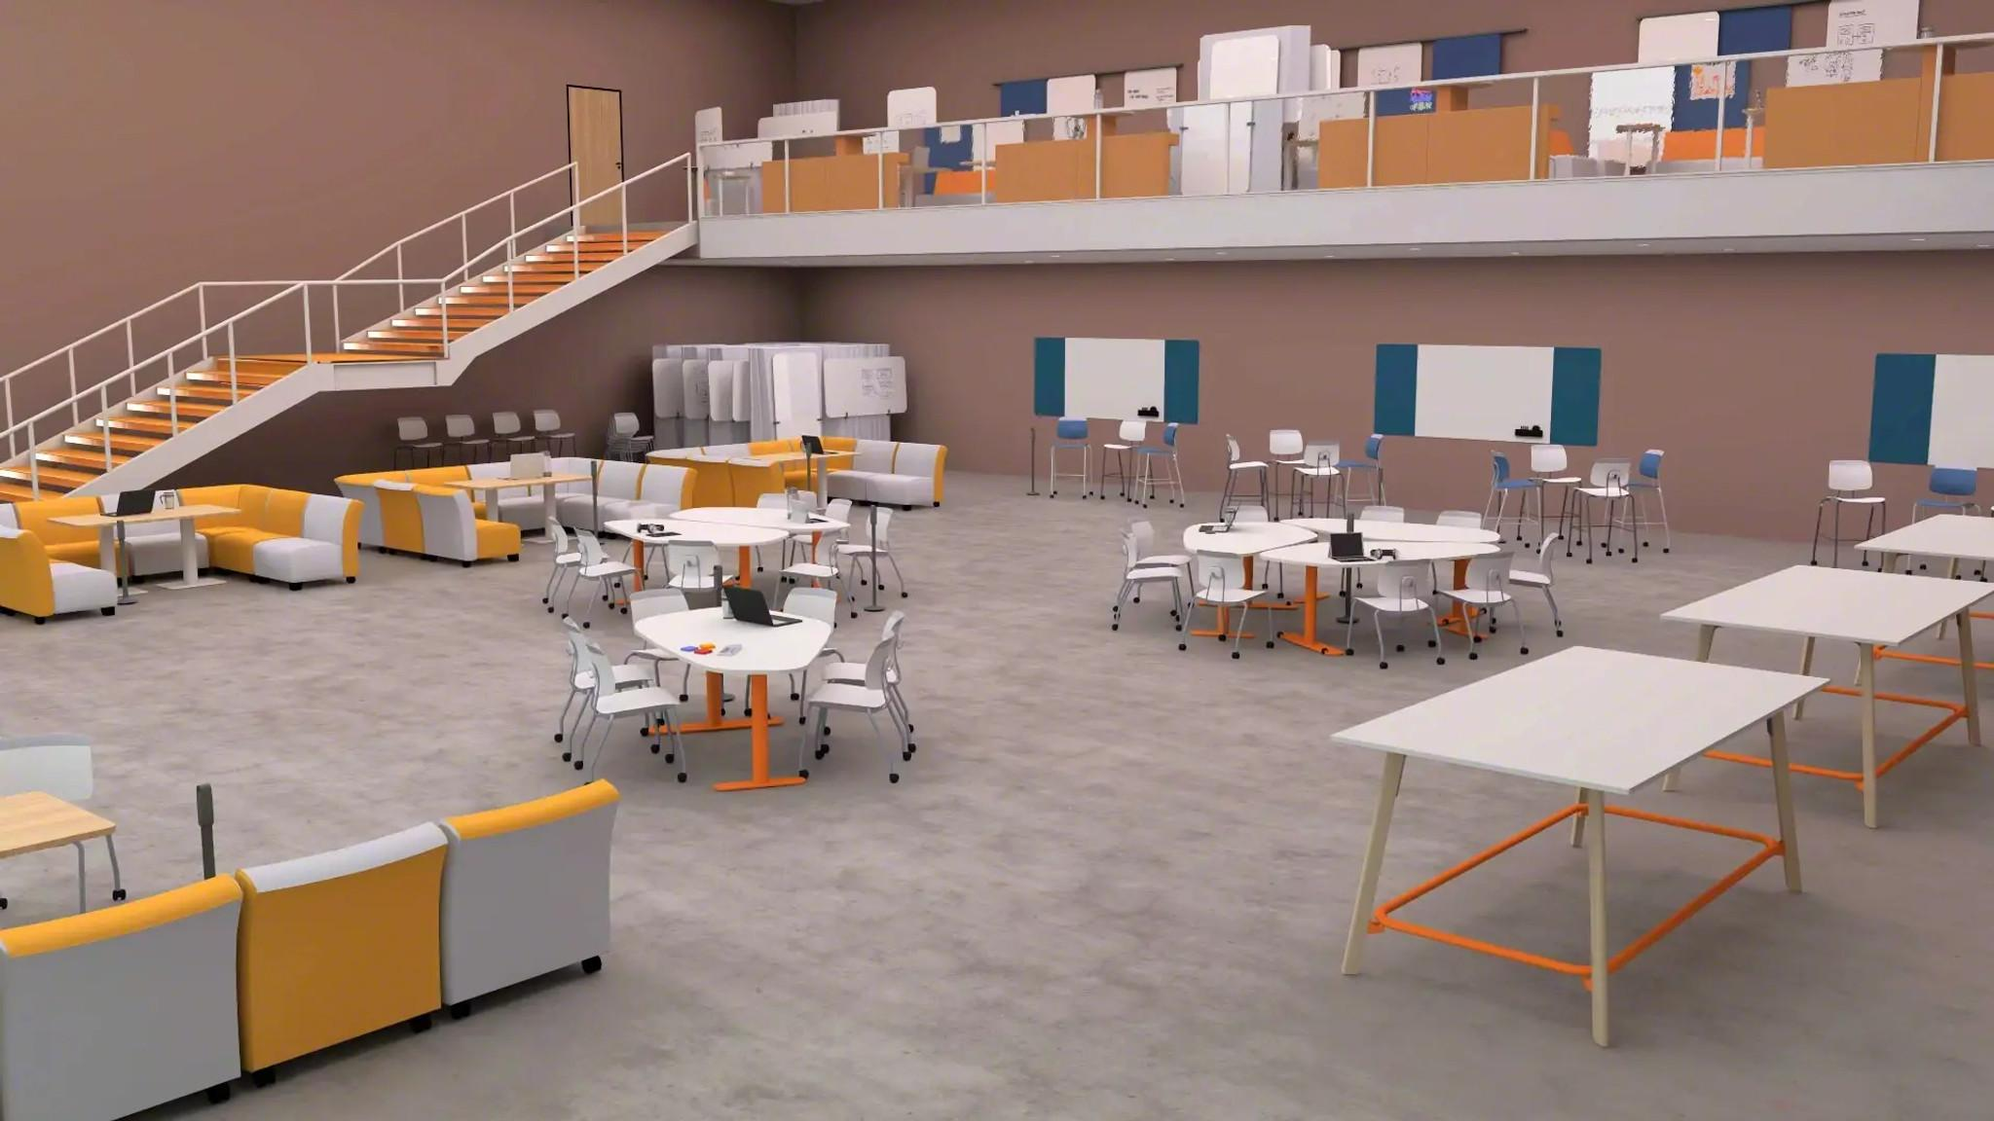
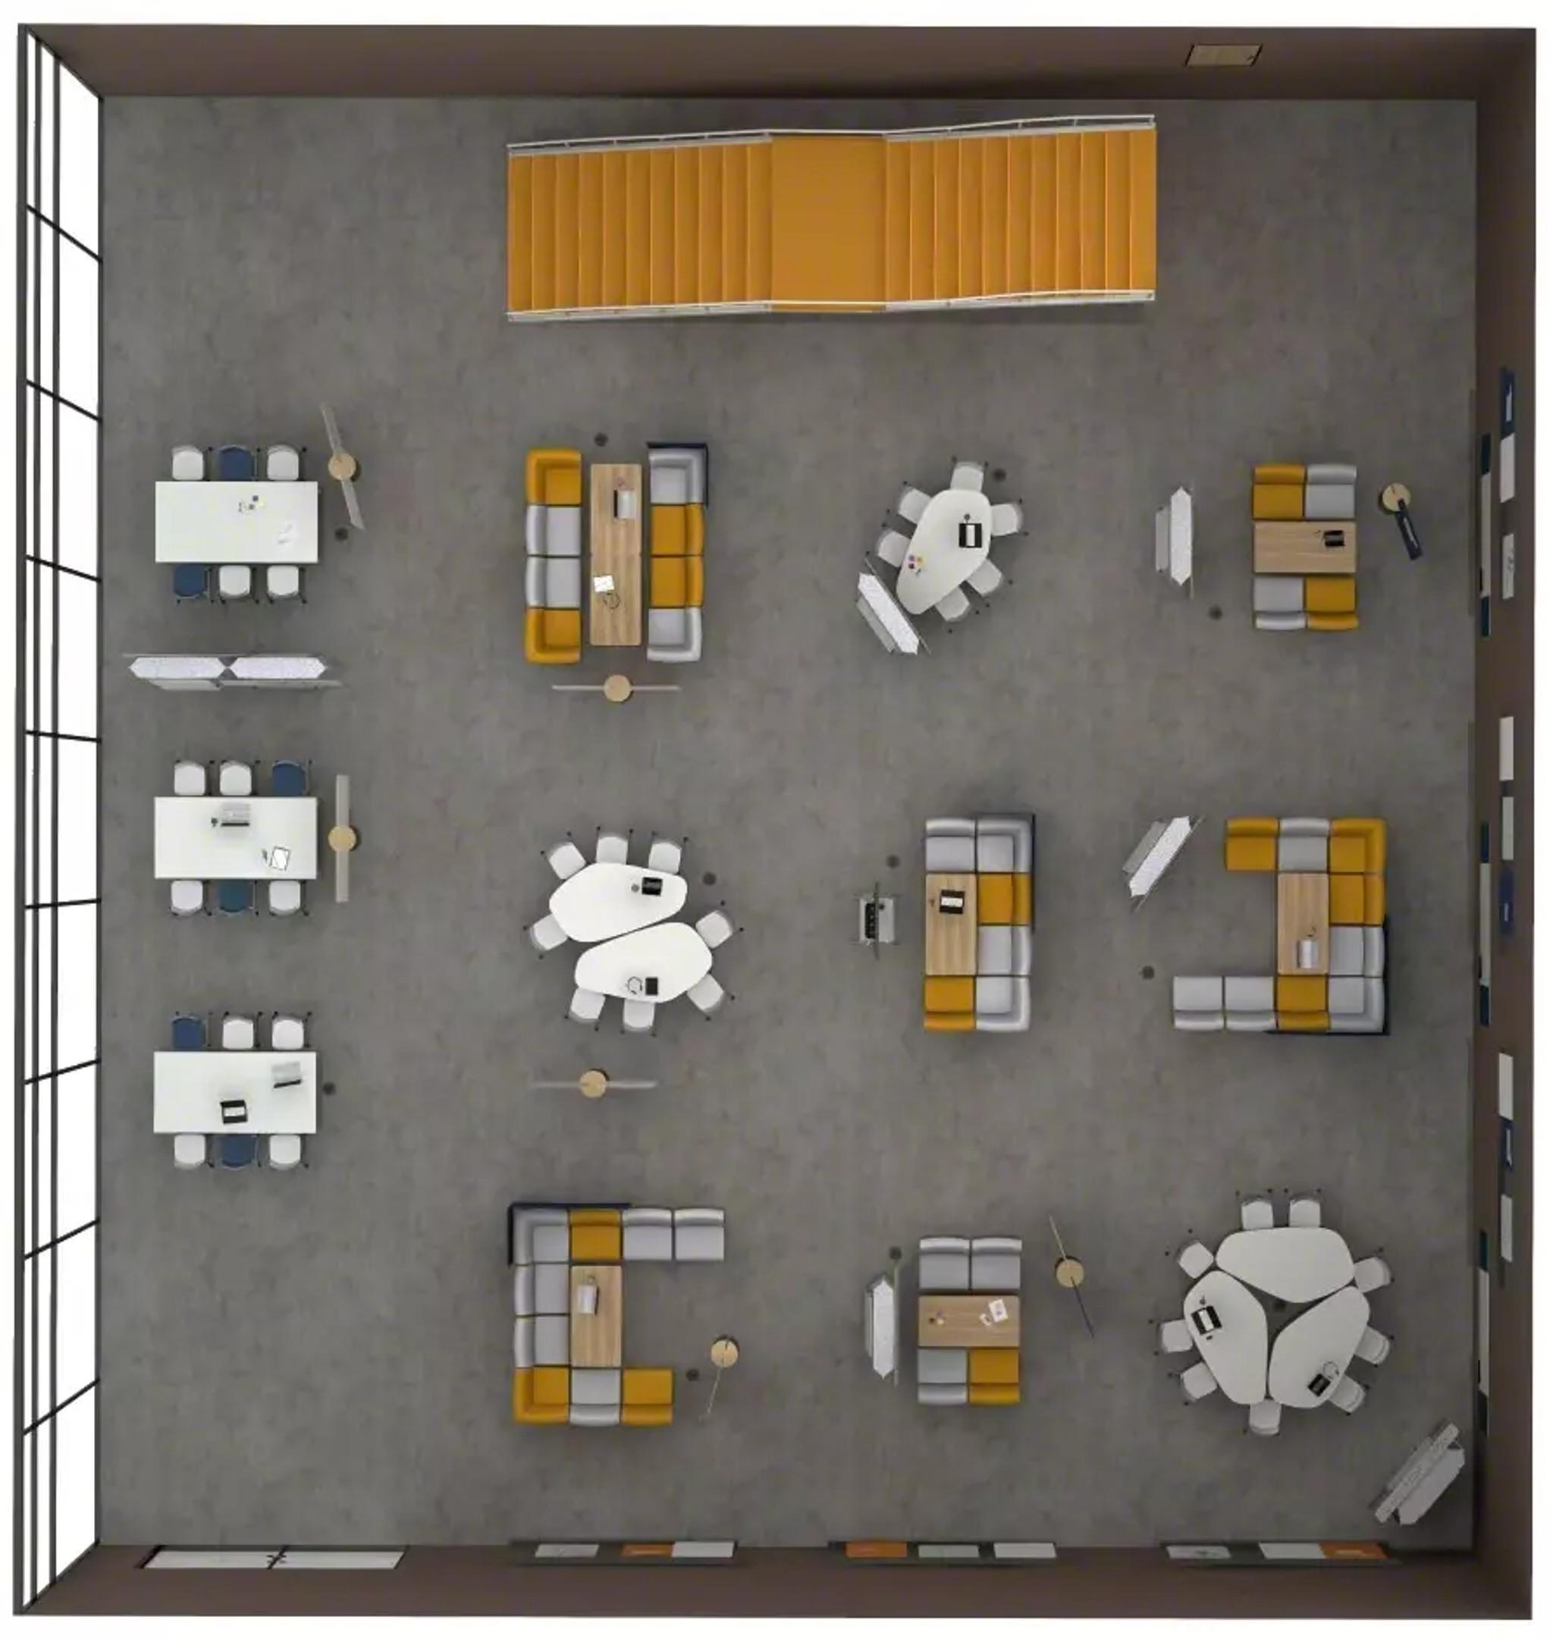
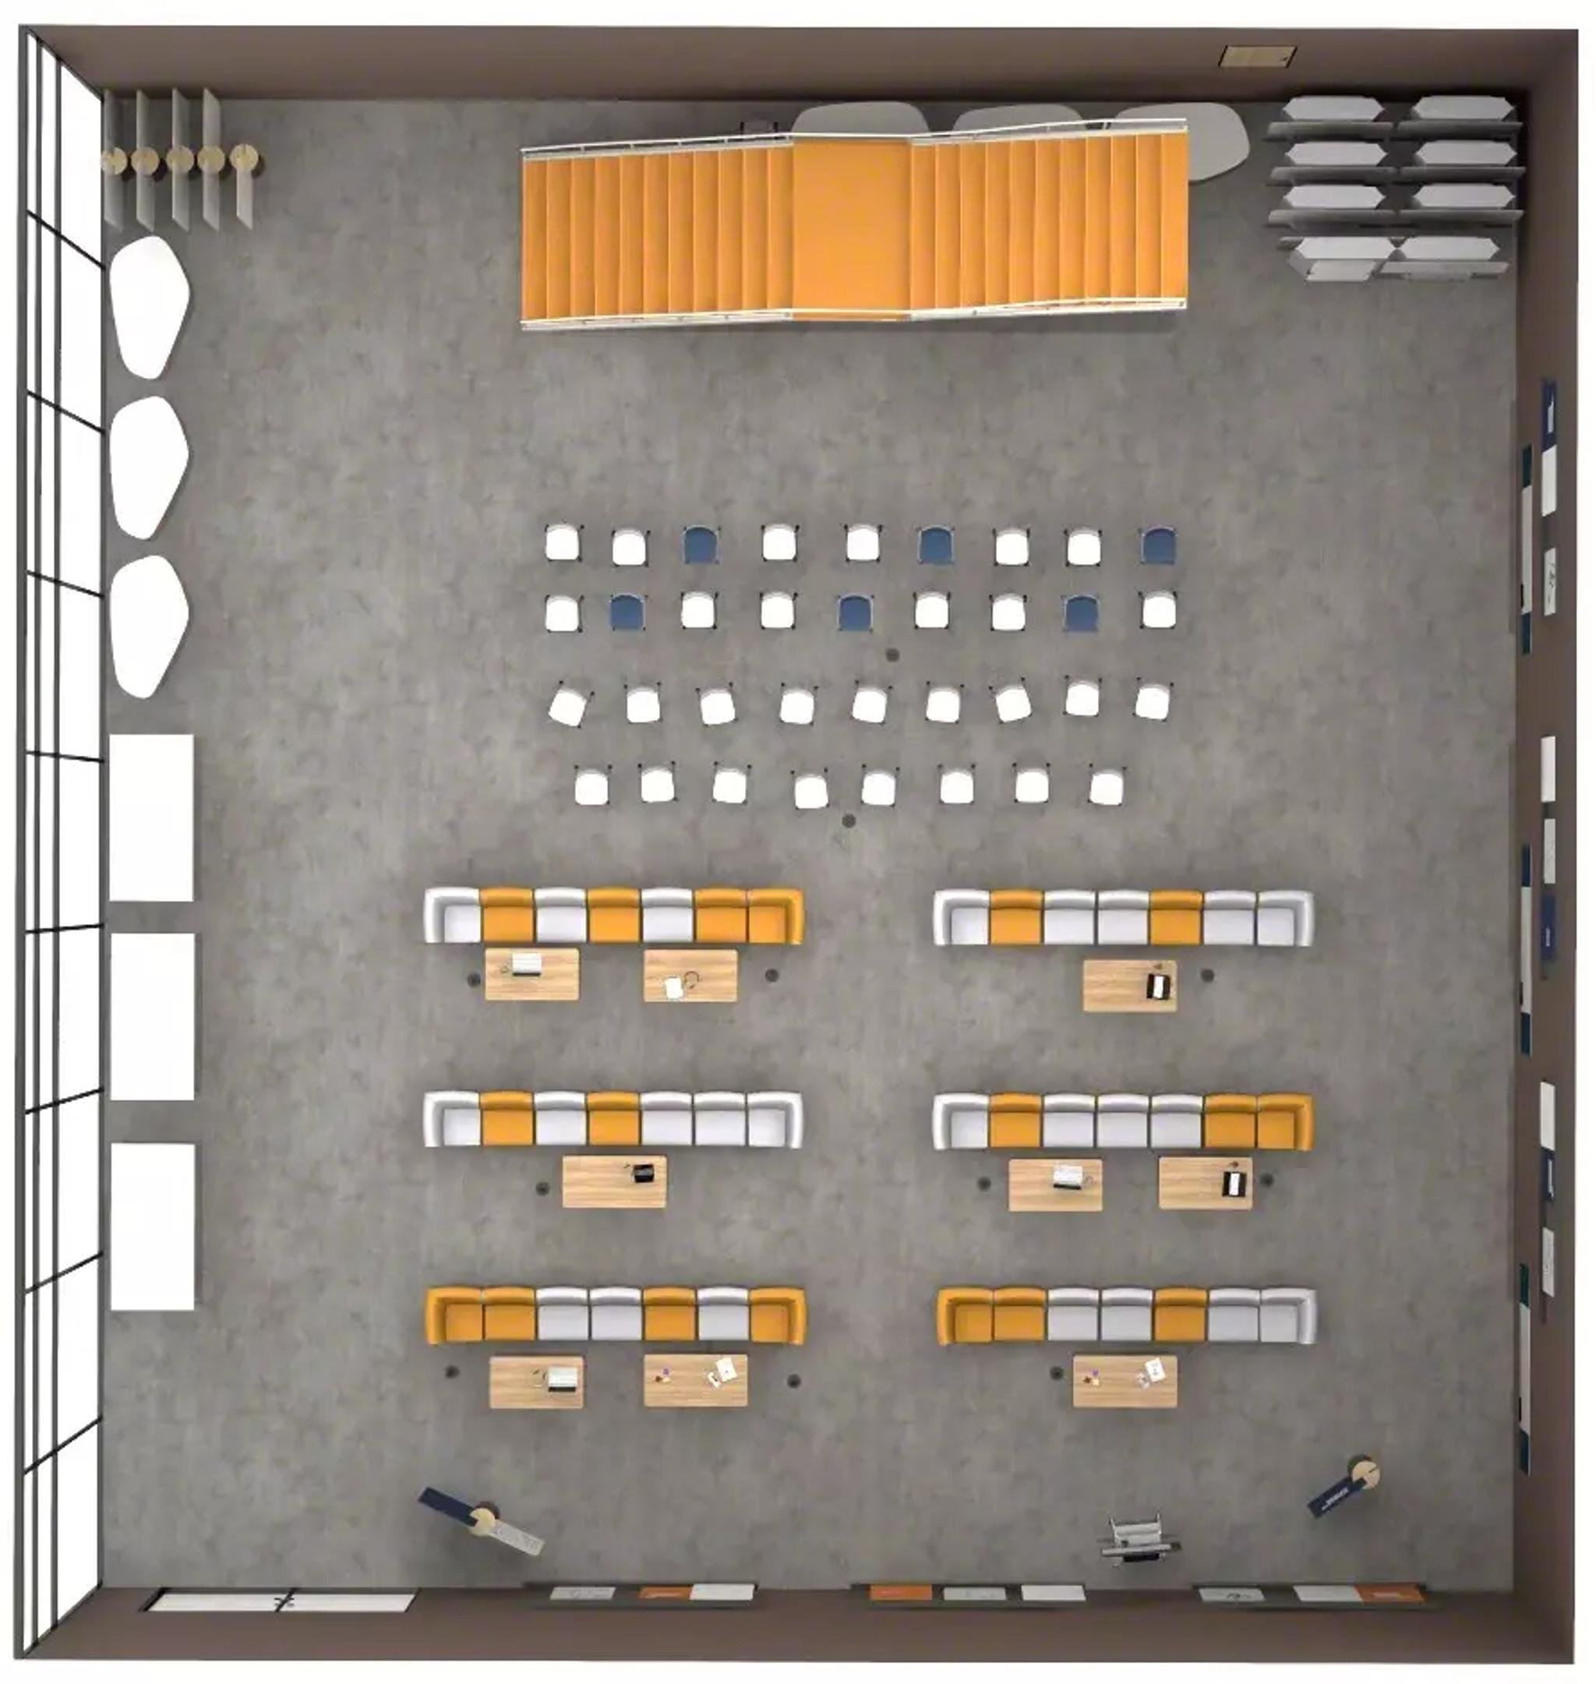
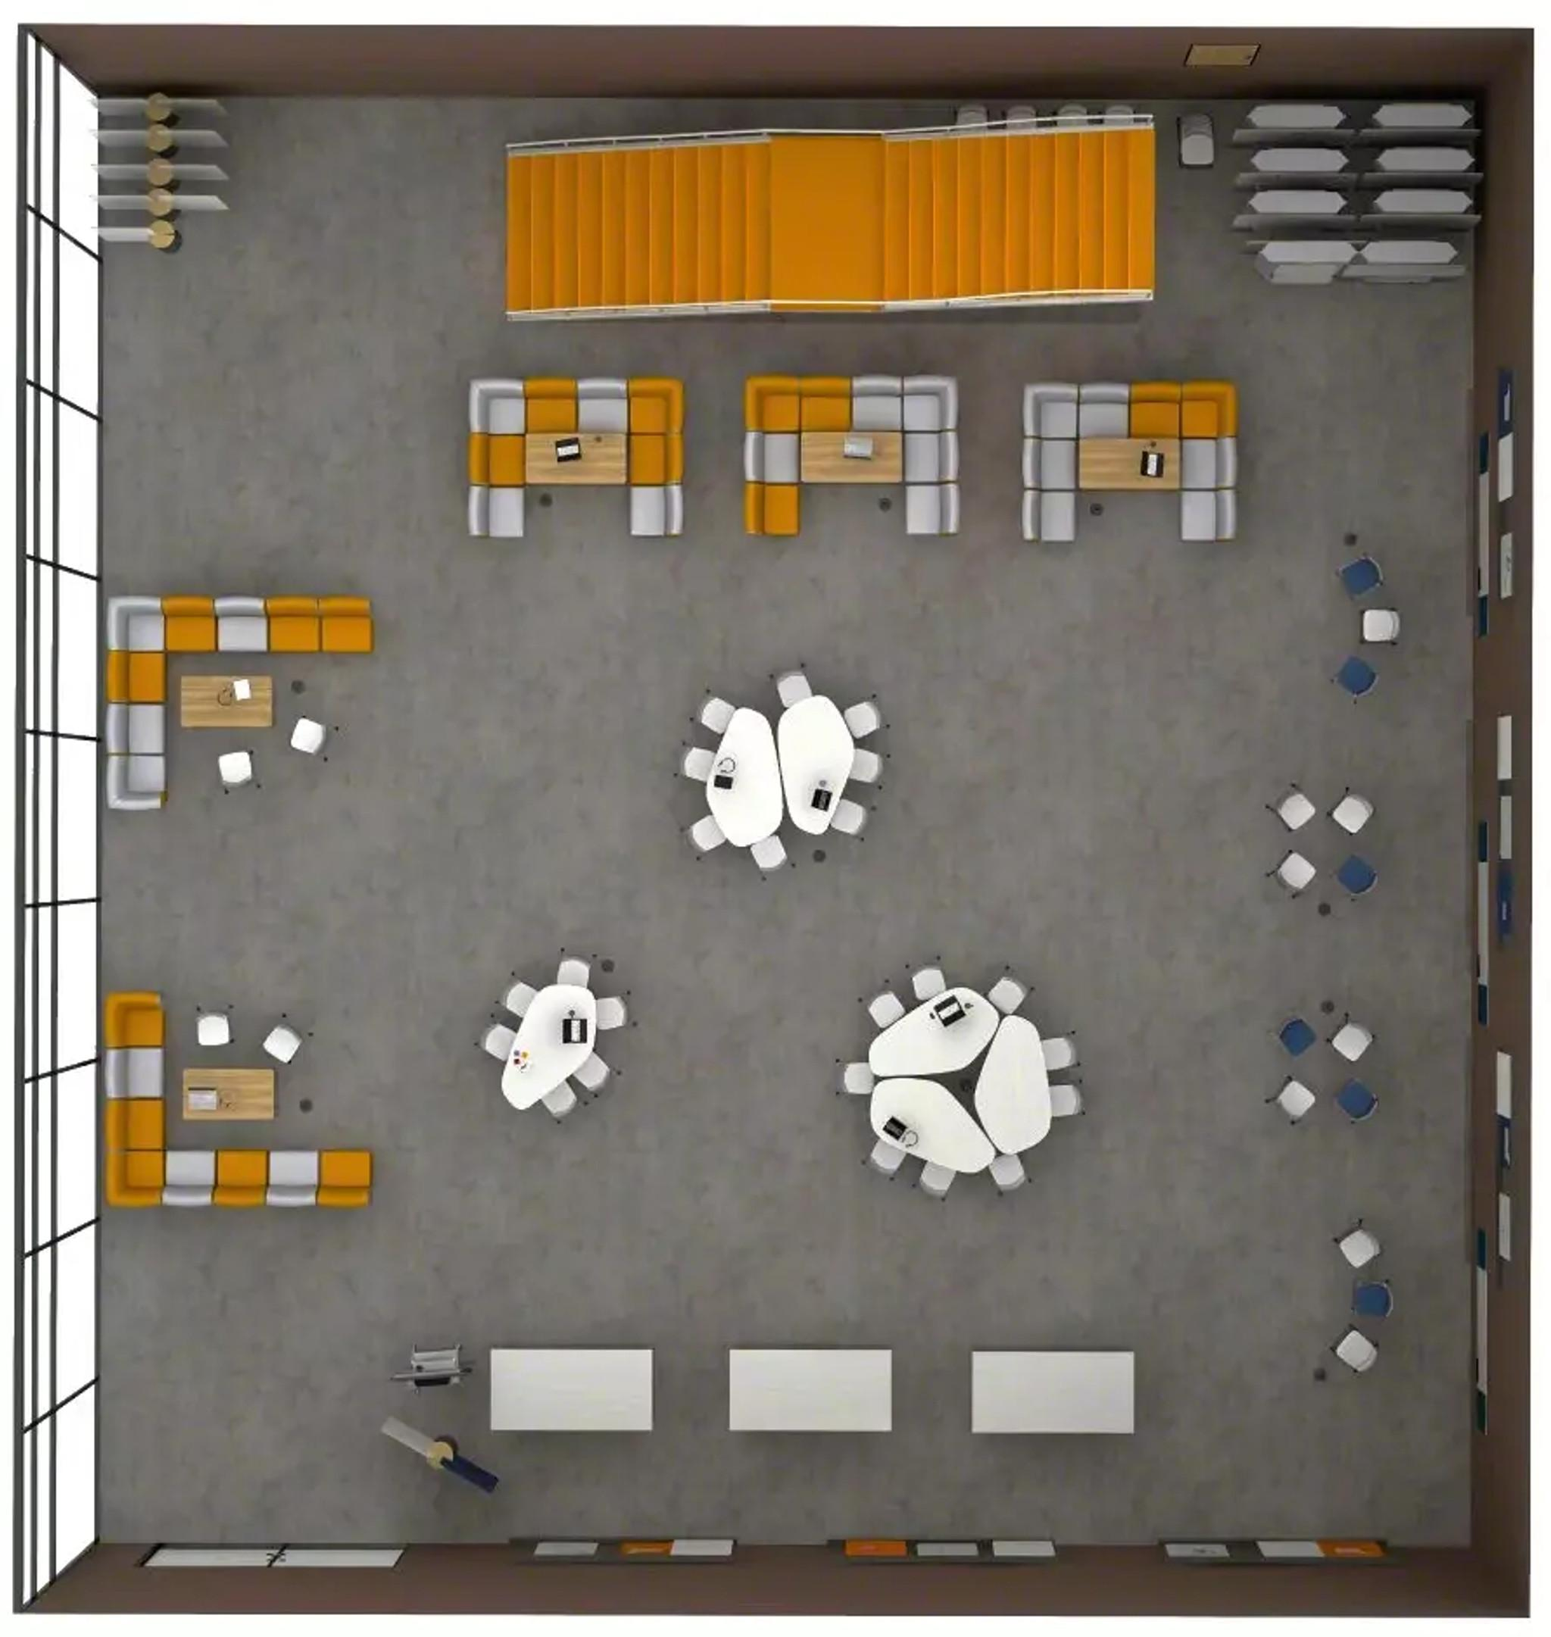
Multipurpose Space
Daytime Collab
Event
Group Presentation
Notes:
The multipurpose space, with careful attention to ergonomics and accessibility, is designed to be a hub for creative, comfortable and innovative learning. It features modular furniture that can be arranged for different uses, supporting changing faculty and student needs.
In the Daytime Collaboration setup, multiple work group areas allow students to meet for formal or informal reviews. Acoustic space dividers create privacy for different groups.
In the Event configuration, furniture is oriented toward a guest speaker.
The third configuration offers multiple options for small group presentations in a lounge or table setting.
Products Shown: Jenny Lounge, Flex Screens, Flex Stand, Flex Boards, Tenor Stool, Simple Rectangular Table, Elbrook Collaborative Table, Verlay Rectangular Table, Thread, Tenor Chairs, Flex Boundary, Accord

Slide 40
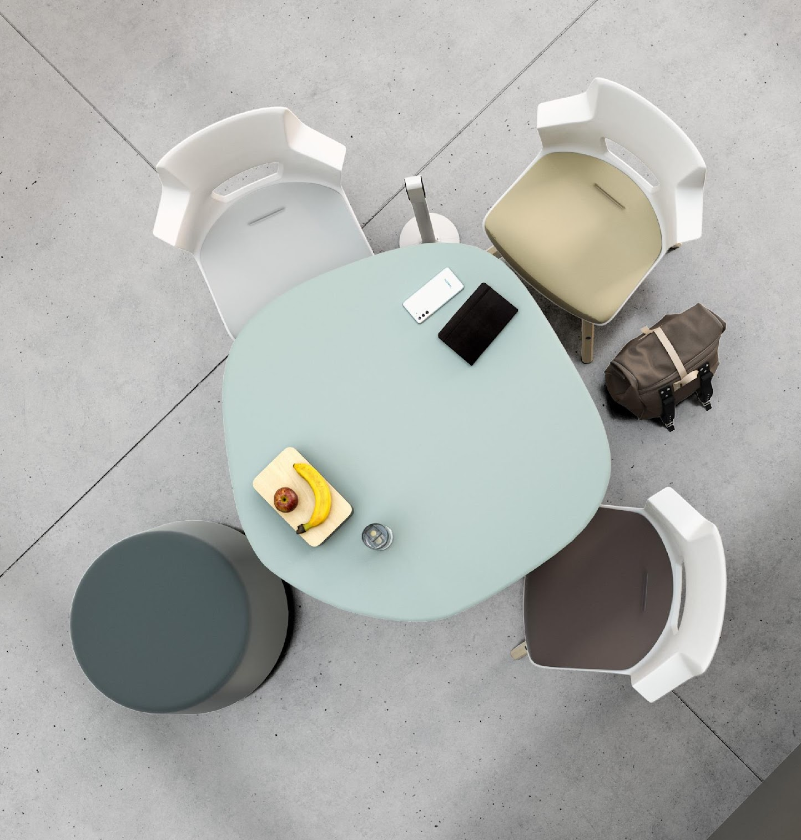
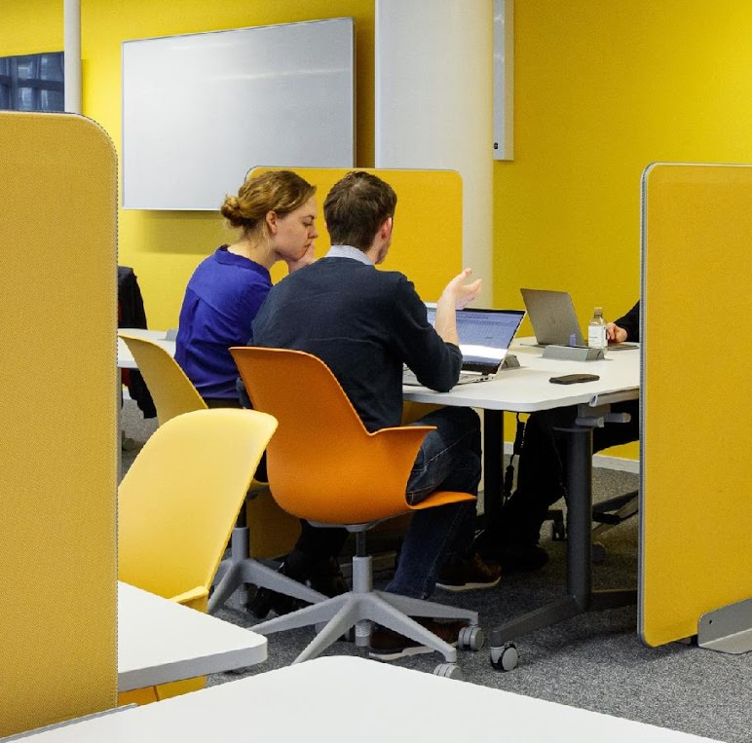
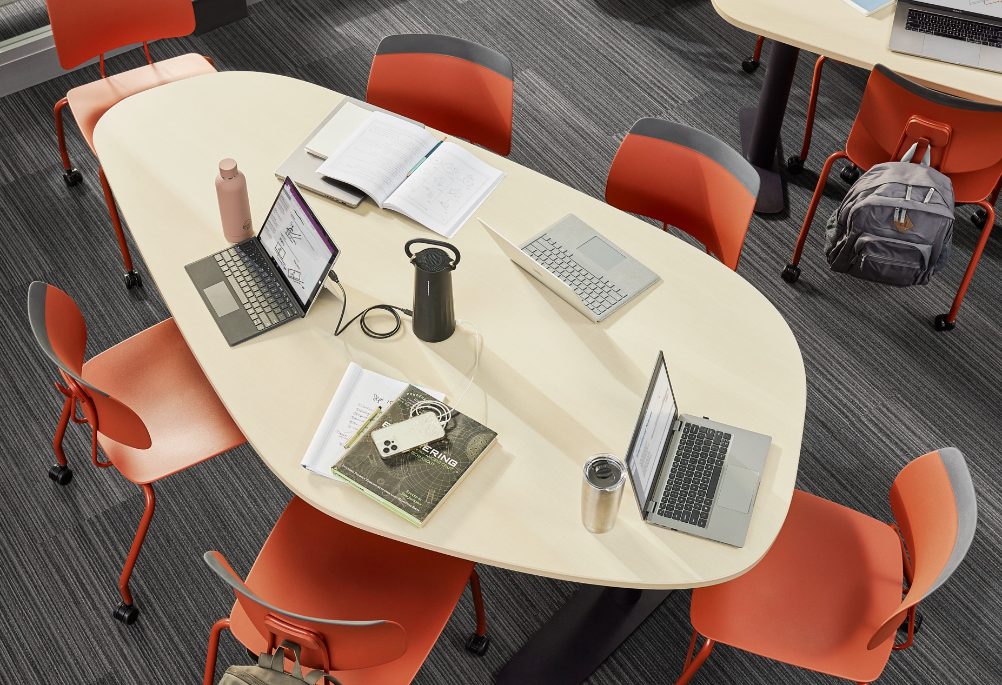
Learning spaces solutions from one partner.
Notes:
We’re a part of the Steelcase family of brands. This means the majority of furnishings for your built environment can be sourced from a single vendor.

Slide 41
Notes:
Community of Brands Americas - January 2024
Steelcase leads the way in creating great work experiences by offering a range of architecture, furniture and technology products to help people reach their full potential.
With a combination of workplace issue research and partnerships, Steelcase embodies a deep understanding of work, health and wellness, and builds products with cross-vertical application for the workplace, education and healthcare through Integrated Delivery Networks (IDN).
Together we create spaces to help people work, learn and heal.
BACKGROUND INFORMATION
https://www.steelcase.com/brands/
Steelcase Brands:
Steelcase, Steelcase Health, Steelcase Education
Coalesse
Turnstone
DesignTex
PolyVision
OrangeBox
AMQ
Smith System
Viccarbe
https://www.steelcase.com/ancillary/
Ancillary Brands:
West Elm
Extremis
Bolia.com
Established & Sons
Moooi
Mattiazzi
Blu Dot
Flos
Carl Hansen & Son
Emu
Nanimarquina
Tom Dixon.
M.a.d.
Bend Goods
Kartell
Snowsound
Skram
Stephen Kenn

Slide 42

Get in Touch
Meet Us
To find out more about solutions + spaces that
propel learning forward,
visit steelcaselearning.com.
Experience our curated spaces,
including our newest solutions for learning and work, while engaging
with experts through in-person or
virtual tours of our showrooms.
Connect with us
facebook.com/steelcaselearning
@SteelcaseLearn
linkedin.com/showcase/steelcase-learning
Notes:
Thank you for your time today.
Let’s talk about what’s next. Steelcase is here to help.
ADDITIONAL INFORMATION
Learn: we can share our latest research and insights
Get Inspired: See our learning spaces
Discover: Sign up for a workshop or start a consulting engagement
Create: Design solutions for your organization
Sign up for a virtual
tour featuring emerging learning spaces, including hybrid classrooms
Explore new application
for your learning and
work spaces
Engage in a workshop
to discover new needs

Slide 43
Notes:
Thank you.

