Slide 1
Architectural Design Forum
1.29.2024

Slide 2
fo·rum /ˈfôrəm/ noun a place, meeting, or medium where ideas and views on a particular issue can be exchanged
We encourage you to:
Ask questions
Speak up
Share topics
Give us praise ☺
Notes:
Welcome to the Architectural Design Forum – the first of hopefully many calls.
The goal of this series is twofold
Get you all excited about Everwall, and make sure you’re comfortable positioning and specifying it….we’ll host the call every two weeks to keep sharing information and answering questions in bite size pieces.
Transition the call from Everwall to covering broader topics relevant to dealer designers who specialize on architecture…we will likely switch our cadence to a monthly call in the new year.
From now until December, our focus is really on Everwall. We’ll be deep diving into various Everwall content…
Sharing Tools and resources
Tips, tricks, and best practices,
Project examples
Q&A – answer questions you have after taking self-paced training or taking on your first project
We’re calling this series a Forum for a reason. This is for you – dealer designers – so help us make it what you need. We will be sharing information, but we don’t want to be the only ones talking. We encourage you to ask questions, speak up, share topics that you’re struggling with…..and of course, you can give us praise. That’s always welcome.
On that topic – please put your comments or questions in the chat at any time. I’ll be monitoring that, and will answer your question, interrupt our hosts to have them answer it, or note it as a future topic to be covered.
So with that, let’s introduce our hosts, Mike Alonzi and Kristina Huisman.

Slide 3


Architectural Design Forum
Hosts
Mike Alonzi
Kristina Huisman
Product Manager
malonzi1@steelcase.com
Applications Consultant
khuisman@steelcase.com

Slide 4
Agenda
01 | Welcome Working with Privacy Wall Enhanced Privacy Wall January Ecat Release -Cut Ends -Automatic Dimensions -Switch Cutouts Privacy Wall/Lite Scale Connections Best Practices For Power Cutouts + Everwall Power Cutouts on Steel Skins
Architectural Design Forum #35
02
03
04

Slide 5
2025 Architectural Design Forum - Calendar
March
April
May
June
January
February
October
October
October
29
26
26
23
21
25
November
July
August
September
October
November
December
October
October
23
27
24
29
19
17

Slide 6
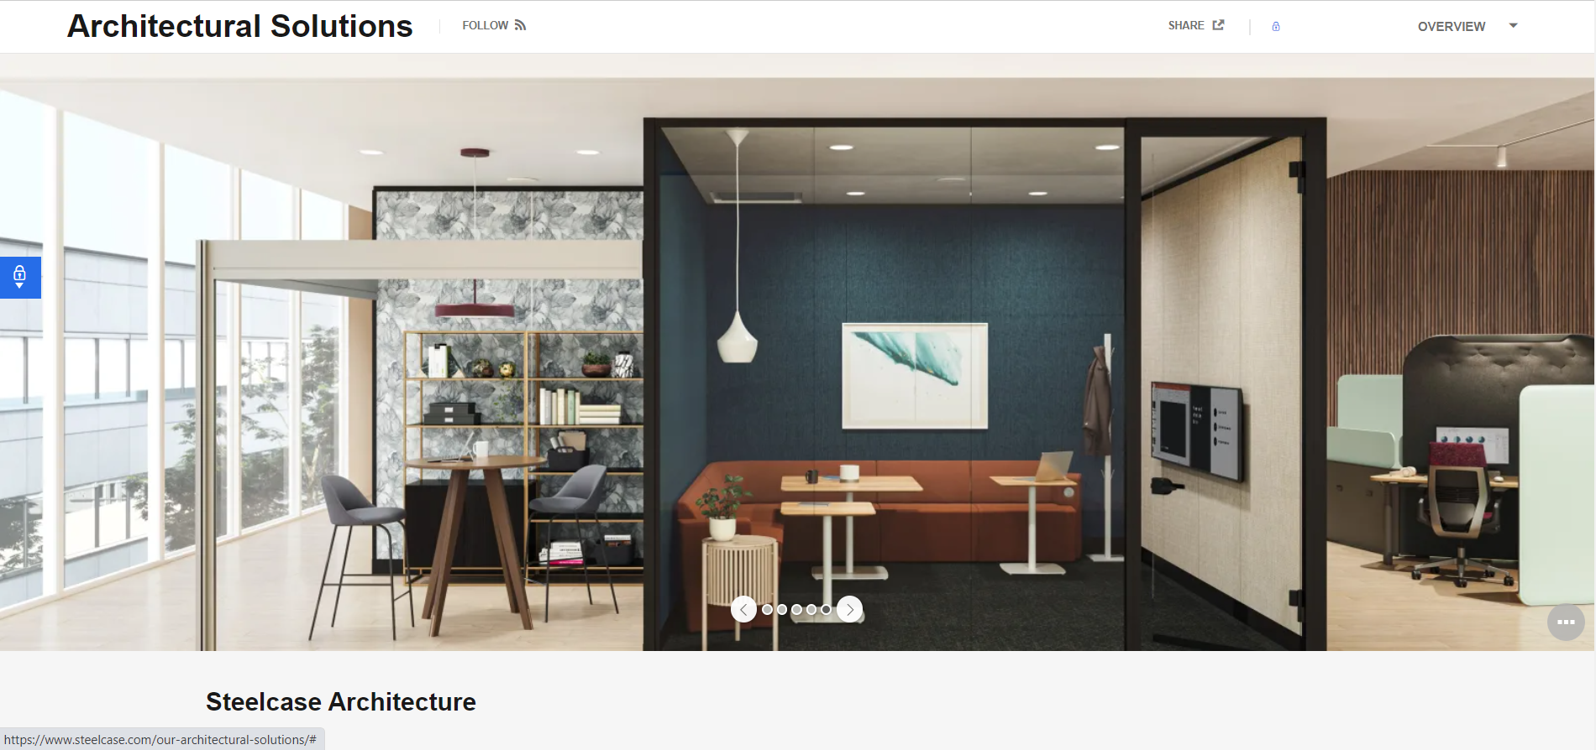
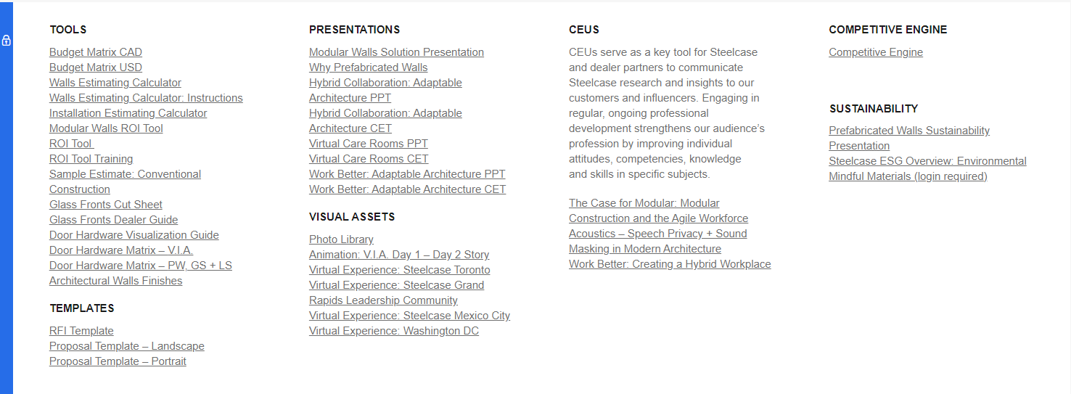
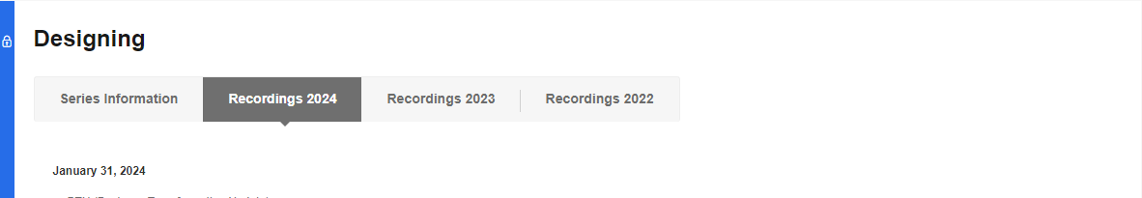
Architectural Design Forum Recordings

Slide 7
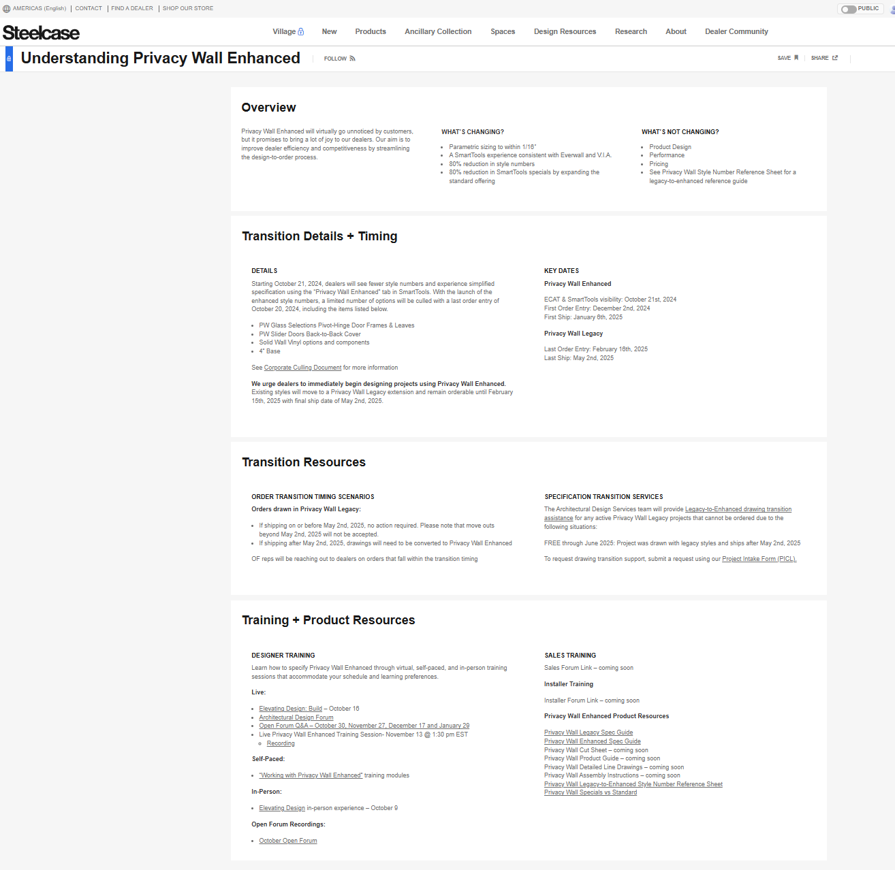
Check out
Understanding Privacy Wall Enhanced
7

Slide 8
Updated Privacy Wall Enhanced-Dates
FOE Enhanced: 12.02.2024
First Ship Enhanced: 01.06.2025
LOE Legacy: 02.16.2025
Last Ship Legacy: 05.02.2025
Corporate Business Transformation Update Communication Nov. 13, 2024

Slide 9
Resource Highlight

Slide 10
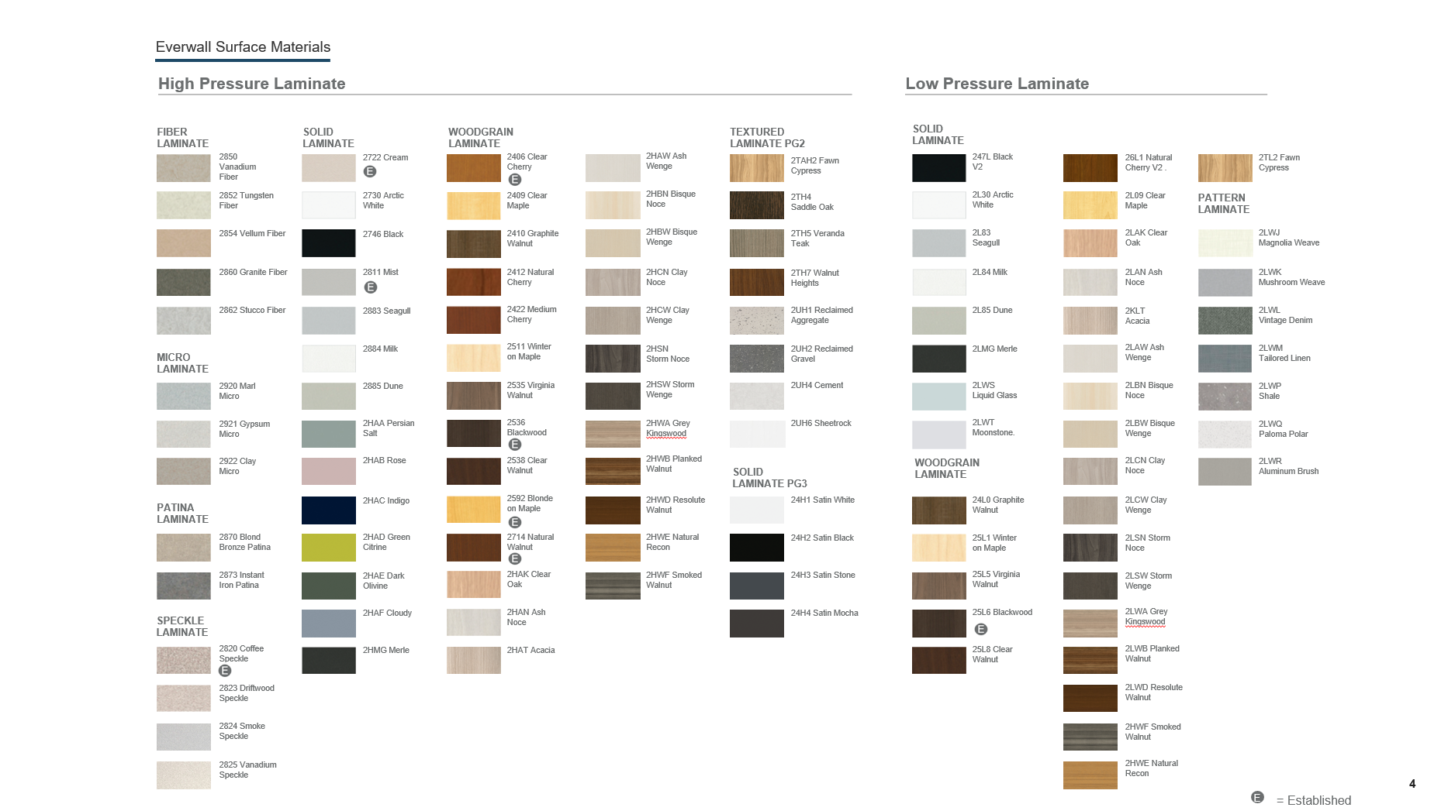

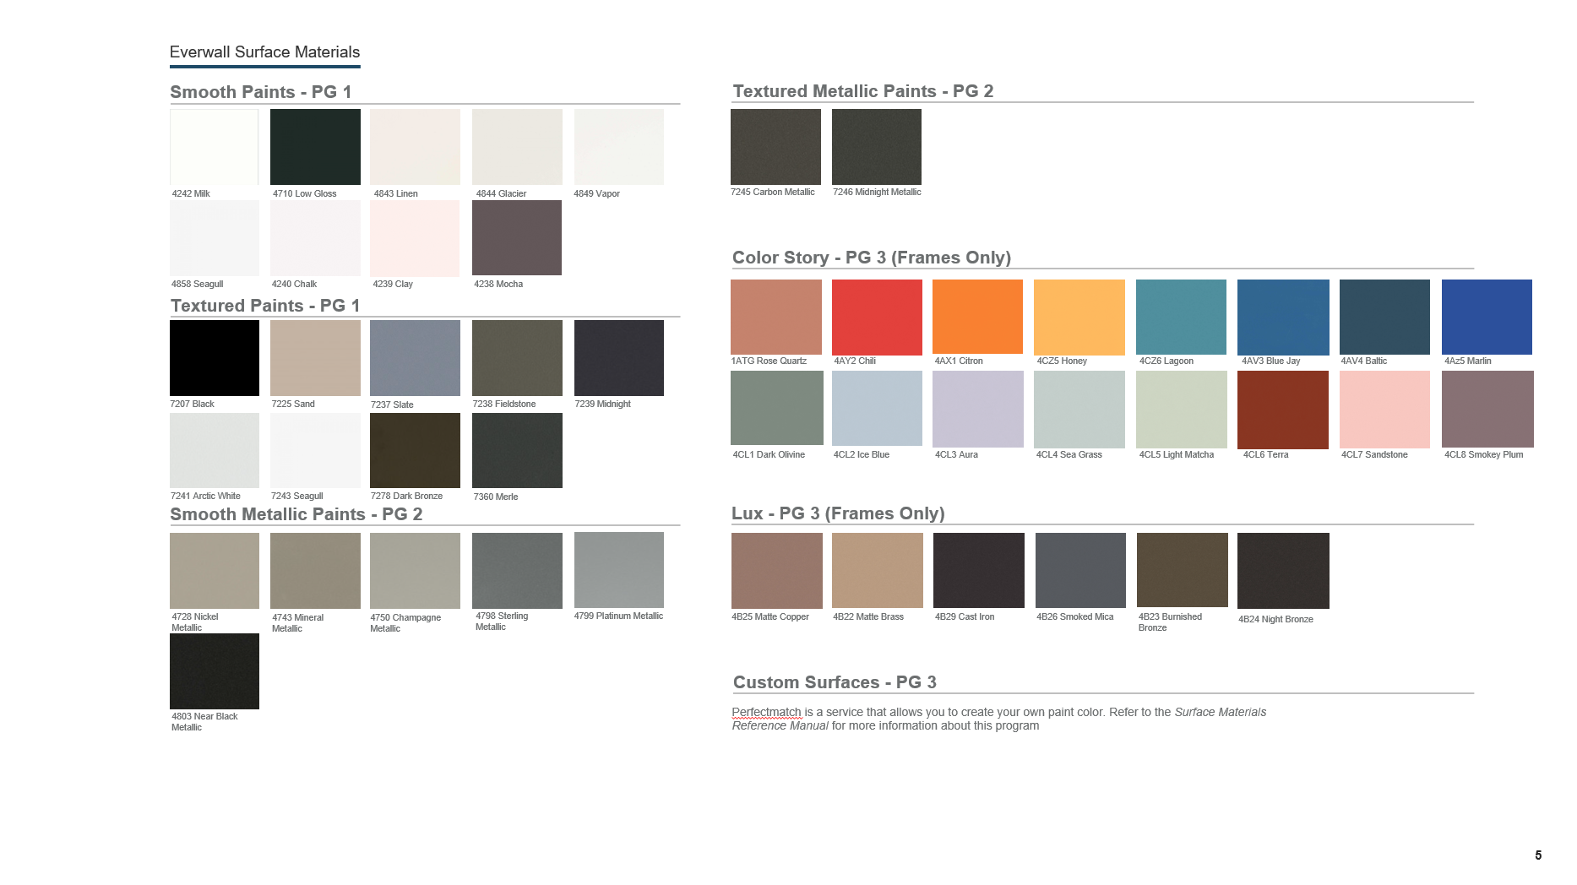
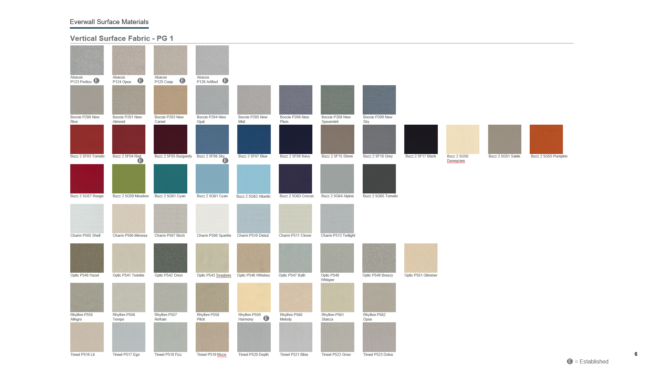
Architectural Wall Finishes

Slide 11
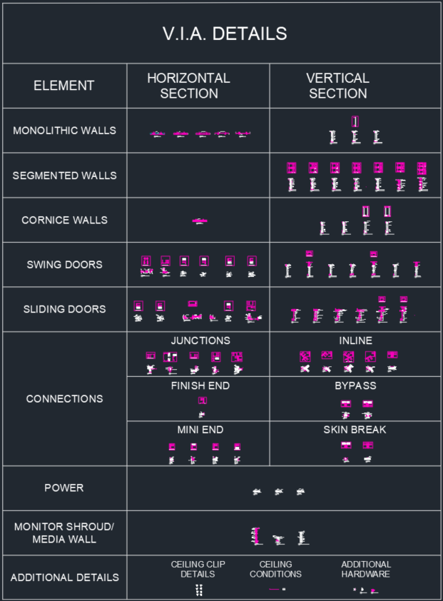
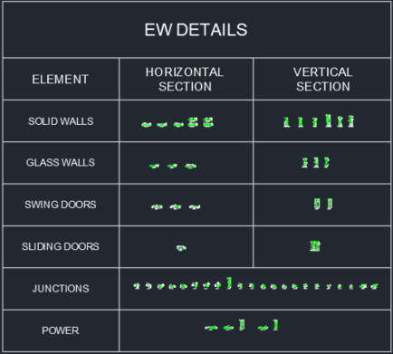
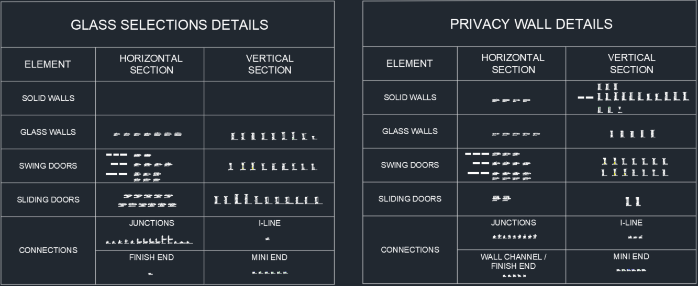
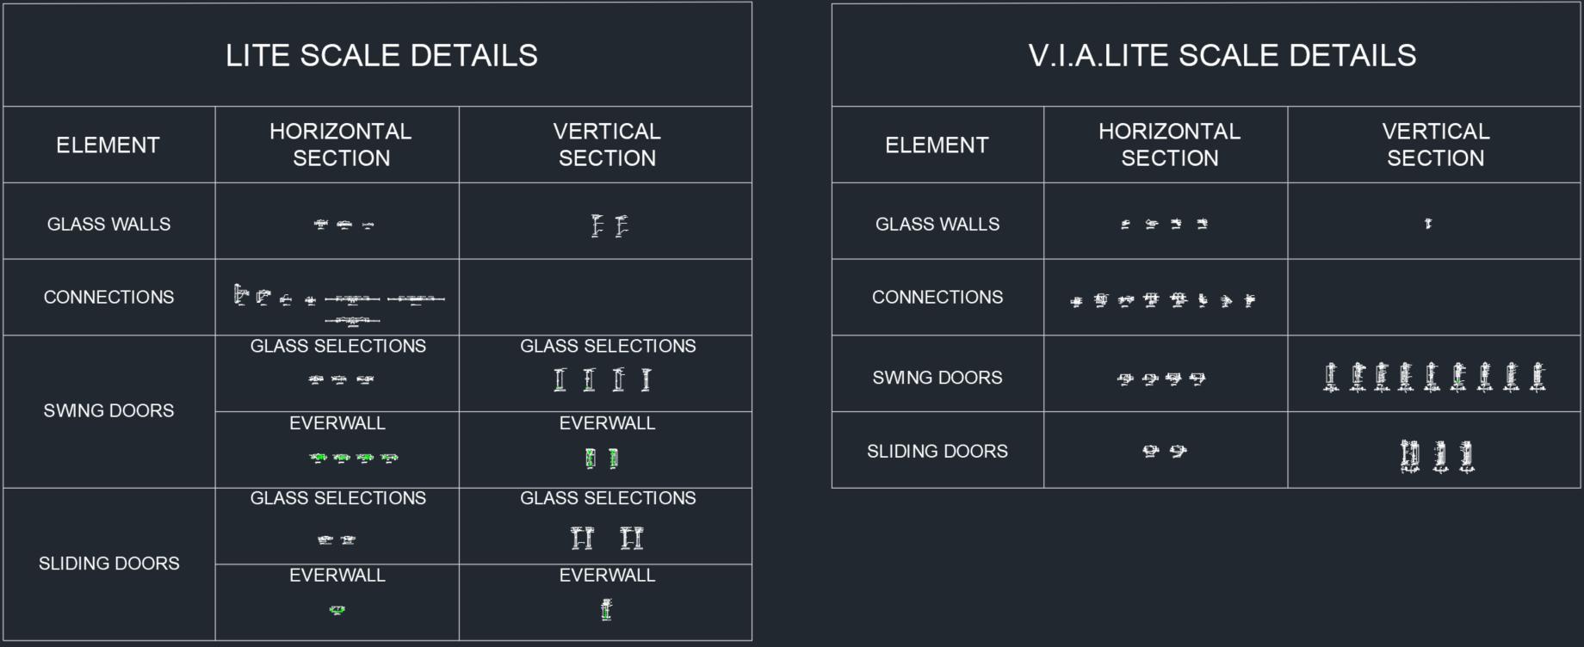
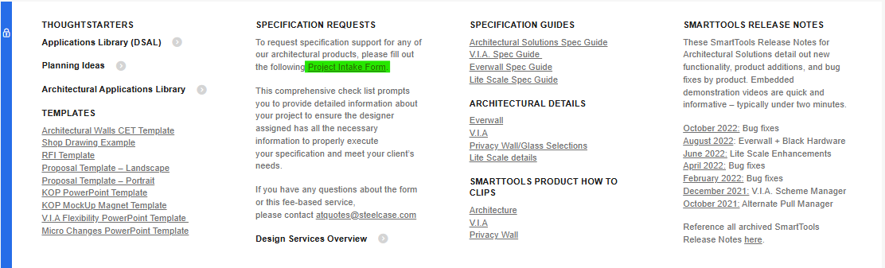
Architectural Details

Slide 12
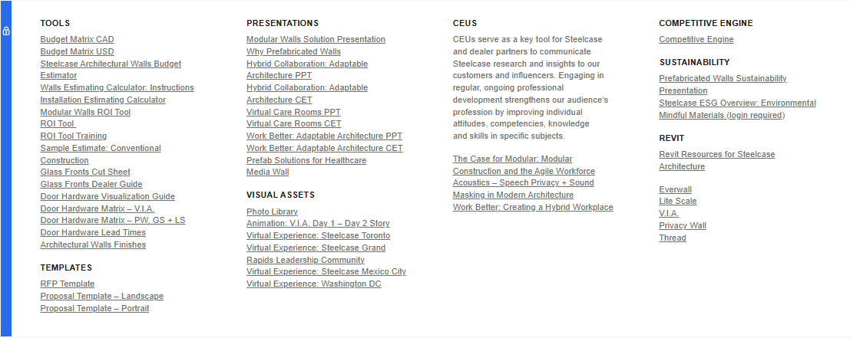
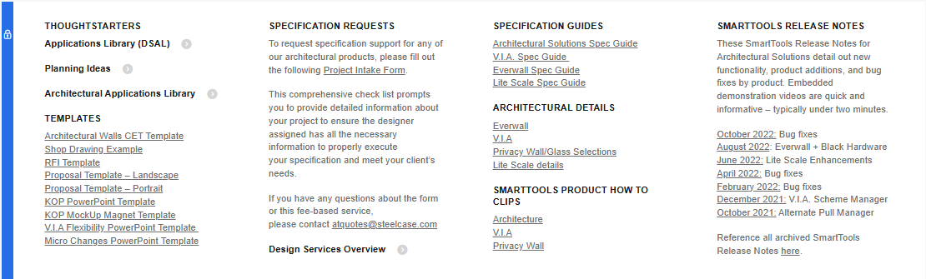
Resources on Village

Slide 13
Privacy Wall Enhanced-January Bugs and Feature Stories

Slide 14
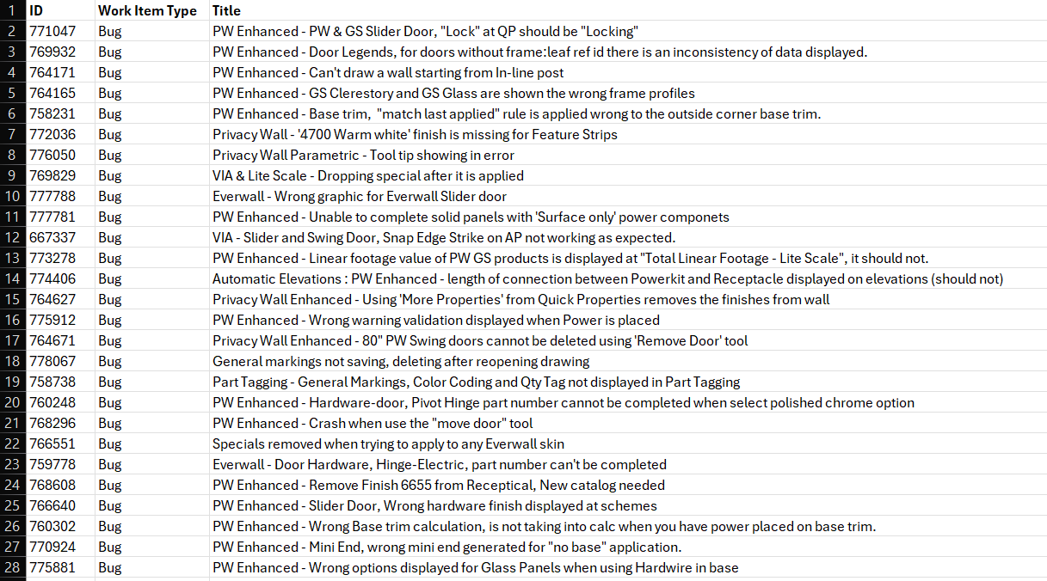
Ecat Release

Slide 15
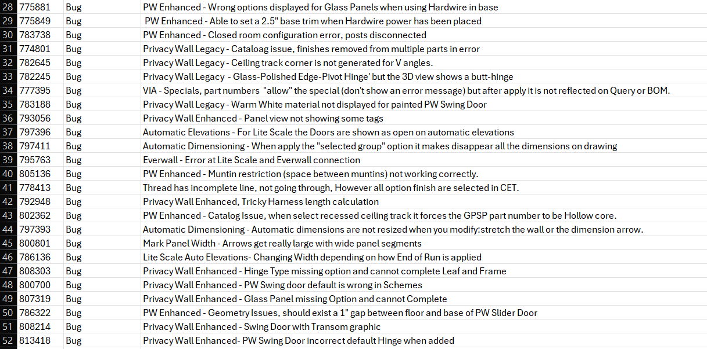
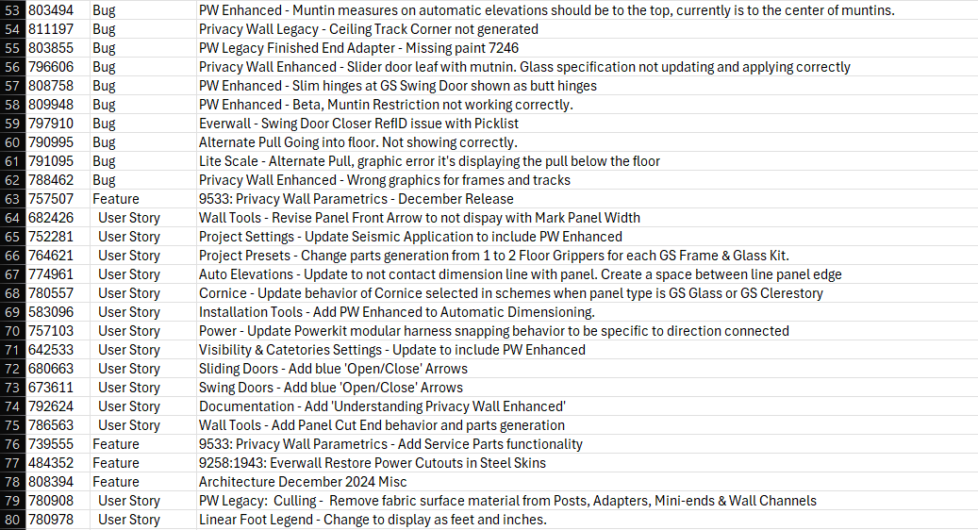
Ecat Release

Slide 16
Ecat Release

Slide 17
Privacy Wall Enhanced/Lite Scale Connections

Slide 18
Everwall Power Cutouts on Steel Skins + Best Practices for Factory Cut Power

Slide 19
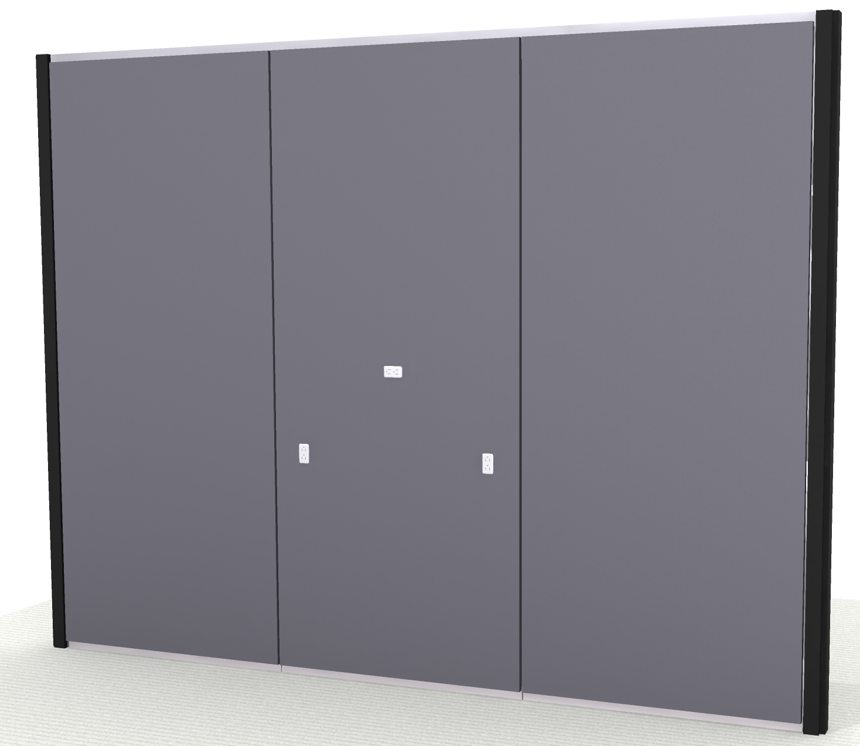
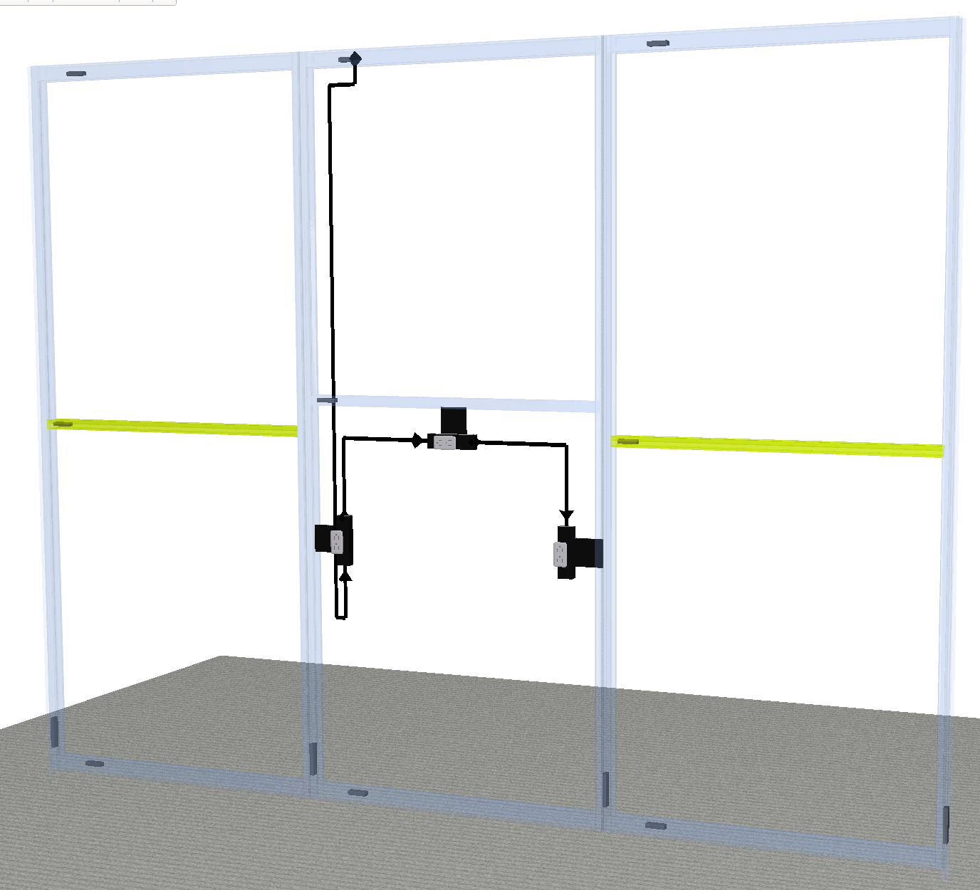
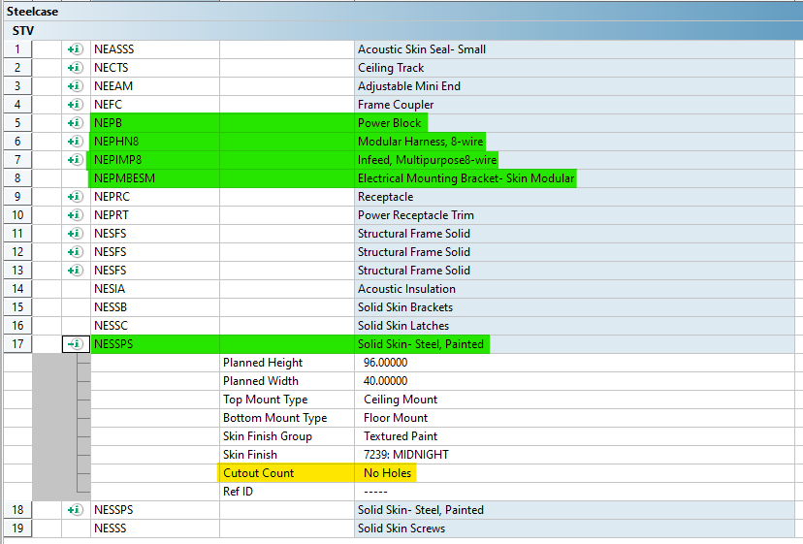
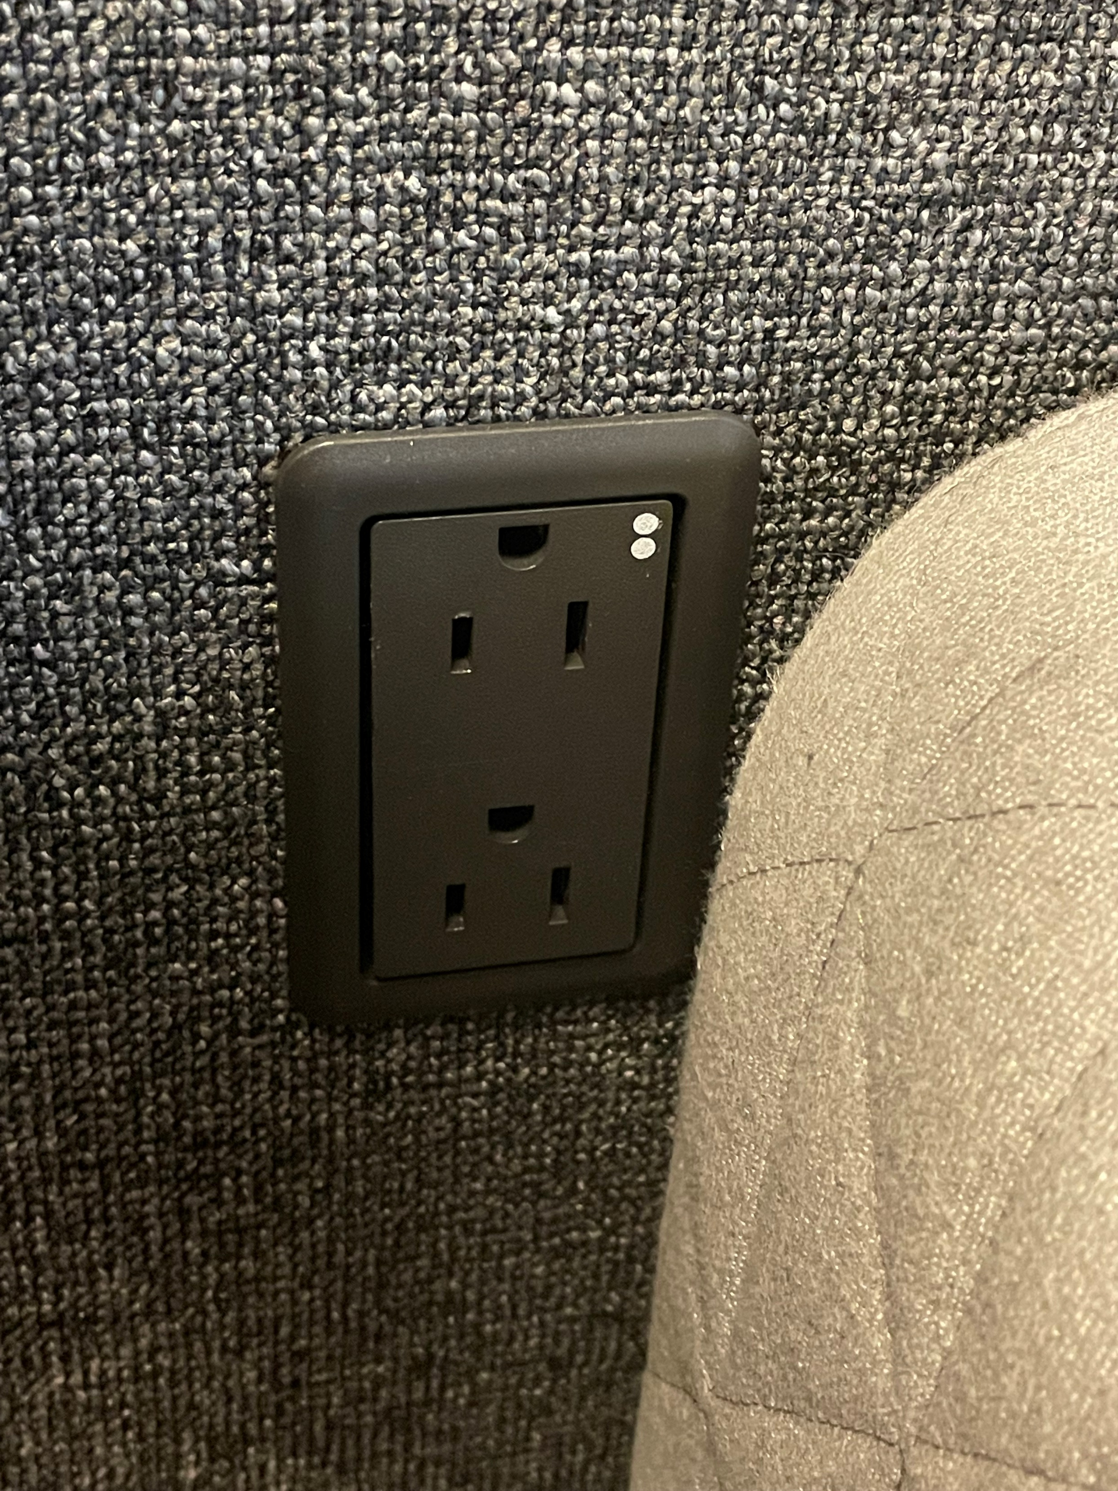
Everwall Power Cutouts on Steel Skins
From FOE electrical and data cutouts needed to be field-cut at the time of install for painted and upholstered steel skins. Electrical could be drawn in Smart Tools, the brackets and components would be placed in the BOM, but skins were still noted as “No Holes” in the configuration.

Slide 20
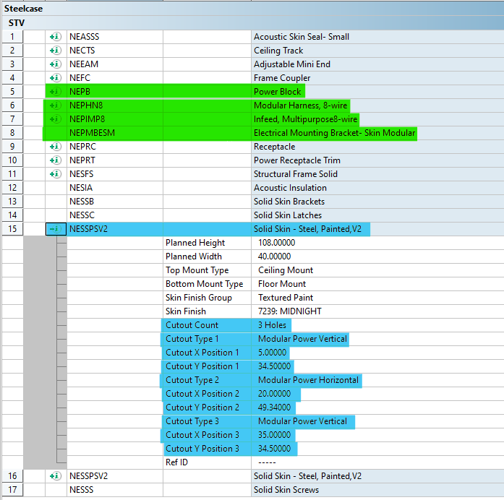
Everwall Power Cutouts on Steel Skins
Steel skins will now have the option to have factory cutouts for electrical and data.

Slide 21
There is a change to style numbers:
NESSFS becomes NESSFSV2 - Solid Steel Skin Fabric
NESSPS becomes NESSPSV2 - Solid Steel Skin Painted
Existing orders do not need to be updated to the new style numbers unless you want to change to factory cutouts. If that is the case, the existing lines need to be cancelled, and new ones linked from Smart Tools need to be ordered.

Slide 22
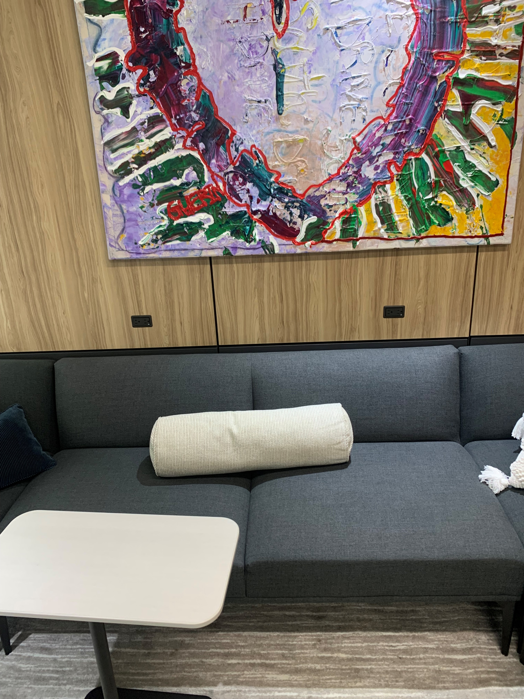
Best Practices
If your furniture plan is still undecided or you need to place power/data behind something with access through the back, consider field-cutting so it can be placed accurately.

Slide 23
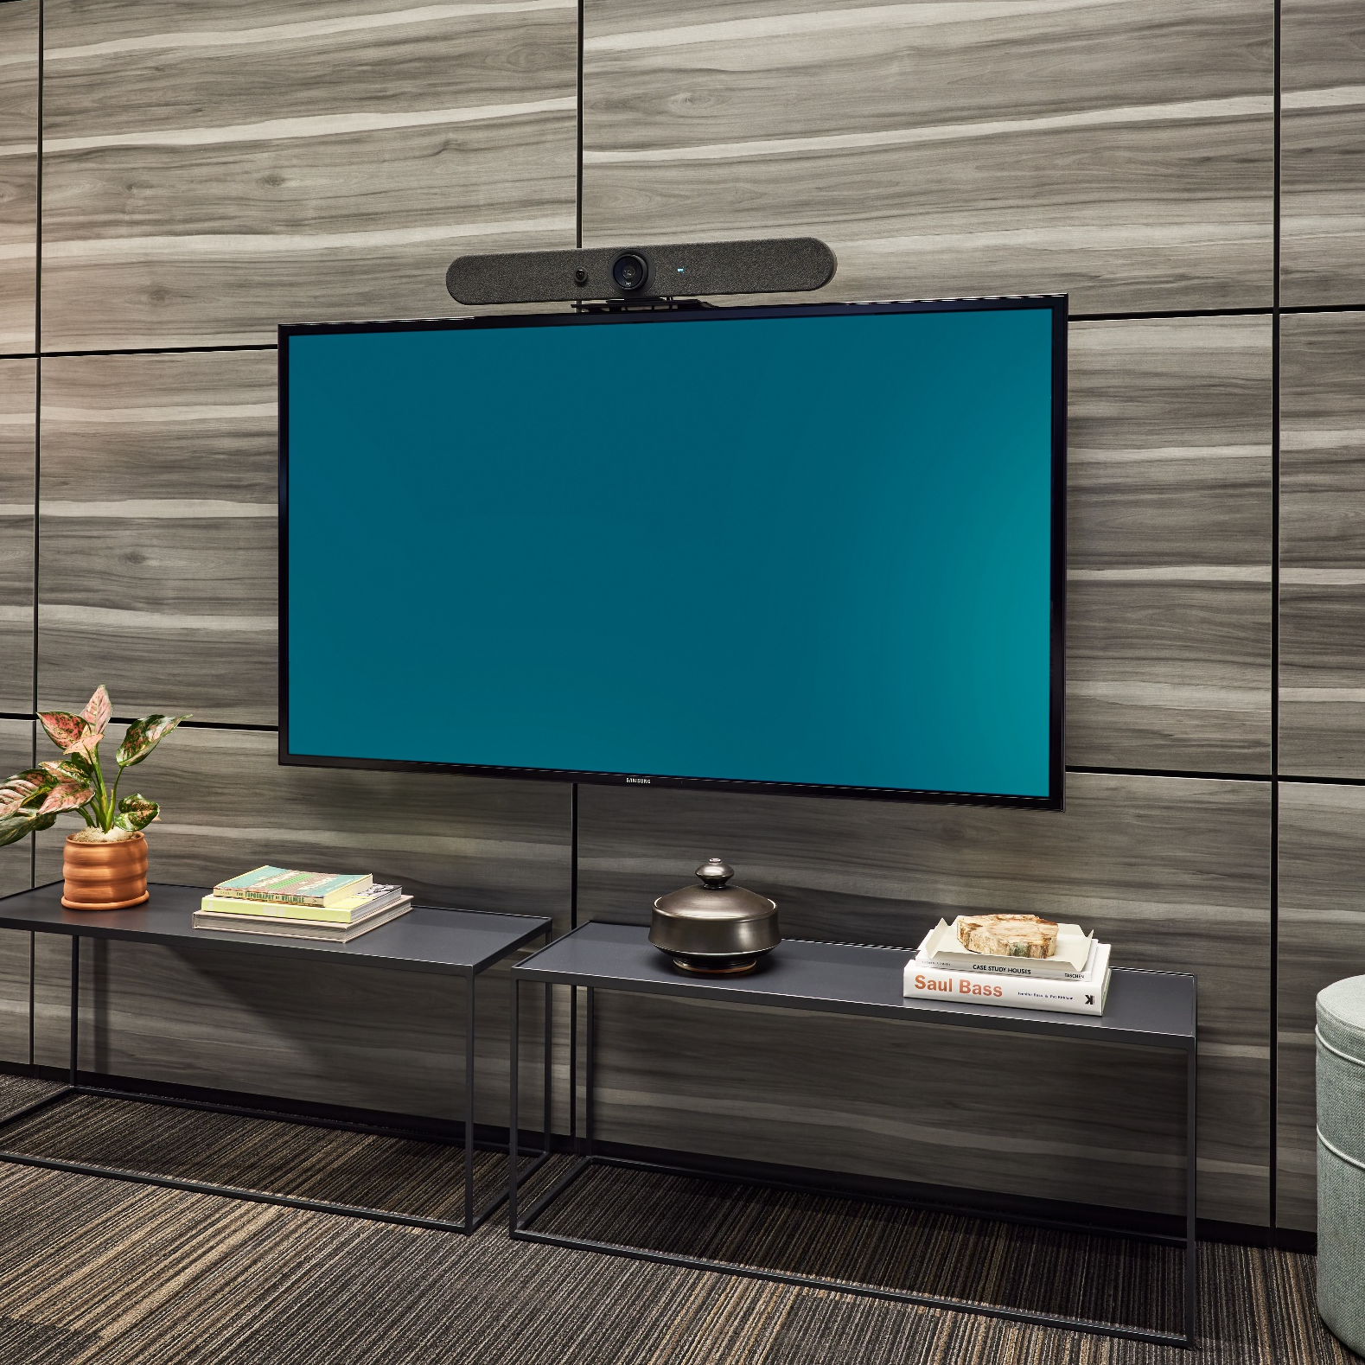
Best Practices
When mounting monitors, consider placing power/data below or to the side of the mounting bracket for easier access. Field-cutting these outlets may be the best solution if the A/V isn’t finalized yet.
POWER/DATA HERE
POWER/DATA HERE

Slide 24
Privacy Wall Enhanced Bug

Slide 25
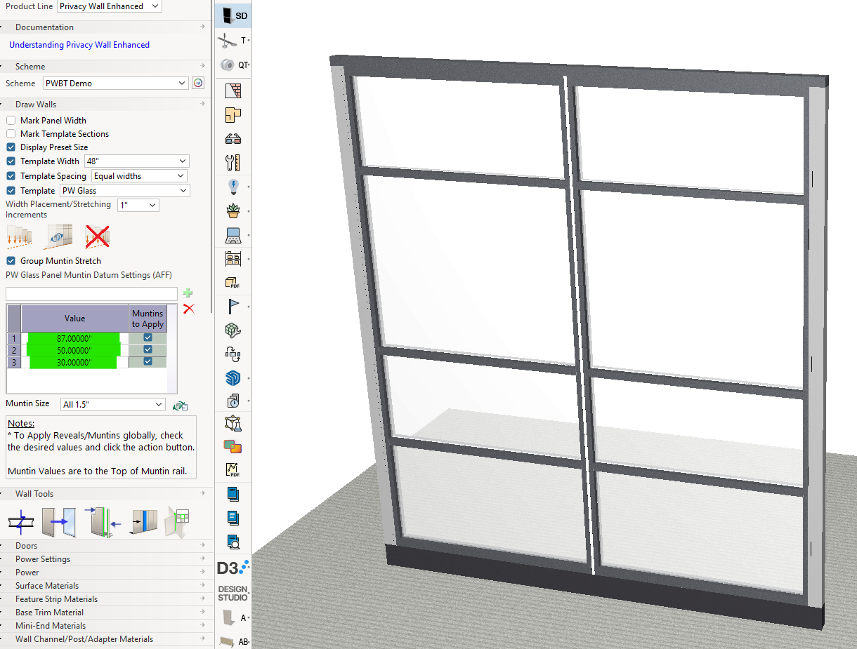
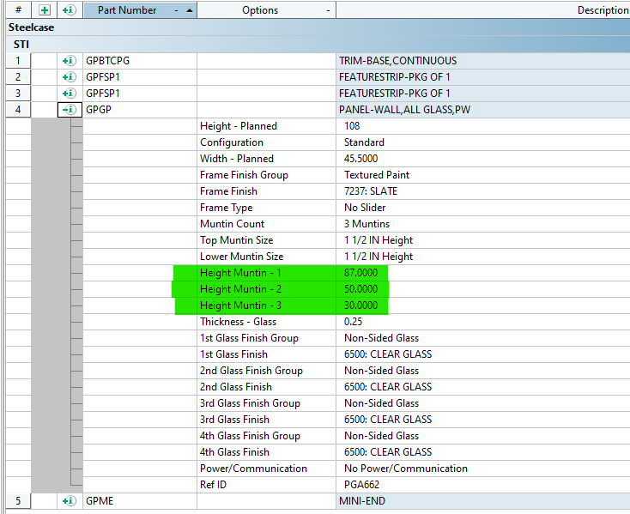
PW Enhanced Bug
Issue Details: When using the Muntin Datum Settings (AFF) tool to segment PW glass panels and slider door leaves, the order of the AFFs in the product configuration can sometimes become out of sequence. This issue occurs under certain conditions when entering and changing values. By default, if you apply the preloaded AFFs, the locations are noted in the configuration as Muntin 1 to 3, ordered from highest to lowest.

Slide 26
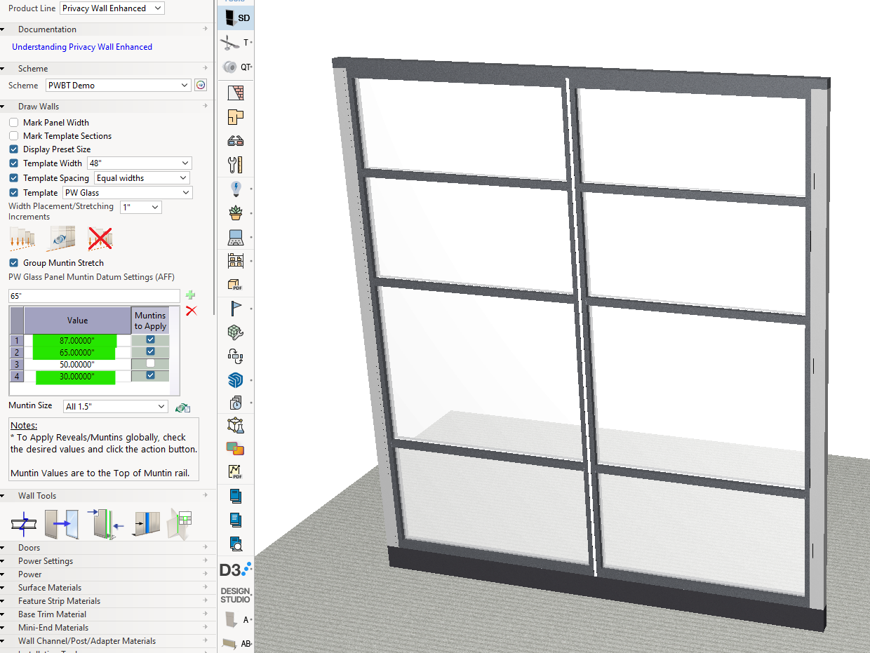
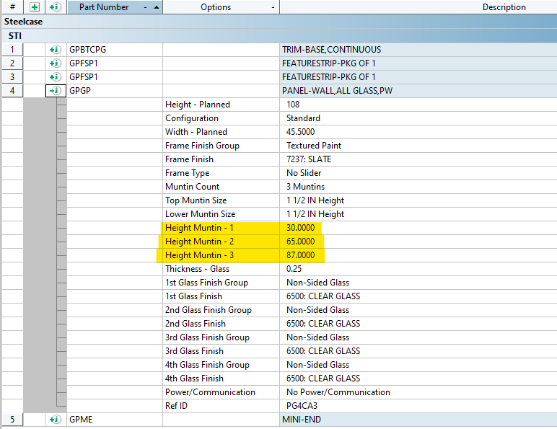
PW Enhanced Bug
However, if you add another AFF dimension to the chart, apply it, and then change any of the default values, the order of the AFFs in the configuration changes to lowest to highest

Slide 27
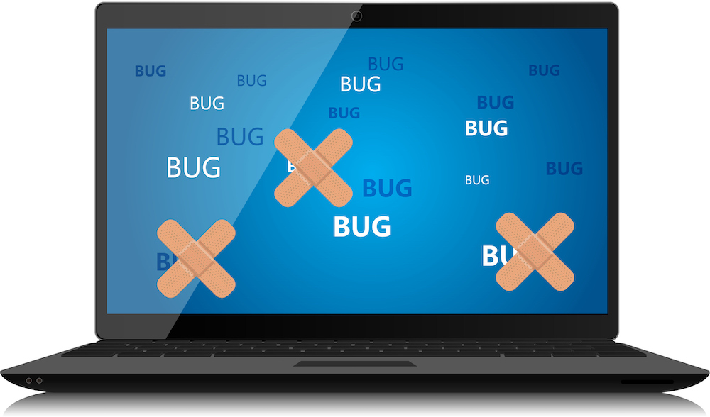
PW Enhanced Bug
A patch is coming this week, but the issue may still be glitchy until the full February release.
Once the patch is installed, you will have to update the AFF locations on your drawing for the changes to take affect.

Slide 28
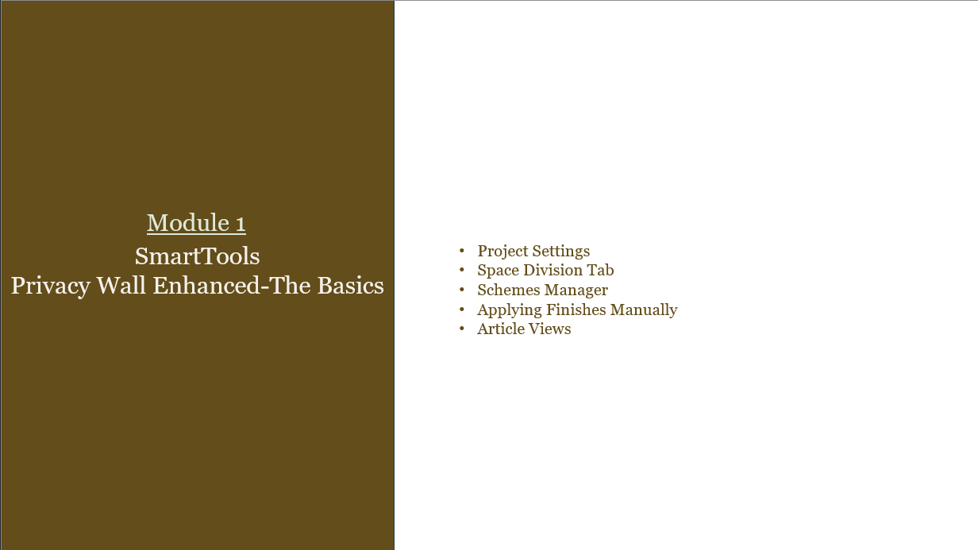
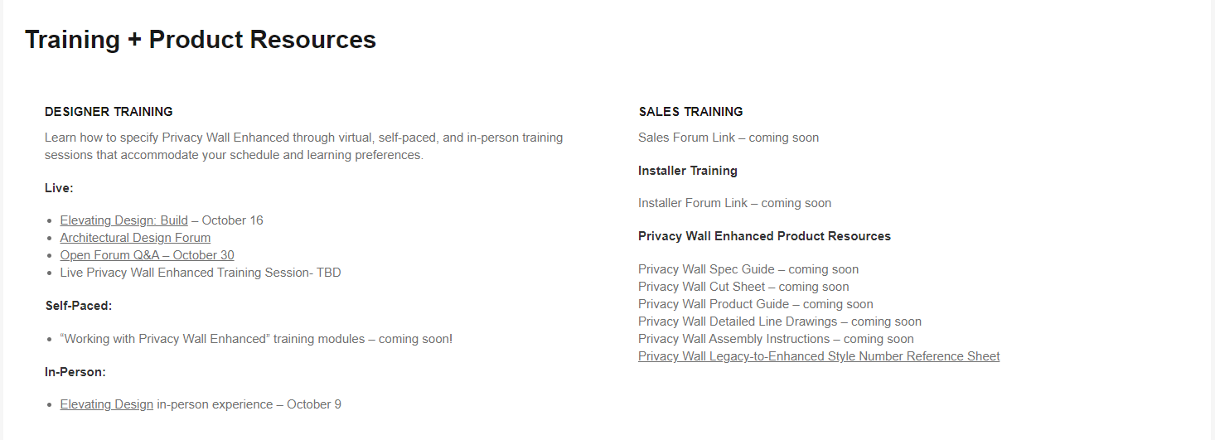
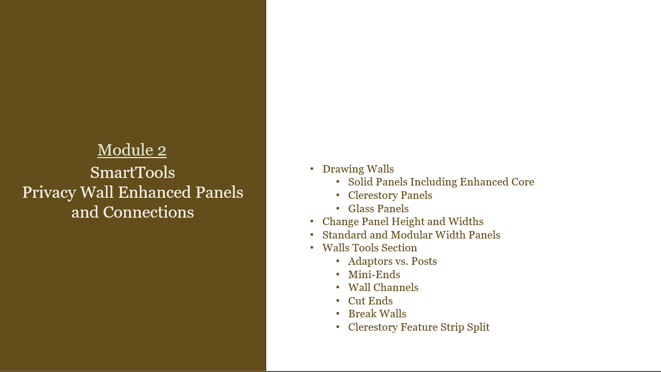
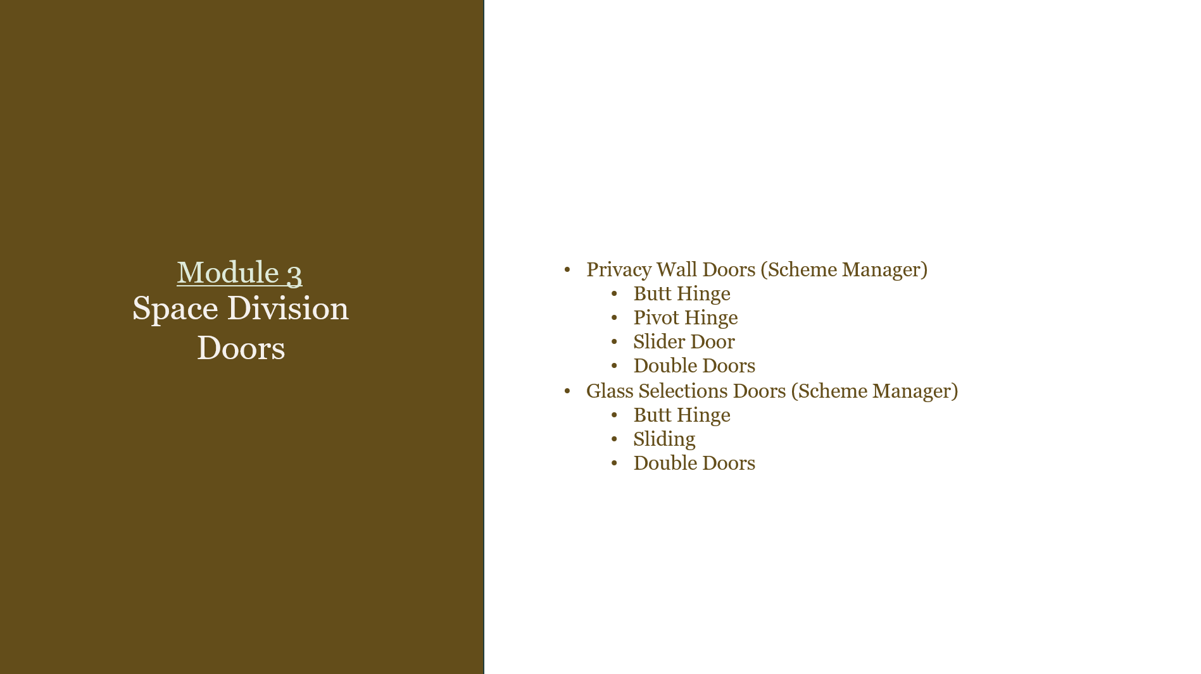
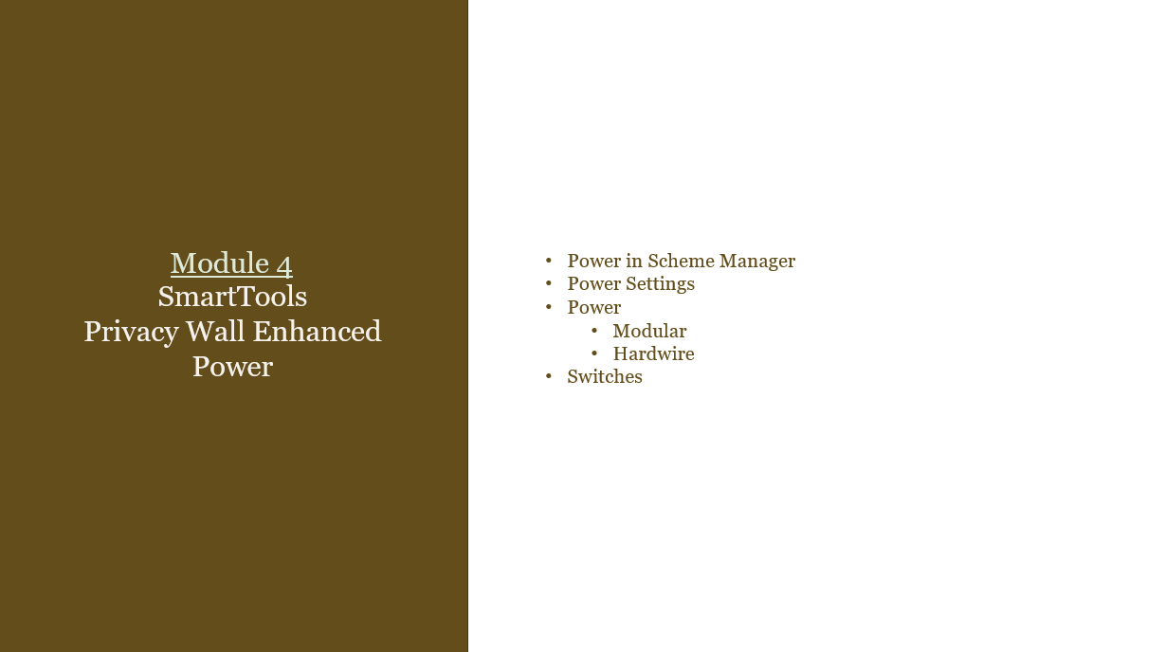
Privacy Wall Enhanced Training

Slide 29
On our next call…
February
ECAT Release Notes
Legacy to Enhanced Discrepancies
Open Q&A
26

Slide 30

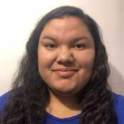

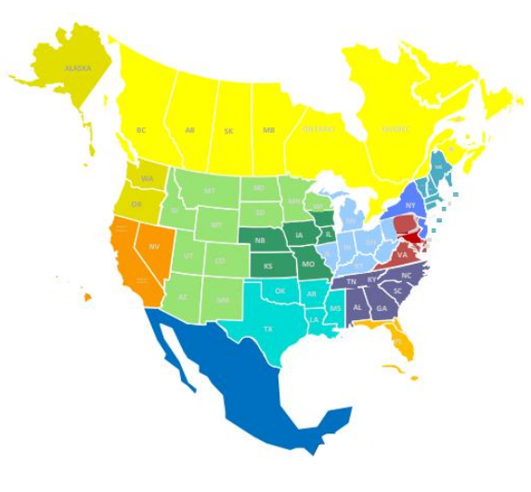




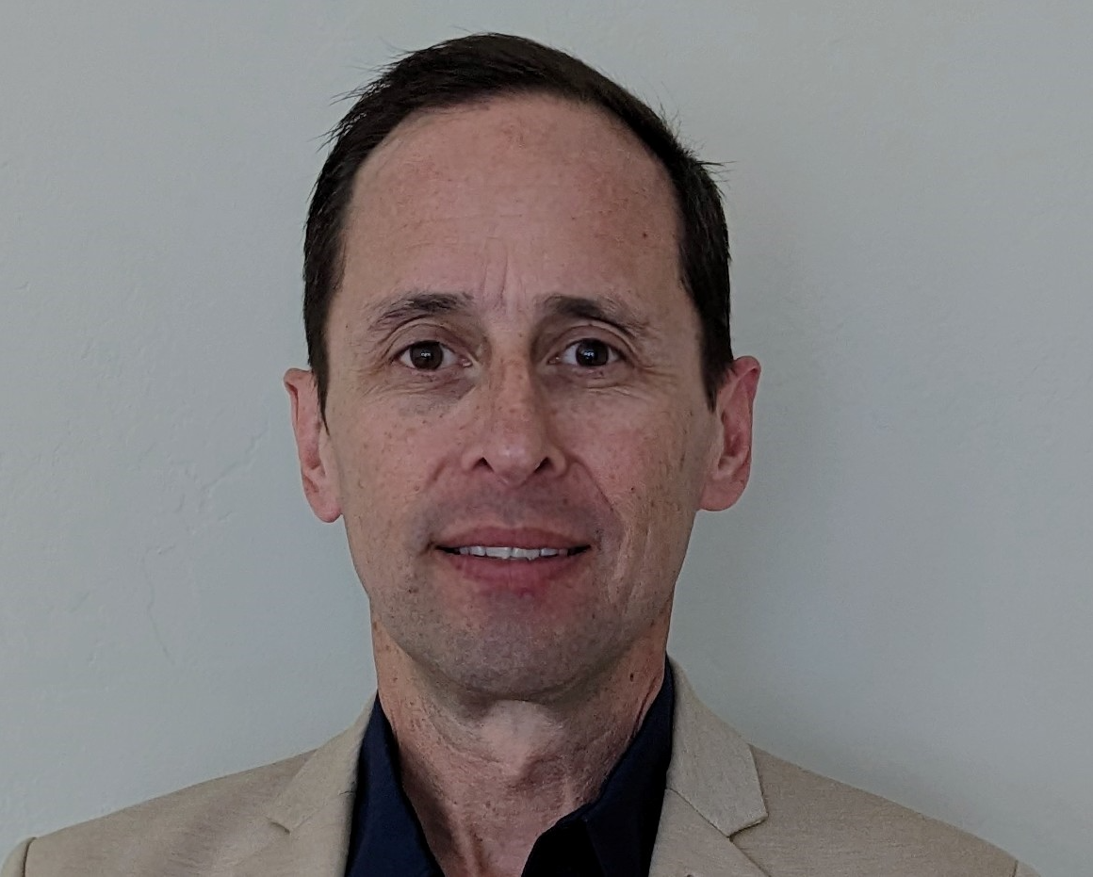
DSC by region
Alan Lopez
Mindy Heyboer
Central NA
Maria Diaz
Mountain NA
Mid-Atlantic
Mexico
South Central NA
New York/New Jersey
Mountain NA
Michelle Hoppes
Rob Salt
Florida and the Caribbean
Canada
Carl Mikail
Midwest
Southeast
New England
Jason Bechtel
Mike Moriarty
South Central NA
Mountain NA
Pacific Northwest
West Coast NA
WHO TO CALL

