Slide 1
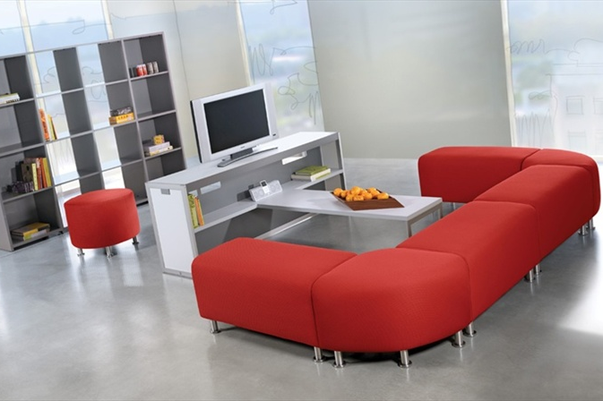
Alight SEATING
Two covers to choose from, dependent upon how the document is being used. DELETE THIS BOX
Product Information Packet

Slide 2
Alight
SEATING
Product Information Packet

Slide 3
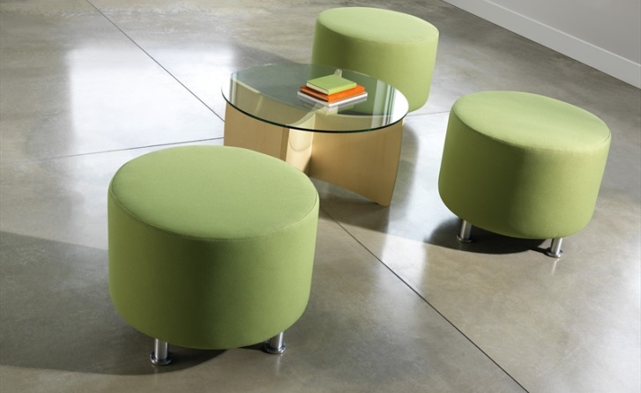
Alight
Alight® pieces are perfect for reception, lounge and teaming areas. They are highly functional for in-between spaces like hallways or in similar areas like private offices.
Why choose Alight?
With dozens of fabric choices and a handful of leg finishes, Alight provides solo seating or creative grouping for any space.
Key Features
Light-scale lounge pieces for impromptu and collaborative spaces
Available in three shapes: bench, corner and round
Fully upholstered
Corner and bench models are capable of ganging
Brushed aluminum or wood legs
level™ 1 certified to BIFMA e3 standard
SCS Indoor Advantage™ certification for protecting indoor air quality – Gold

Slide 4
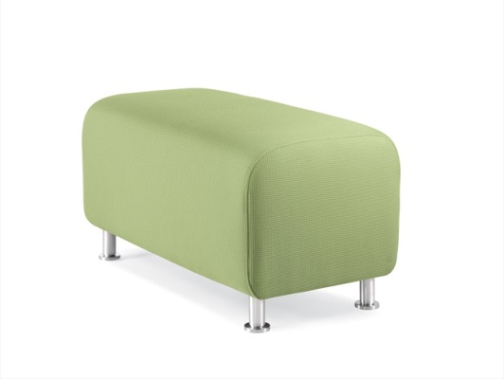
Frame
Plywood components are doweled, glued and stapled together for rigidity. Dowels are used to reinforce critical locations.
Legs
Standard legs are aluminum with threaded post for adjustability. Optional wood legs are solid maple with threaded steel inserts for adjustability. Low profile models feature adjustable glides in place of the legs.
Seat
Fabric is stretched over the foam and frame and stapled into place.
Product Data
Additional Product Information:
http://myturnstone.com/products/lounge-furniture/alight-bench-ottoman/

Slide 5
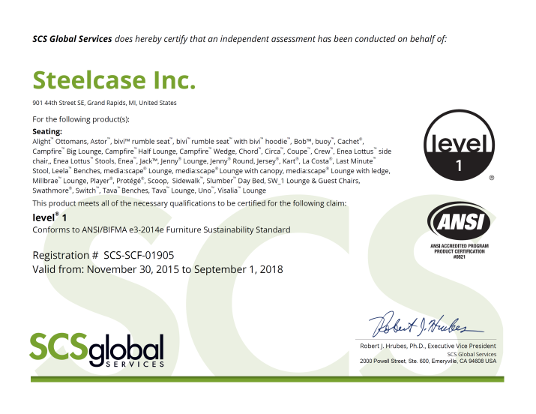
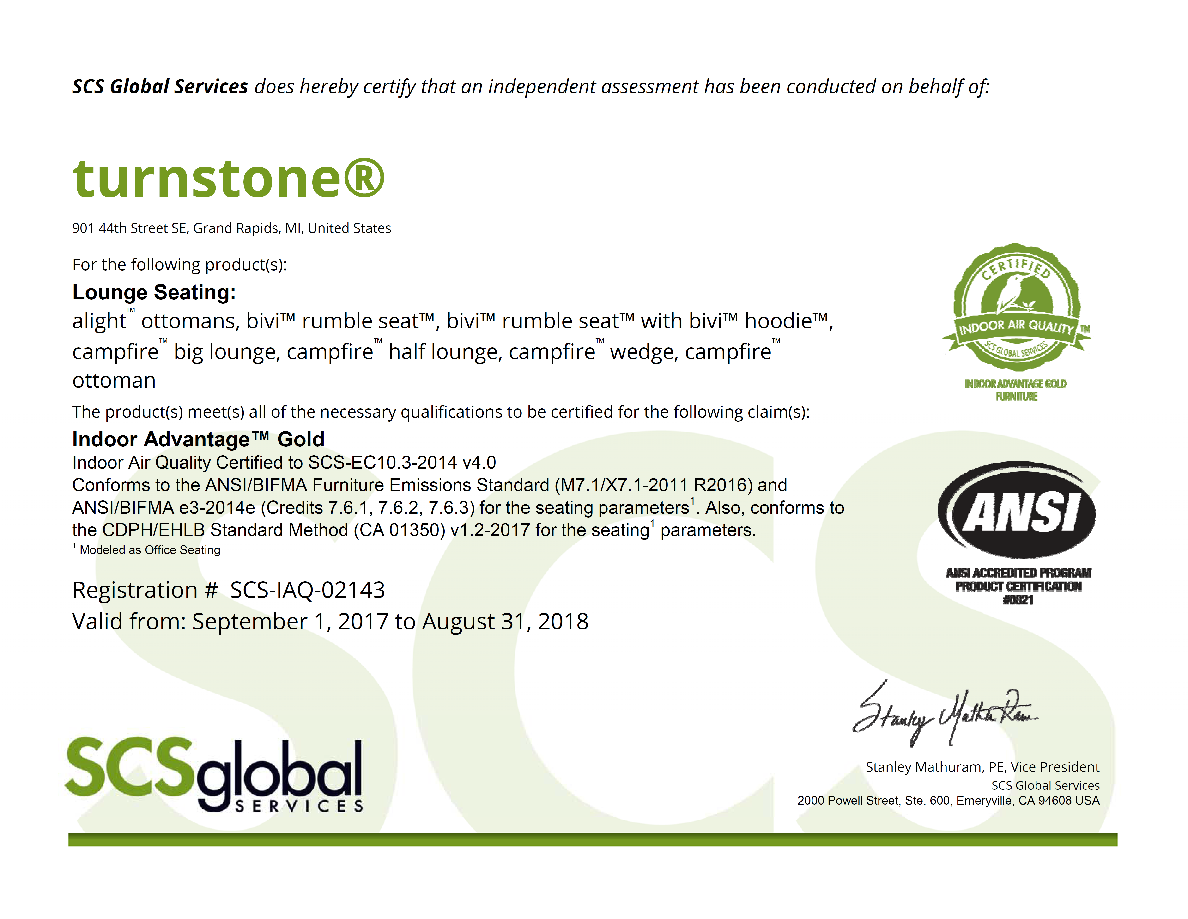
Sustainability Highlights
level™ 1 certified to BIFMA e3 standard
SCS Indoor Advantage™ certification for protecting indoor air quality – Gold

Slide 6
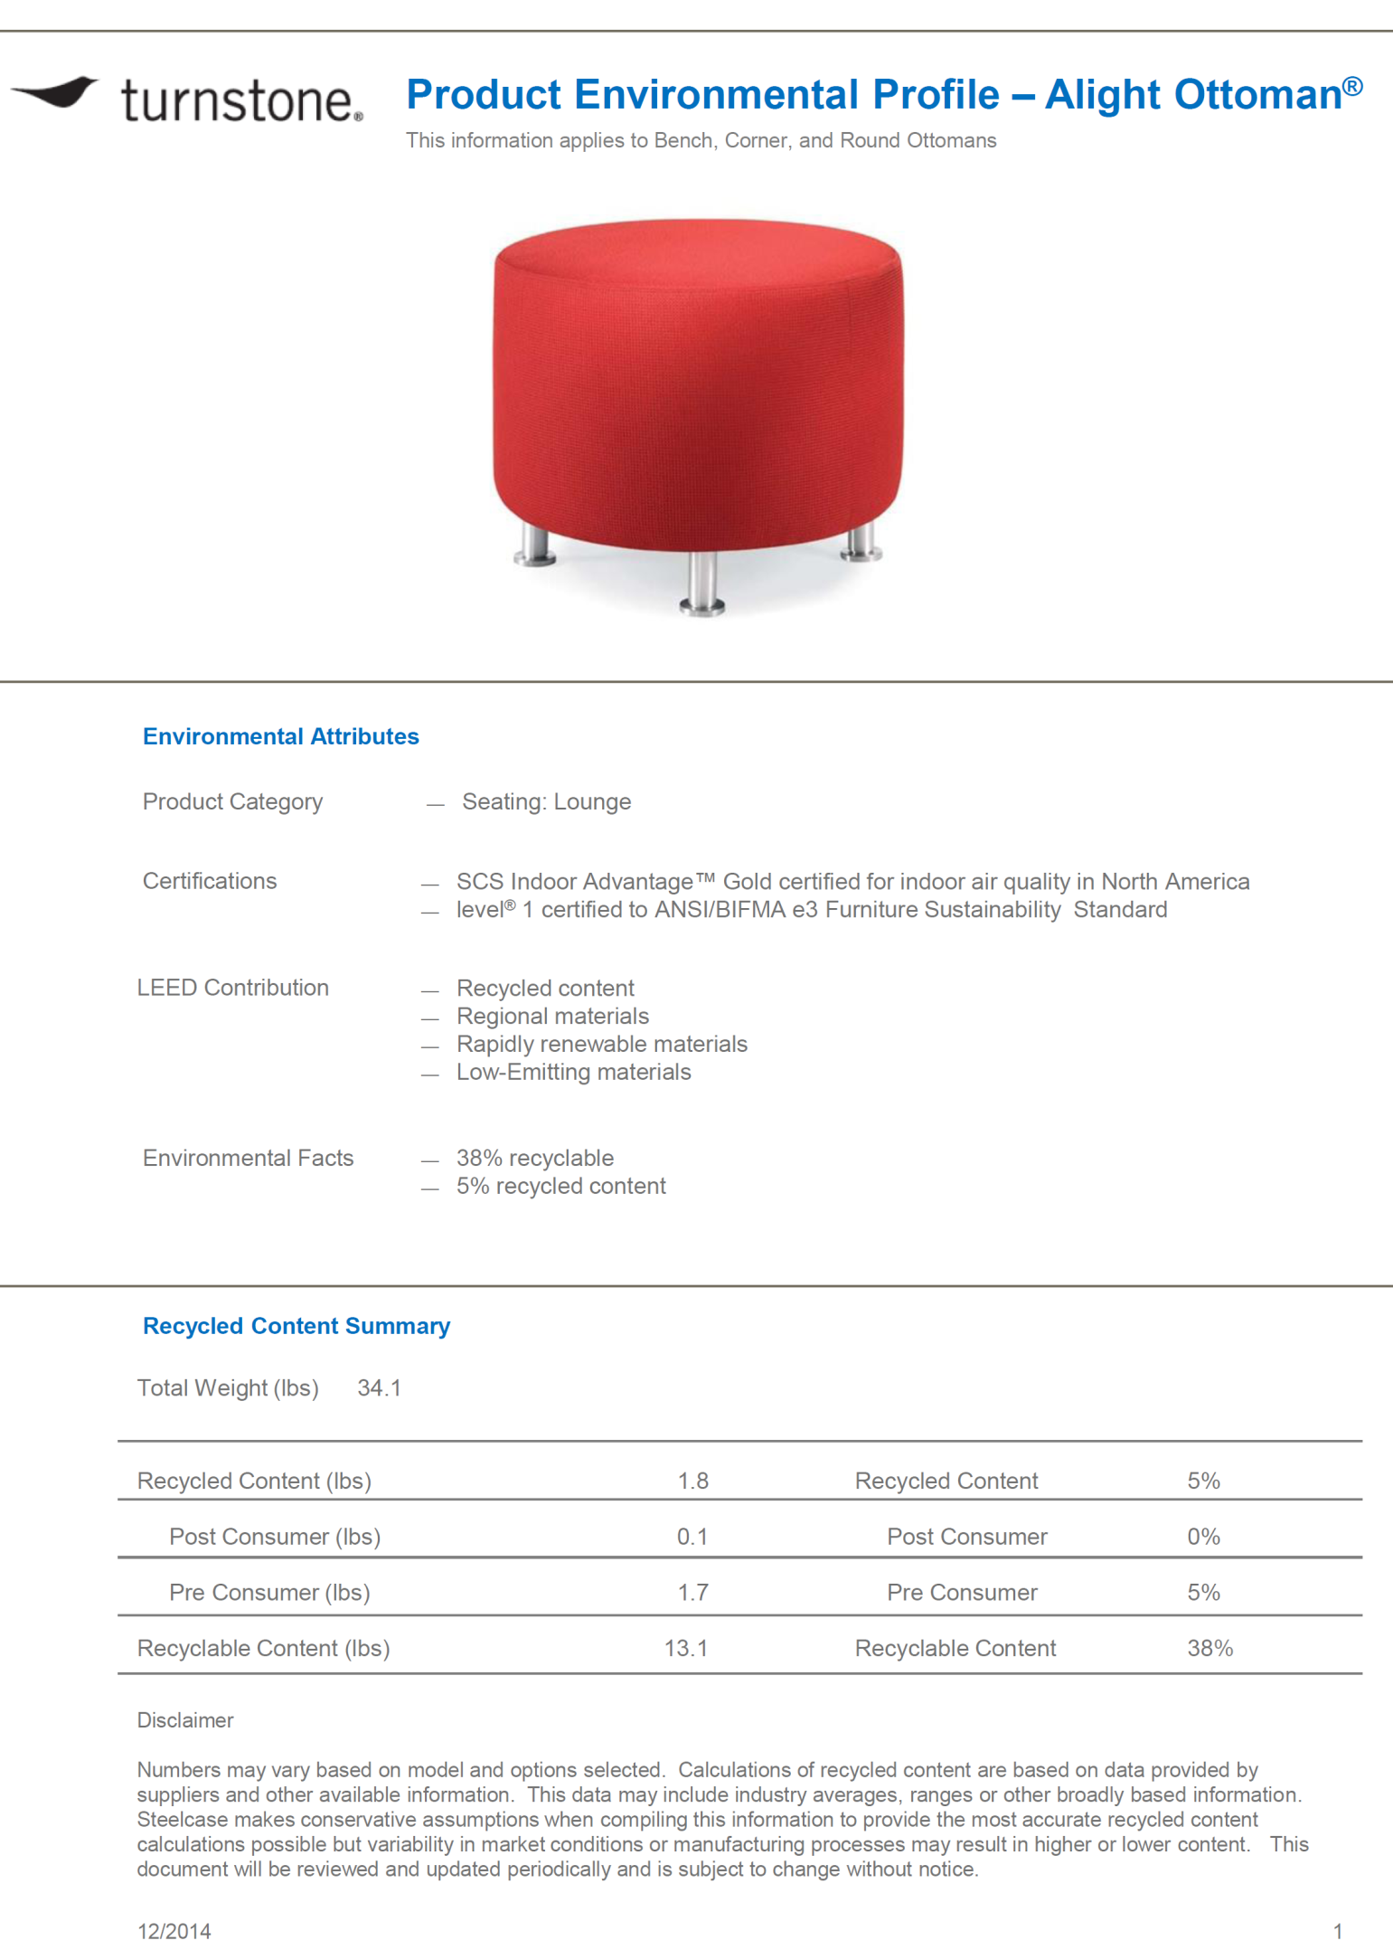

Slide 7
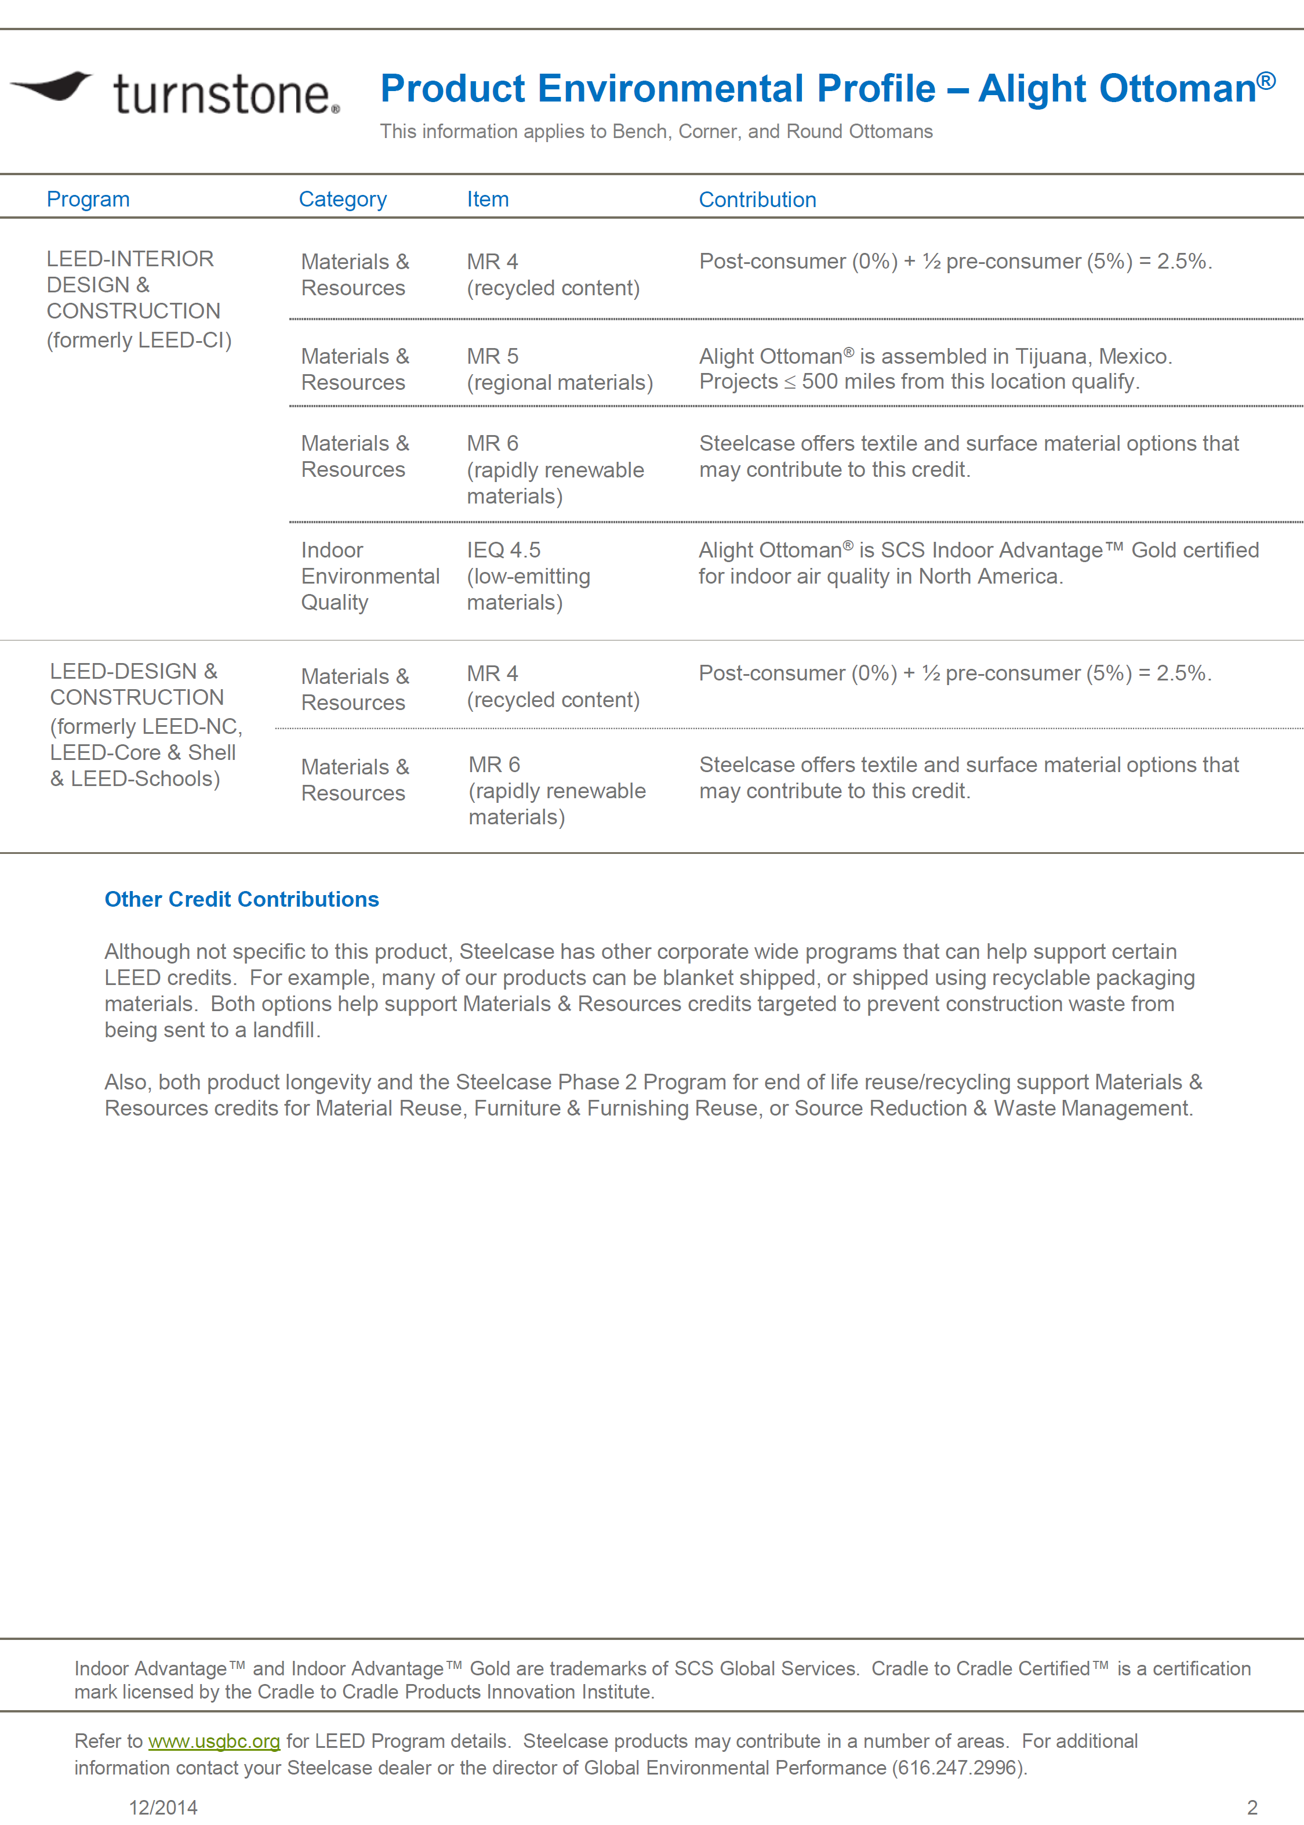

Slide 8
