Slide 1
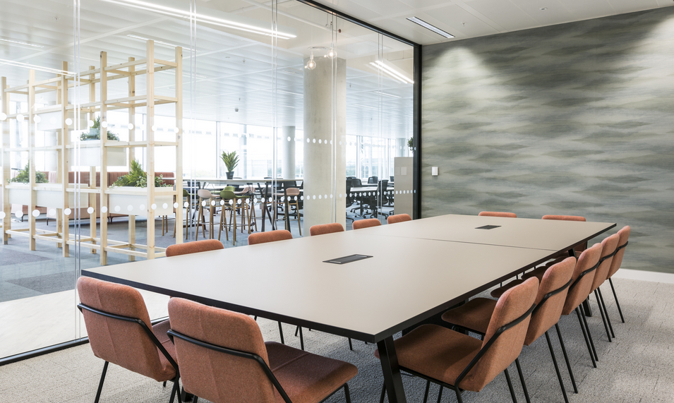
Surface Material APAC
m.a.d design
A Steelcase Partner
2021 / 2022

Slide 2
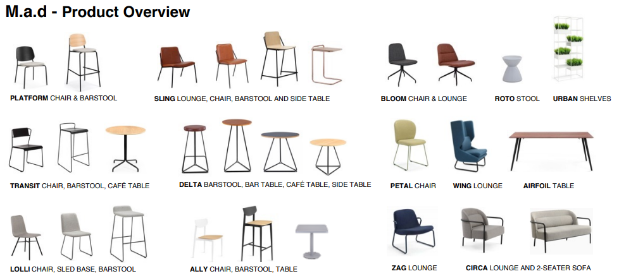
Surface Material
Chairs & Stools
Transit Chair/ Stool
Sling
Lolli
Trace
Bloom
Delta
Ally
Roto Stool
Petal
Platform
Tables
Airfoil
Delta
Sling Side Table
Accessories
Urban Shelf
Lounge
Bloom
Trace
Sling
Circa Lounge
Wing Lounge
Zag

Slide 3
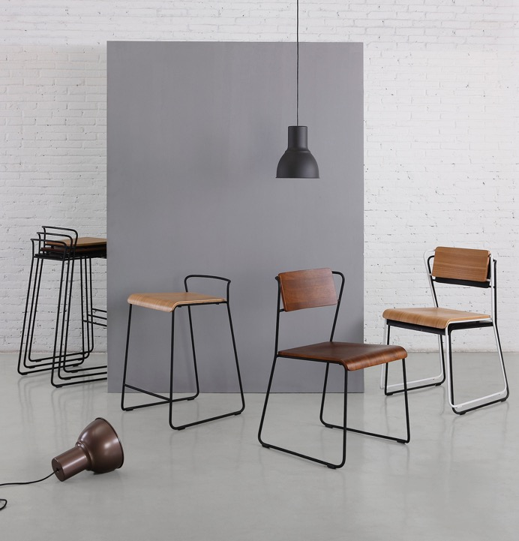
Steelcase x M.a.d
M.a.d
Thoughtful, accessible & design-driven furniture for the modern, urban dweller.
Founded in 2009 by long time collaborators Matt Cole, Dan Given, and Mark Daniel.
Based in southern China, m.a.d leverages its expertise to develop innovative furniture exceeding international quality standards.
m.a.d sources the highest quality materials and test s products in their state-of-the-art m.a.d lab to ensure durability and high standards. Products are modern with industrial aesthetics.

Slide 4
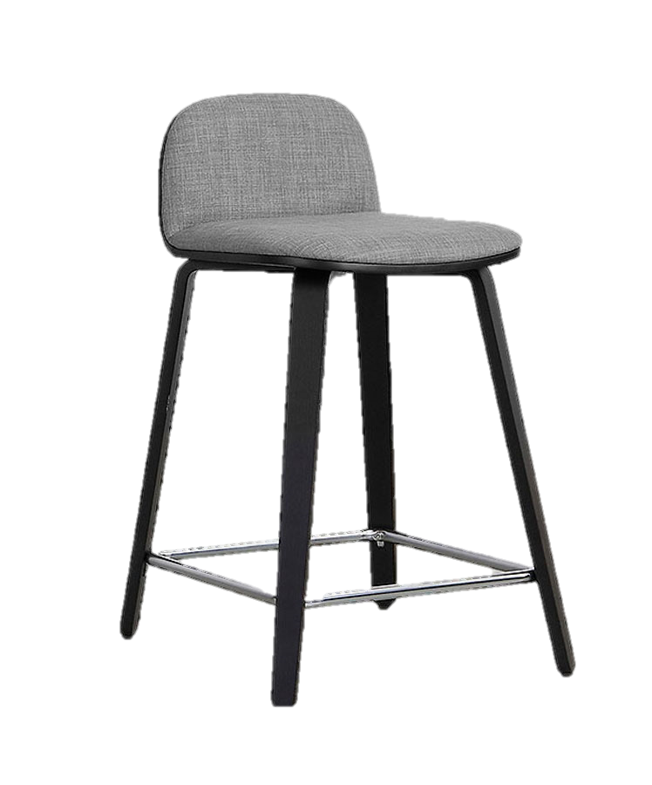
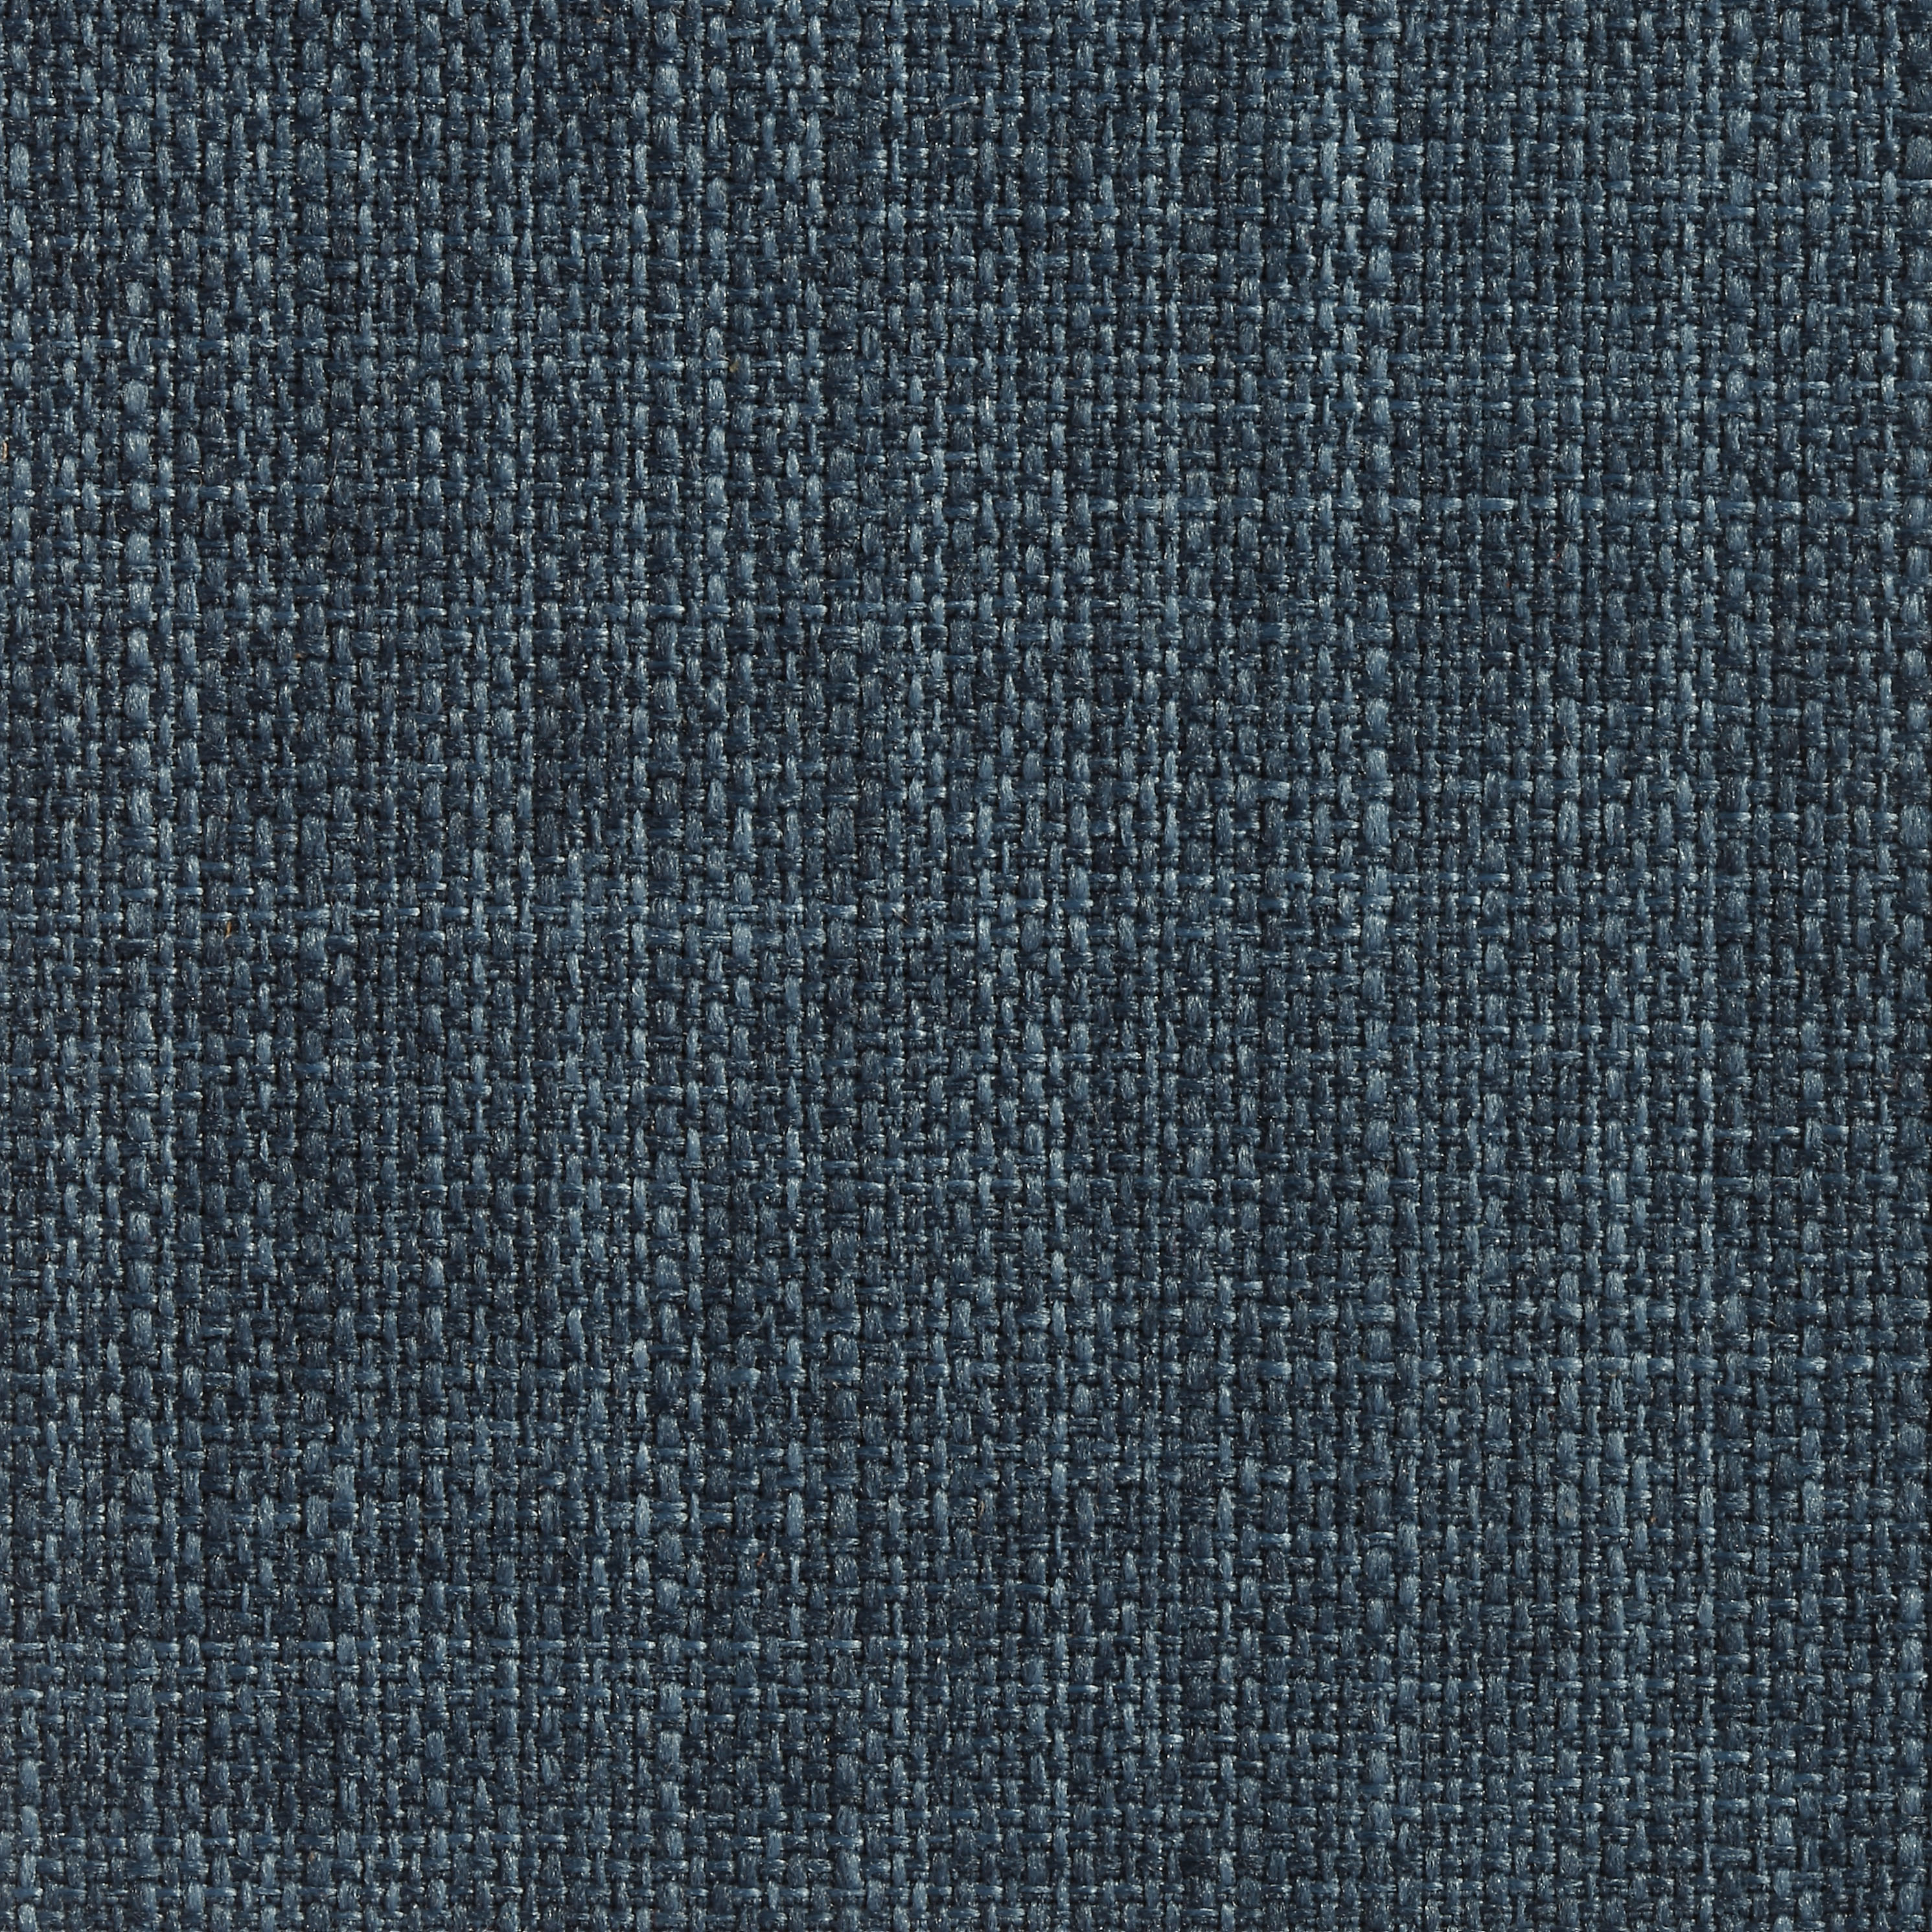
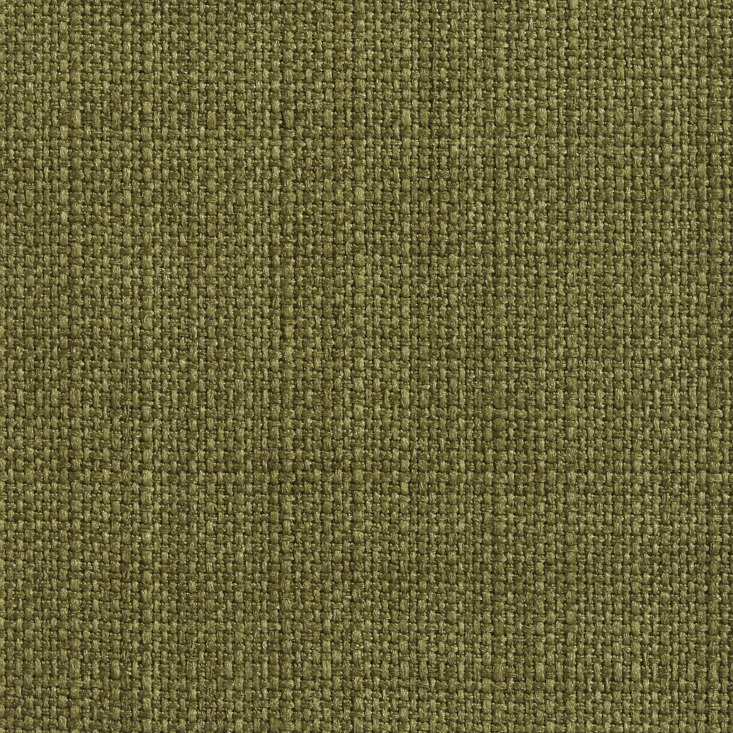
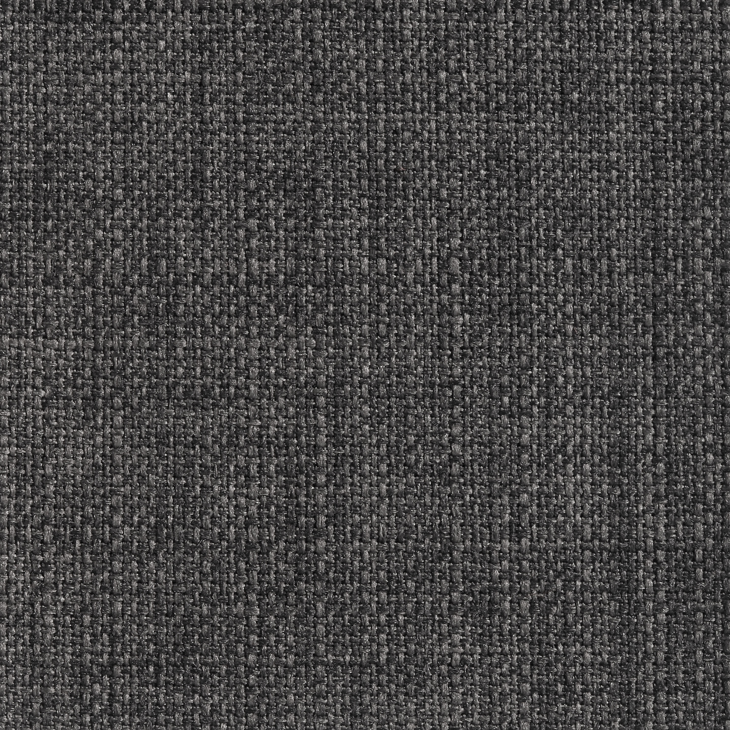
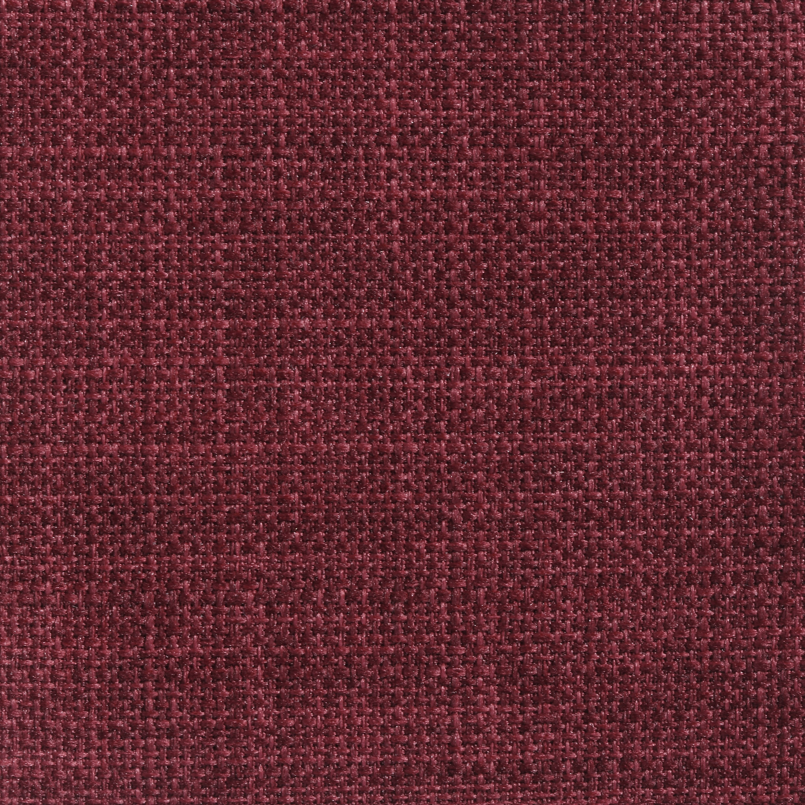
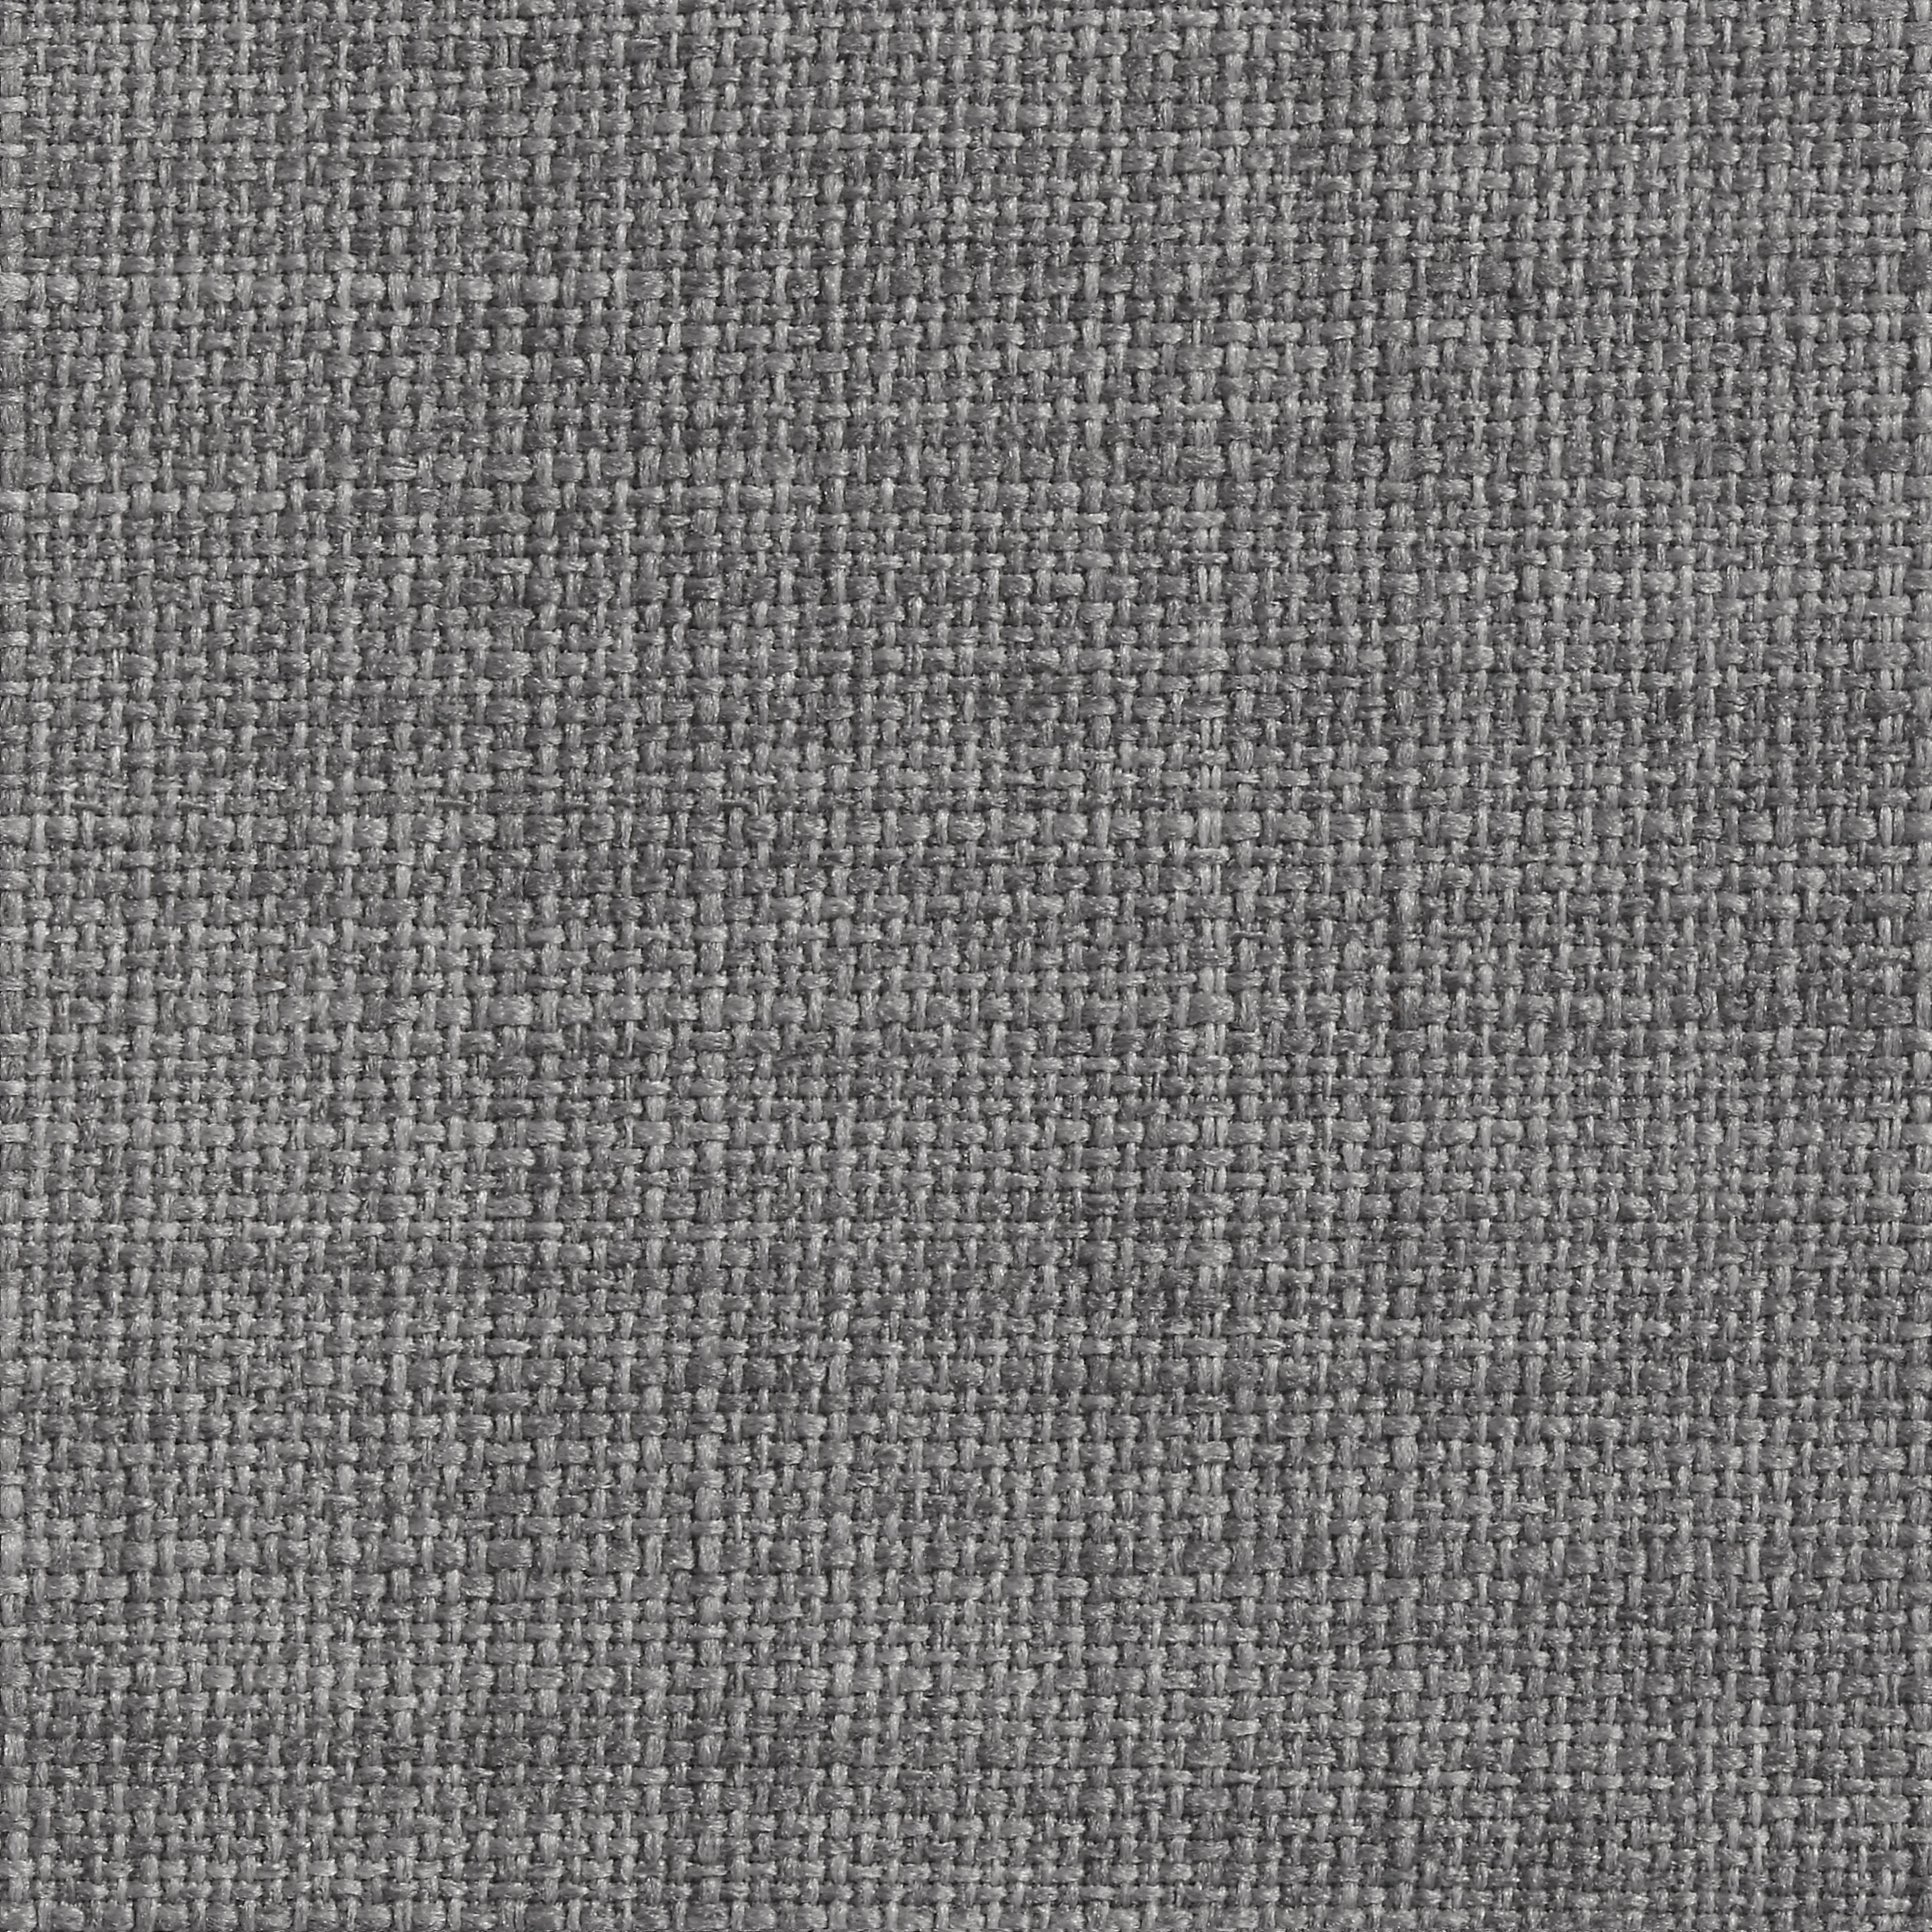
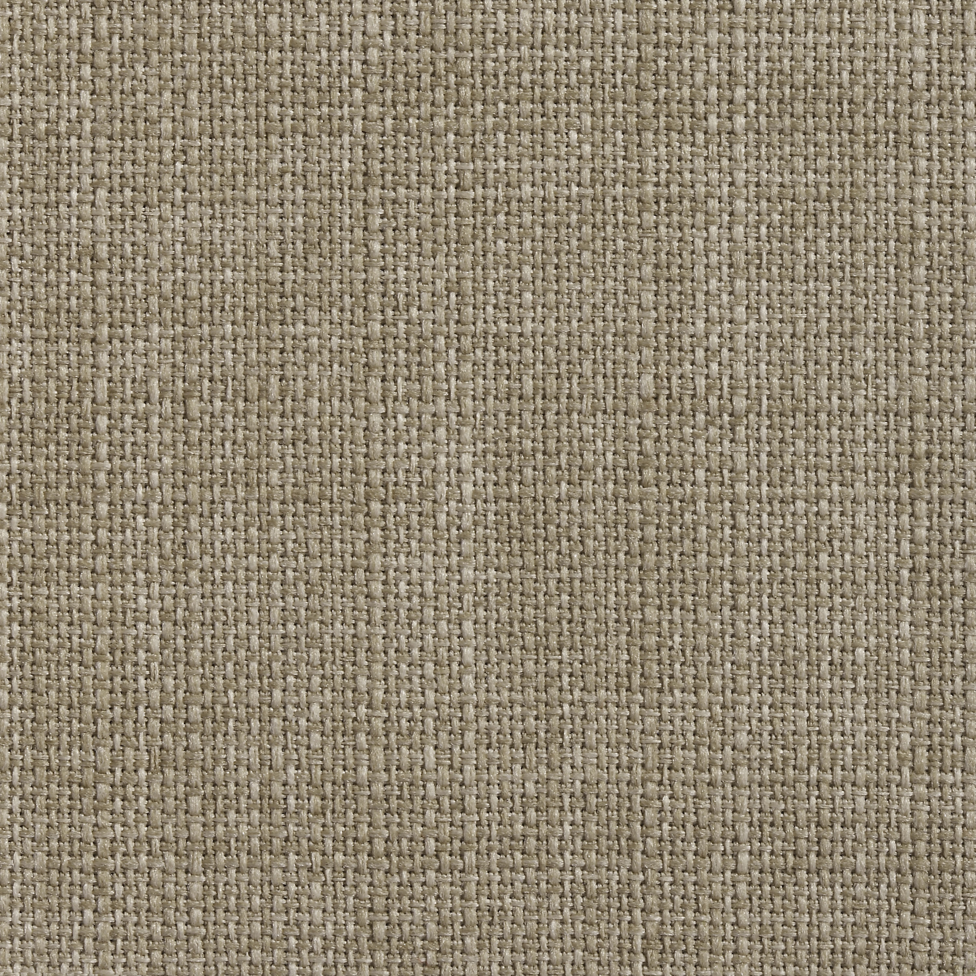
Standard Textile
m.a.d design I A Steelcase Partner
Surface Material
Fabric
Atlantic Blue
Chloro Green
Graphite (Dark) Grey
Pinot Red
Smoke (Light) Grey
Latte Brown
** Refer to material matrix for all available finishes configurations

Slide 5
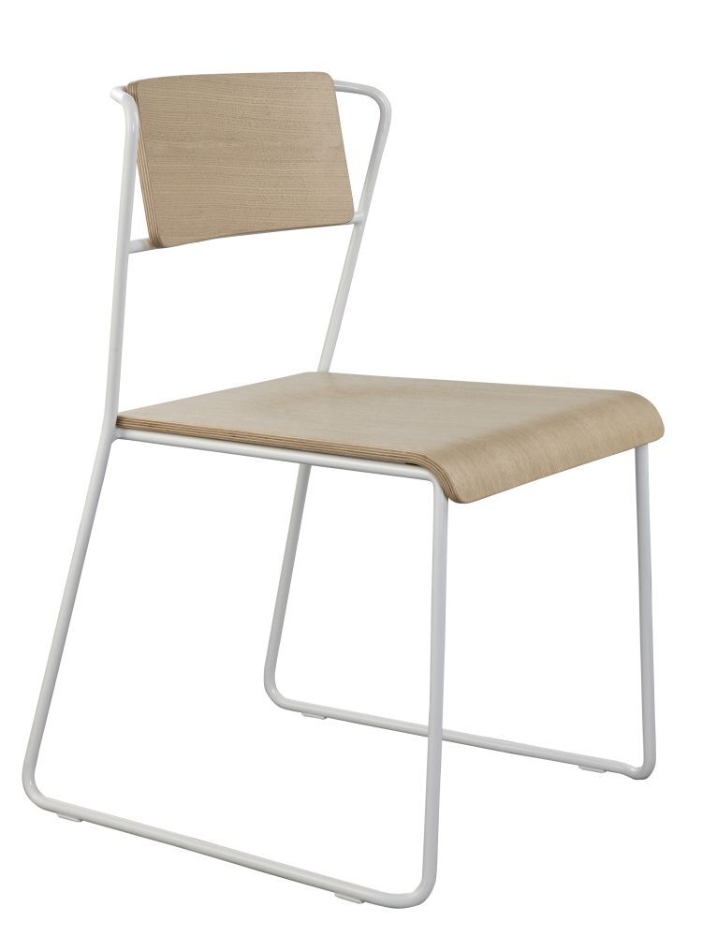
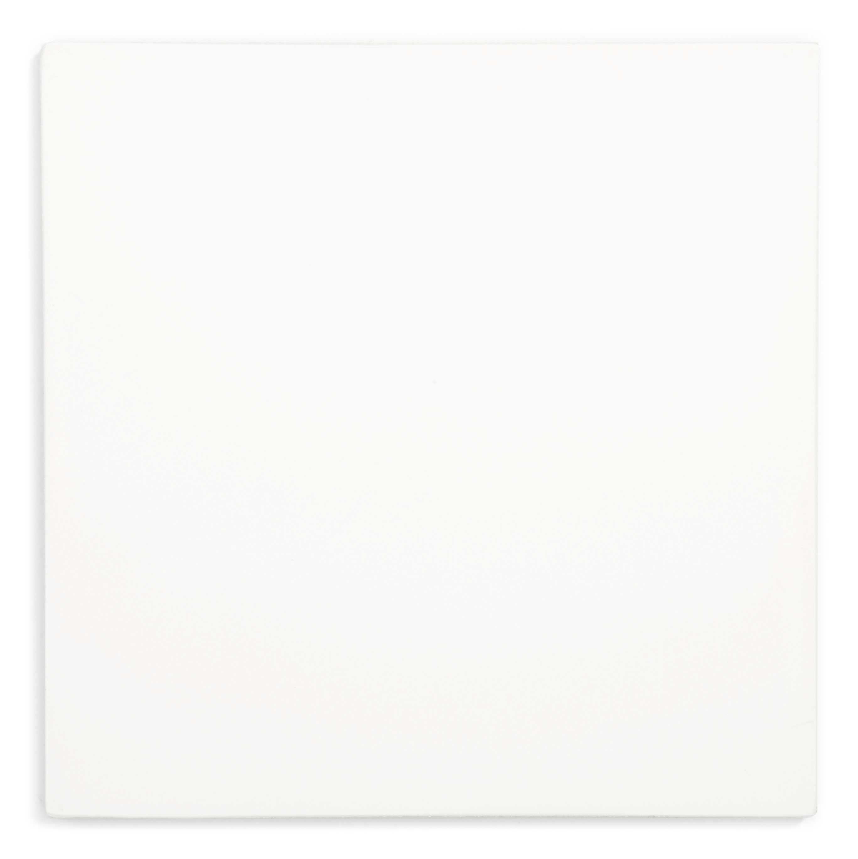
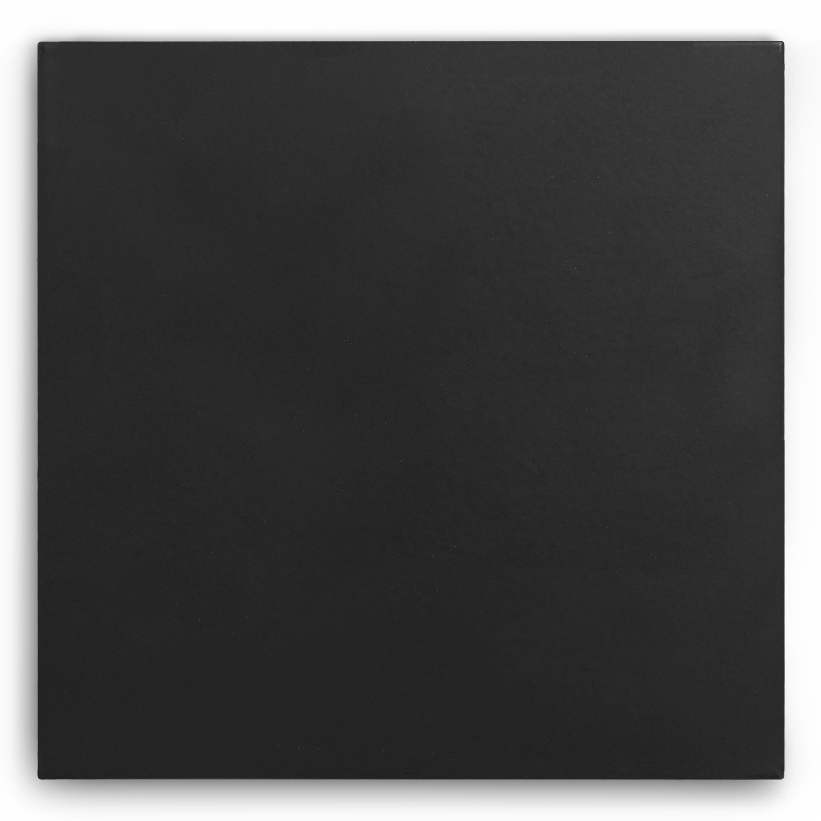
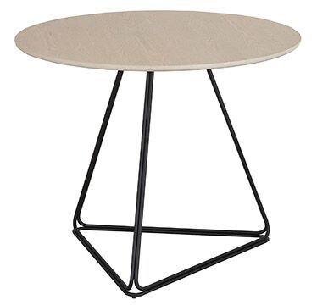
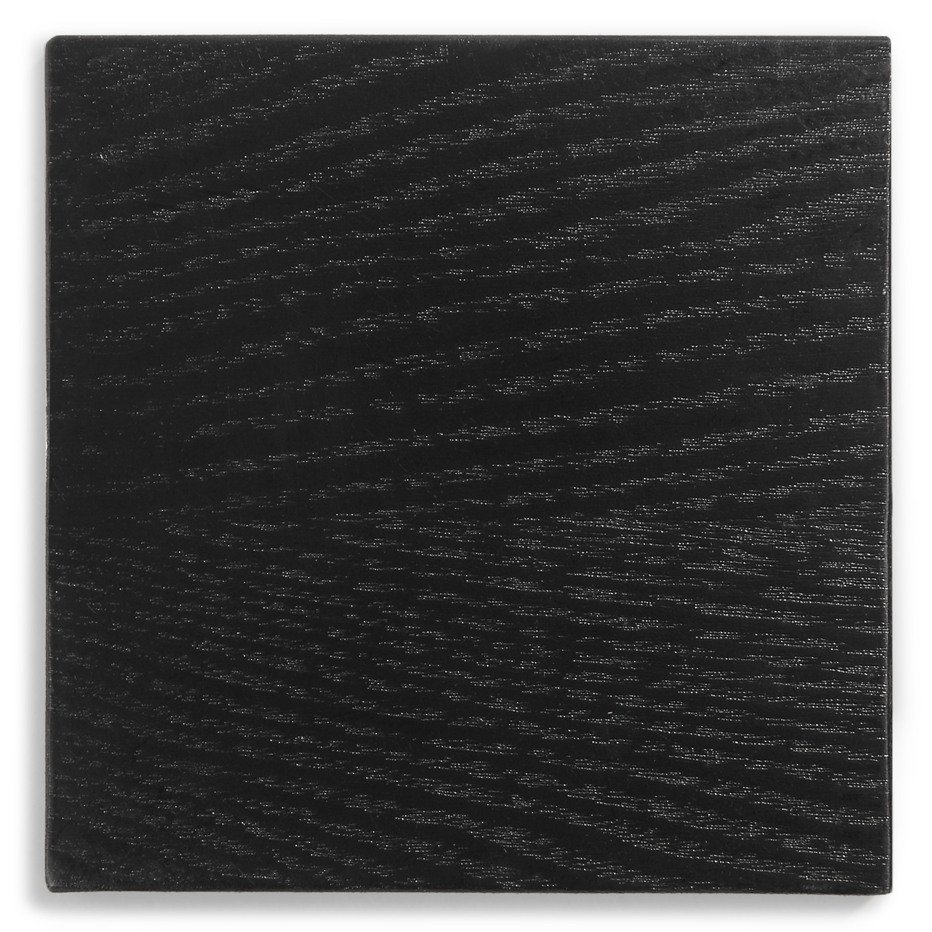
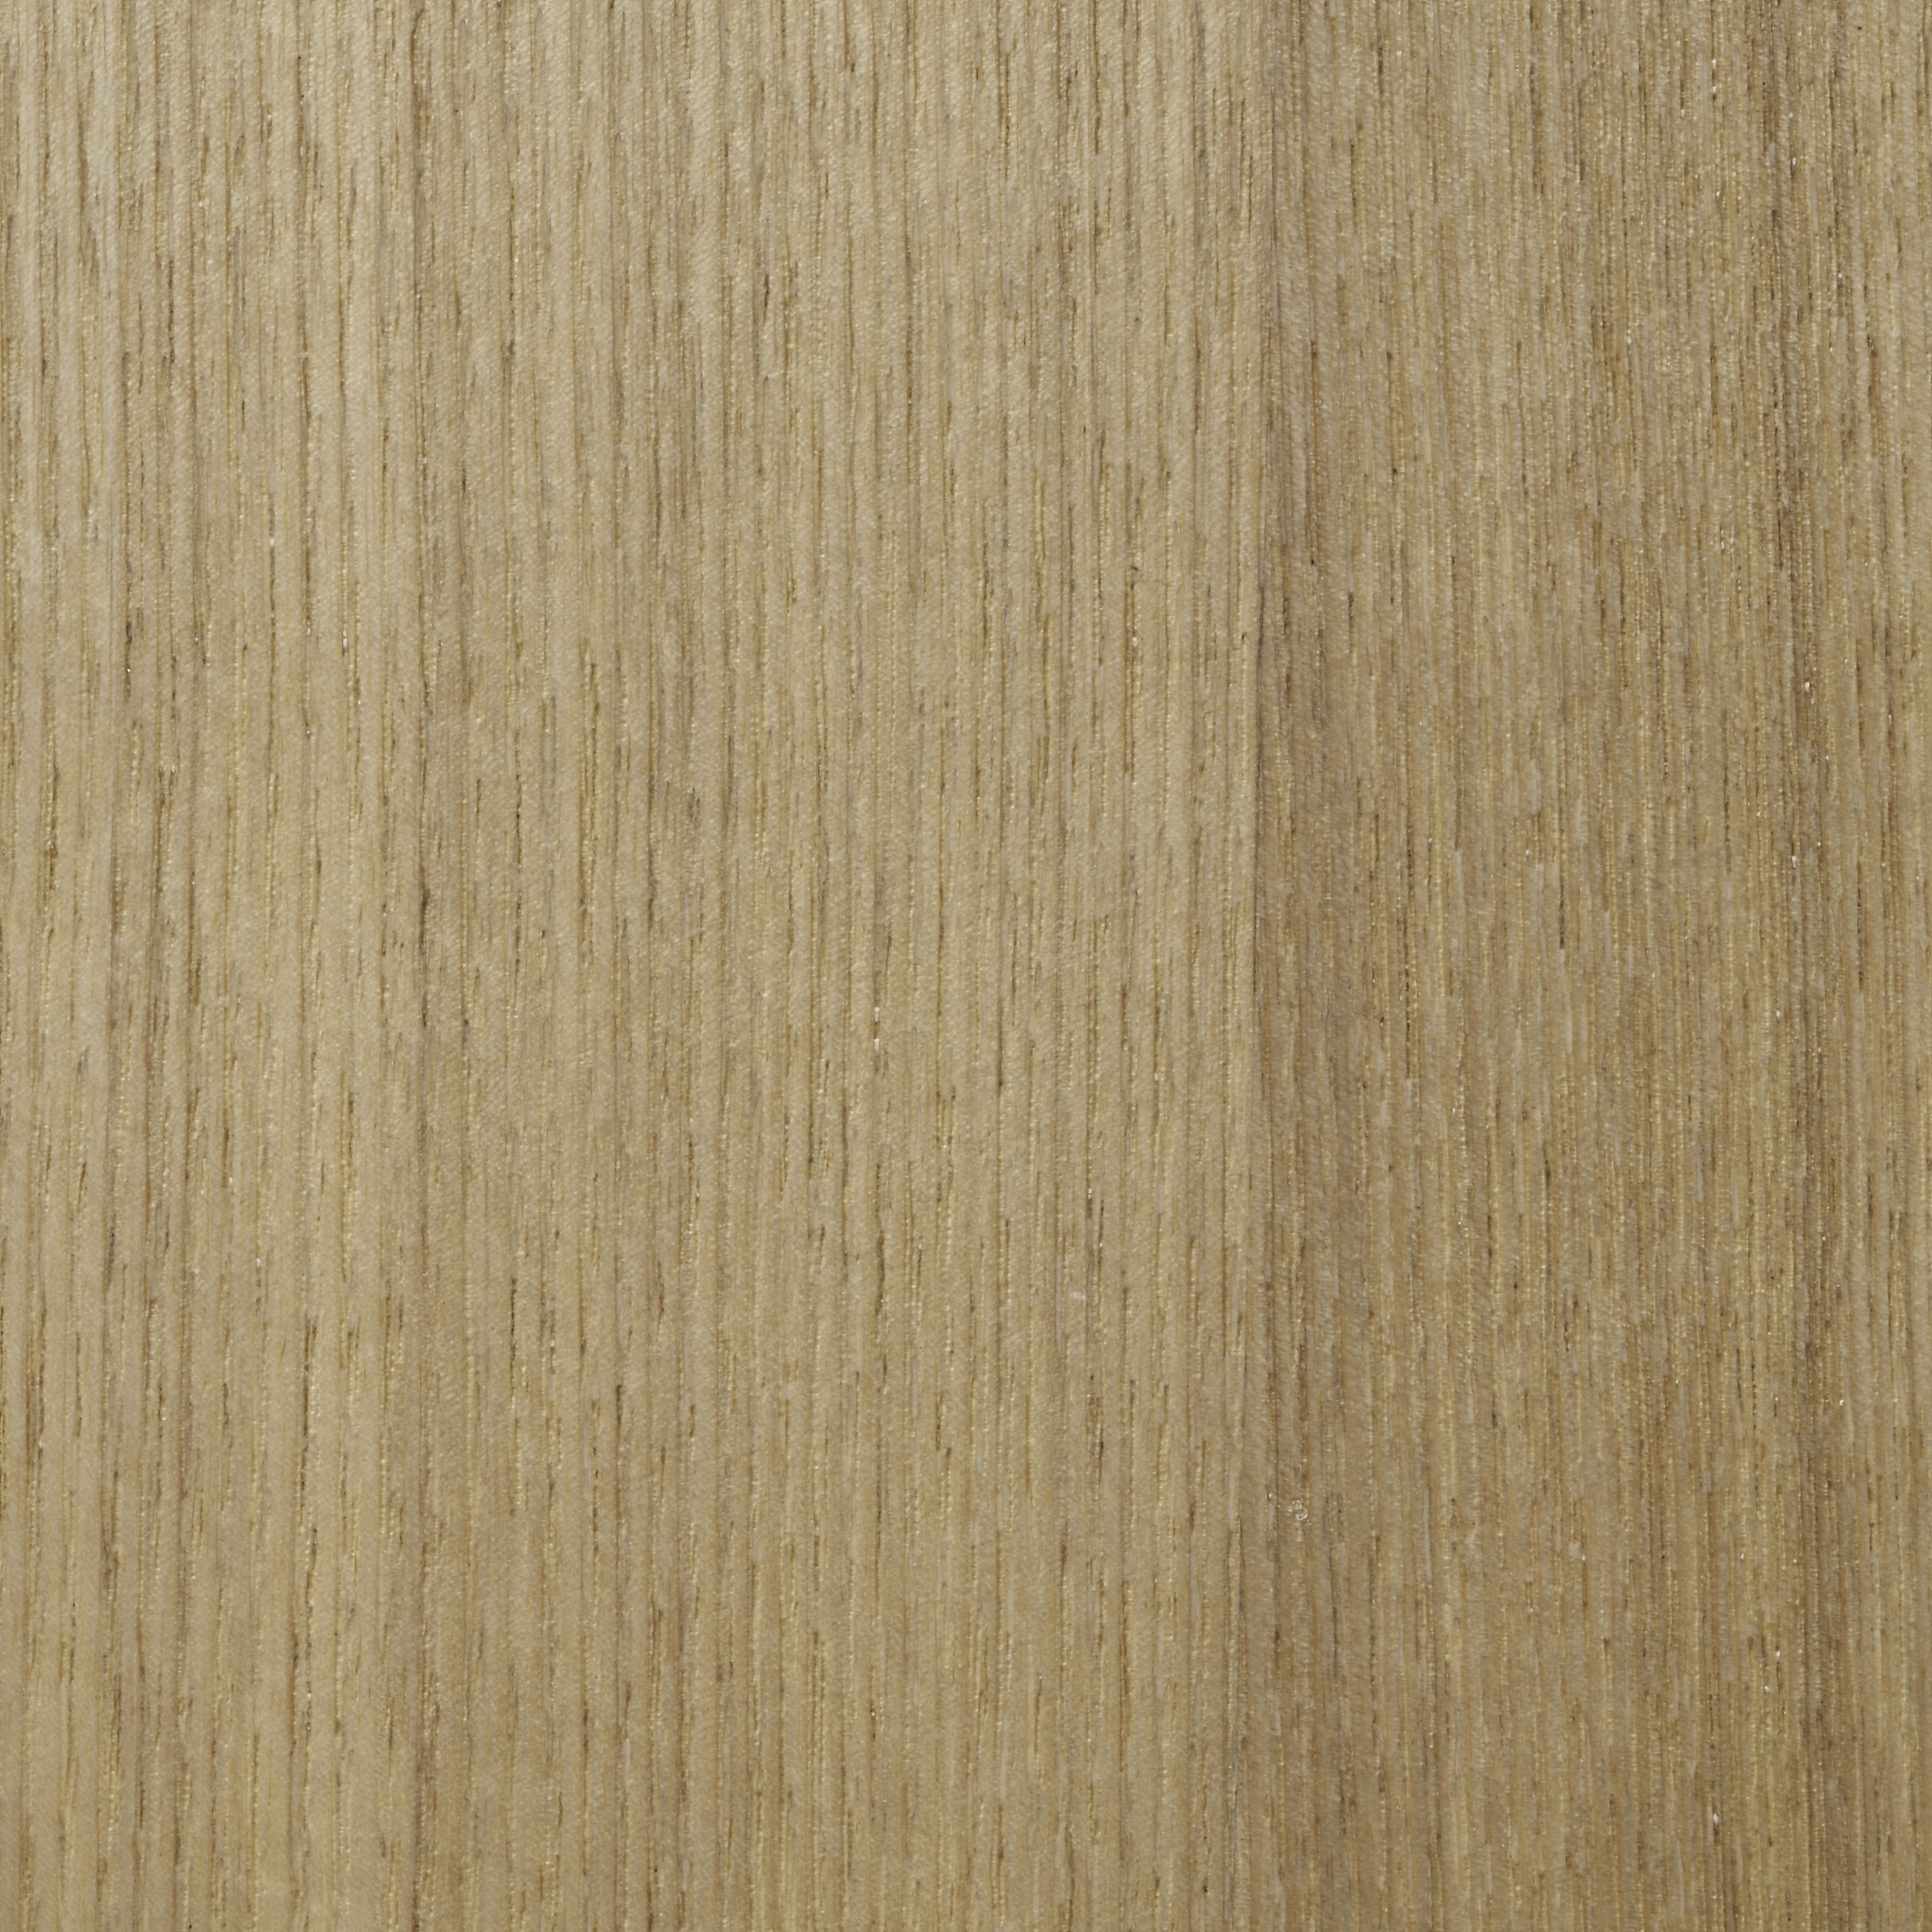
Wood & Paint
m.a.d design I A Steelcase Partner
Surface Material
Paint I Base
White
Black
Wood
Black Ash
Natural Ash
Transit Chair in Natural Ash and White frame
Delta Café Table in in Natural Ash and Black frame
** Refer to material matrix for all available finishes configurations

Slide 6
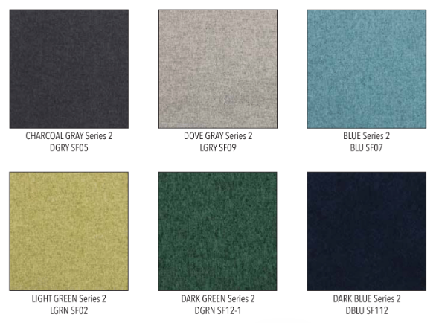
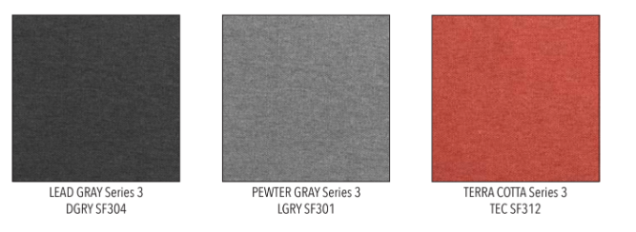
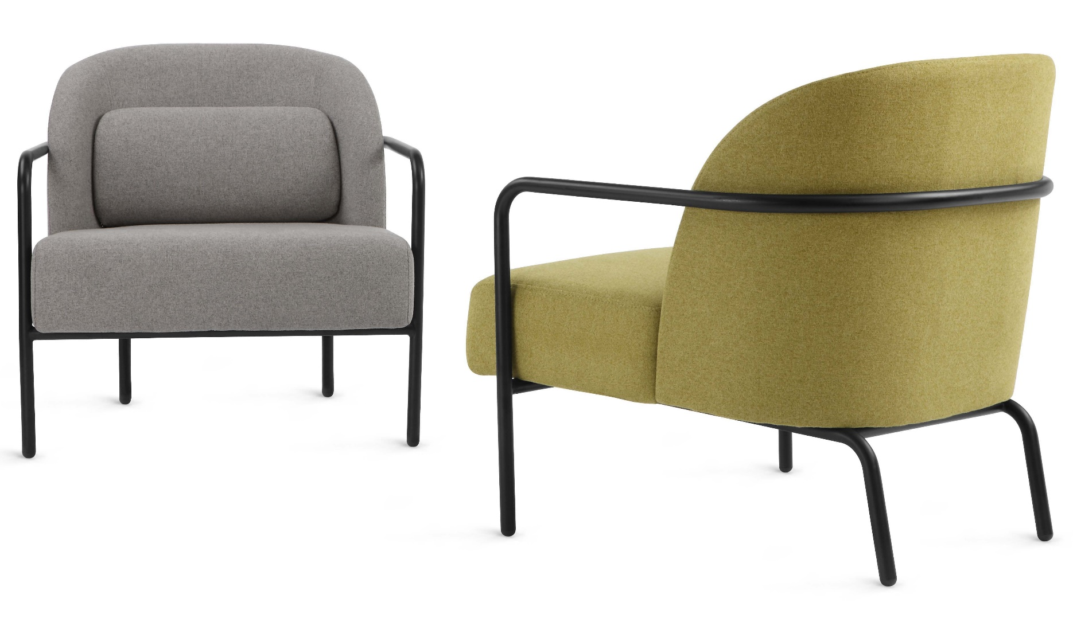
Textiles
m.a.d design I A Steelcase Partner
Surface Material
Circa Lounge in Smoked Grey & Light Green

Slide 7
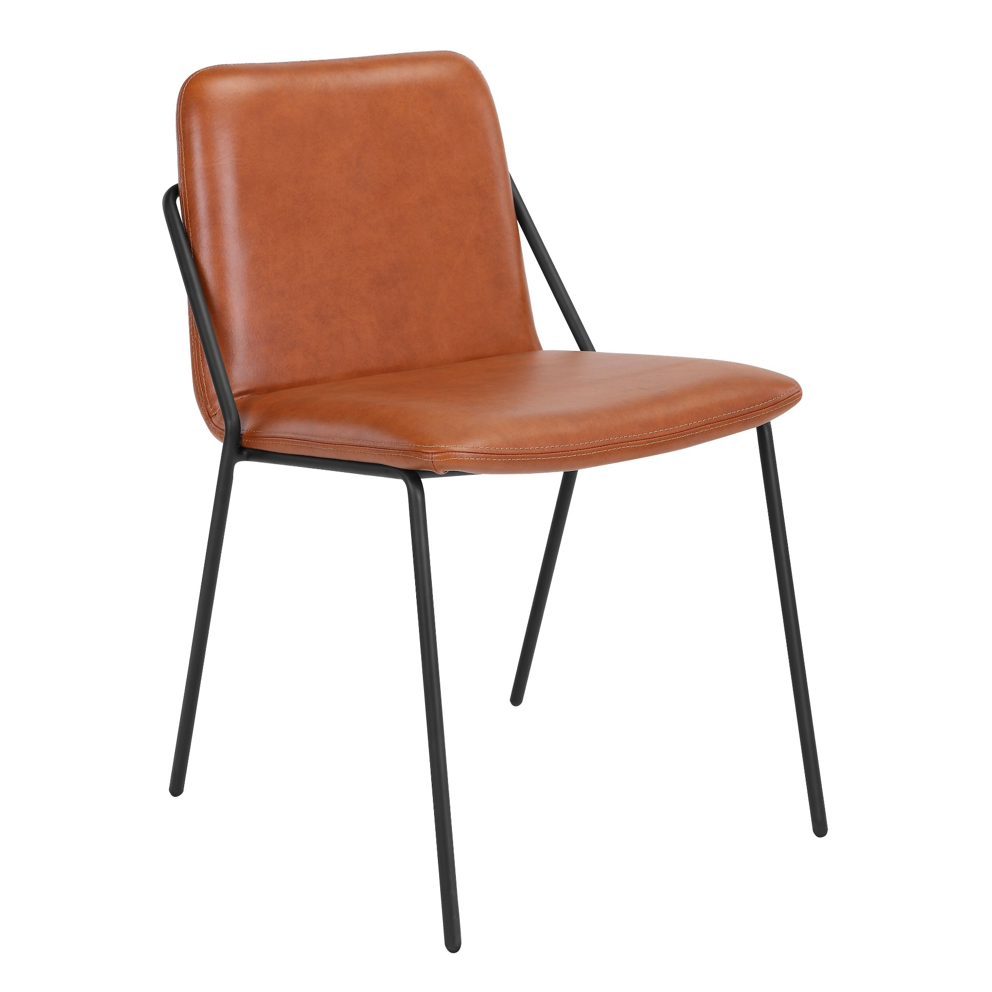
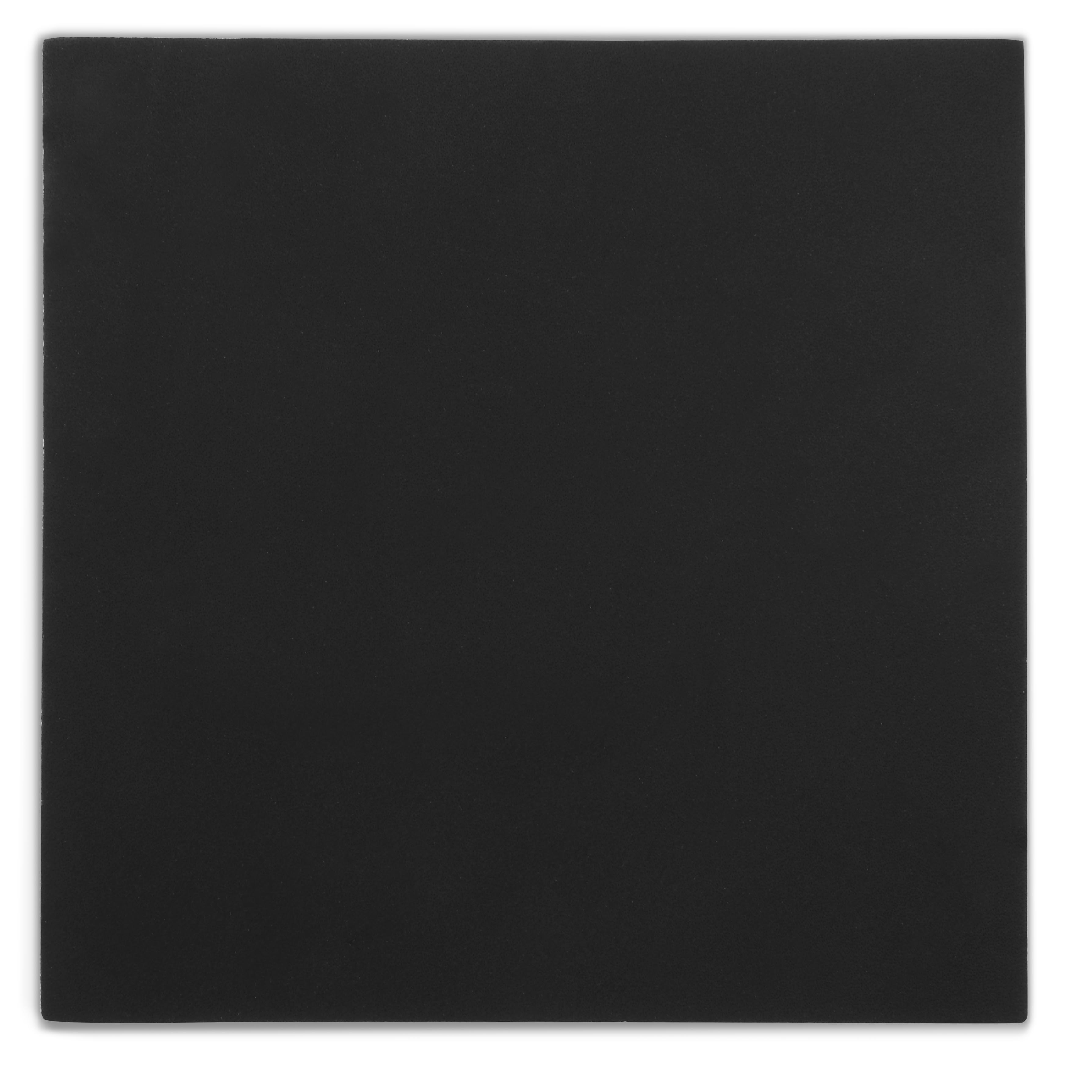
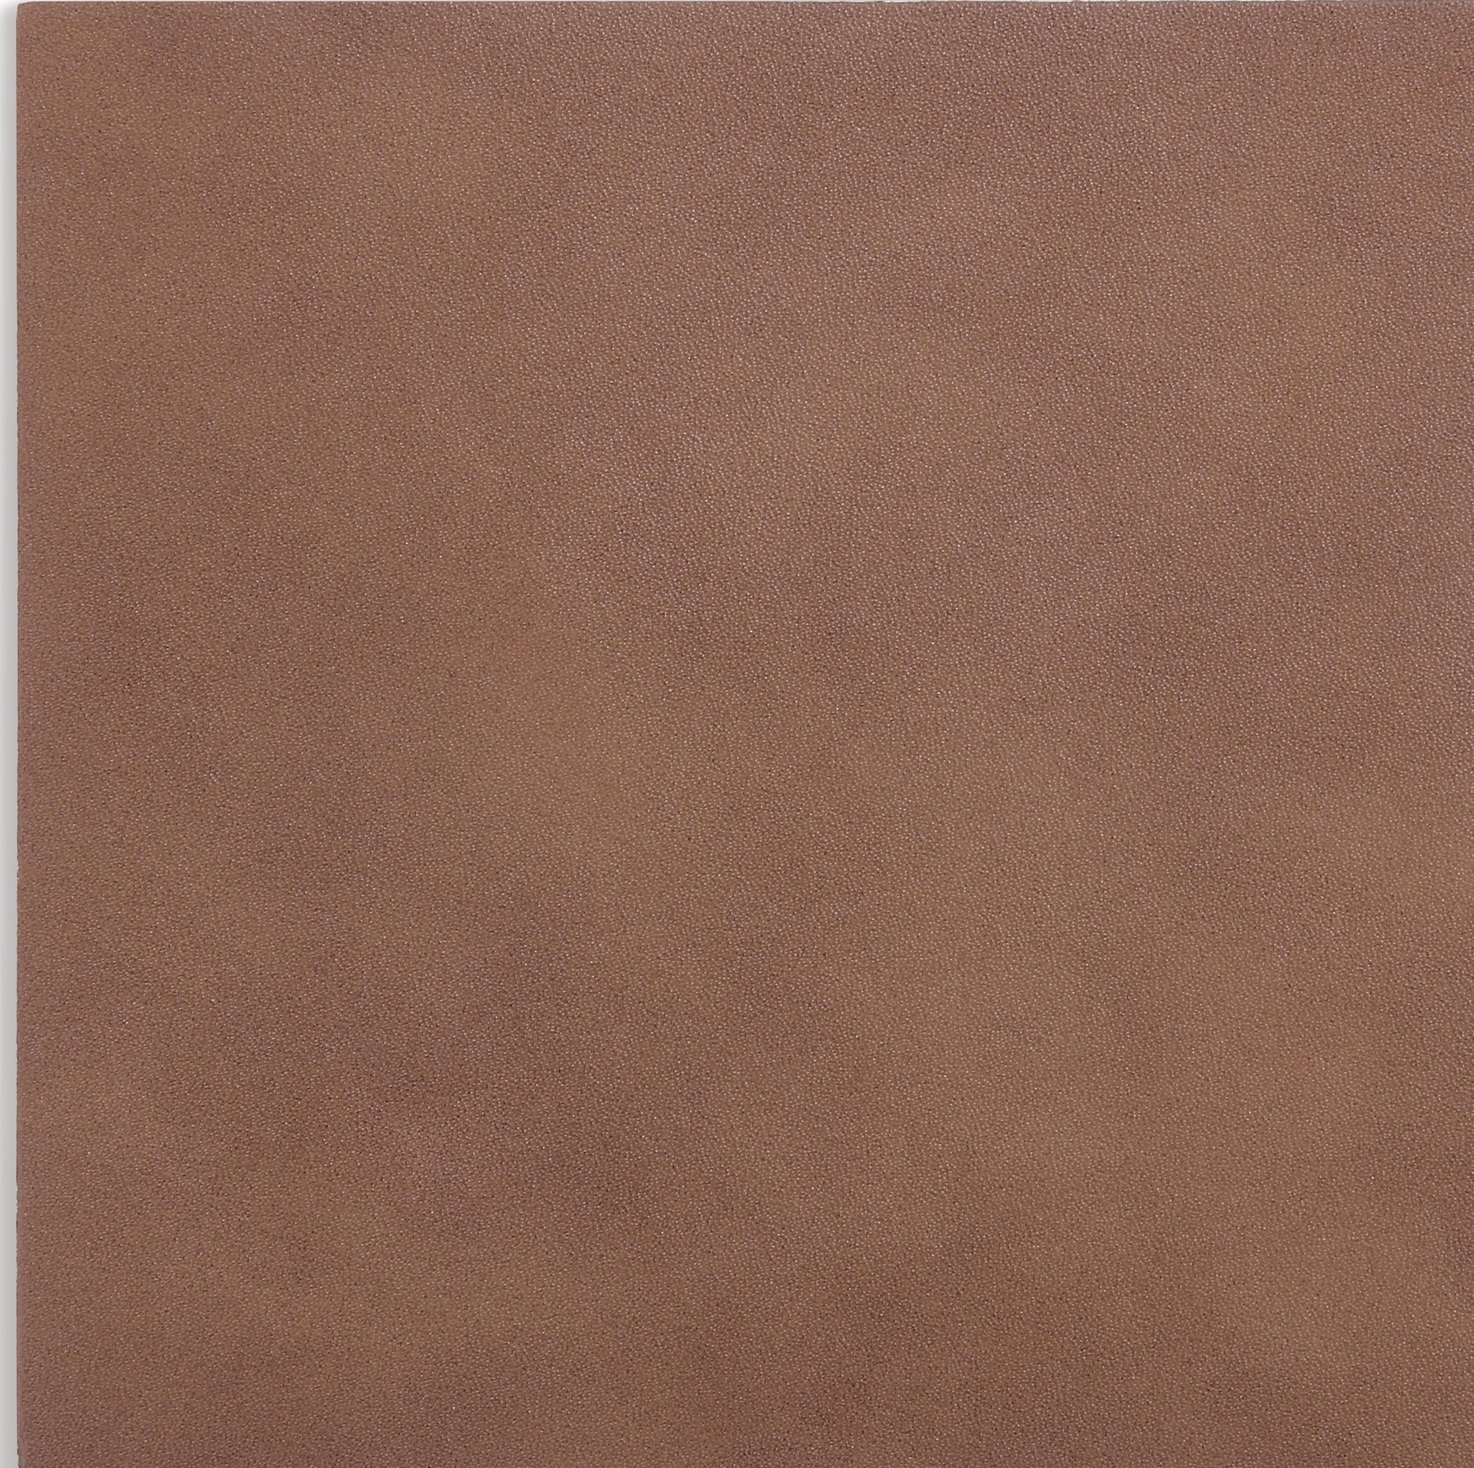
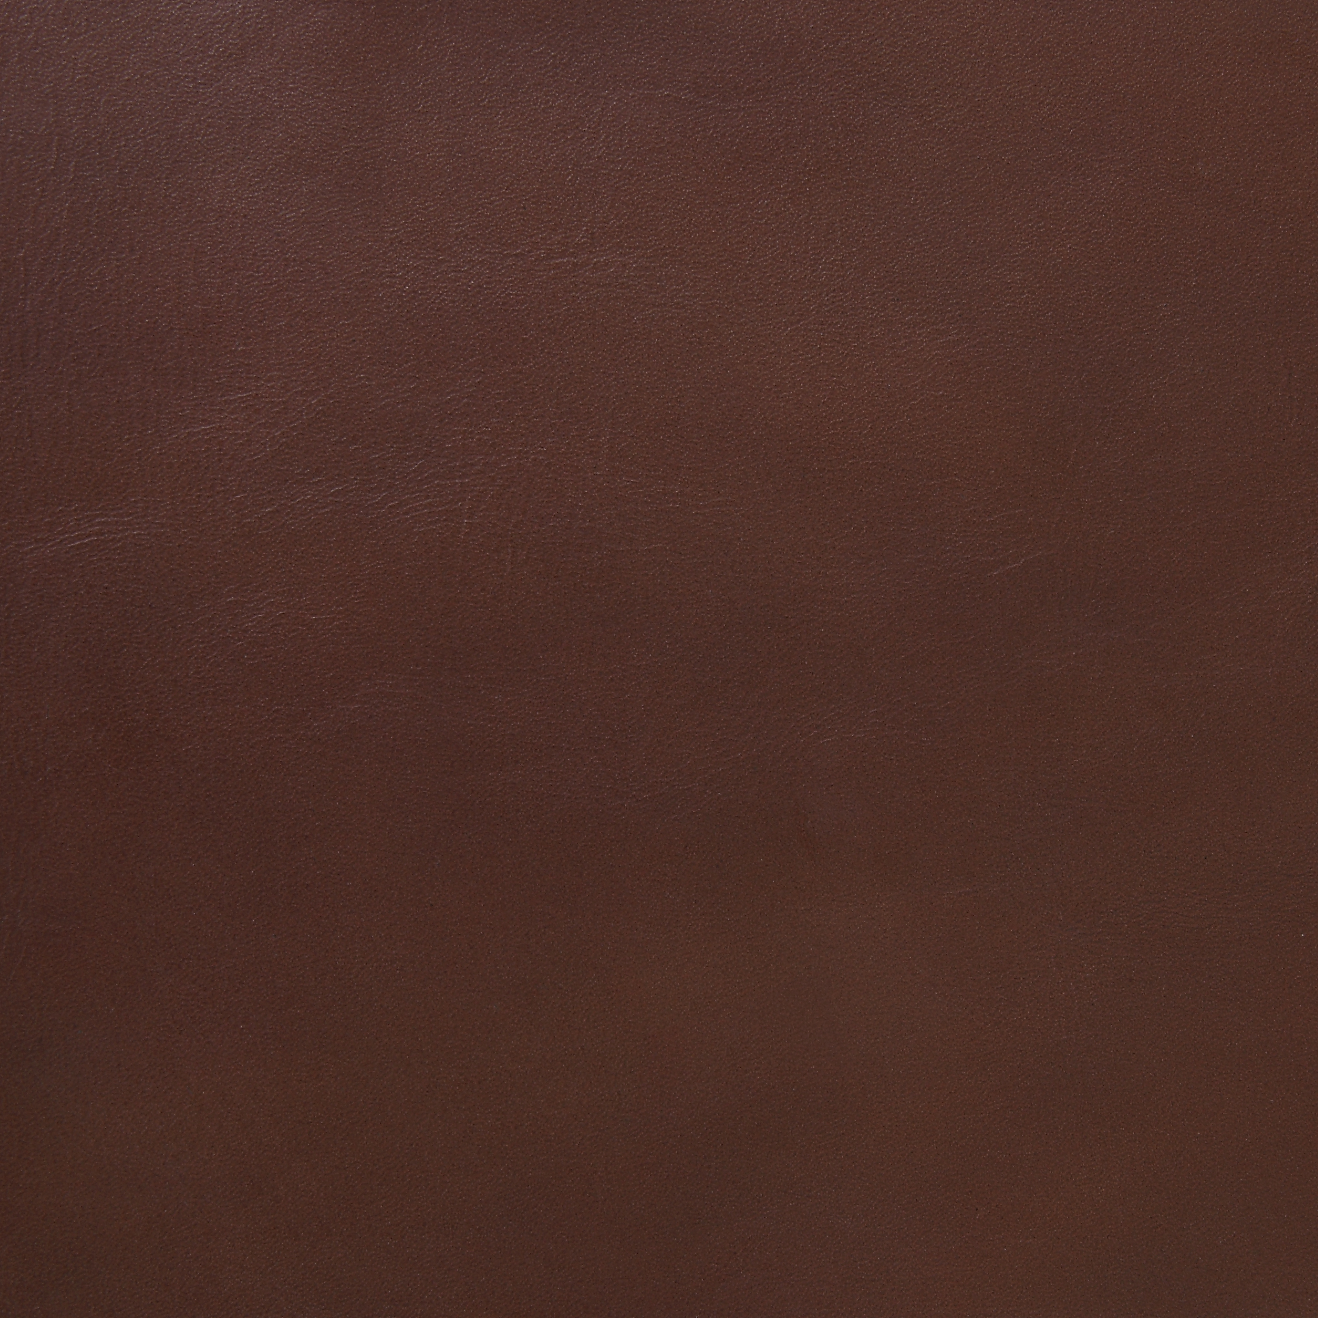
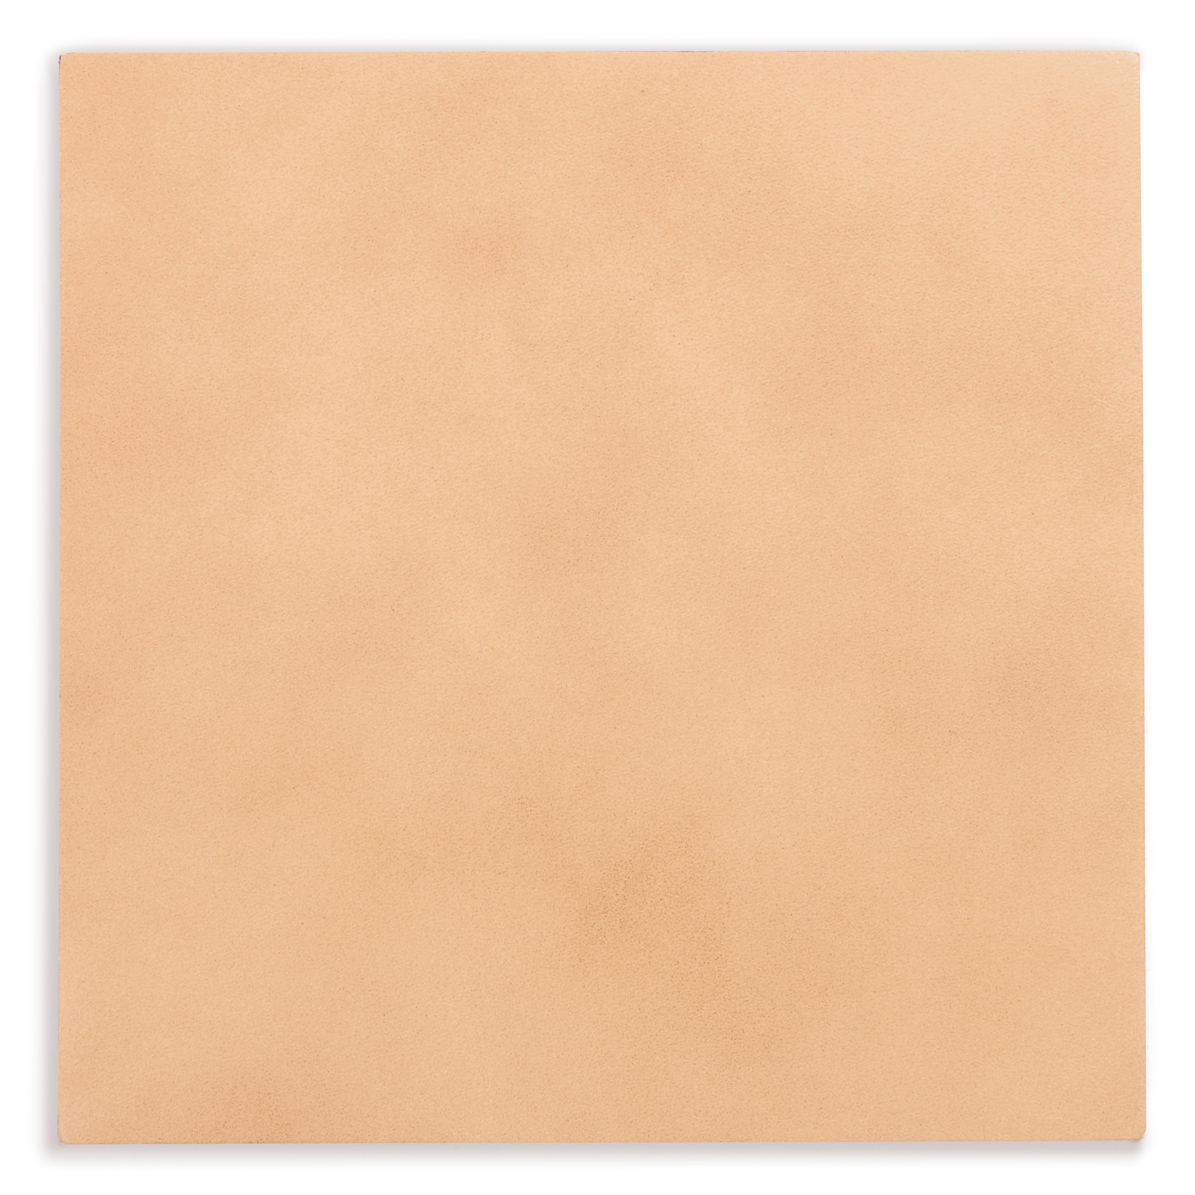
Leather
m.a.d design I A Steelcase Partner
Surface Material
Leather
Black
Chestnut
Cognac
Tan
PU Leather
Sling Chair in Cognac Leather and Black frame
Black
Cognac
** Refer to material matrix for all available finishes configurations

Slide 8
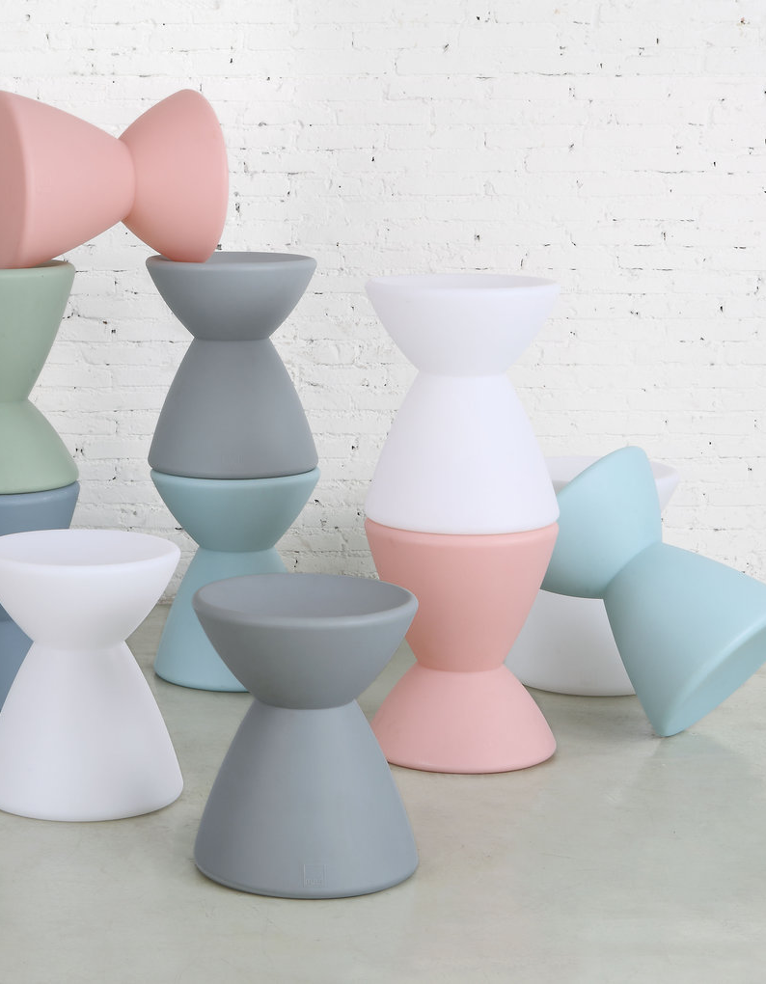




Plastics
m.a.d design I A Steelcase Partner
Surface Material
Molded Plastic (G53 Roto Stool)
Blush
White
Robin’s Egg Blue
Sage Green
Slate
** Refer to material matrix – Note: Grey not in standard offer
Roto Stool

Slide 9
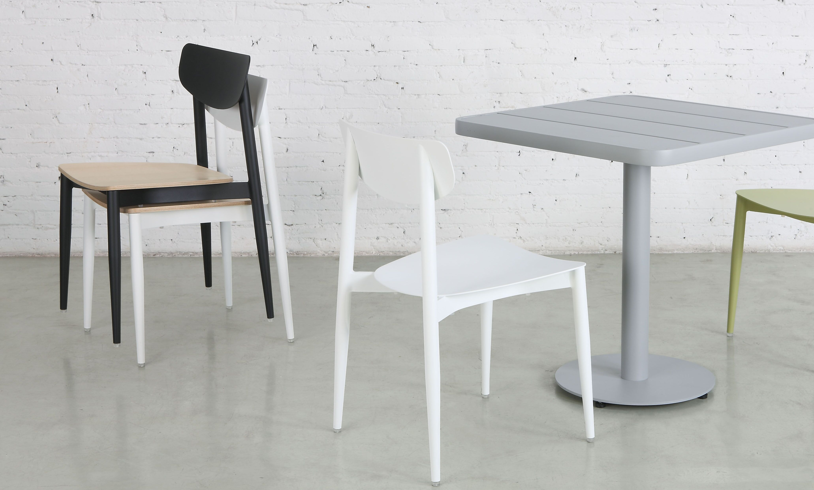
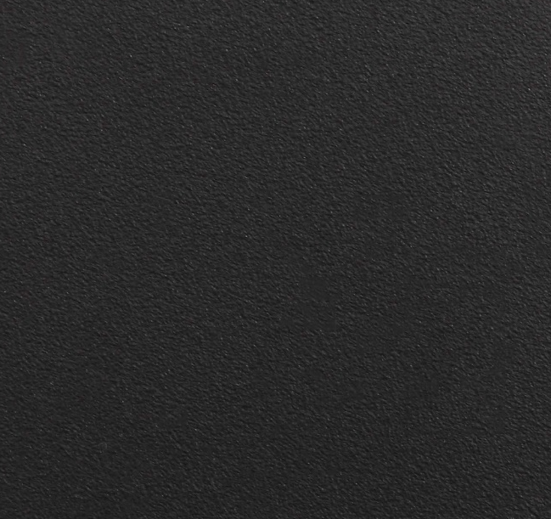
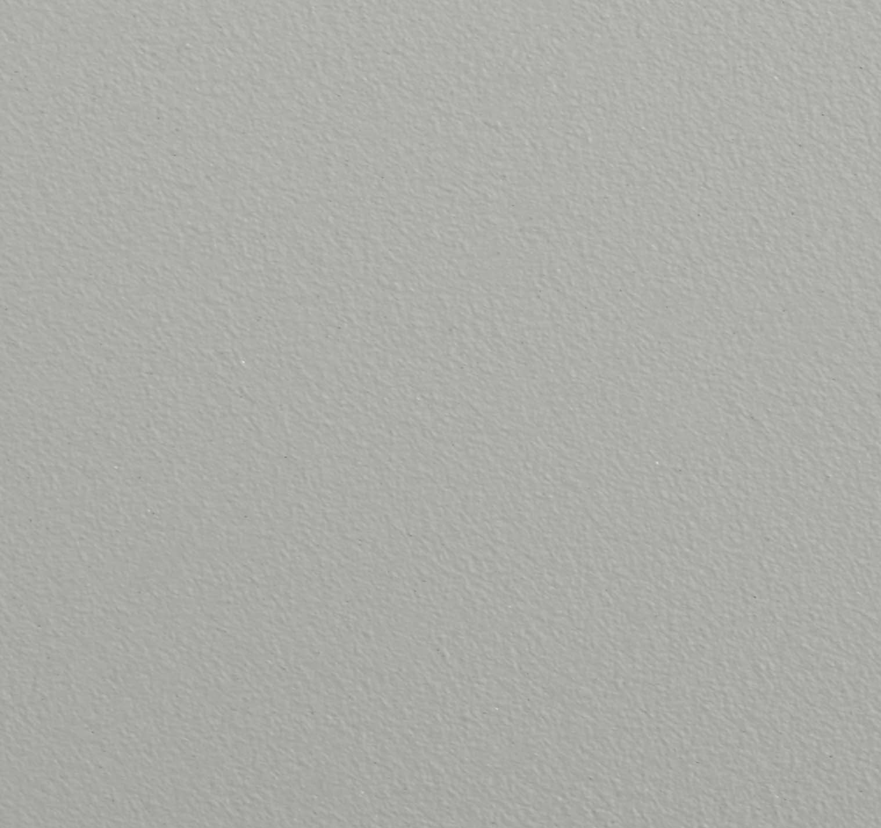
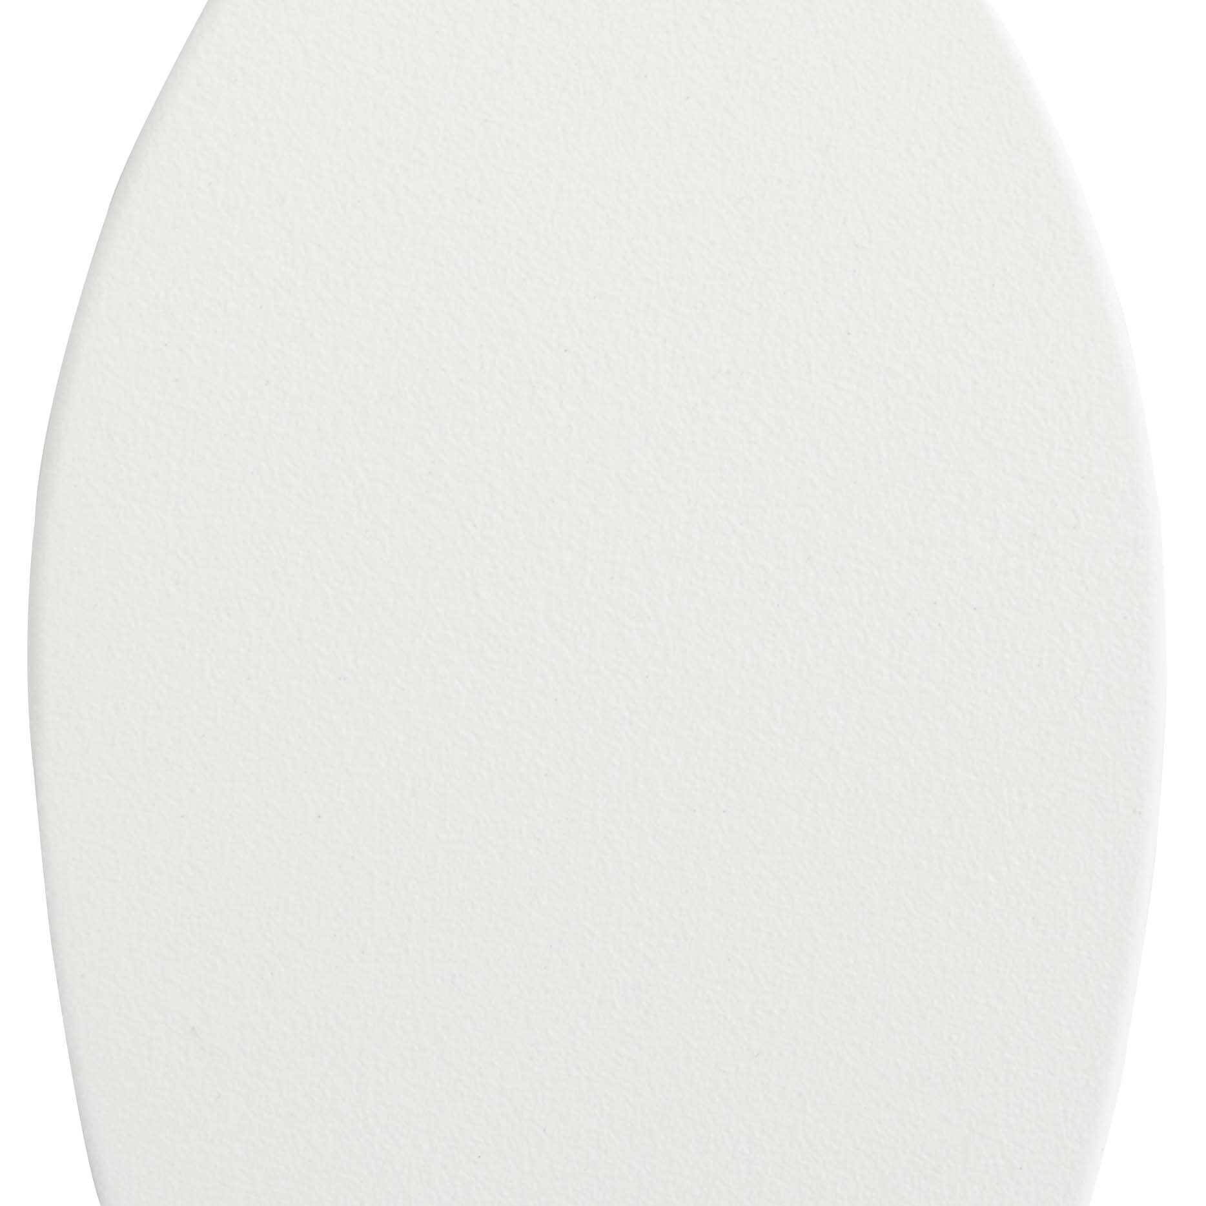
Aluminum
m.a.d design I A Steelcase Partner
Surface Material
Metal (G48 Ally Chair and Table)
Black
Grey
White
Ally Chair and Table
* Natural Ash seat options for Ally Chair with Black or White
*Table only in Black or Grey
** Refer to material matrix for all available finishes configurations

Slide 10
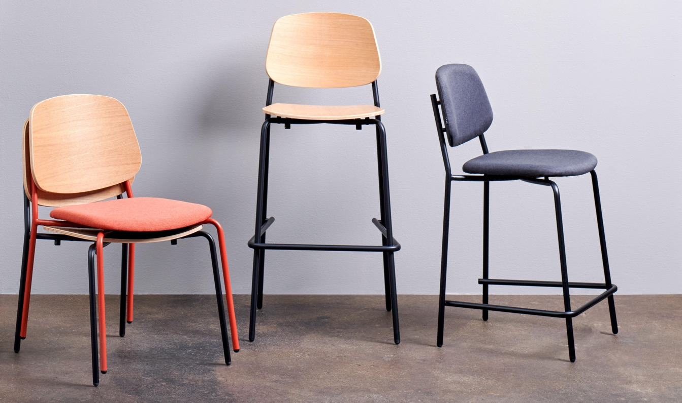

Steelcase x m.a.d. furniture design
PLATFORM

Slide 11
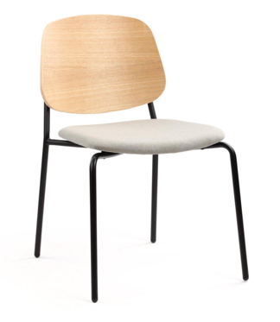
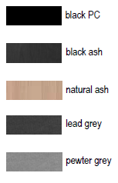
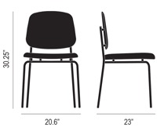
PLATFORM CHAIR
Steelcase x m.a.d. furniture design
Echoing the MAD primary style but this time playing on 3 different touch points using materiality. Platform continue to use exposed metal tubing as the main frame, a slightly curved Ash wood back and a softer seat upholstery, giving this family more visual interest and tactile cues.
Features
Light metal tube legs elevate the seat, creating a visually lighter aesthetic
Suitable for residential or commercial use
Versatile design to fit modern or traditional settings
Choice of matching wood and upholstered finish
Technical Specifications
BACKREST
LEGS
COLOR
Ash wood backrest
Light metal tube legs
Pewter grey and lead grey
Certifications
BIFMA, GB
Notes:
https://www.madfurnituredesign.com/mad-furniture-design/platform-dining-chair

Slide 12
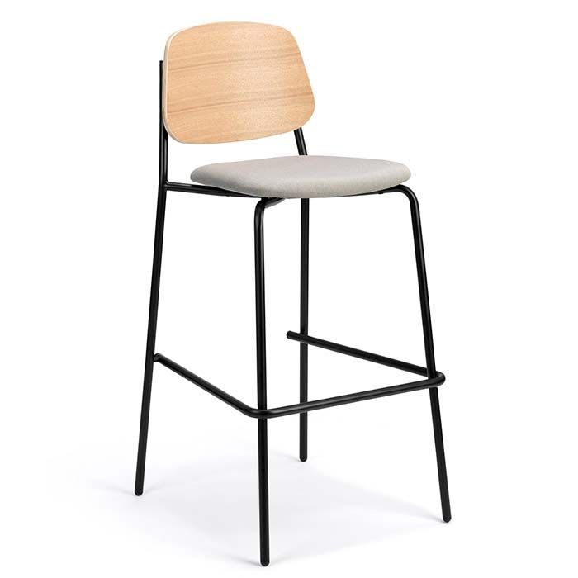
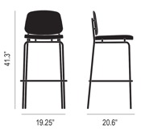
PLATFORM BARSTOOL
Steelcase x m.a.d. furniture design
Echoing the MAD primary style but this time playing on 3 different touch points using materiality. Platform continue to use exposed metal tubing as the main frame, a slightly curved Ash wood back and a softer seat upholstery, giving this family more visual interest and tactile cues.
Features
Suitable for residential or commercial use
Stackable, not recommended stacking more than 4 units
Technical Specifications
BACKREST
LEGS
Ash wood or upholstered seat and back
Light metal tube legs
Certifications
BIFMA, GB
Notes:
https://www.madfurnituredesign.com/mad-furniture-design/platform-bar-stool

Slide 13
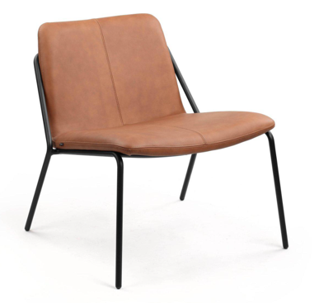
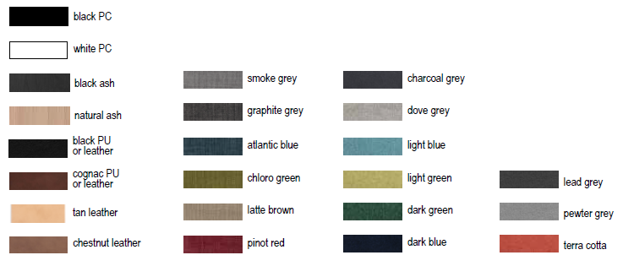
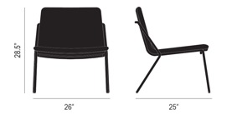
SLING LOUNGE
Steelcase x m.a.d. furniture design
Our best-selling collection, the Sling ticks all the boxes, modern, comfortable and functional. Their feature is the continuous metal tube frame that wraps around the body of the chair & table. This creates a transparent and honest feel of the product to the users.
Features
Sturdy, minimalist metal frame that can withstand high traffic environments
Light silhouette that can support range of settings.
Stacks 2 high efficiently with stacking bumpers to protect the seat surface
Certifications
BIFMA, GB
Notes:
https://www.madfurnituredesign.com/mad-furniture-design/sling-lounge-chair

Slide 14
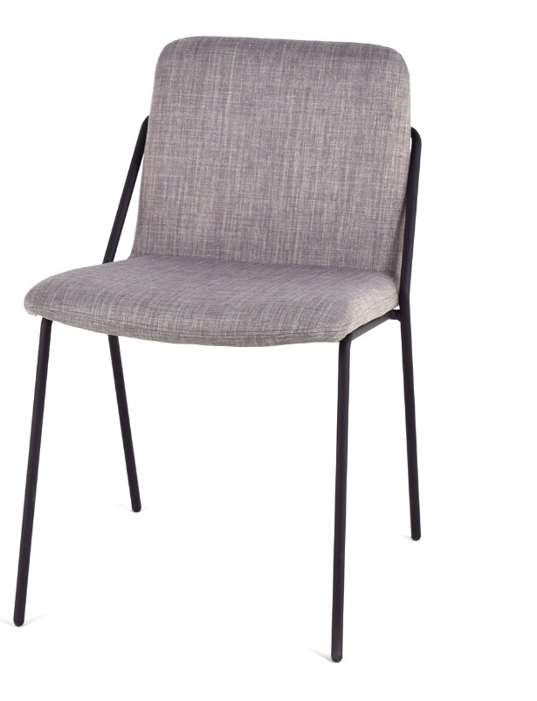
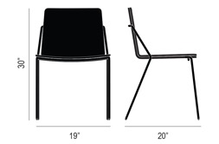
SLING CHAIR
Steelcase x m.a.d. furniture design
Our best-selling collection, the Sling ticks all the boxes, modern, comfortable and functional. Their feature is the continuous metal tube frame that wraps around the body of the chair & table. This creates a transparent and honest feel of the product to the users.
Features
Sturdy, minimalist metal frame that can withstand high traffic environments
Light silhouette that can support range of settings.
Stacks 2 high efficiently with stacking bumpers to protect the seat surface
Certifications
BIFMA, GB
Notes:
https://www.madfurnituredesign.com/mad-furniture-design/sling-dining-chair

Slide 15
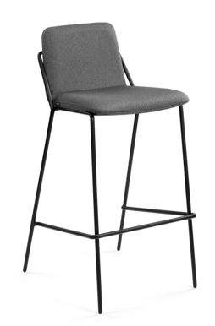
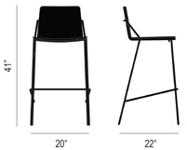
SLING BARSTOOL
Steelcase x m.a.d. furniture design
Our best-selling collection, the Sling ticks all the boxes, modern, comfortable and functional. Their feature is the continuous metal tube frame that wraps around the body of the chair & table. This creates a transparent and honest feel of the product to the users.
Features
Sturdy, minimalist metal frame that can withstand high traffic environments
Light silhouette that can support range of settings.
Stacks 2 high efficiently with stacking bumpers to protect the seat surface
Certifications
BIFMA, GB
Notes:
https://www.madfurnituredesign.com/mad-furniture-design/sling-bar-stool

Slide 16
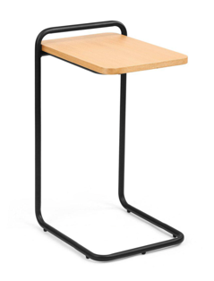
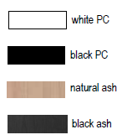
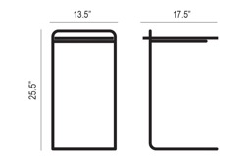
SLING SIDE TABLE
Steelcase x m.a.d. furniture design
Designed to work as a laptop stand or a side table, the Sling C table features a continuous steel tube frame that acts as an integral handle. A veneered, cantilevered tabletop completes this multifunctional table.
Features
Contract grade quality
Simple tubular steel frame
Suited for Commercial or Residential use
Technical Specifications
LEGS
TOP
Steel tube legs
Ash Veneer top
Certifications
BIFMA, GB
Notes:
https://www.madfurnituredesign.com/mad-furniture-design/sling-side-table

Slide 17
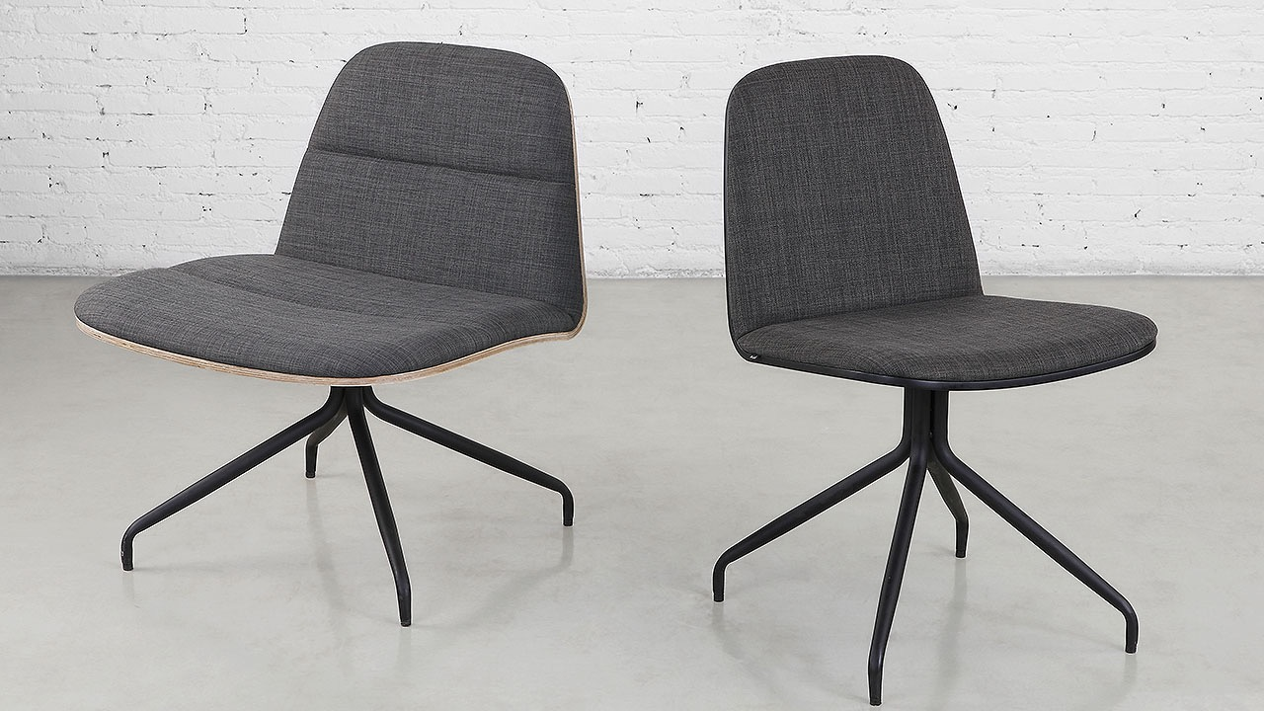
Steelcase x m.a.d. furniture design
BLOOM

Slide 18
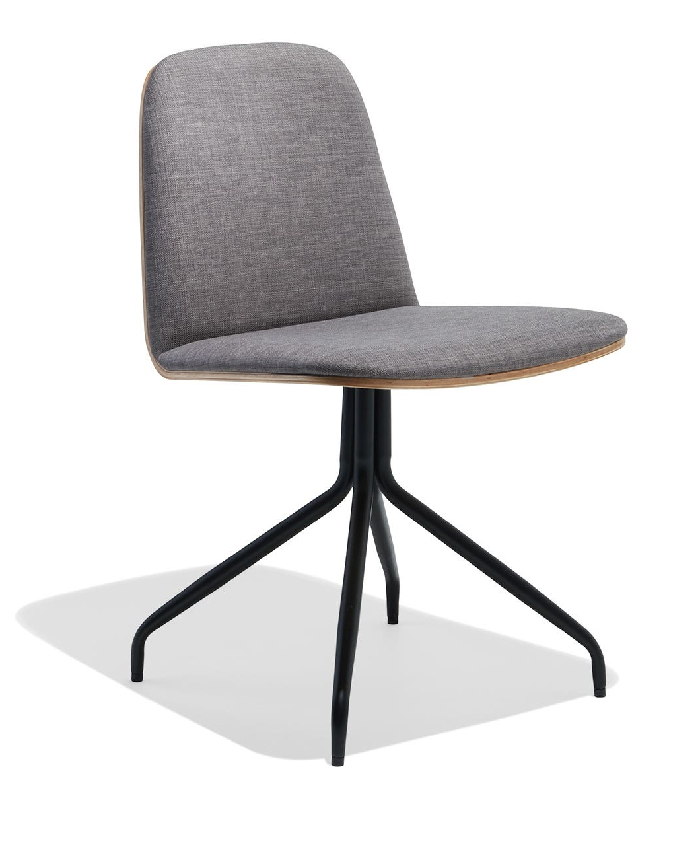
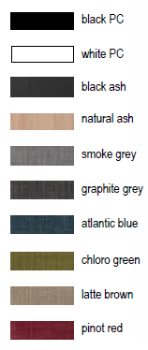
BLOOM CHAIR
Steelcase x m.a.d. furniture design
Their feature is the continuous metal tube frame that wraps around the body of the chair & table. To create a transparent and honest feel of the product to the users.
Features
Stacks efficiently with stacking bumpers to protect the seat surface
Family of lounge, chair and ottoman to match more work settings
Technical Specifications
SEAT
LEGS
Upholstered
Steel tube legs
Certifications
BIFMA, GB
Notes:
Could not be found on website and no white sweep

Slide 19
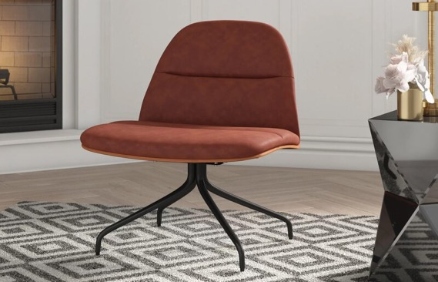
BLOOM LOUNGE
Steelcase x m.a.d. furniture design
Their feature is the continuous metal tube frame that wraps around the body of the chair & table. To create a transparent and honest feel of the product to the users.
Features
Complements new interiors -Upholstered seat and back with exposed, molded plywood shell
Common Typology - Family of lounge, chair and ottoman to match more work settings
Technical Specifications
SEAT
LEGS
Upholstered Metal swivel steel leg base
Certifications
BIFMA, GB
Notes:
Could not be found on website and no white sweep

Slide 20
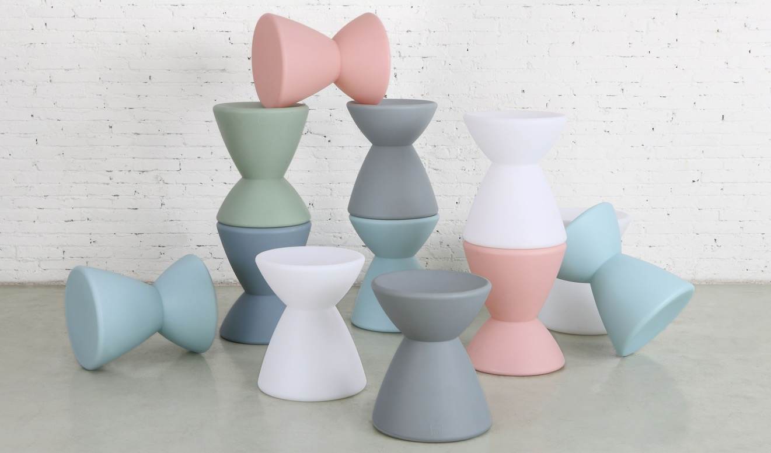
Steelcase x m.a.d. furniture design
ROTO

Slide 21



ROTO STOOL
Steelcase x m.a.d. furniture design
Very playful pieces, playing on the concept of rotation. Users can use Roto as a casual seat or flip it over as a simple side table.
Features
Playful - These loose pieces can be used as side tables or casual seats. It comes with 5 different colours.
Materiality - Made with moulded plastic, Roto’s surface is very easy to maintain and clean.
Technical Specifications
MATERIAL
COLOR
moulded plastic
Blush, Grey, Sage Green, White, Blue
Certifications
BIFMA, GB
Notes:
https://www.madfurnituredesign.com/mad furniture-design/roto-stool-side-table

Slide 22

Steelcase x m.a.d. furniture design
URBAN

Slide 23



URBAN SHELVES
Steelcase x m.a.d. furniture design
As we bring in more natural elements into our ’urban’ workplace, MAD has introduced a shelving unit that can not only house planters to create greener environments, but it also acts as storage and partitions.
Features
Removable bins with optional liners for planters
Steel clip hardware included to connect multiple units
Technical Specifications
MATERIAL
Metal frames
Certifications
BIFMA, GB
Notes:
https://www.madfurnituredesign.com/mad-furniture-design/urban-shelves

Slide 24





TRANSIT CHAIR AND BARSTOOL
Steelcase x m.a.d. furniture design
The Transit collection has been in the m.a.d. collection from day one. It features a continuous, solid steel wire leg frame that supports moulded plywood seat and back panels. Minimal design with maximum impact, the Transit is a modern classic in the making.
Features
No assembly required
Stackable (recommended to stack no more than 4 chairs)
Choice of molded plywood or upholstered seat
Technical Specifications
MATERIAL
Molded plywood
Upholstered seat & back Metal tube frame
Certifications
BIFMA, GB
Chair
Barstool
Notes:
Combine the chair and barstool together
https://www.madfurnituredesign.com/mad-furniture-design/transit-bar-stool

Slide 25



TRANSIT CAFÉ TABLE
Steelcase x m.a.d. furniture design
A modern take on the classic café table, the Transit table features 4 formed steel tube legs that effortlessly support a veneered plywood top. The classic proportions of this table will complement just about any chair in the m.a.d. collection.
Features
Modern interpretation of the classic cafe table
Simple tubular legs draws the attention up to the centre table top
Technical Specifications
TOP
LEGS
Ash Veneer
Steel tube legs
Certifications
BIFMA
Notes:
https://www.madfurnituredesign.com/mad-furniture-design/transit-caf%C3%A9-table

Slide 26

Steelcase x m.a.d. furniture design
DELTA
Notes:
CAFÉ TABLE AND SIDE TABLE are not found on website
Only dining table and counter stool on the website

Slide 27



DELTA BARSTOOL
Steelcase x m.a.d. furniture design
The Delta stool collection features 3 triangulated steel wire frames with integral footrests that support either a veneered seat or a fabric or leather upholstered seat. Visually minimal, but built to contract standards, these stools are great options for both dining and working environments.
Features
Versatile design to fit modern or traditional settings
Suitable for residential or commercial use
Industrial inspired base with footrest
Technical Specifications
SEAT
FRAME
Upholstered
Metal tube frame
Certifications
BIFMA
Notes:
https://www.madfurnituredesign.com/mad-furniture-design/delta-bar-stool

Slide 28



DELTA BAR TABLE
Steelcase x m.a.d. furniture design
Utilizing the same triangulated steel wire frame design as the barstools, the pedestal style base of the Delta tables features a minimal footprint, allowing flexible seating options. Available with a choice of veneered plywood tabletops.
Features
Versatile design to fit modern or traditional settings
Suitable for residential or commercial use
Industrial inspired metal tube base
Technical Specifications
TABLETOP
FRAME
Ash Veneer
Steel
Certifications
BIFMA
Notes:
https://www.madfurnituredesign.com/mad-furniture-design/delta-bar-table

Slide 29

Steelcase x m.a.d. furniture design
PETAL
Notes:
CAFÉ TABLE AND SIDE TABLE are not found on website
Only dining table and counter stool on the website

Slide 30



PETAL CHAIR
Steelcase x m.a.d. furniture design
The focus on Petal Chair is around the robust backrest. The soft curvature of the back gives a feminine silhouette. The solid steel wire sled frame supports the molded foam seat and back and bolster cushion.
Features
Suitable for residential and commercial use.
Supportive, moulded foam seat and back cushion.
Metal sled base in black, green or grey.
Technical Specifications
SEAT AND BACK
LEGS
moulded foam seat and back cushions.
Power coated steel sled legs
Certifications
BIFMA, GB
Notes:
https://www.madfurnituredesign.com/mad-furniture-design/petal-dining-chair-sled-base

Slide 31

Steelcase x m.a.d. furniture design
WING

Slide 32



WING CHAIR
Steelcase x m.a.d. furniture design
A well-designed chair that incorporates a level of privacy and acoustic elements, MAD was inspired by the symmetrical and angular features of wings. The concept was abstracted, and new fabrics were selected to have a more wool-like touch.
Features
The high back and projected ‘wings’ give users a level of privacy and acoustic barrier
Added lumbar support on the back and seat gives better comfort to users.
Technical Specifications
FRAME
Tubular steel frame
Certifications
BIFMA, GB
Notes:
https://www.madfurnituredesign.com/mad-furniture-design/petal-dining-chair-sled-base

Slide 33

Steelcase x m.a.d. furniture design
AIRFOIL

Slide 34


AIRFOIL TABLE
Steelcase x m.a.d. furniture design
Inspired by the aviation term ‘Airfoil’, the cross sectional of the airplane wing. The steel tube legs takes the elongated form with its refined silhouette. The ranges cover dining, occasional and cafe tables.
Features
Large tables are connected using mounting plates with continuous, robot welded seam.
Low profile tabletop support frame to prevent warping of tabletop
Technical Specifications
TOP
LEGS
Laminated MDF Steel tube legs
Paint I Base
White
Black
Certifications
Black Ash
Natural Ash
BIFMA, GB
Wood
Notes:
https://www.madfurnituredesign.com/mad-furniture-design/airfoil-dining-table

Slide 35

Steelcase x m.a.d. furniture design
LOLLI By 365° North
Notes:
CAFÉ TABLE AND SIDE TABLE are not found on website
Only dining table and counter stool on the website

Slide 36






LOLLI
Steelcase x m.a.d. furniture design
An update to our popular Lolli seating, this new collection features a plush, upholstered moulded foam seat, with a double stitched seam detail. Its classic, modern silhouette is complemented by a solid steel wire sled base with a durable powder coat finish.
Features
Complements new interiors
Classic, minimal modern seat silhouette, upholstered or with wood veneer
Unique details
Seamless wrap around edge
For all spaces
Different typologies with non-marking plastic feet
Chair – Sled Base
Counter Stool
Bar Stool
Technical Specifications
SEAT AND BACK
BASE
upholstered
Solid steel wire sled
Certifications
Chair
Counter stool
Bar stool
BIFMA, GB
Notes:
Combine the all the LOLLI items
https://www.madfurnituredesign.com/mad-furniture-design/lolli-dining-chair

Slide 37

Steelcase x m.a.d. furniture design
ALLY
Notes:
ALLY TABLE not found on the website

Slide 38



ALLY CHAIR
Steelcase x m.a.d. furniture design
Ally’s versatile features can be used for indoor and outdoor settings. The chairs are made from aluminum. Its durability can withstand high traffic use in various weather conditions.
Features
Various finish options
The seating comes in seat, bar and counter height with 2 different colours. The seat pad can be also configured in wood finish.
2. Simple aesthetics
The chair and table designs are kept simple and is appropriate for numerous settings together or paired with other products.
Technical Specifications
MATERIAL
Power – coated aluminium
Wood Seat option
Certifications
BIFMA, GB
Notes:
https://www.madfurnituredesign.com/mad-furniture-design/ally-dining-chair

Slide 39


ALLY BAR STOOL
Steelcase x m.a.d. furniture design
Ally’s versatile features can be used for indoor and outdoor settings. The chairs are made from aluminum. Its durability can withstand high traffic use in various weather conditions.
Features
Various finish options
The seating comes in seat, bar and counter height with 2 different colours. The seat pad can be also configured in wood finish.
2. Simple aesthetics
The chair and table designs are kept simple and is appropriate for numerous settings together or paired with other products.
Technical Specifications
MATERIAL
Power – coated aluminium
Wood Seat option
Certifications
BIFMA, GB
Notes:
https://www.madfurnituredesign.com/mad-furniture-design/ally-bar-stool

Slide 40



ZAG LOUNGE CHAIR
Steelcase x m.a.d. furniture design
Zag family is a fun piece. It uses the frame as a continuous line that wraps around the seat using a ‘Z’ shape, that gives a friendly visual detail.
Features
The lounge seat is typically lower at 16” high
Perfect to pair with an occasional table
Sturdy sled leg frame that terminates into a small arm rest, that also functions as a handle
Technical Specifications
BACK AND SEAT
FRAME
Upholstered
Metal tube sled leg
Certifications
BIFMA, GB
Notes:
https://www.madfurnituredesign.com/mad-furniture-design/zag-lounge-chair

Slide 41

Steelcase x m.a.d. furniture design
CIRCA

Slide 42


CIRCA LOUNGE
Steelcase x m.a.d. furniture design
Enhancing the soft lounge seating category, MAD introduced the Circa Collection. Featuring a very organic silhouette with curved back rest which highlights the lumbar support. Repeating the exposed metal tube frame in this collection, it strengthens the whole MAD portfolio.
Features
The organic and continuous flow, lines the structure of the seat.
The lumbar support is emphasized along with a thicker seat for added comfort
Contract grade and suitable for residential and commercial settings
Technical Specifications
LEGS
SEATS
Light metal tube legs
Moulded form seats, bolster cushion attached
Certifications
BIFMA, GB
Notes:
https://www.madfurnituredesign.com/mad-furniture-design/circa-lounge-chair

Slide 43


CIRCA 2-SEATER SOFA
Steelcase x m.a.d. furniture design
Enhancing the soft lounge seating category, MAD introduced the Circa Collection. Featuring a very organic silhouette with curved back rest which highlights the lumbar support. Repeating the exposed metal tube frame in this collection, it strengthens the whole MAD portfolio.
Features
The organic and continuous flow, lines the structure of the seat.
The lumbar support is emphasized along with a thicker seat for added comfort
Contract grade and suitable for residential and commercial settings
Technical Specifications
LEGS
SEATS
Light metal tube legs
Moulded form seats, bolster cushion attached
Certifications
BIFMA, GB
Notes:
Same with the lounge
https://www.madfurnituredesign.com/mad-furniture-design/circa-double-lounge

Slide 44


Slide 45


Slide 46


Slide 47



Slide 48


