Slide 1
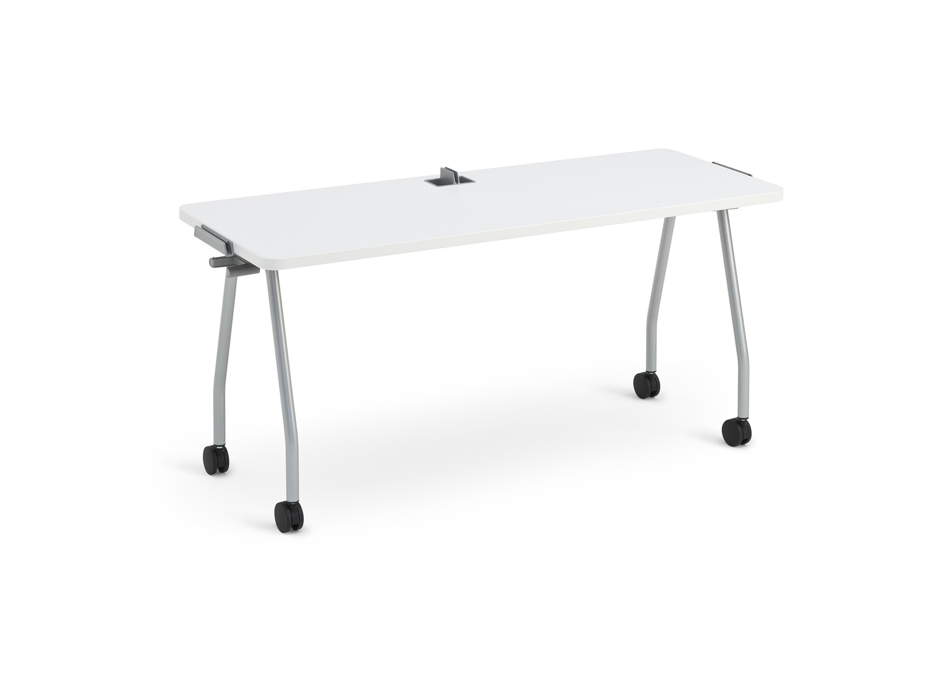
Verb
Dec 2021
Products & Material Color Theme Template

Slide 2
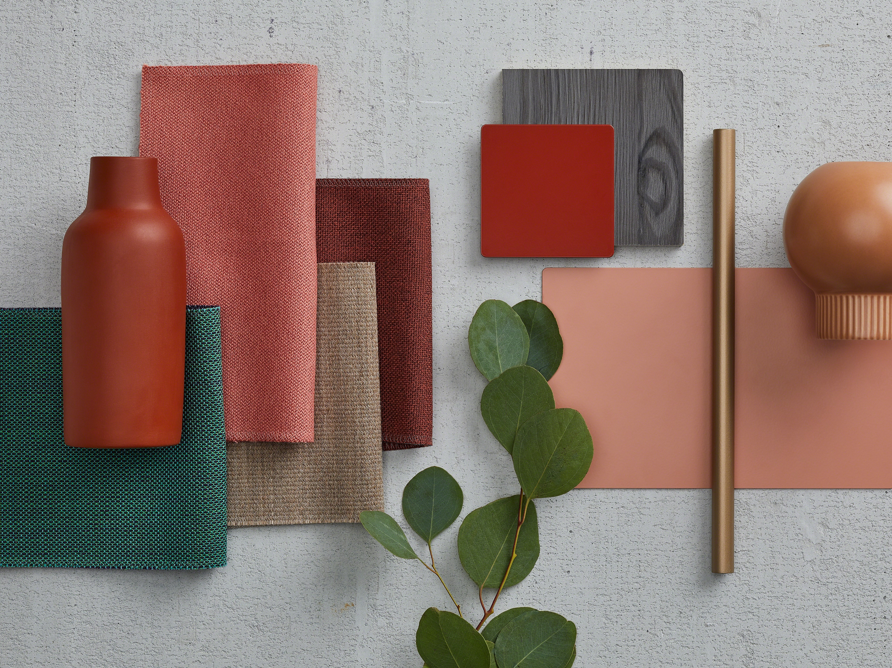
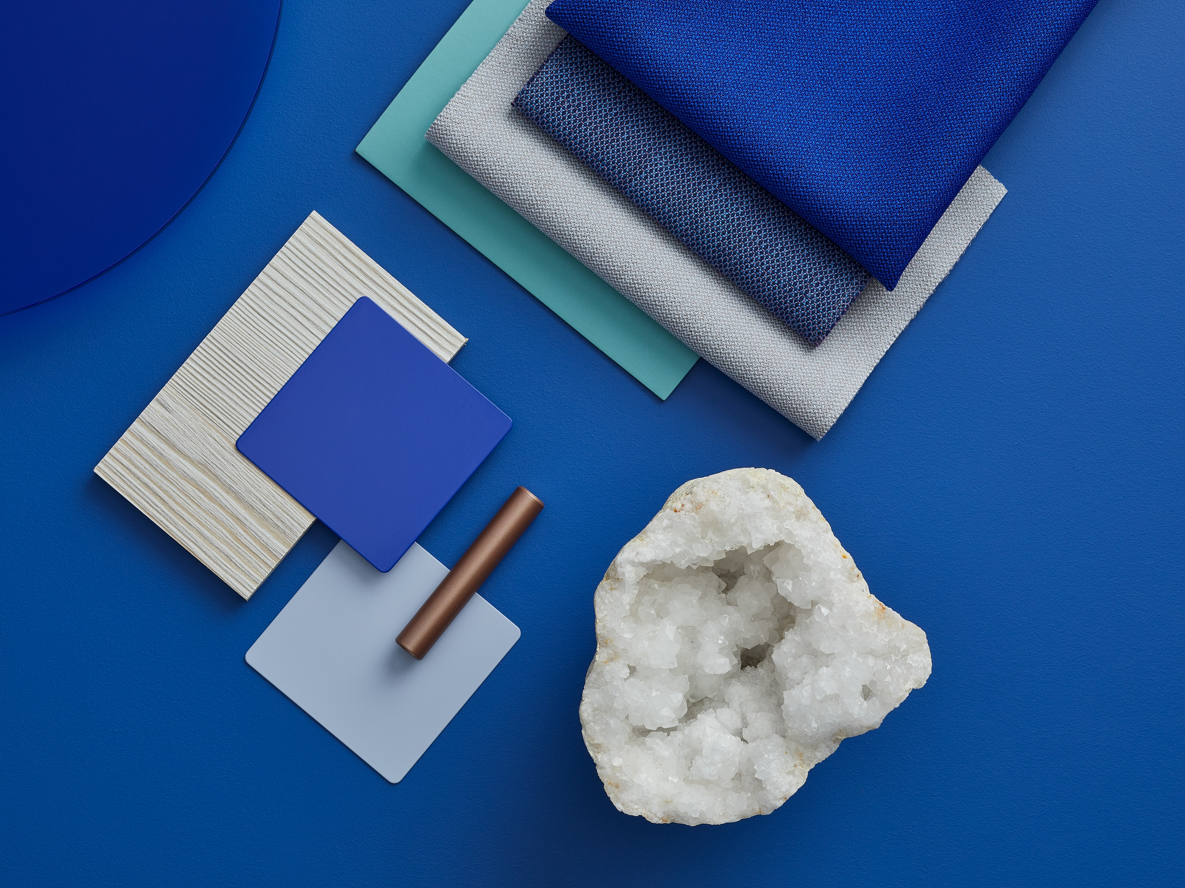
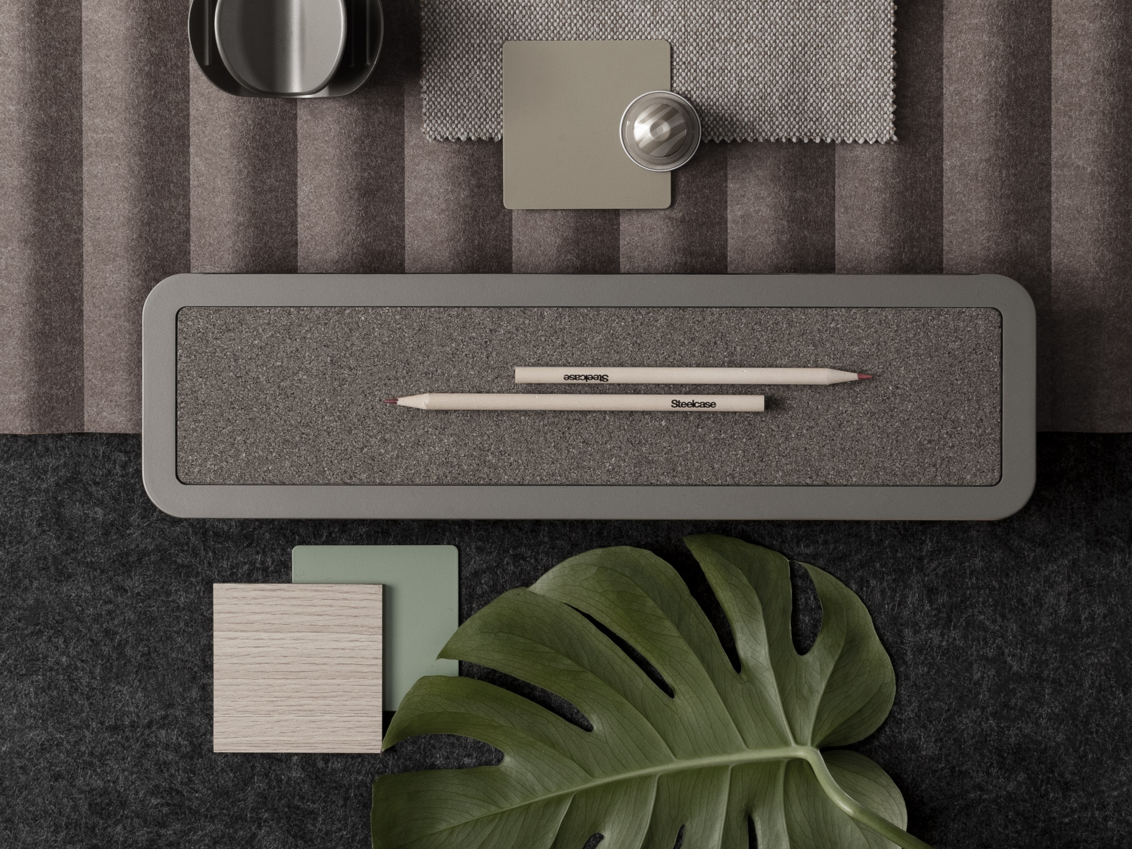
Theme Overview
Warm
Cool Tones
Neutral Tones
[Key in your title]
Generally thought of as bolder tones, red, orange, and yellow grab the attention of passersby. In essence, they captivate and intrigue individuals. It’s not uncommon for warm shades to make people feel alive and uplifted. These hues have a way of breathing life into everything they touch.
[Key in your title]
Cool Colors tend to have a calming effect. At one end of the spectrum, they are cold, impersonal, antiseptic colors. At the other end, cool colors are comforting and nurturing. Blue, green, and the neutrals white, gray, and silver are examples.
[Key in your title]
The neutral colors of black, white, silver, gray, and brown make good backgrounds, serve to unify diverse color palettes, and often stand alone as the only or primary focus of a design. Neutral colors help to put the focus on other colors or serve to tone down colors that might otherwise be overpowering on their own.

Slide 3
Verb
Product & Swatches
Worktop
LPL Color Accents
Worktop
LPL Color Accents
Leg
Paint Color Accents
Leg
Paint Color Accents
Chevron Student Table
Team Student Table
Arm
Paint Color Accents
Worktop
LPL Color Accents
Worktop
LPL Color Accents
Caddy
Paint Color Accents
Leg
Paint Color Accents
Leg
Paint Color Accents
Rectangular Student Table
Instructor Station

Slide 4
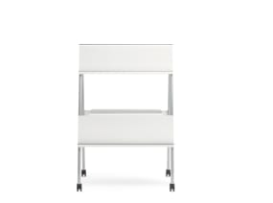
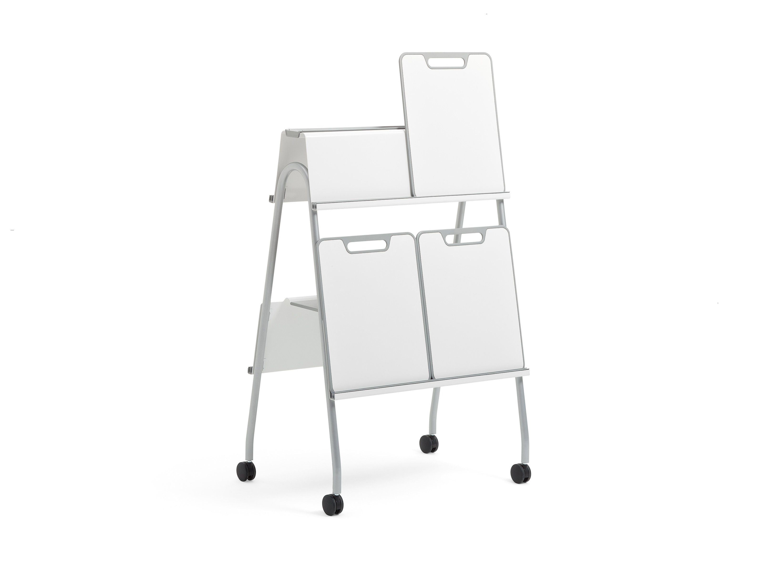
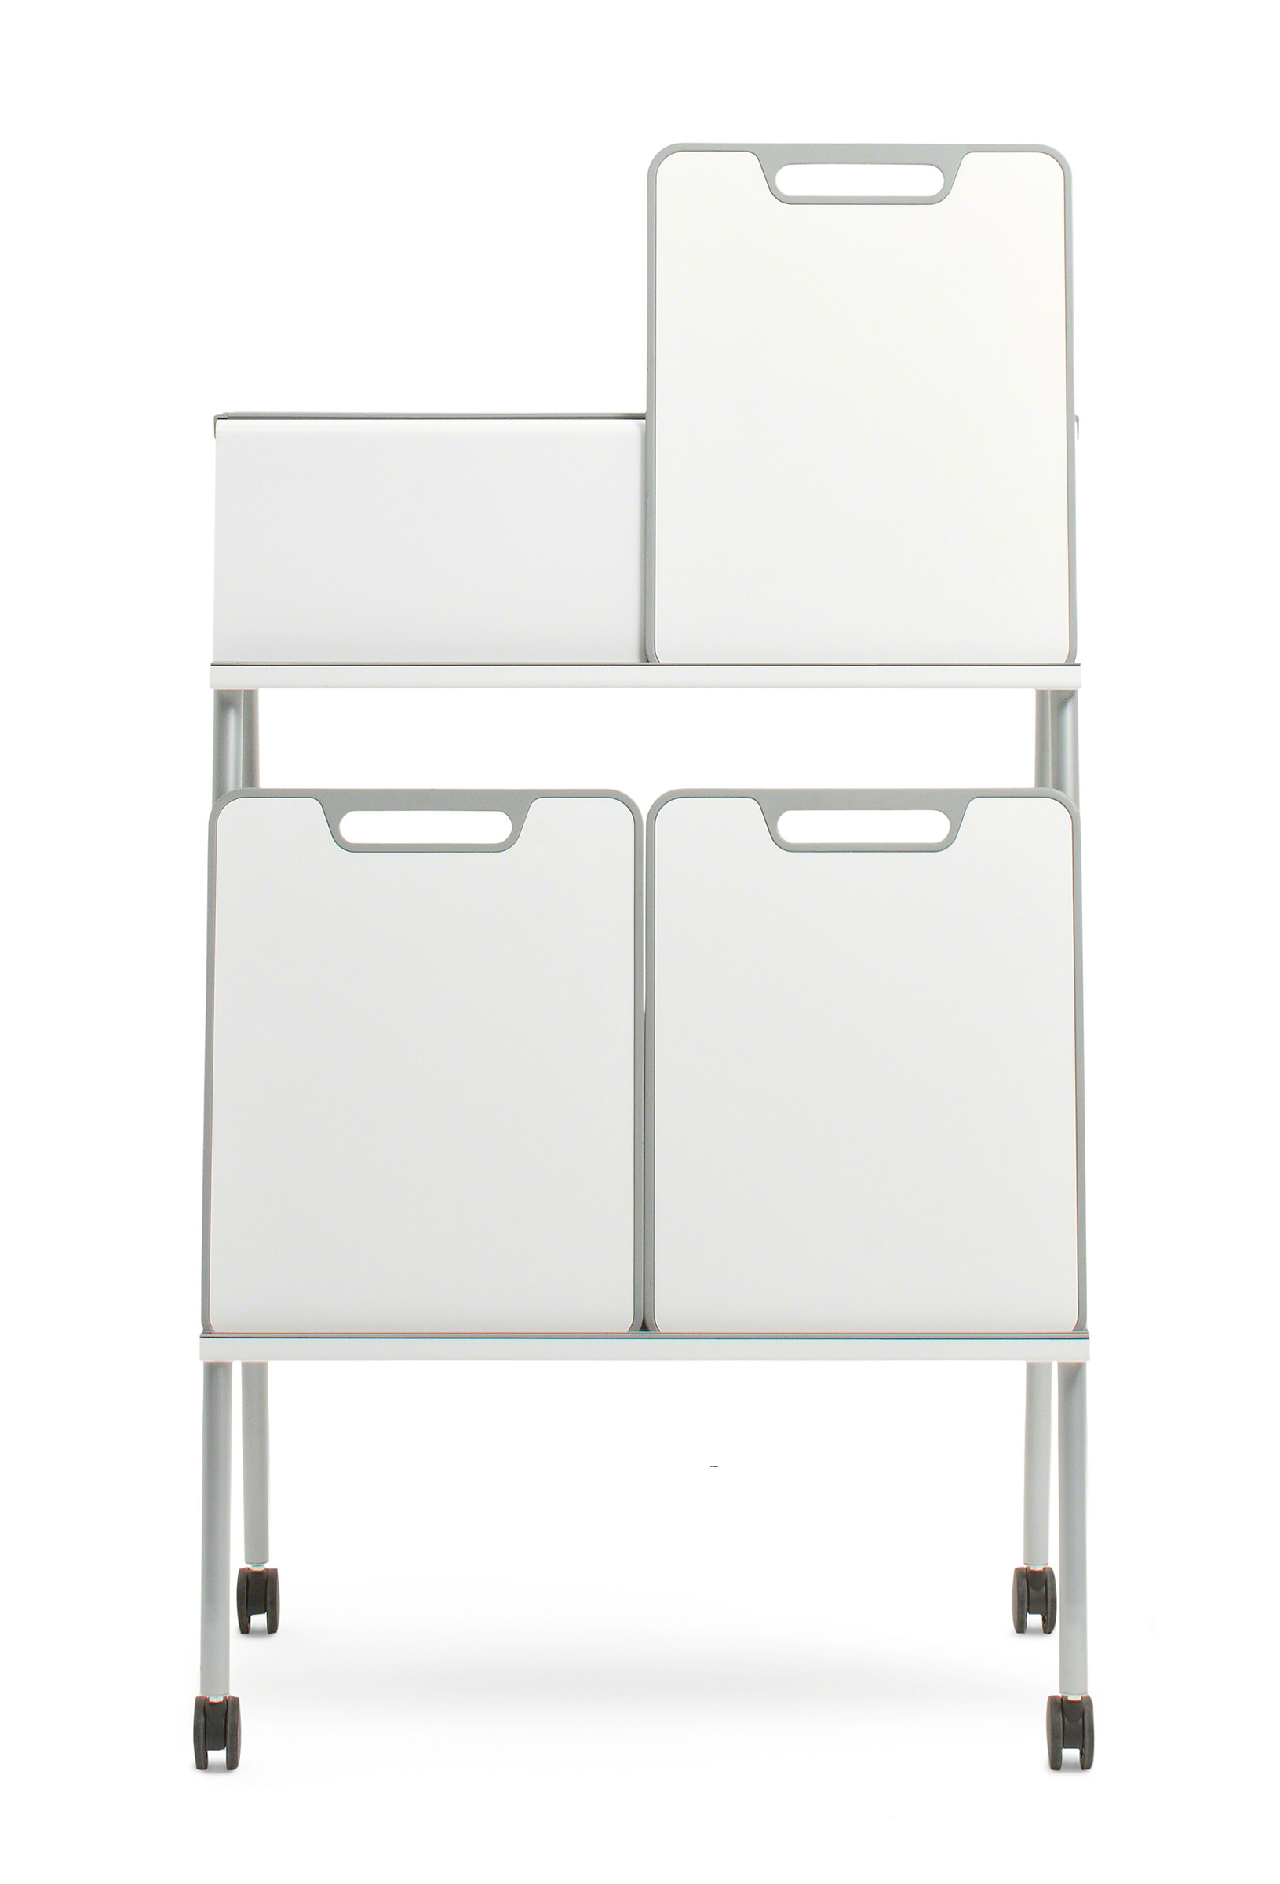
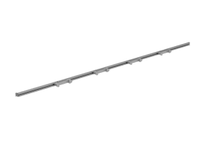
Verb
Product & Swatches
Frame
Paint Color Accents
Frame
Paint Color Accents
Easel
Whiteboard
Frame
Paint Color Accents
Wall Track

Slide 5
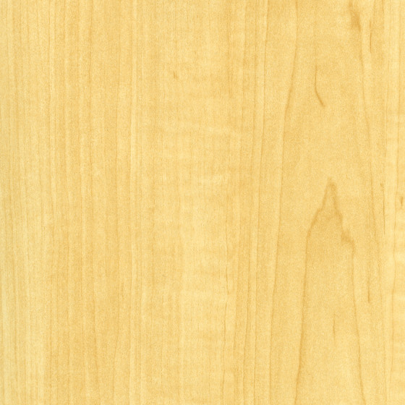
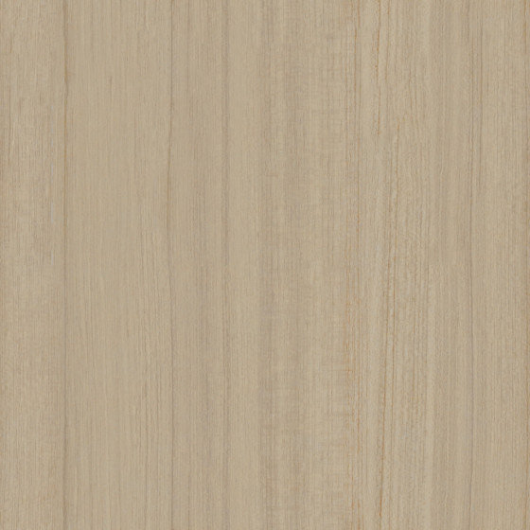
Verb
Chevron Student Table
Worktop
Structure
Laminate Color Accents
Wood Grain Laminate
Smooth paint color accents (Leg Only)
Worktop
LPL Color Accents
160: Maple
2LAT: Acacia
25L8: Clear
Walnut
2L40:
Graphite Walnut
SL: Silver
Solid Laminate
Leg
Paint Color Accents
AW01: Arctic
White
2L83: Seagull
Neutral Tones

Slide 6
Verb
Team Student Table
Worktop
Structure
Laminate Color Accents
Wood Grain Laminate
Smooth paint color accents (Leg Only)
Worktop
LPL Color Accents
160: Maple
2LAT: Acacia
25L8: Clear
Walnut
2L40:
Graphite Walnut
SL: Silver
Solid Laminate
Leg
Paint Color Accents
AW01: Arctic
White
2L83: Seagull
Neutral Tones

Slide 7
Verb
Rectangular Student Table
Worktop
Structure
Laminate Color Accents
Wood Grain Laminate
Smooth paint color accents (Leg Only)
Worktop
LPL Color Accents
160: Maple
2LAT: Acacia
25L8: Clear
Walnut
2L40:
Graphite Walnut
SL: Silver
Solid Laminate
Leg
Paint Color Accents
AW01: Arctic
White
2L83: Seagull
Neutral Tones

Slide 8
Verb
Rectangular Student Table
Worktop
Structure
Laminate Color Accents
Wood Grain Laminate
Smooth paint color accents (Leg Only)
Arm
Paint Color Accents
Worktop
LPL Color Accents
160: Maple
2LAT: Acacia
25L8: Clear
Walnut
2L40:
Graphite Walnut
SL: Silver
Solid Laminate
Smooth Metallic paint color accents (Arm Only)
Leg
Paint Color Accents
AW01: Arctic
White
2L83: Seagull
4799: Platinum Metallic
Textured paint color accents (Caddy Only)
7190: Platinum Solid
Neutral Tones

Slide 9
Verb
Easel
Structure
Smooth paint color accents (Leg Only)
SL: Silver
Frame
Paint Color Accents
Neutral Tones

Slide 10
Verb
Whiteboard
Structure
Smooth paint color accents (Leg Only)
SL: Silver
Frame
Paint Color Accents
Neutral Tones

Slide 11
Verb
Wall Track
Structure
Aluminum color accents
Anodized aluminum
Frame
Paint Color Accents
Neutral Tones

Slide 12
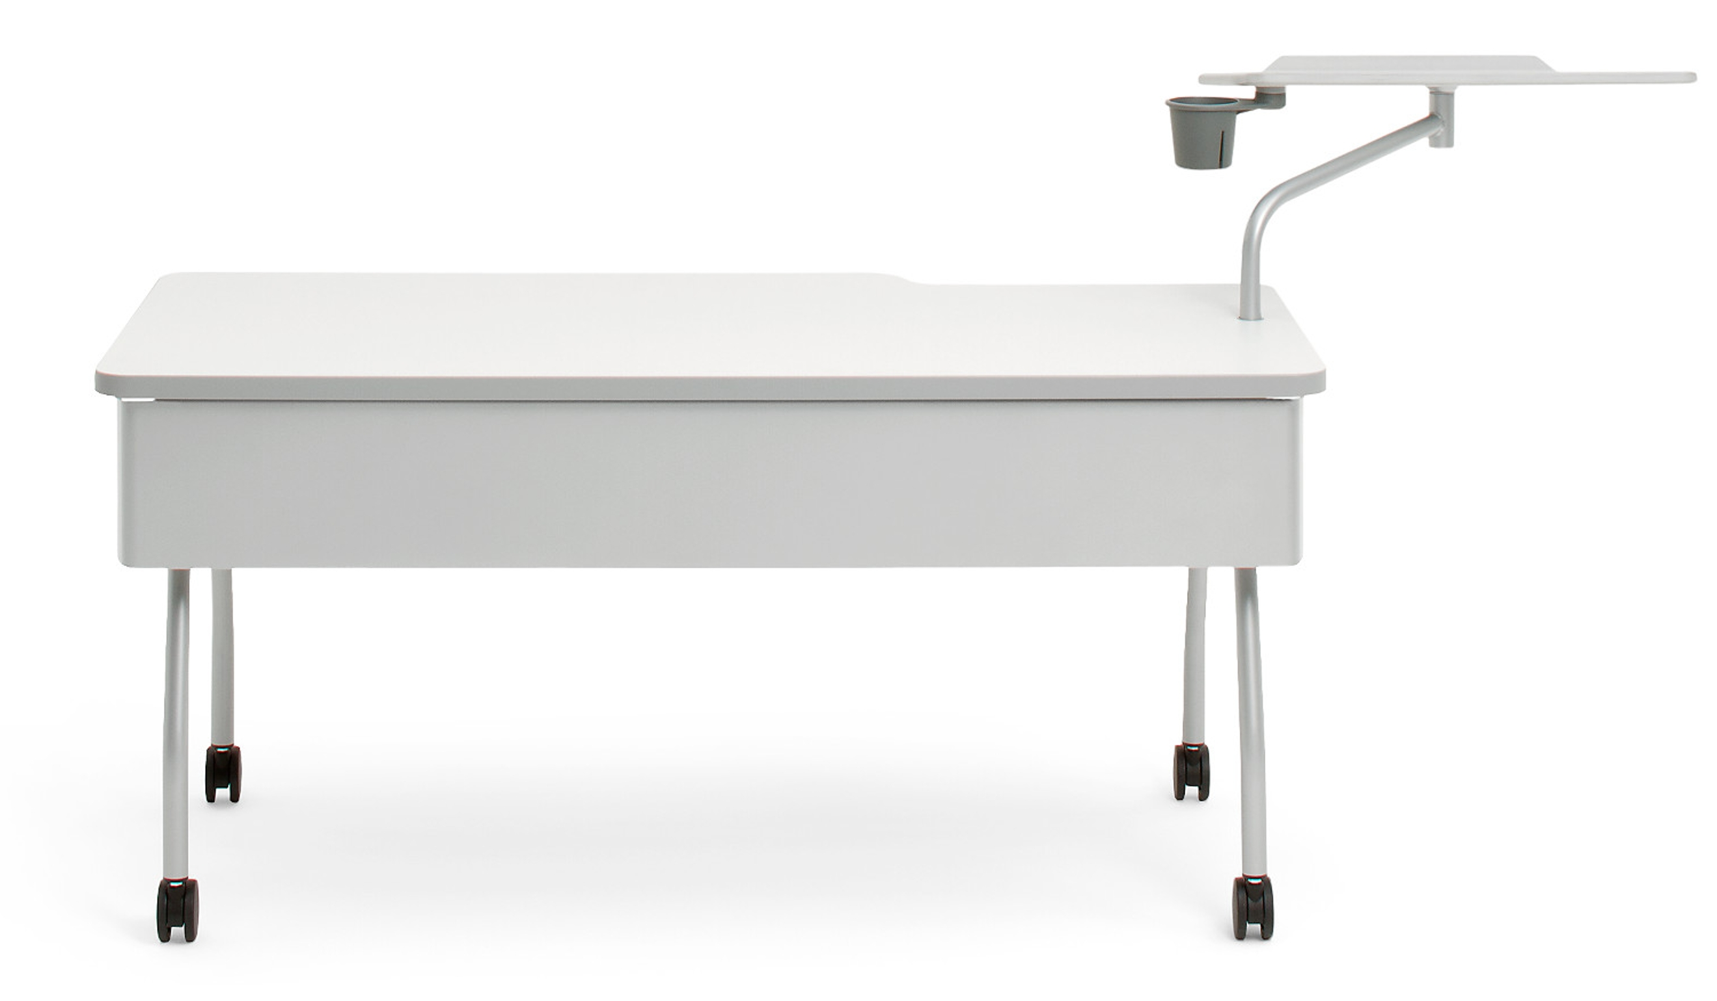
Verb
Instructor Station
WARM TONES
[Key in your title]
Generally thought of as bolder tones, red, orange, and yellow grab the attention of passersby. In essence, they captivate and intrigue individuals. It’s not uncommon for warm shades to make people feel alive and uplifted. These hues have a way of breathing life into everything they touch.
Arm
Smooth Metallic Paint Color Accents
Worktop
LPL Color Accents
Paint
Solid Laminate
4799: Platinum Metallic
AW01: Arctic
White
Leg
Smooth Paint Color Accents
Paint
SL: Silver
Warm Tones
Mix and match your proposed color matching

Slide 13
Product Name
Specifications
COOL TONES
[Key in your title]
Cool Colors tend to have a calming effect. At one end of the spectrum, they are cold, impersonal, antiseptic colors. At the other end, cool colors are comforting and nurturing. Blue, green, and the neutrals white, gray, and silver are examples.
Arm
Smooth Metallic Paint Color Accents
Worktop
LPL Color Accents
Paint
Solid Laminate
Insert here
Insert here
key in here
key in here
Leg
Smooth Paint Color Accents
Paint
Insert here
key in here
Cool Tones
Mix and match your proposed color matching

