Slide 1
APAC eQuote
https://equote.steelcase.com/

Slide 2
GLOBAL eQuote TRAINING
Objectives:
1. A Global Request Tool to be implemented in APAC to replace current tool - SPQ Online
2. This tool has the same main function, is to allow you to place special request at Steelcase in an easy way including all required information to process and get a special quotation.
3. Features: Select a current product and request a modification Attached image to your description of the special request Delivery information – tell us if it’s a phased delivery Mock Up – if you have a Mock Up, include the delivery date Add/Cancel Request – Unassigned quotes can be added to or canceled Call-Back-Request – Provide your phone number and we’ll call you to discuss your special request Request Status – See the status of your current requests

Slide 3
GLOBAL eQuote TRAINING
Follow these steps prior submitting an eQuote Request:
1. Check product Spec Guide to make sure the product is currently not standard product
2. Compile the following information: Customer Name Quantity of Special products required Style number of product that most closely resembles the Special product that being requested Complete description of Special product, including the product line, dimensions, and surface materials Drawing of the Special product and the application, especially if the Special is complicated. Attach it to your eQuote Request

Slide 4
GLOBAL eQuote TRAINING
Training Content
Step | Content | Slide# | Step | Content | Slide#
Step 1 | Open the tool | 5 | Step 13 | Request Copy | 47
Step 2 | The Header | 7 | Step 14 | Request Copy of Quote | 50
Step 3 | Open a Request | 10 | Step 15 | Extend Quote | 51
Step 4 | Modify an Existing Product | 20 |  | End Training | 54
Step 5 | Browse All Catalogs | 27
Step 6 | Search by Product Number | 30
Step 7 | pCon File Upload (new feature) | 33
Step 8 | Submit your request | 36
Step 9 | Review Request Status | 38
Step 10 | Edit Submitted Request | 39
Step 11 | Search for Another Requestor’s Request | 43
Step 12 | To review Quote Validity | 45

Slide 5
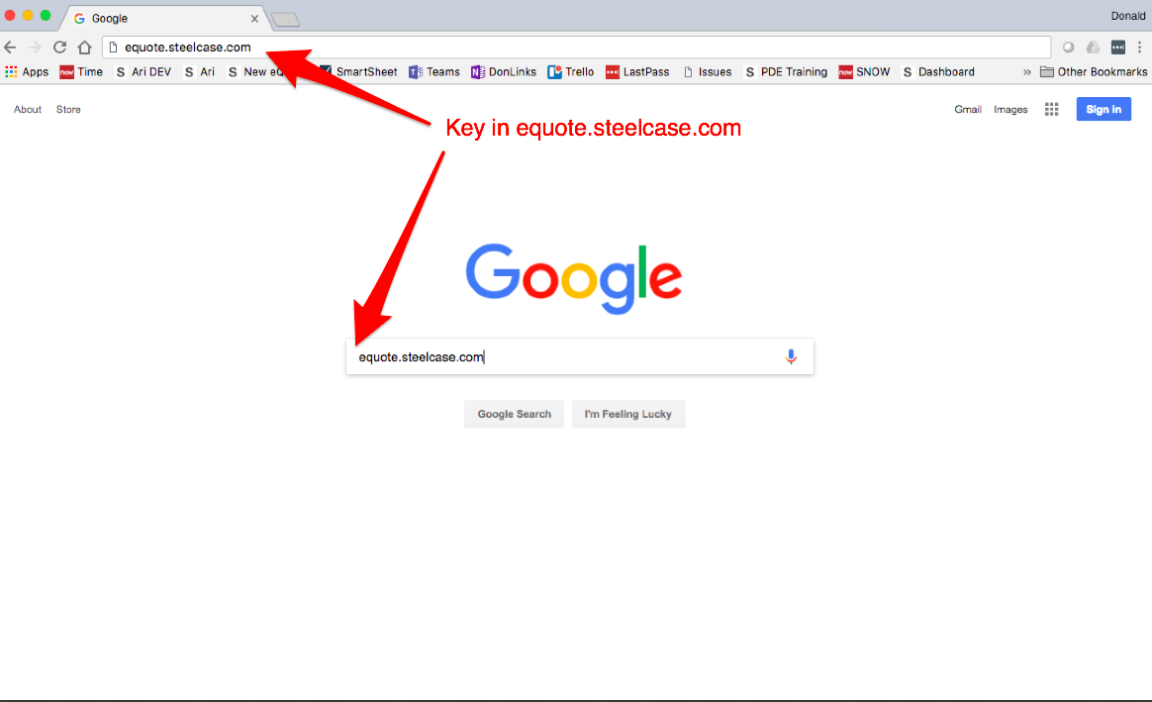
GLOBAL eQuote TRAINING
Step 1: Open the tool
Welcome to Steelcase Global eQuote training. To begin, there are two ways to access the new Global eQuote app.
1.1 First, simply key in “equote.steelcase.com”.

Slide 6
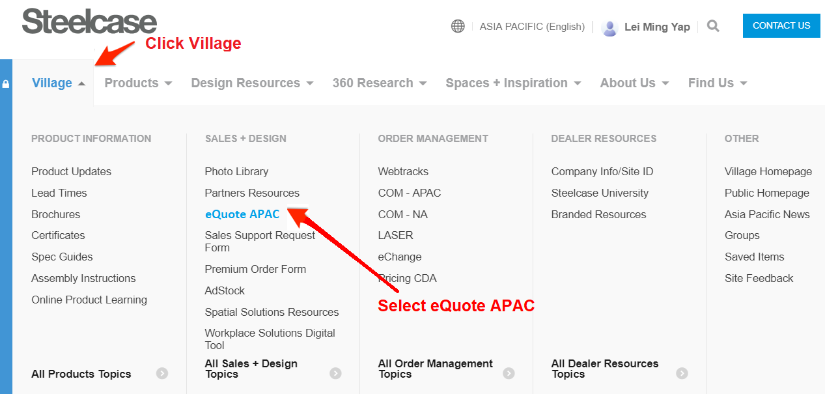
GLOBAL eQuote TRAINING
The second way to access the new Global eQuote is to go to Steelcase Village and select “Village” from the top pull down menu and then select eQuote APAC.

Slide 7
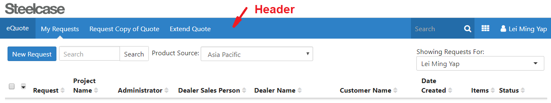
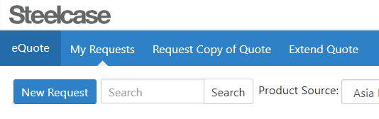
GLOBAL eQuote TRAINING
Step 2: The Header
2.1 Get acquainted with the header menu at the top of eQuote
2.2 On the top Left corner, there’s button for “eQuote = Home”, “My Requests”, “Request Copy of Quote” and “Extend Quote” button.

Slide 8
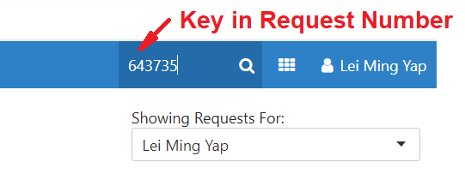
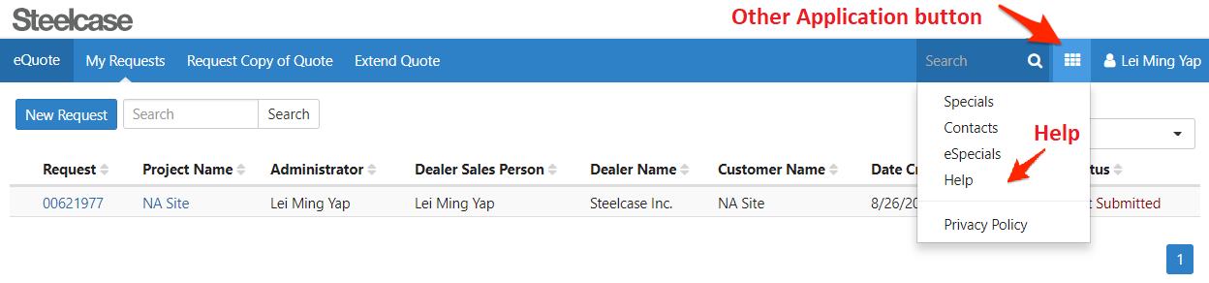
GLOBAL eQuote TRAINING
2.3 Search for requests by placing your cursor in the search field on the and keying in a request number.
2.4 Click the “Other Applications” button to see relates Specials applications. This is also where to find the “help” menu.

Slide 9
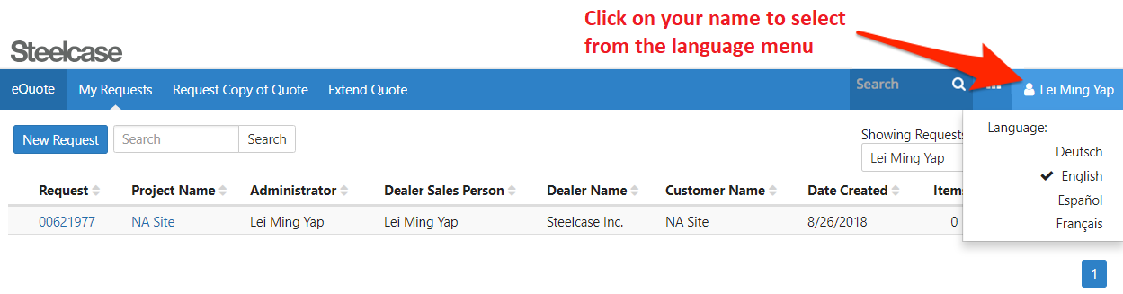
GLOBAL eQuote TRAINING
2.5 You can click on you name on the right side of the header to change the language to Deutsch, English, Español or Français.

Slide 10
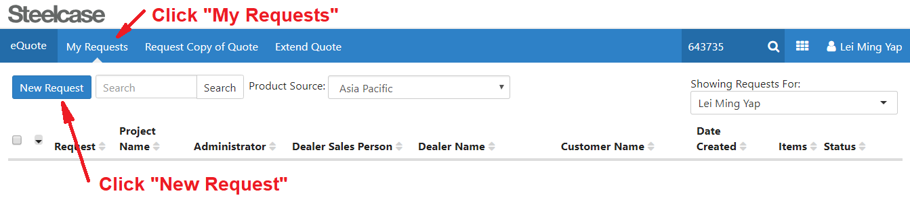
GLOBAL eQuote TRAINING
Step 3: Open a Request
3.1 Now create a new request. First, click on “My Requests” on the header.
3.2 Next, click on the “New Request” button

Slide 11
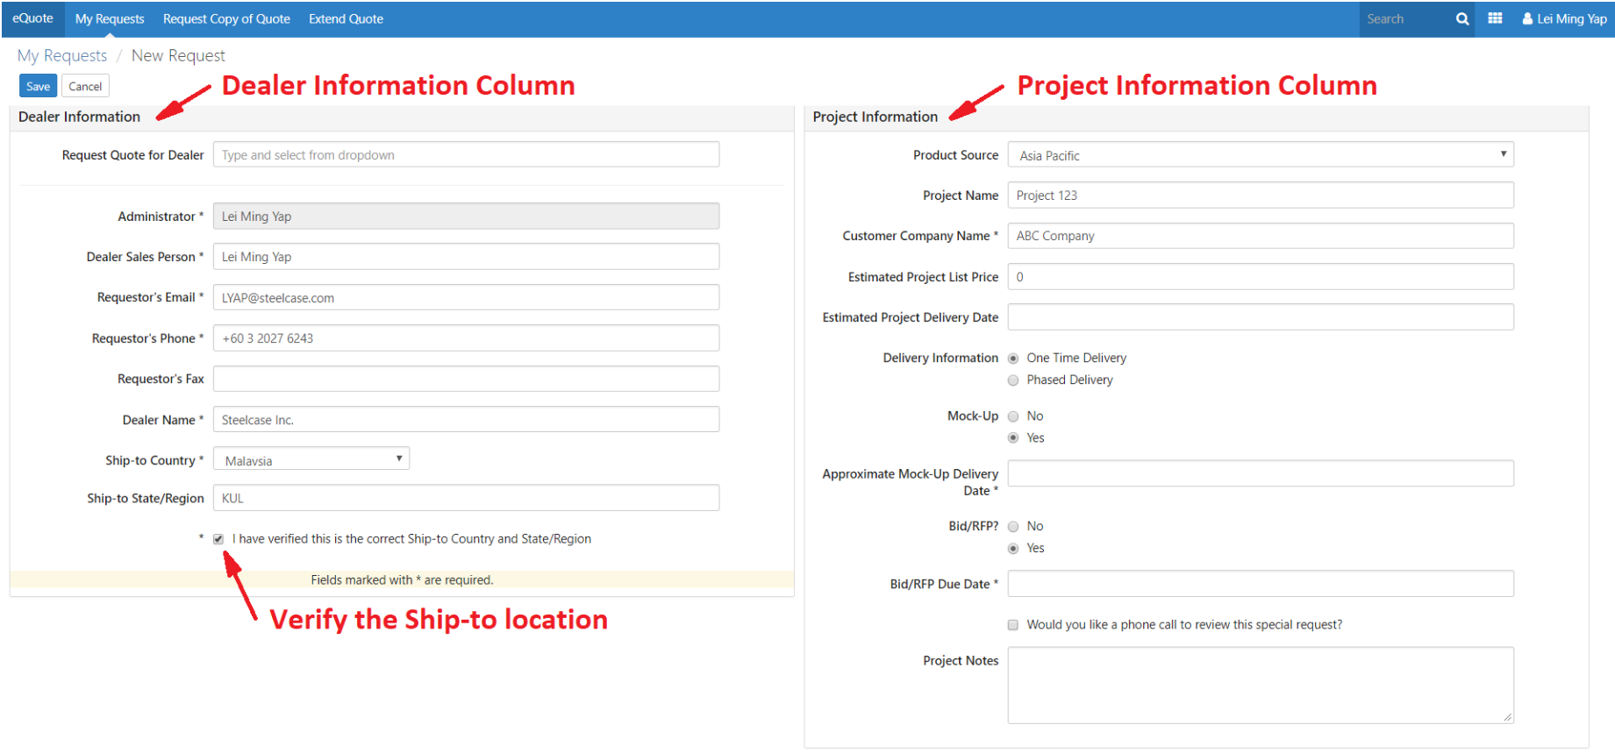
GLOBAL eQuote TRAINING
3.3 You will see some fields already filled with your profile information. Click the check box at the bottom of the left “Dealer Information” column to verify the Ship-to Country. This is one of the required fields as indicated by the asterisk.
Request Quote for Dealer: key-in the Dealer’s name
Dealer Name: Dealer’s Company Name (auto capture once dealer name entered)

Slide 12
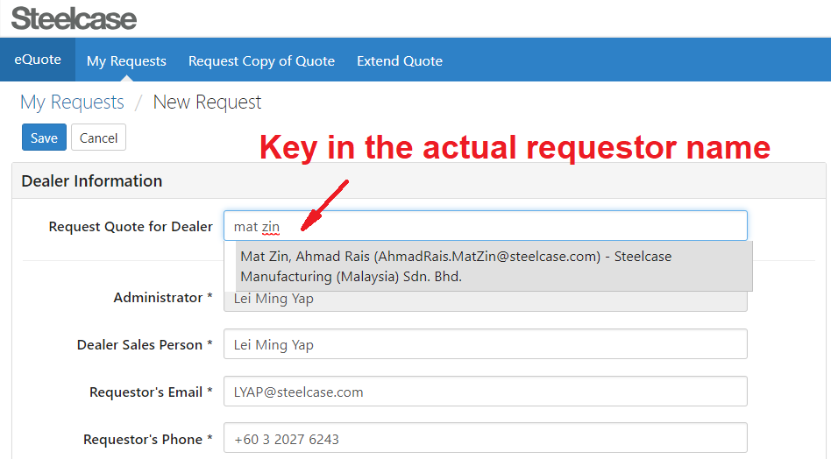
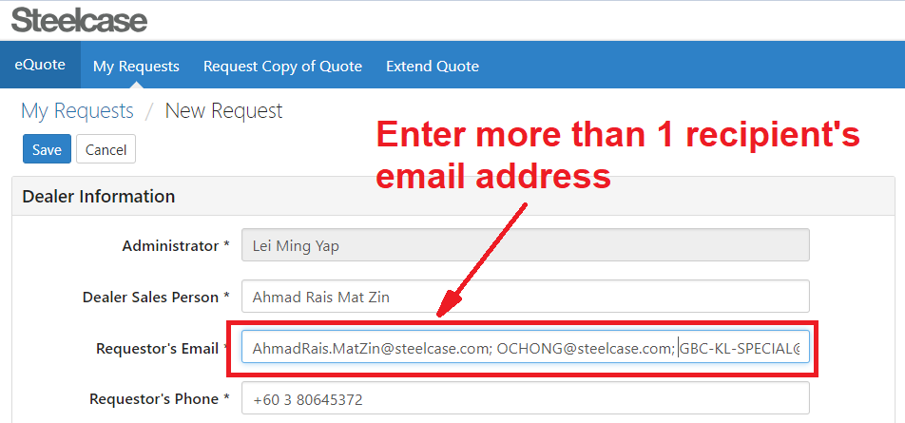
GLOBAL eQuote TRAINING
Note: If you’re requesting on behalf of others, you need to key in the Requestor’s Name in the “Request Quote for Dealer” box.
You can also add more 1 recipient’s email address in the “Requestor’s Email” box

Slide 13
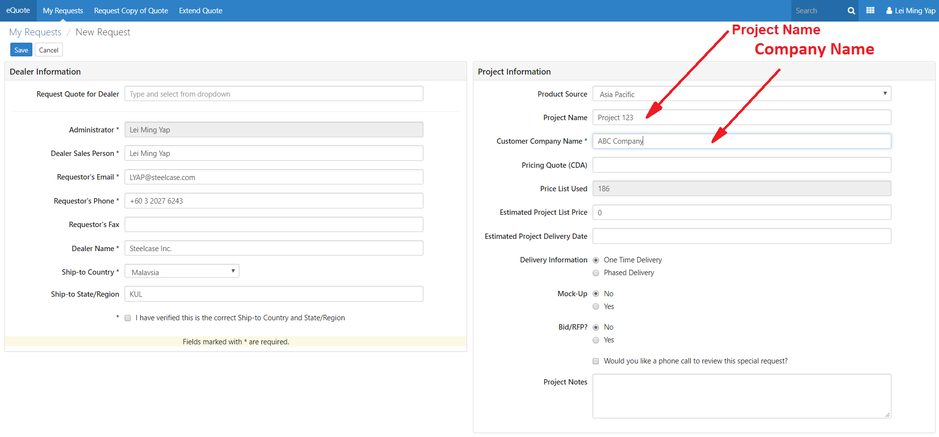
GLOBAL eQuote TRAINING
3.4 Give your new request a project name. On the right column under “Project Information” is a field labeled “Project Name”
3.5 Give the request a “Customer Company Name”. You can find the Customer Company Name filed on the right-hand Product Information column, third field down.

Slide 14
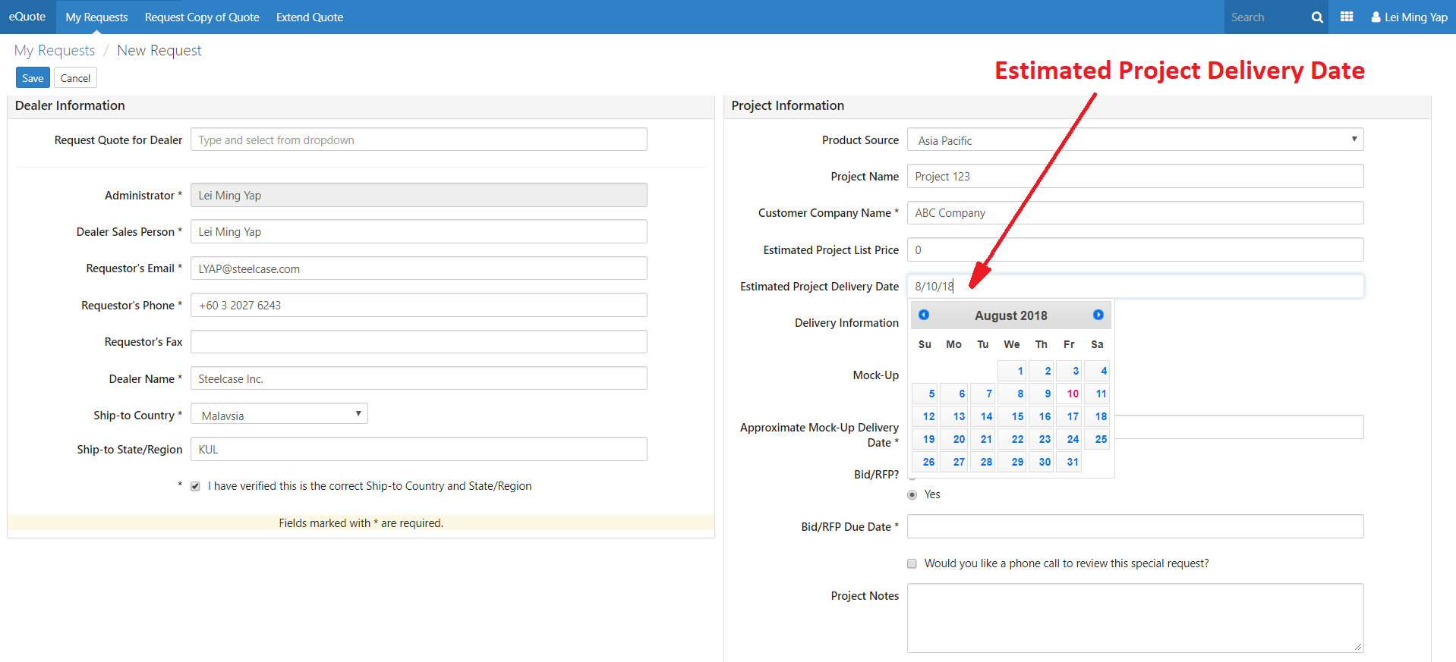
GLOBAL eQuote TRAINING
3.6 Click on the “Estimated Project Delivery Date” field on the right-hand column and select a date four weeks from today.

Slide 15
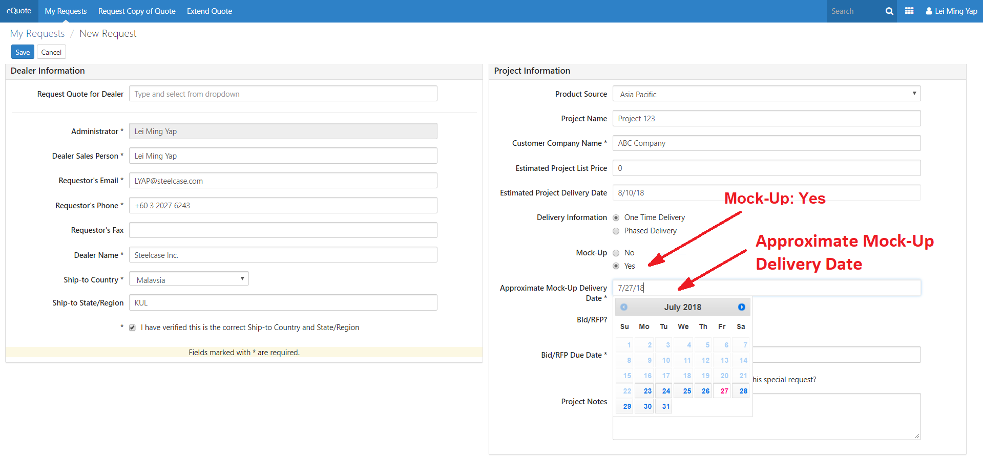
GLOBAL eQuote TRAINING
3.7 Tell Steelcase that this project has a Mock-Up by clicking the “Yes” button by “Mock-Up” near the bottom of the right-hand Project Information column.
3.8 Click on the “Mock-Up Delivery Date” field and select a date two weeks from today.

Slide 16
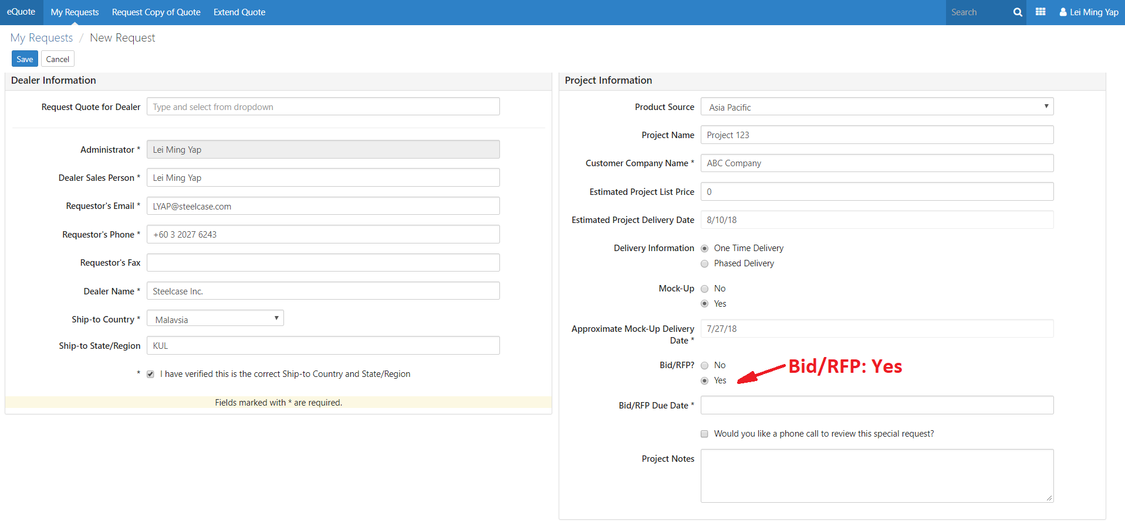
GLOBAL eQuote TRAINING
3.9 Tell Steelcase that this project is a Bid by clicking the “Yes” button by the “Bid/RFP” field near the bottom of the right-hand Project Information column.

Slide 17
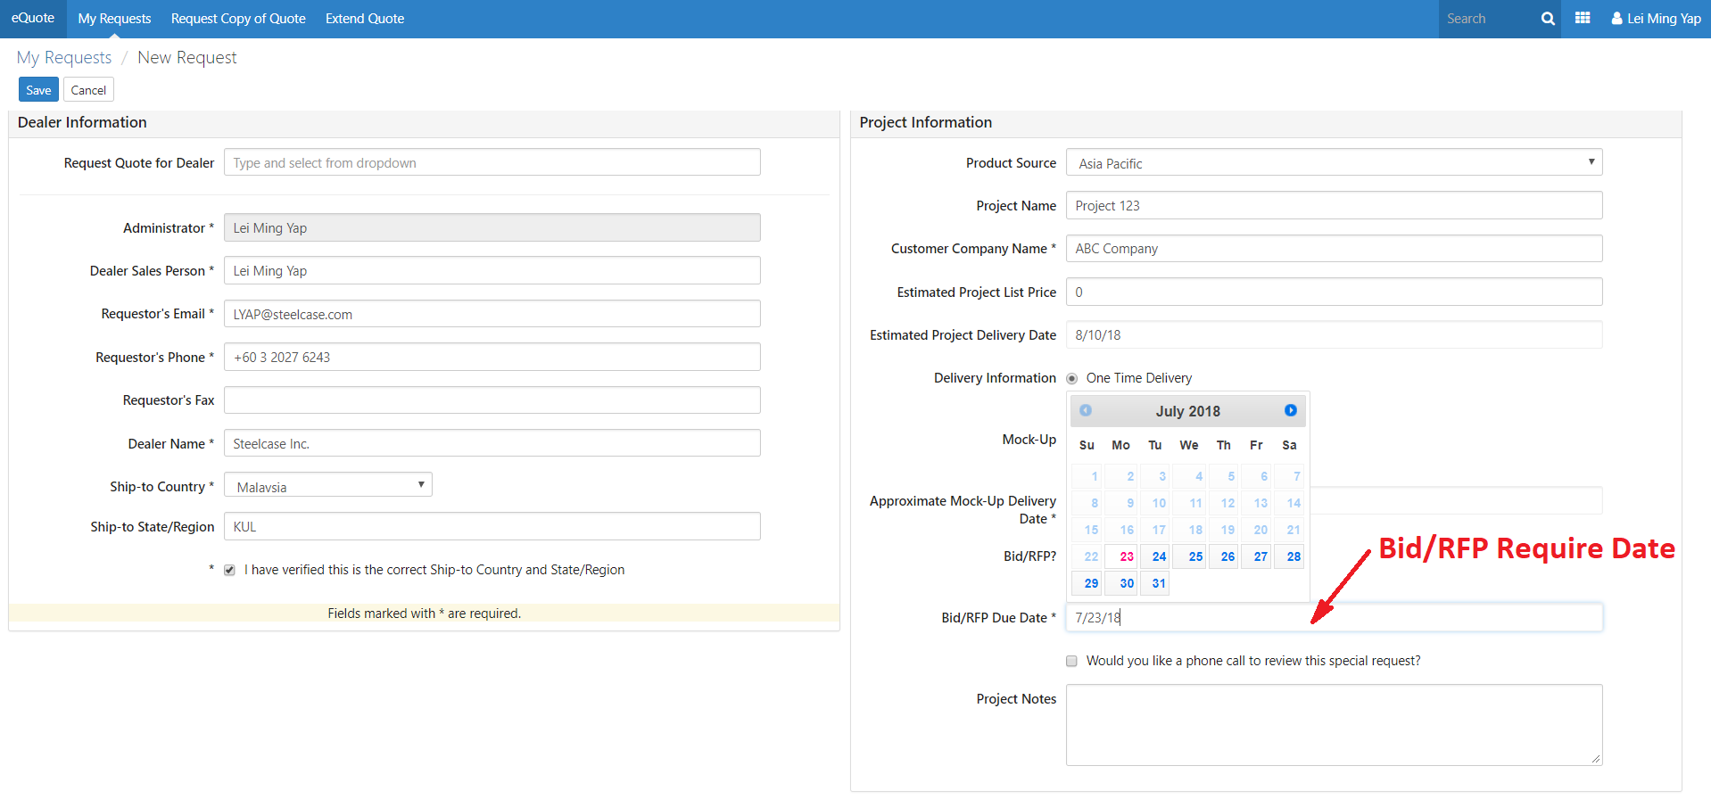
GLOBAL eQuote TRAINING
3.10 Next, click on the “Bid/RFP Due Date” field on the right-hand Project Information column and select a date one week from today.

Slide 18
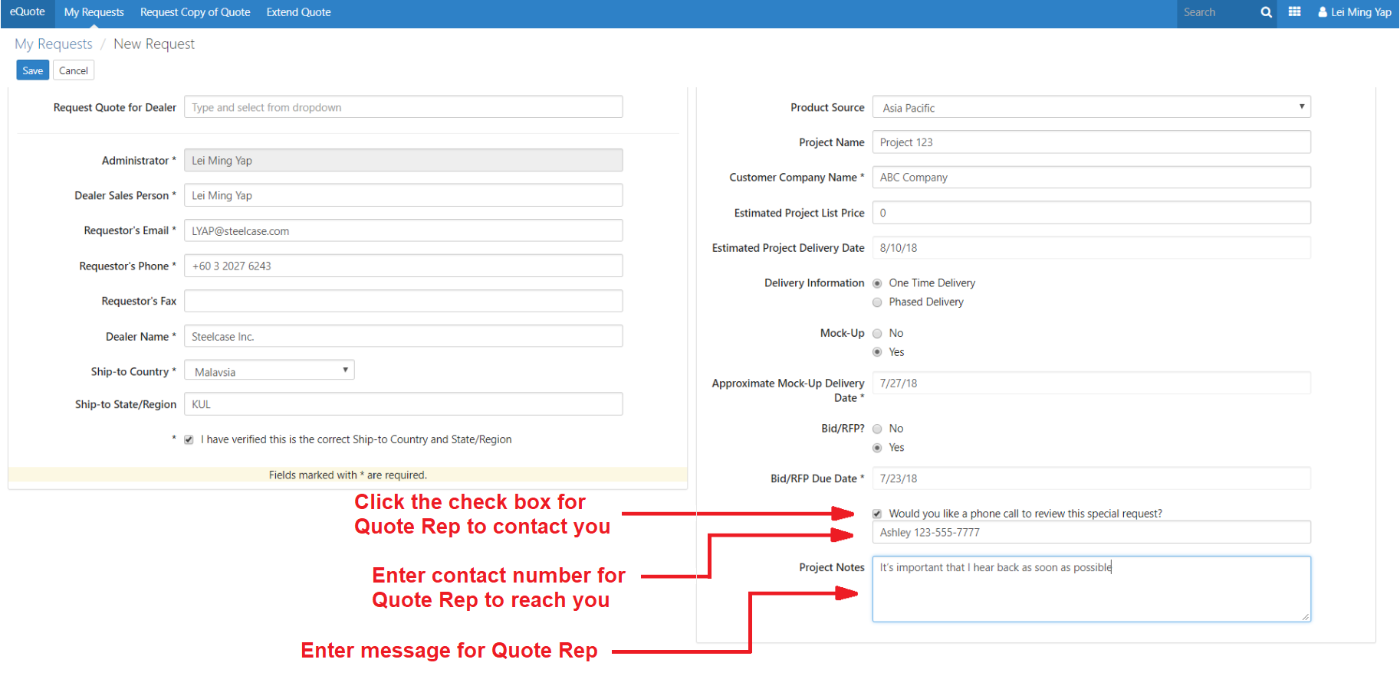
GLOBAL eQuote TRAINING
3.11 Click the check box at the bottom of the right-hand Project Information column to indicate you would like a phone call to review this special request.
Key-in your contact number for our Quote Rep to call you back.

Slide 19
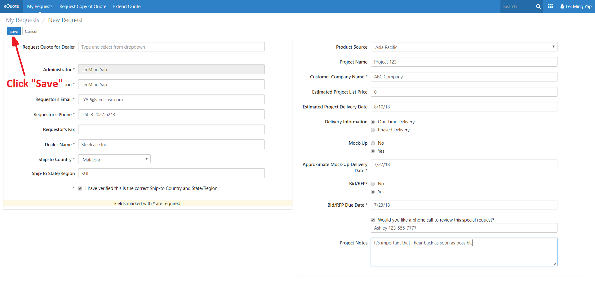
GLOBAL eQuote TRAINING
3.12 Click “Save” in the upper left-hand corner of the form

Slide 20
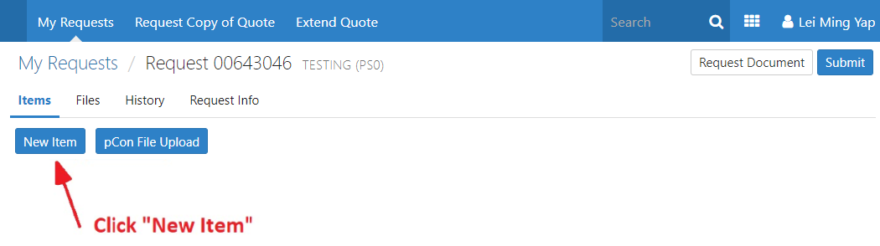
GLOBAL eQuote TRAINING
Step 4: Modify an Existing Product
4.1 OK, now let’s search for an existing product that is the closest match to our special. Click “New Item”

Slide 21
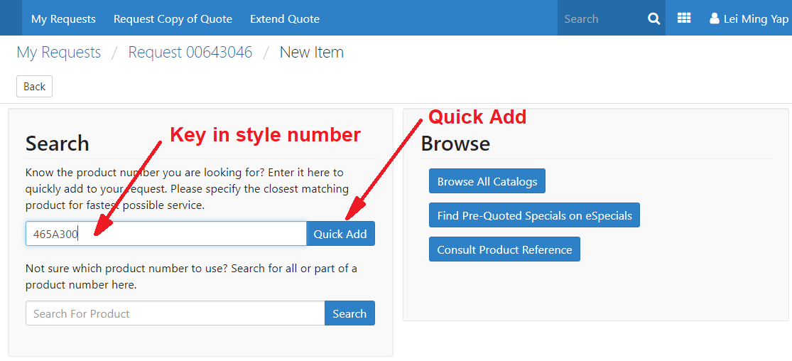
GLOBAL eQuote TRAINING
4.2 Let’s start by keying a product number for a Gesture chair, 465A300.
Click the “Quick Add” button next to the search field.

Slide 22
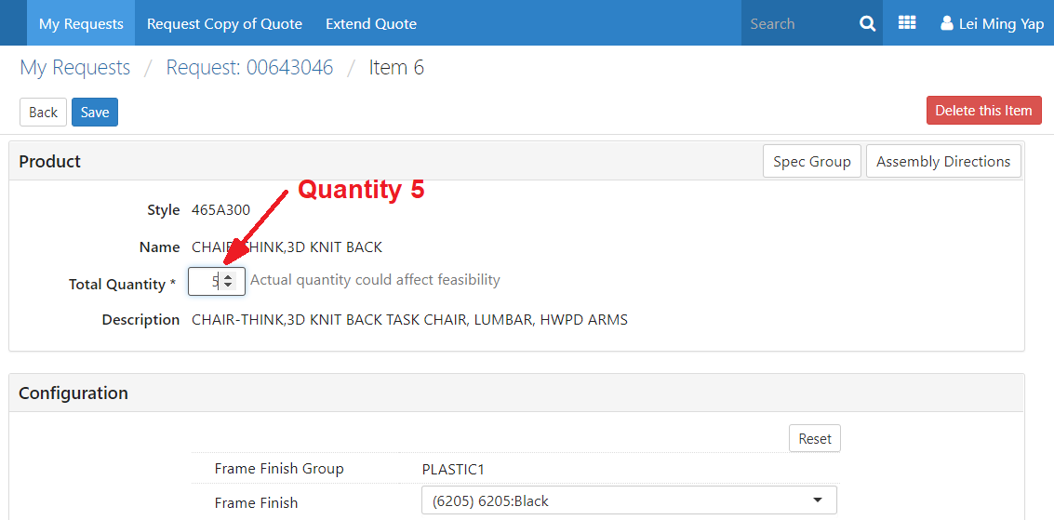
GLOBAL eQuote TRAINING
4.3 eQuote is showing all the attributes that can be specified for 465A300. You do not have to specify all of them. However, need to specify a total quantity because it’s required, as indicated by the asterisk. Enter 5 into the quantity field.

Slide 23
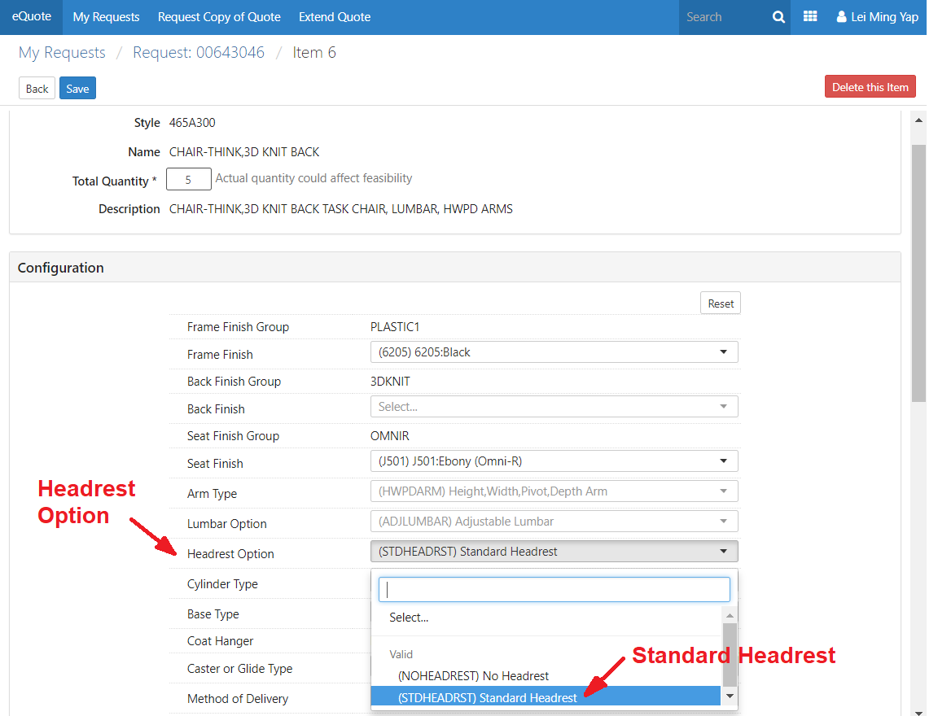
GLOBAL eQuote TRAINING
4.4 Select any of the finishes and options that are important to the special. Click on the pull-down menu next to “Headrest Option” and select Standard Headrest.

Slide 24
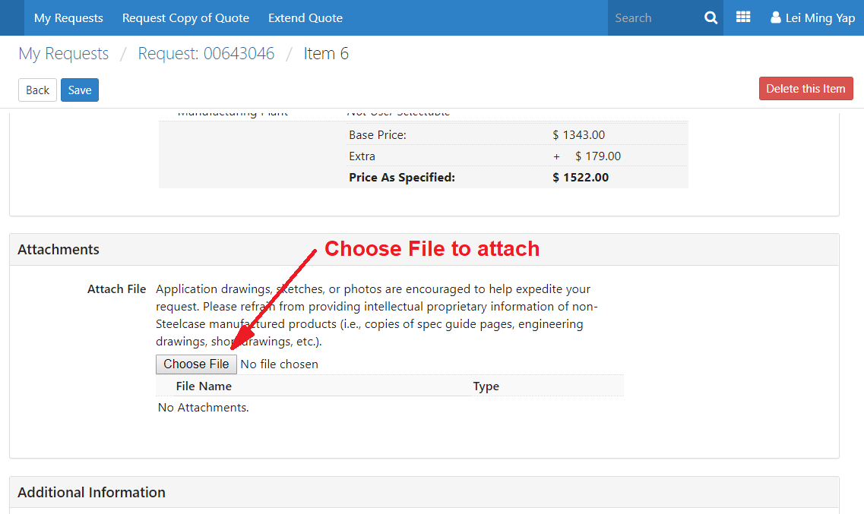
GLOBAL eQuote TRAINING
4.5 Scroll down and attached a file that could be helpful to illustrate what is special. For this training, simply attach any file from your computer. Click “Choose File” button and browse to a file and click “Open”.

Slide 25
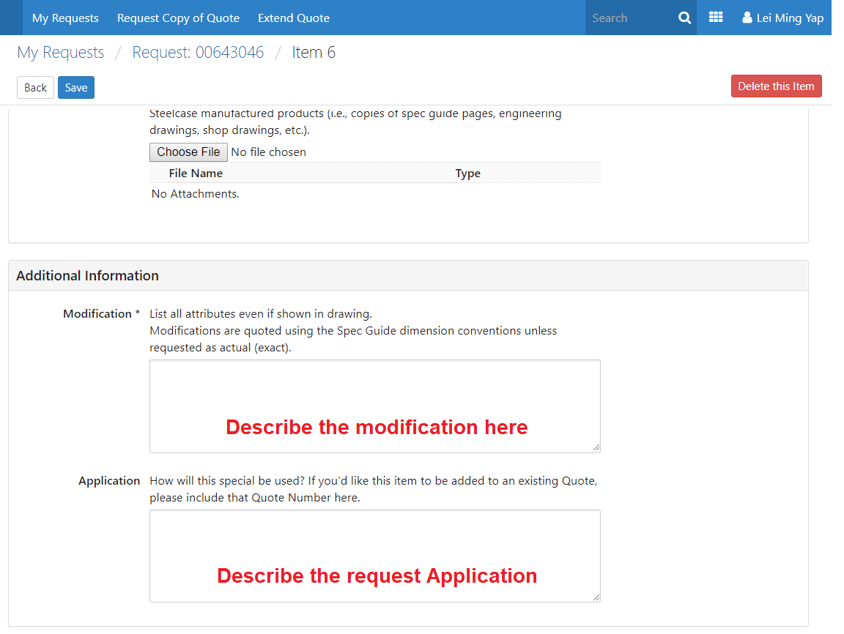
GLOBAL eQuote TRAINING
4.6 Scroll down to the “Modification” field and describe what is special about your request. Notice that this field is required. Key in, “Please change the headrest to do this, that and the other thing”.

Slide 26
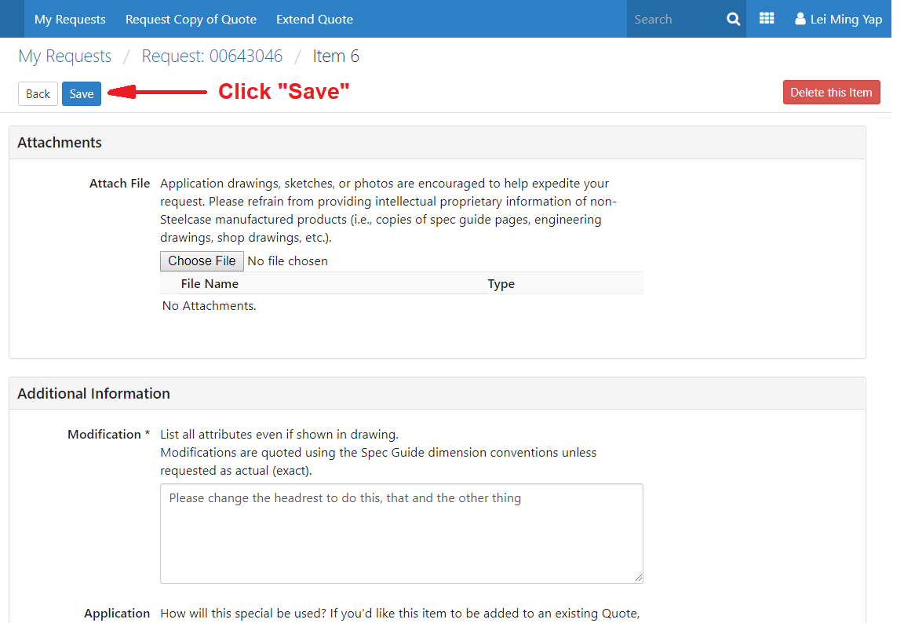
GLOBAL eQuote TRAINING
4.7 Click “Save” in the upper left-hand corner.

Slide 27
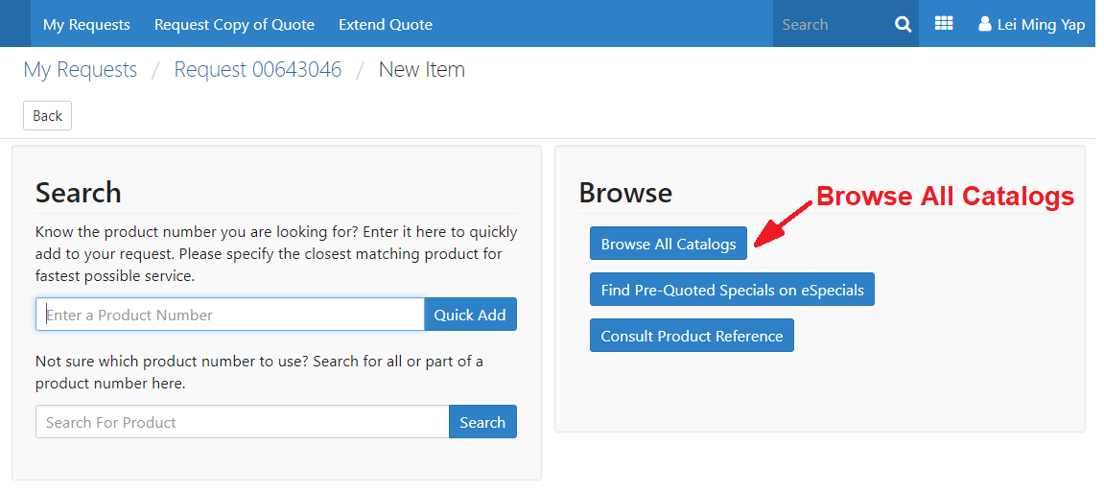
GLOBAL eQuote TRAINING
Step 5: Browse All Catalogs
5.1 If you don’t know the product number, you can browse the catalogs. Click the New Item button and look for “Browse All Catalogs” on the right-hand column.

Slide 28
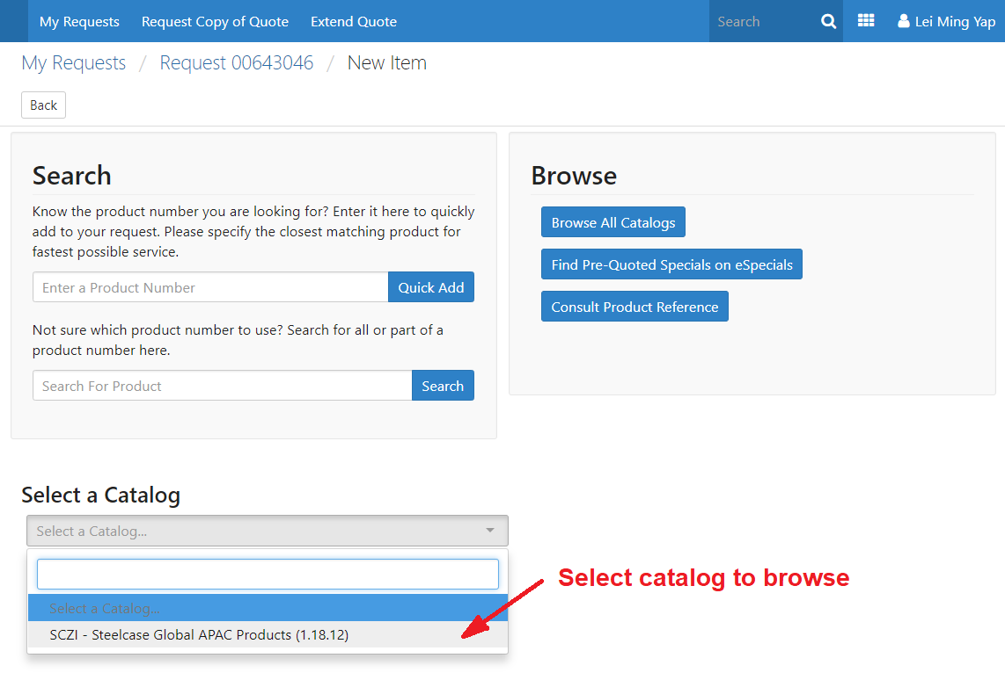
GLOBAL eQuote TRAINING
5.2 Select “SCZI – Steelcase Global APAC Products (1.18.6)”

Slide 29
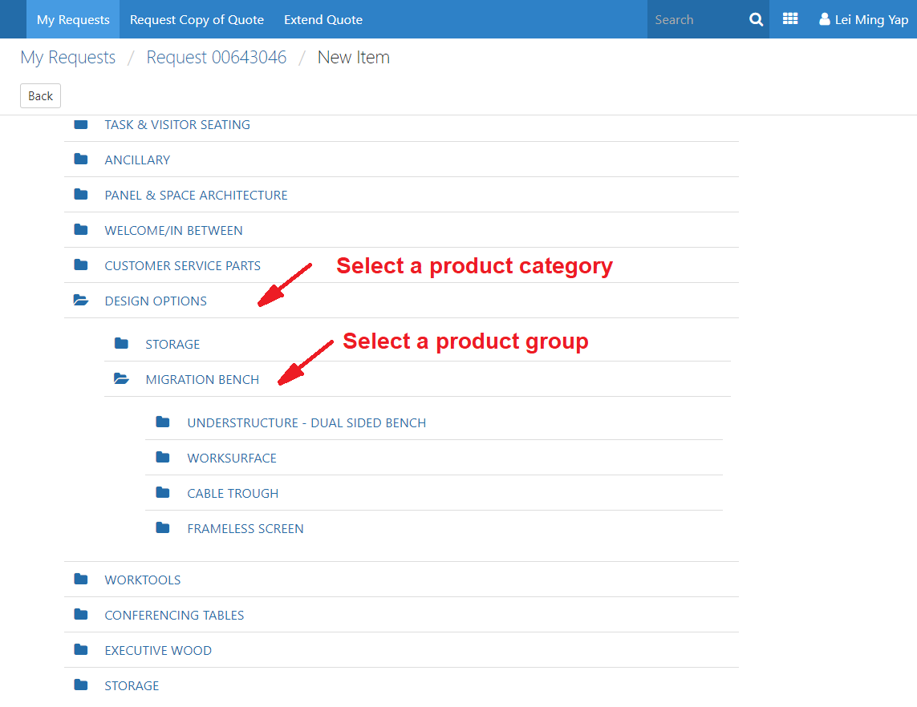
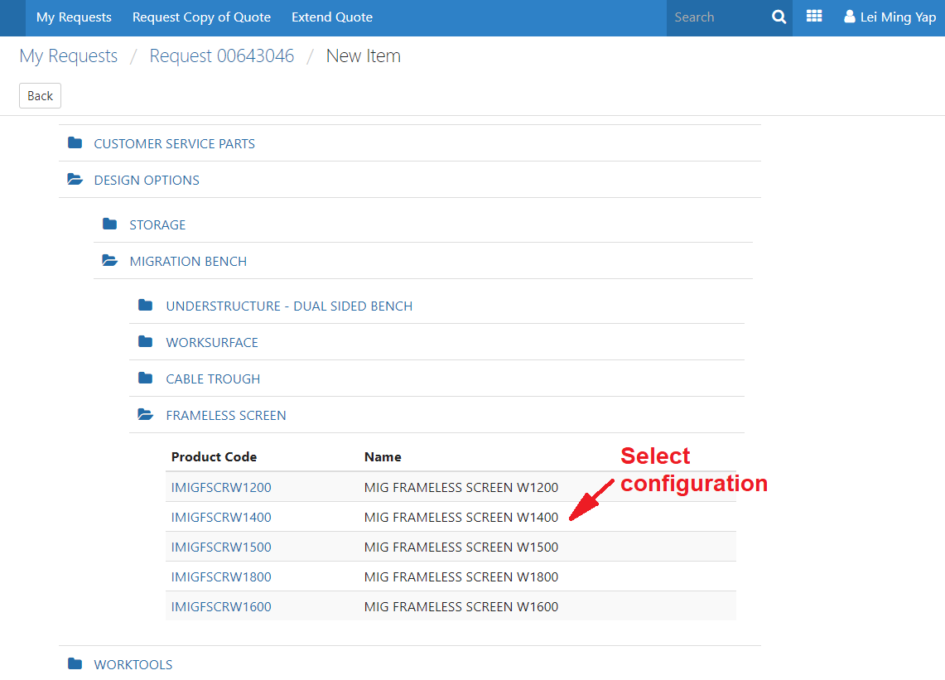
GLOBAL eQuote TRAINING
5.3 Here you can Select a catalog from the pull-down menu browse to the product you would like to use as the starting point of another special.
5.4 Select require configuration from the drop-down selections. Select the nearest available.
5.5 Repeat steps 4.3 – 4.7

Slide 30
GLOBAL eQuote TRAINING
Step 6: Search by product number
6.1 Now create an item by product number. Click New Item button.

Slide 31
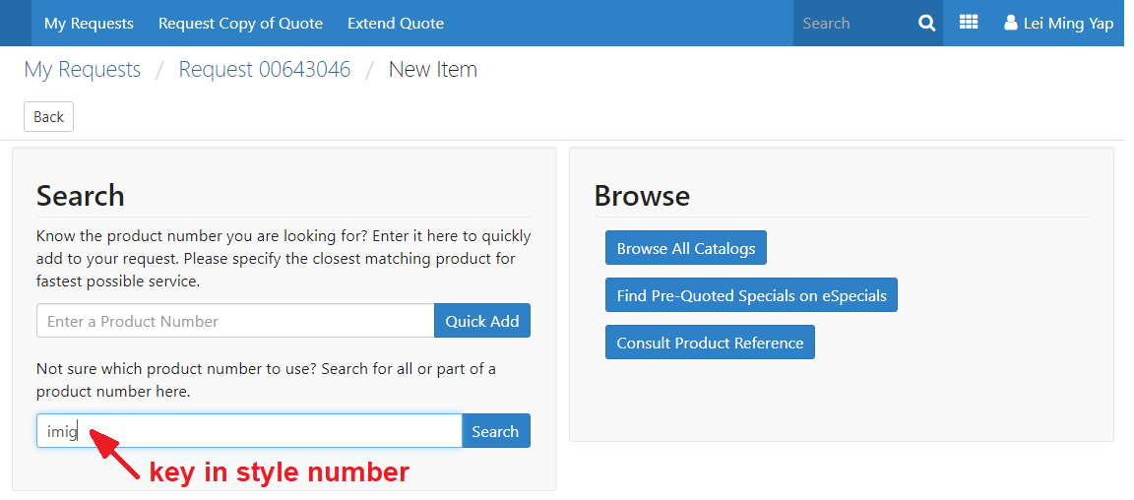
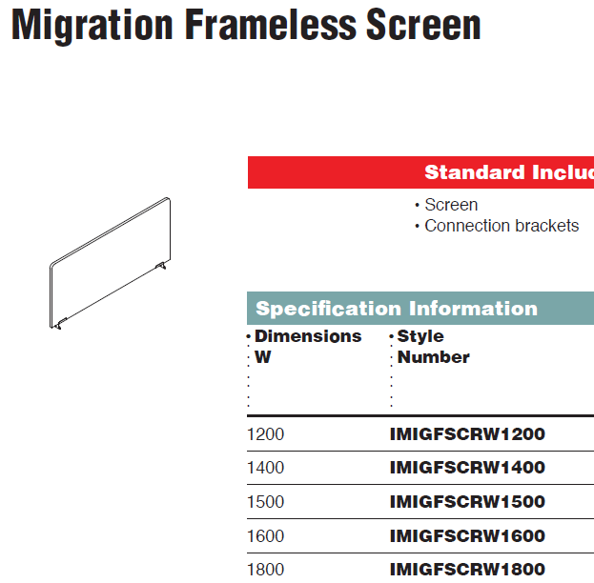
GLOBAL eQuote TRAINING
6.2 Enter Product number in the Search field. Product number with MUST be the first few alphabets/numeric digits. Do not use numeric in the middle or alphabetical at back of the product number, example; “IMIG”

Slide 32
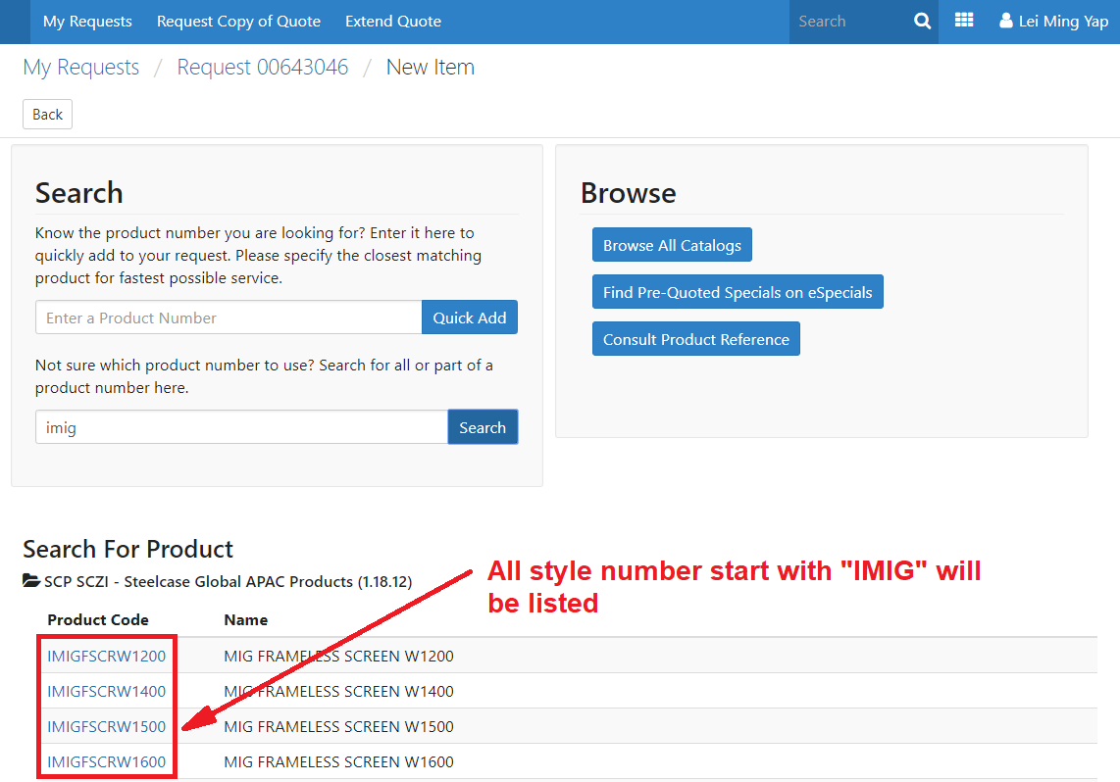
GLOBAL eQuote TRAINING
6.3 All product number with “IMIG” will be display. Select the nearest product number and proceed with special specification.
6.4 Repeat steps 4.3 – 4.7

Slide 33
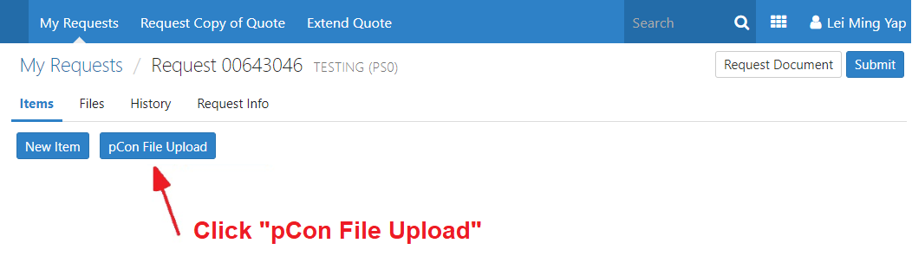
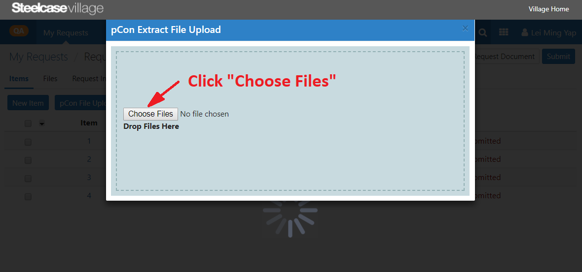
GLOBAL eQuote TRAINING
Step 7: pCon File Upload (new feature)
7.1 Now Create multiple new items by csv file extract from pCon Cad. Click “pCon File Upload” button.
Note:
System only accept .csv file loading.
Please note, if your project contains more than ONE .csv file, loading file take 1 at a time.
7.2 Click on the “Choose File” button and browse a csv file from your computer and click “Open”.

Slide 34
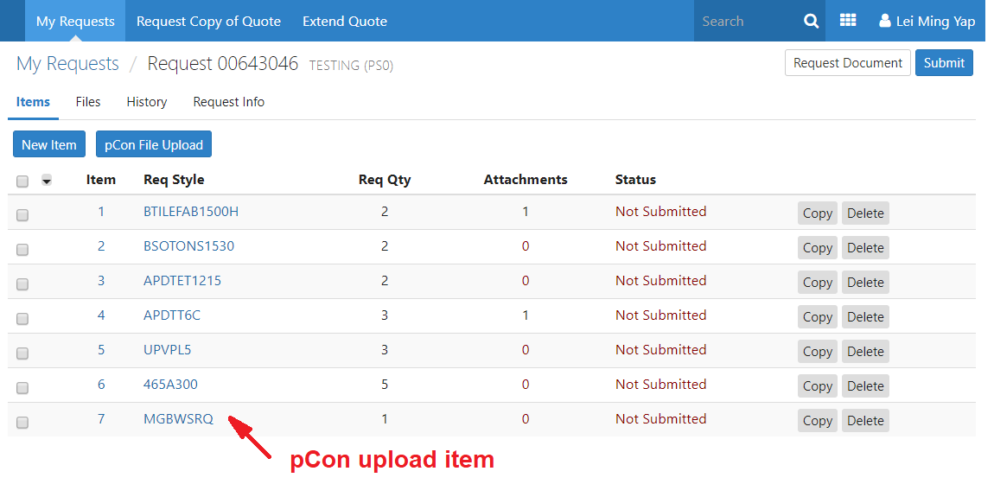
GLOBAL eQuote TRAINING
7.3 pCon uploaded item

Slide 35
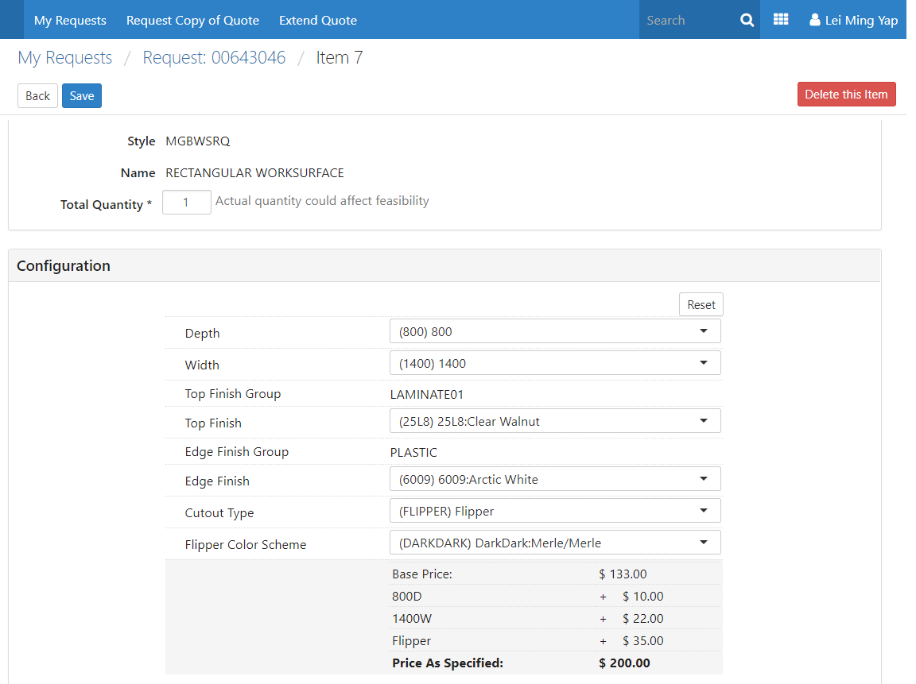
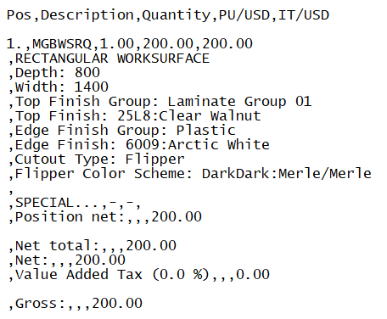
GLOBAL eQuote TRAINING
7.4 Click on the item to see quantity, options, finishes & special specification captured in Modification field. Info maintains as specified in pCon cad.

Slide 36
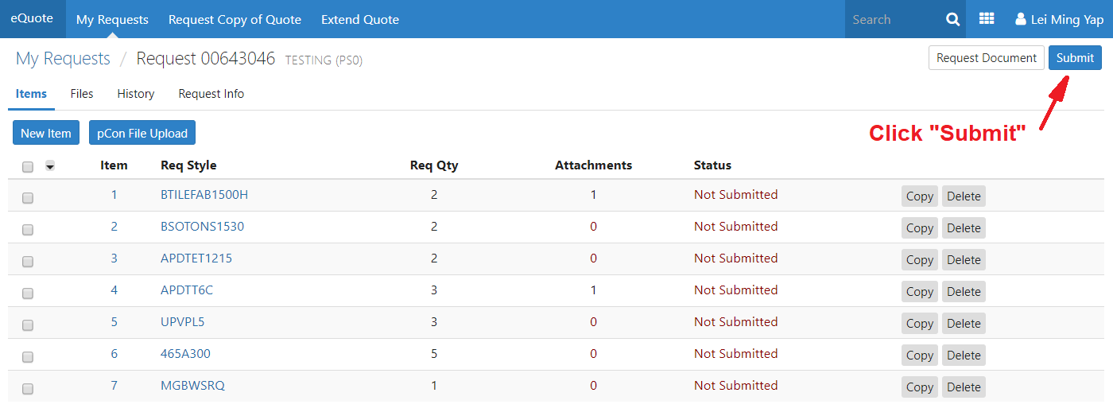
GLOBAL eQuote TRAINING
Step 8: Submit your Request
8.1 Now You are now ready to submit your request, however, don’t do it with this training request. Wait until you have a real request before you hit the submit button.

Slide 37
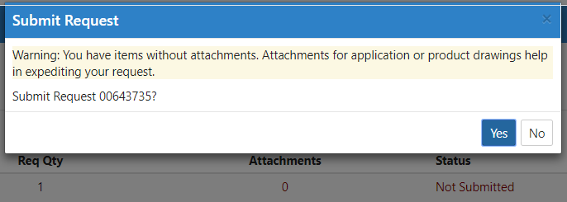
GLOBAL eQuote TRAINING
Note:
A message box will pop-up if item without attachments.

Slide 38
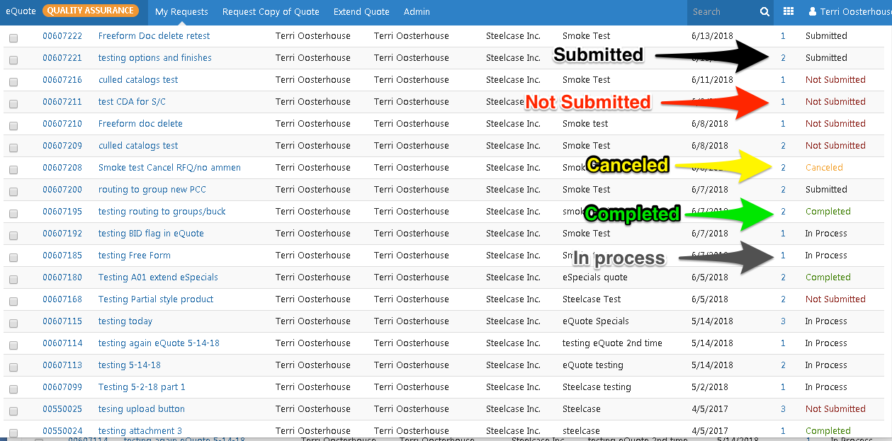
GLOBAL eQuote TRAINING
Step 9: Review your status
9.1 You can check here for the status of your “My Request” screen on the right-hand column. There are five possible statuses: Submitted, Not Submitted, Canceled, Complete and In Process.
Only items with "Not Submitted", "Submitted" and "In Process" status can be amended or canceled.
Items with the status of "Completed" or "Canceled" cannot be amended.

Slide 39
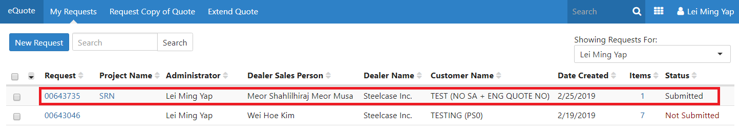
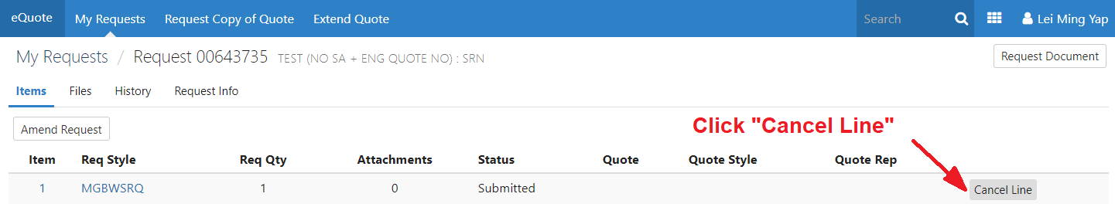
GLOBAL eQuote TRAINING
Step 10: Edit Submitted Request
10.1 For Submitted Request, you can only Add/Cancel Lines. No changes to the submitted lines. To Add/Cancel Lines, click onto the request number.
10.2 As shown below, there’s only option for Cancel Line button.

Slide 40
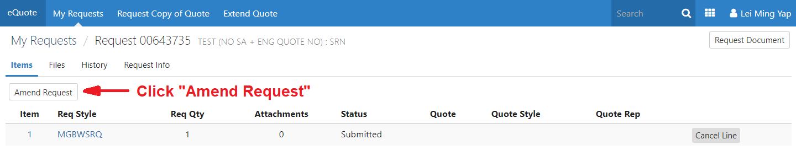
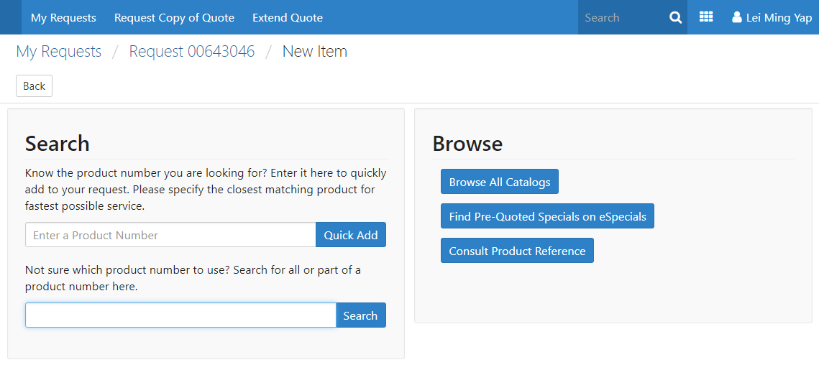
GLOBAL eQuote TRAINING
10.3 To Add lines, click onto the pointed button “Amend Request”
10.4 Clicking “Amend Request” will bring up the New Item window
10.5 Repeat steps 4.3 – 4.7

Slide 41
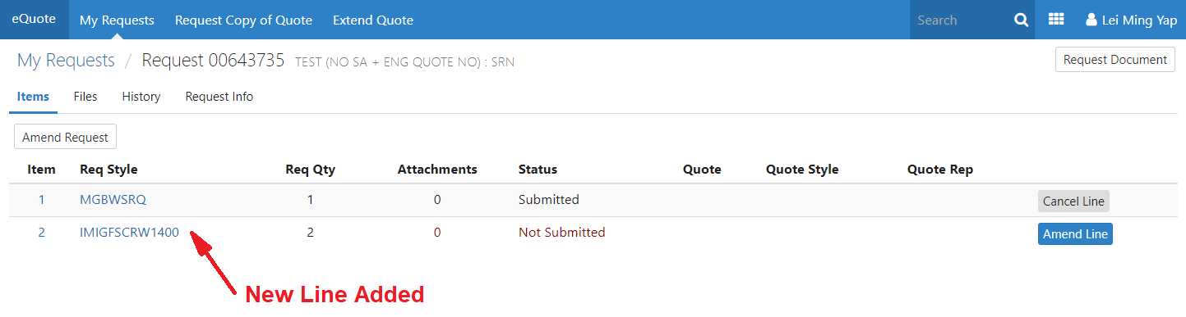
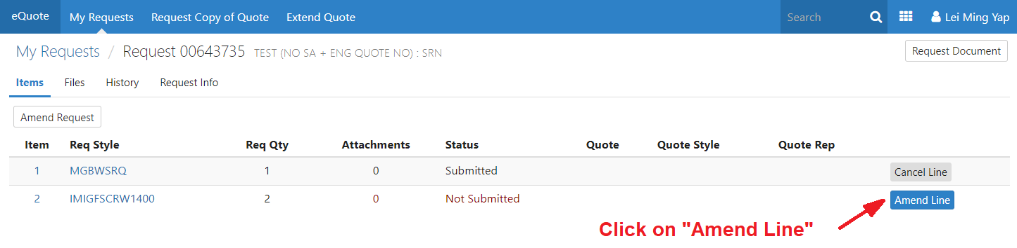
GLOBAL eQuote TRAINING
10.6 New Line added into the request
10.7 Click on “Amend Line” to Submit new line added

Slide 42
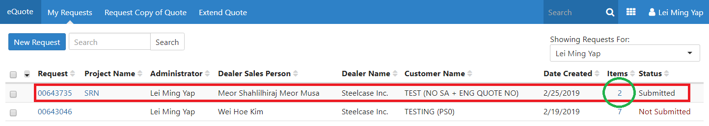
GLOBAL eQuote TRAINING
10.8 Edited Request – item increase to 2 due to the newly added line

Slide 43
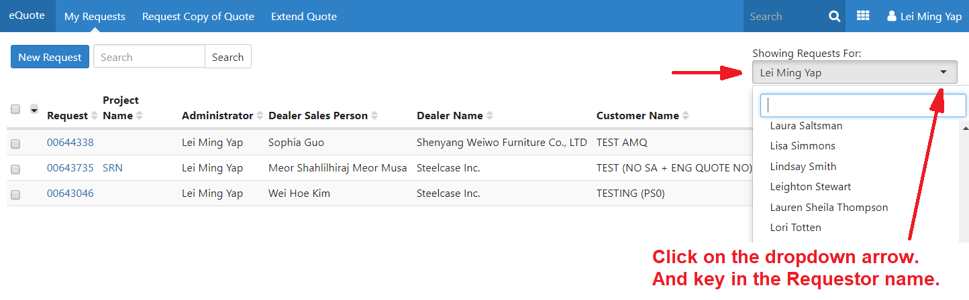
GLOBAL eQuote TRAINING
Step 11: Search for Another Requestor’s Request
11.1 To search for another requestor’s request, click on the dropdown box below the "Showing Request For" on the header, right top corner.

Slide 44
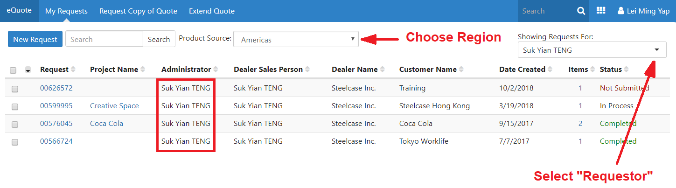
GLOBAL eQuote TRAINING
11.2 Look for the requestor name (ie: Suk Yian TENG)
11.3 Select Region from the Product Source dropdown box.
All quotes under “Suk Yian TENG” will be displayed.

Slide 45
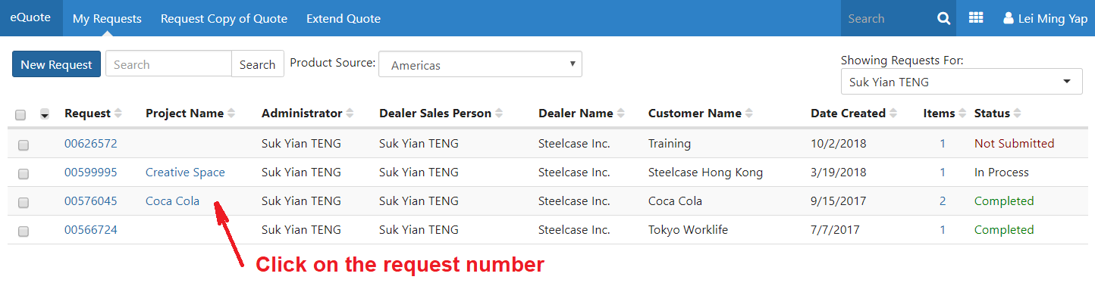
GLOBAL eQuote TRAINING
Step 12: Review quote validity
12.1 To view to request/quote validity, click on the Request number

Slide 46


GLOBAL eQuote TRAINING
12.2 Then click on the Quote number
12.3 Expiry date is shown in Expiration Date column
12.3 Expiry date is shown in Expiration Date column

Slide 47
GLOBAL eQuote TRAINING
Step 13: Request Copy
13.1 Go to the specific request, click on the Request number

Slide 48


GLOBAL eQuote TRAINING
13.2 Click “Request Copy” button next to the Quote number
13.3 Input Requestor (your) email address in the box displayed. Click “OK”

Slide 49

GLOBAL eQuote TRAINING
13.2 Within minutes, you will receive an email from system for the Quote Copy requested.

Slide 50

GLOBAL eQuote TRAINING
Step 14: Request Copy of Quote
14.1 Click on the Request Copy of Quote on the header

Slide 51

GLOBAL eQuote TRAINING
Step 15: Extend Quote
15.1 To extend a quote, click "Extend Quote" on the header.
15.2 Enter an Engineering Quote number (ie: SF156652) and hit the “+” sign, or “add button” to see if the quote is current. You may add more quote numbers; they are for the same customer.

Slide 52

GLOBAL eQuote TRAINING
15.3 Review the status of the quote and confirm that it’s expired. Now enter all the required fields and hit save. This become a new eQuote request for the quote reps to review.

Slide 53

GLOBAL eQuote TRAINING
15.4 Extend Quote request will be display as below in eQuote. It shows the expired quote number as a new request with status “Submitted”
Note:
Extend Quote does not work for expired quotes from previous tool, SPQ Online. One will have to raise new request for the expired items.

Slide 54
GLOBAL eQuote TRAINING
End of Training
That’s it for our training. Please let us know if you have any questions by emailing AP_EQUOTE@steelcase.com

